Slide 1
Element 3 Space Data Support to GFOI R&D
A. Rosenqvist, N. Fujimoto, B. Mora
SDCG-9 Session #8

Slide 2
Session 8 outline

Slide 3
Status Overview of 3-Year Work Plan Tasks and Outcomes

Slide 4
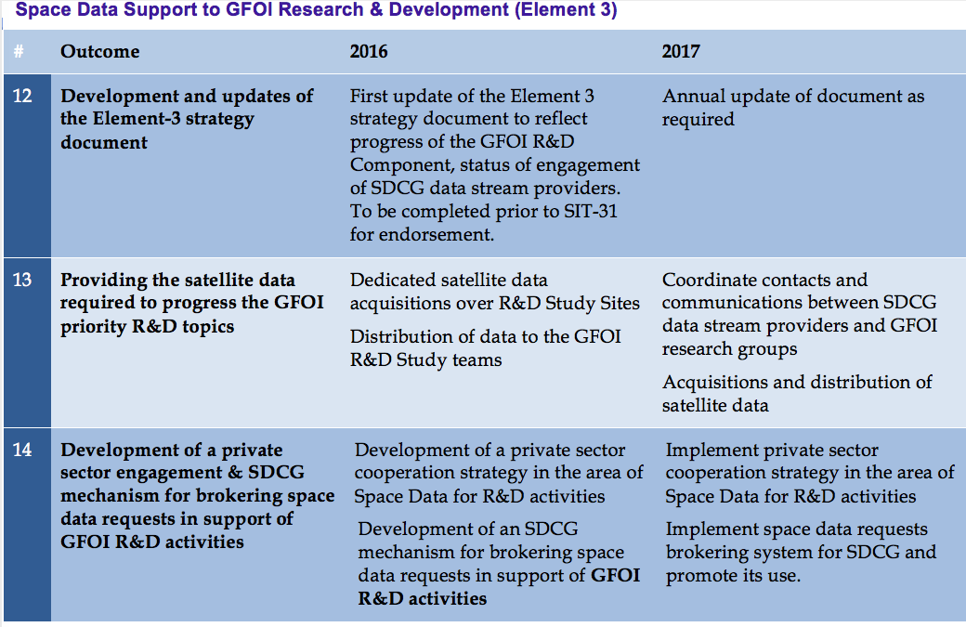
3-Year Work Plan

Slide 5
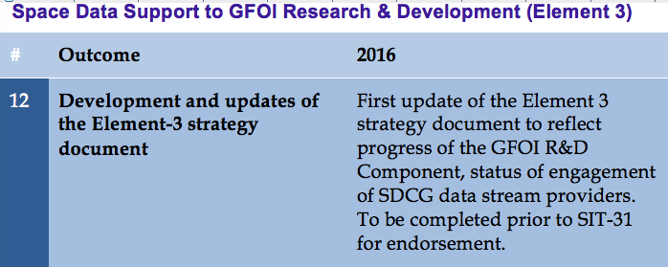
3-Year Work Plan
Status: On schedule.
Latest draft provided to Agencies (15 Feb 2016)
Agencies to review and update agency-related info (chapter 5 and Annex A)
Ake to revise doc to reflect SDCG-9 discussions (today). To be completed in time
before SIT-31

Slide 6
3-Year Work Plan
Status: Have started in Q1/2016. Bulk of activities expected during next few months.
Agency status to be reported below

Slide 7
3-Year Work Plan
Status: Ongoing
Airbus (France): strong engagement. Has committed to contribute SPOT-6/7 data. Willing follow same procedures as to be defined for SDCG agencies
BlackBridge/PlanetLabs: Expressed interest at SDCG-8 to contribute once implications of BB-PL merger clarified. Response still pending.
GAF: Distributor of 3rd party mission data. No possibility to contribute.

Slide 8
3-Year Work Plan
3 Year Work Plan Outcomes:
1) Implementation of the Element-3 strategy. Ongoing
Providing the satellite data required to progress the GFOI priority R&D topics outlined in the GFOI R&D plan to pre-operational or operational status, in coordination with the R&D component, and in support of improvements to the Methods and Guidance.
Just started
3) Private sector engagement implemented in conjunction with an
SDCG mechanism for brokering space data requests in support of
GFOI R&D activities.
Just started

Slide 9
Status of GFOI R&D Component coordination and resources (Brice)

Slide 10
Data provision Agency updates (summary)

Slide 11
ASI – Cosmo-SkyMed

Slide 12
ASI – COSMO-SkyMed
Background
The Italian Space Agency has joined the CEOS SDCG in occurrence of the 2014 SDCG-6 in Oslo.
ASI is interested to support R&D activities involving
Validation studies;
Activities taking advantages from the use of X-band:
exploit the information content of dual and quad-polarised SAR data;
synergy with L-band, C-band and optical data;

Slide 13
ASI – COSMO-SkyMed
Data provision procedures
Regarding the access procedures nothing has changed :
Access for research/institutional users;
Submission of an R&D project to ASI for the exploitation of COSMO-SkyMed data;
Accepted proposals must sign an agreement with ASI and obtain a data license;
The access to the COSMO-SkyMed archive available through the website http://87.241.31.78/index.php by subscription;
Research Announcements
The “Open Call for Science” has started on 25th February 2015, details for application available at the following link: http://www.asi.it/en/agency/bandi_en/calls/cosmoskymed_open_call_for_science
Land Cover & Vegetation is among the primary application domains.

Slide 14
ASI – COSMO-Skymed
ASI:
3 R&D groups have requested COSMO-SkyMed data and ASI is able to support
New acquisitions by COSMO-SkyMed requested
Contacts established and licence agreements underway

Slide 15
CNES – Pléiades

Slide 16
CNES – Pléiades
CNES:
CNES in principle able to support all groups that requires optical VHR data
Both archive and new acquisitions possible
Up to approx. 20,000 km² during 2016 (min area 100 km²)
4) Quota available during 2016. Quick start

Slide 17
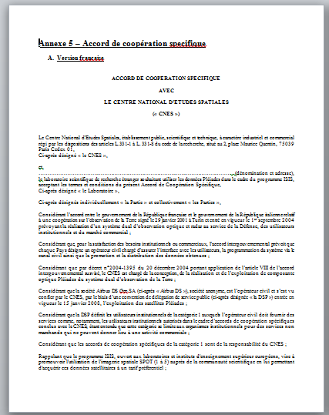
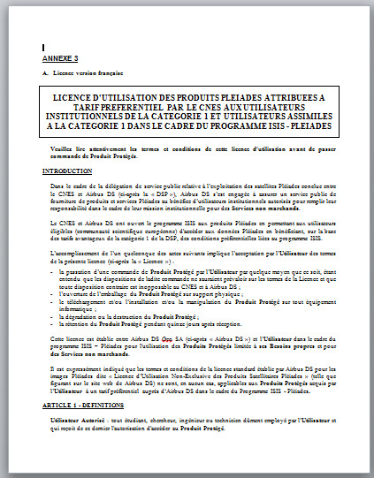
CNES Pléiades
Data provision procedures
Data distribution framework to international institutional research teams now finalised
Once signed by CNES and ADS, pleiades data can be distributed
Each participating laboratory must sign an agreement with CNES
A licence must be signed for the images

Slide 18
CSA – Radarsat-2

Slide 19
Canadian Space Agency – RADARSAT
Introduction
The Canadian Space Agency overarching objectives in support of the GFOI Element 3:
To support our National Forest community (government, academic and private sectors)
In the context of multiple constellations of C-Band SAR missions:
To support science and R&D activities demonstrating unambiguously the contribution of C-Band data in an individual, interoperable and complementary basis.
To enable end-users to exploit the large amount of SAR data that is now or will soon be available in support of their programs for forest management, ecosystem protection, carbon accounting, etc.
To the development of documented, validated and repeatable algorithms directed to the development of products on forest attributes – this should avoid the constraints related to restricted data policy

Slide 20
Main Areas of Interest
The Canadian Space Agency will focus its contribution towards the SDCG Element 3 objectives related to the use of C-Band:
As an individual / repeatable source of data (individual data collection)
Under a sensor interoperability framework - obtaining the same thematic results from different sensor (required coordination)
Full interoperability: Same thematic results (i.e. intercalibrated sensors)
Partial interoperability: Varying range of similarity (i.e. use of multiple missions)
Partial interoperability generally acceptable if the differences can be quantified and corrected for
Under a sensor complementarity framework -obtaining additional thematic information through the (synergistic) use of two or more different sensors (required coordination)
SAR / Optical missions
SAR / SAR missions – multi-frequency
20
Notes:
20

Slide 21
DLR – TSX & TDX

Slide 22
TerraSAR & TanDEM-X Mission
DLR’s interest to contribute to the GFOI R&D activities
Identify the residual gaps (region-wise & problem-wise) where TSX/TDX data can complement the cost-free baseline data or provide an added value
Increasing number of researchers and operational use of TSX/TDX data
Streamlining GFOI/REDD related R&D using TSX/TDX & Sentinel data by bringing together R&D groups & test sites
Development of new methodologies using different TSX/TDX data products, e.g. multi-frequency, multi-temporal, Pol-InSar & TDX-DEM e.g. for degradation monitoring, biomass estimation, improved change detection
Support synergies & complementary use of TSX/TDX with other SAR and Optical data for multi-sensor approaches

Slide 23
TerraSAR-X Data provision procedures & Research Announcements
TerraSAR Archive AO open permanently
New AO Terrasar-x Like Products From Tandem-x Pursuit Monostatic Mode planned at March 2015
TSX Background Mission for GFOI R&D Groups
All Prio 1 sites supersites are regularly (every 22 days) monitored from an ascending and a descending orbit.
For About half of the sites regularly (every 22 days) are sucessfull
All other sites have at a minimum 3 successful acquisitions
Status can be checked by R&D teams via DLR EOWEBmKML will be provided after the meeting
Access to acquired TSX GFOI Background Mission for R&D Groups via General TSX AO, in advance information is required to allow cost-free access -> see Coordinated approach suggestion

Slide 24
Data provision procedures & Research Announcements
TanDEM-X :
DEM AO will finally be announced in March 2016. High request are expected - > First come , First serve, amount of data restricted to 4-20 tiles (1 tile 10,000 km2)
For GFOI R&D Groups an access to data after closure after AO on request.
Acquisition plan 2016 ff: DEM and HDEM Demo products acquisitions till 12.09.2016 (Baseline not suited well for forest),
Planning & Mission constellation after Sept. 2016 not yet finalized
Addition of new R&D group proposed (U. Jena – Mexico study site)

Slide 25
JAXA – ALOS-2

Slide 26
JAXA – ALOS-2
JAXA:
Distribution at cost of reproduction (currently JPY 9000/scene) to R&D groups approved.
For free of charge data provision, further internal coordination required before decision can be made.

Slide 27
Airbus/France – SPOT 6/7

Slide 28
Airbus – SPOT 6/7
Airbus:
Airbus very positive to support selected R&D groups with SPOT-6/7 (VHR) data
No fixed scene limitation. To be evaluated on a case by case basis
Airbus may propose new R&D group to join

Slide 29
Element 3 implementation – Discussions

Slide 30
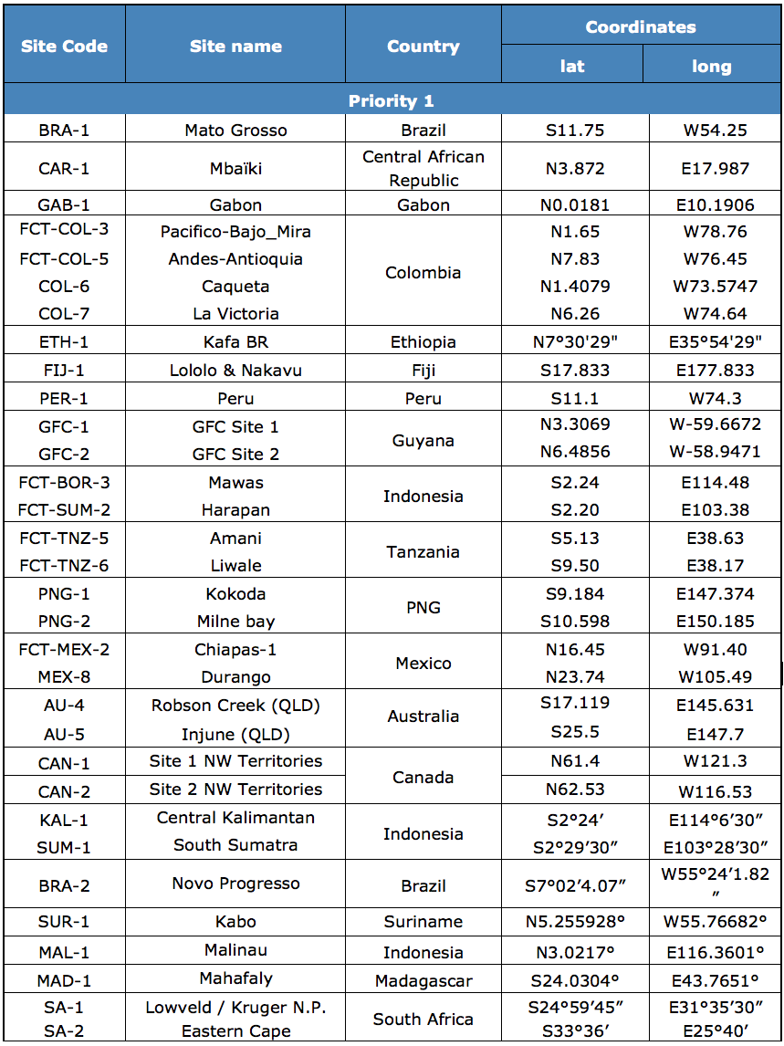
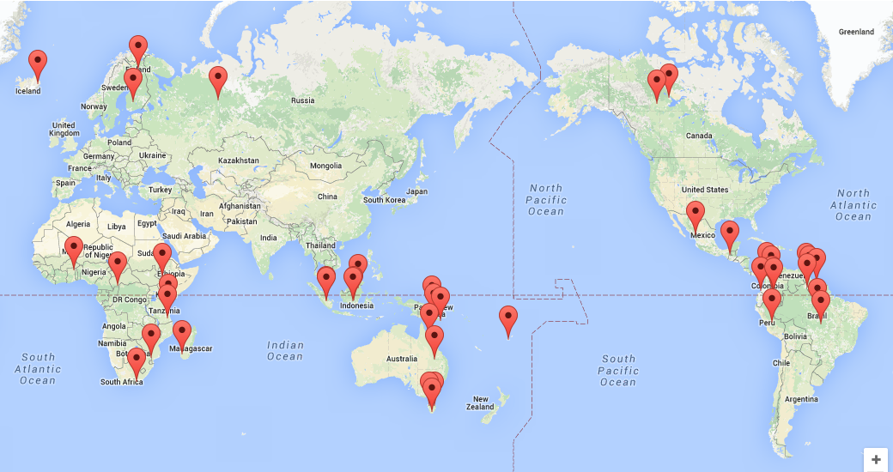
El-3 implementation – current process
GFOI R&D Study Sites & R&D teams
Currently 32 multi-disciplinary sites, addressing multiple GFOI Priority R&D topics
Including Study Sites in former GEO-FCT National Demonstrator countries
Currently 13 R&D teams from GFOI countries and national and int’l research organisations

Slide 31
El-3 implementation – current process
Process (1/3)
1. Identification of priority R&D topics for GFOI
- Through Review of Priority R&D Topics (peer-reviewed study, published by GFOI Office Dec. 2013)
- Country consultations (GFOI capacity building workshops and SDCG “country days”)
2. Engagement of int’l science community
- Organisation of workshops for top experts in the field - “R&D Expert workshops” - with focus on selected priority topics.
- Sensor interoperability/complementarity (Boston/US, May 2014)
- Forest degradation (Wageningen/NL, Oct. 2014)
- Vegetation biomass est. (Brisbane/AU, Feb. 2015)
- Global datasets for national REDD+ (Wageningen/NL, Oct. 2015)
- Regional Expert WS (Mexico City, June 7-10, 2016 )
- GFOI/GOFC-GOLD Science Meeting (Oct/Nov 2016)

Slide 32
El-3 implementation – current process
Process (2/3)
3. Group/project selection
- Experts engaged through GFOI workshops
- Nominations by space agencies
- National Demonstrator country groups from GEO-FCT R&D prog (2009-2011)
- Accommodation of new groups as GFOI R&D Component progresses
4. Group details (El-3 doc, Annex B)
- Priority topic targeted (primary, secondary)
- Relevance in the field, publications etc.
- Study areas and satellite data requirements
5. Funding
- R&D programme depends on voluntary contributions by external groups. Sub- optimal but reality.
6. Programme timelines
- Start Q1/2016.: 2-3 years minimum duration requirement of meaningful R&D. Continued funds for GOFC-GOLD coordination anticipated.

Slide 33
El-3 implementation – current process
Process (3/3)
7. Reporting
- Technical progress reports (compilation of research group results) – published annually for CEOS (Oct/Nov) [ = GEO-FCT R&D prog.]
- Presentations at annual GFOI Science meeting and Expert Workshops
- Dedicated reports to space agencies and data providers in accordance with relevant user agreements.
- Final reports by all groups at end of programme
9. Assessing progress
- GFOI R&D goal: Advancing R&D topics towards operational (technical readiness) status
- Assessment criteria to be defined
9. Links to GFOI MGD and GOFC-GOLD Sourcebook
- Mechanism for integration of new “mature” methods into GFOI Methods and Guidance Document – to be defined through GFOI Component Coordination
- Results screened for possible inclusion in yearly updates of G-G Sourcebook

Slide 34
El-3 implementation
Proposed improvements to the current process.
[Yves Crevier]

Slide 35
El-3 implementation
Additional information requests from the R&D groups:
“Minimum required datasets” to complete research task (sensor, mode, time window, teporal frequency etc.)
Improved study site definition [kml]
Anticipated impact
Standardised template agreed by SDCG agencies
Link to Brisbane WS presentations
Add info on agency AOs on GFOI.org/RD

