Slide 1
ESA Forestry TEP
GFOI Plenary
24 Feb 2016, Frascati

Slide 2
Copernicus Capabilities and Requirements Capture
GFOI Plenary
24 Feb 2016, Frascati

Slide 3
GFW: Cooperation with DigitalGlobe and Urthecast
GFOI Plenary
24 Feb 2016, Frascati

Slide 4







Fred Stolle
World Resources Institute, Washington, DC
Forest Team
Forest and Landscape Restoration and
Global Forest Watch

Slide 5

Knowledge Remote
sensing firms
Science
Action
GFW:
Data → Information
Journalist
Planners
Countries
Satellite
companies
Donors

Slide 6

GOAL: Global Forest Watch aims to reduce deforestation …. by transforming forest management and conservation at a global scale
How: GFW will improve the availability and accessibility of information about the world’s forests, allowing forest management decisions to be based on reliable, accurate, and open information
-

Slide 7

GFW builds on the assumption that reliable and accurate information is vital for sound decision-making and sustainable natural resource management.
GFW recognize that information is necessary but not sufficient to change behaviors of governments, companies, NGOs, and ordinary citizens.
GFW will therefore pursue additional tools, capacity building, convening, partnerships, and communication to transform information into action

Slide 8
Knowledge Remote
sensing firms
Science
Action
GFW:
Data → Information
Journalist
Planners
Countries
Satellite
companies
Donors

Slide 9
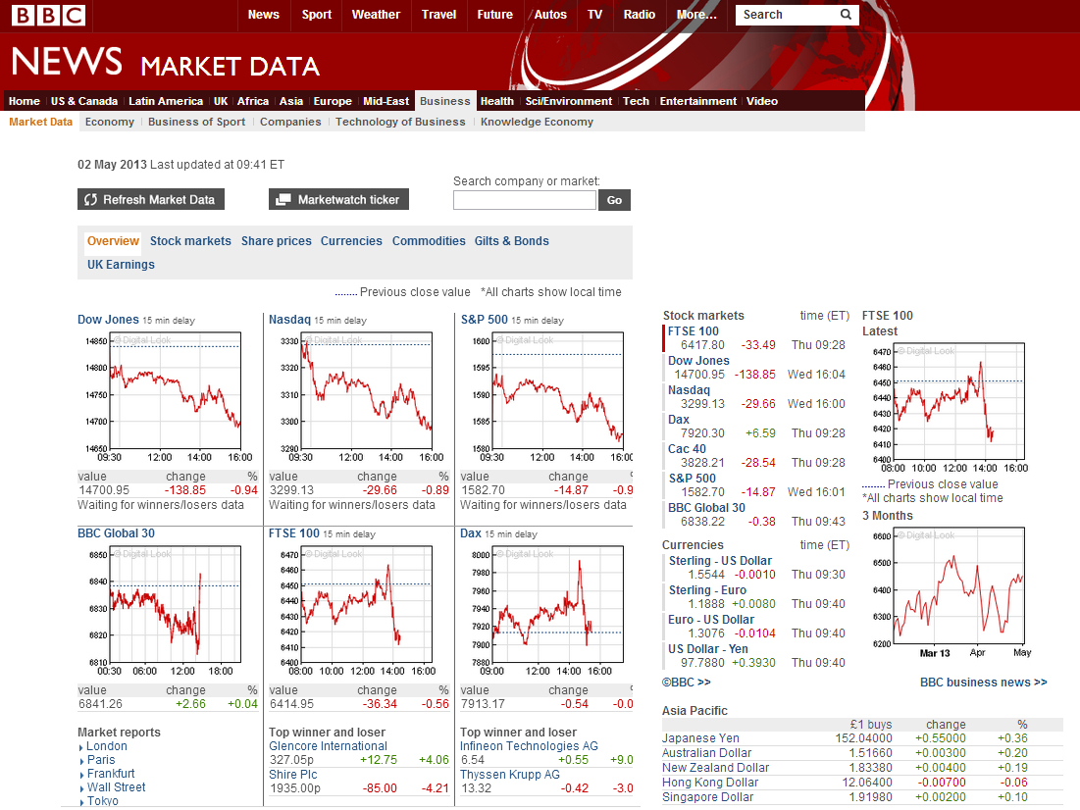
The Vision: as up-to-date and available
Notes:
Now contrast that with the world of finance and business, where everyone – from a CEO to an individual managing her personal savings - has access to information about thousands of companies in hundreds of countries that is updated almost every second. This information is completely free and presented in ways that are easy to understand and draw conclusions from, despite the incredible complexity of the underlying data.

Slide 10

Data → Information → Users
information
Data
users
analysis

Slide 11
Changing satellite data/information landscape

Slide 12
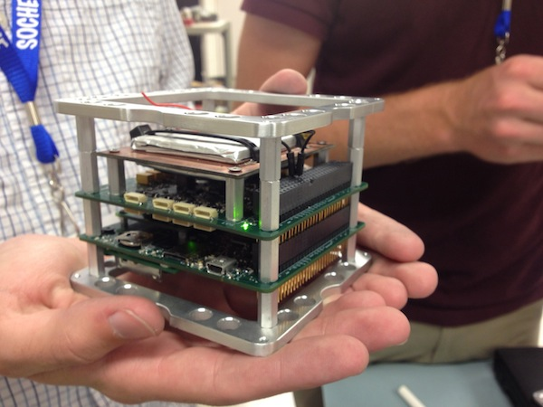
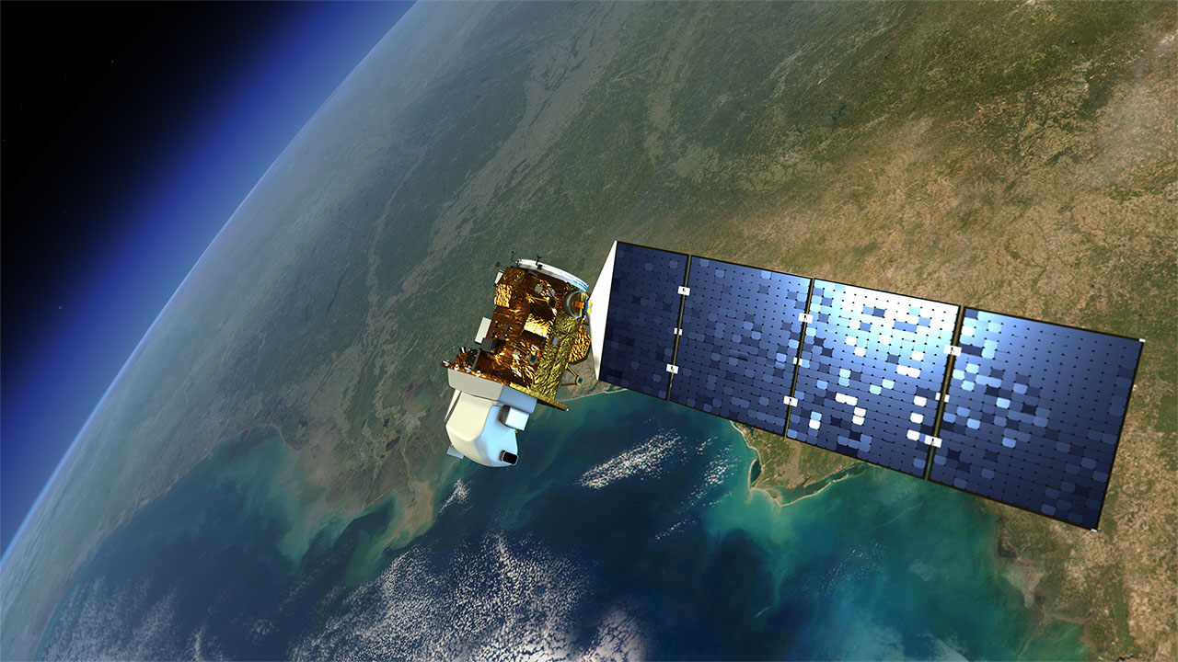
Data

Slide 13
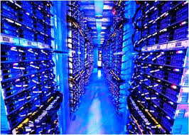

Notes:
changes in satellite Earth observations and with
new op
We have 5 Mou with
Astro digital, Planetlabbs, digital globe, orbital iisths, Urthecast
portunities provided by computing technology such as data cubes and analysis-ready data

Slide 14
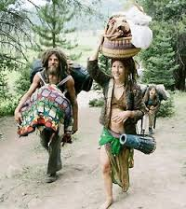


Slide 15
information
Data
users
analysis

Slide 16
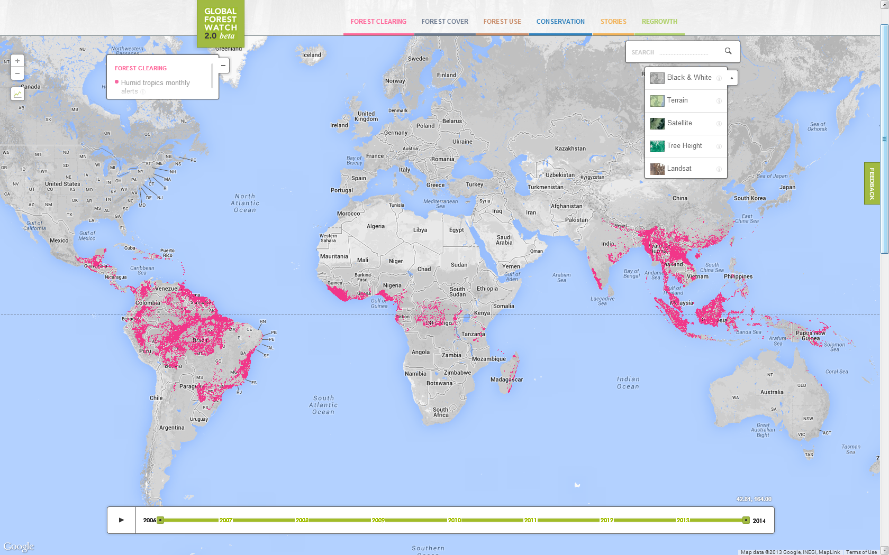
Notes:
Different basemaps available

Slide 17
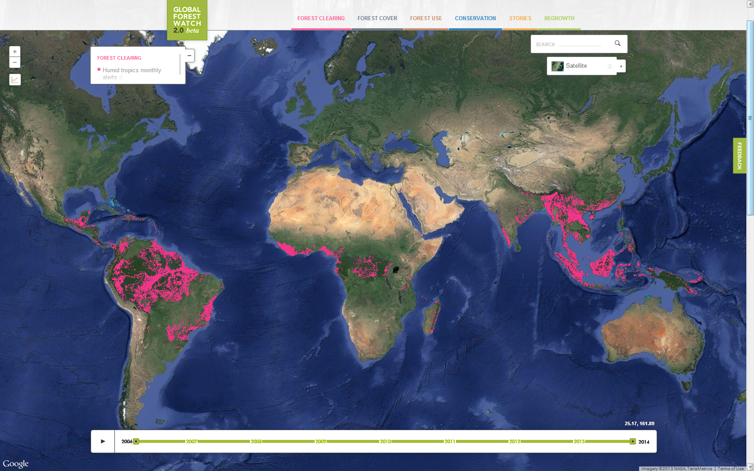
Notes:
Satellite

Slide 18
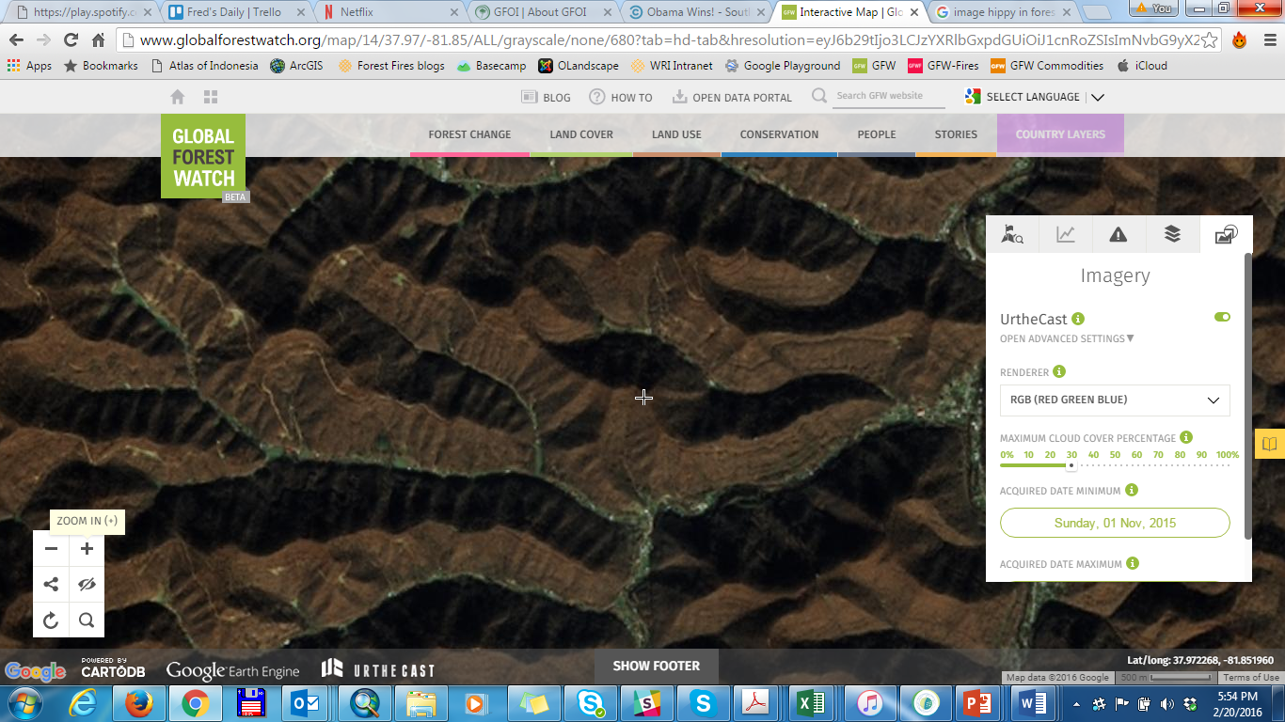

Slide 19
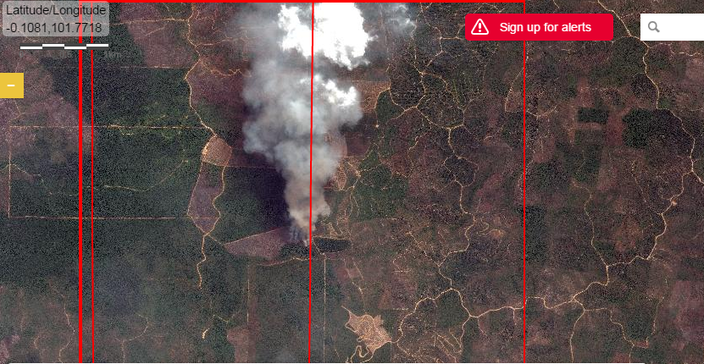

Slide 20
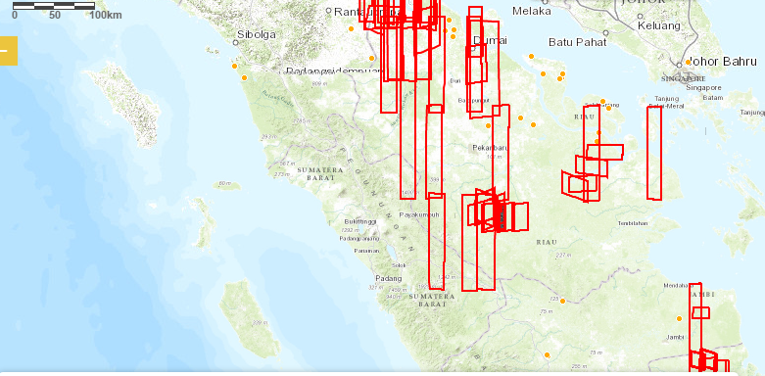

Slide 21
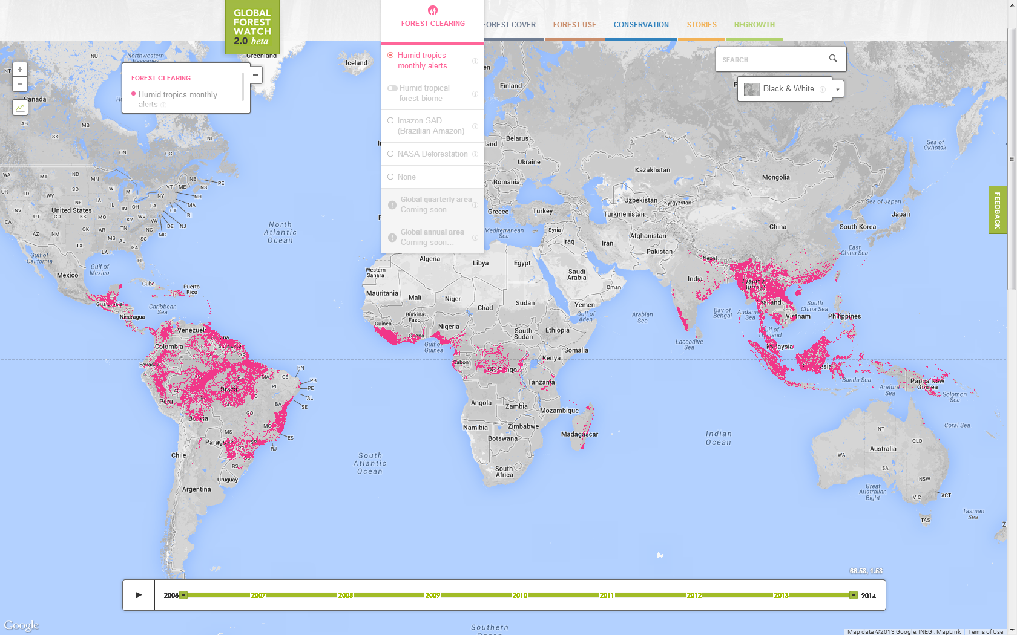
Notes:
Forest clearing layer. Currently viewing the tropical monthly alert system. Will also have the Brazilian alert system developed by Imazon, the quarterly alert system developed by NASA, and the annual, 30m forest loss layer developed by UMD.
Timeslider are the bottom allows you to view the alerts through time

Slide 22
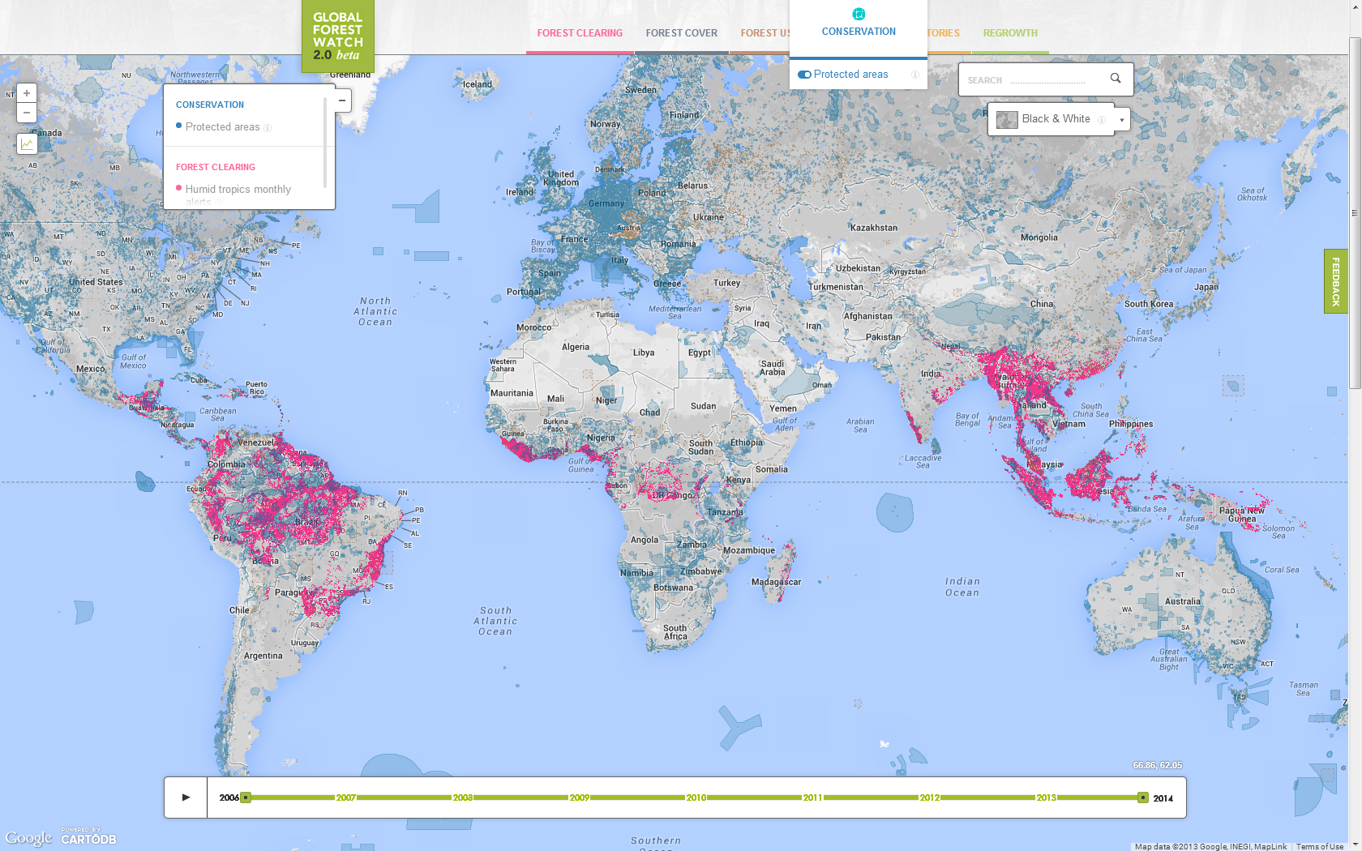
Notes:
Under conservation we have protected areas layer provided by UNEP – WCMC.

Slide 23
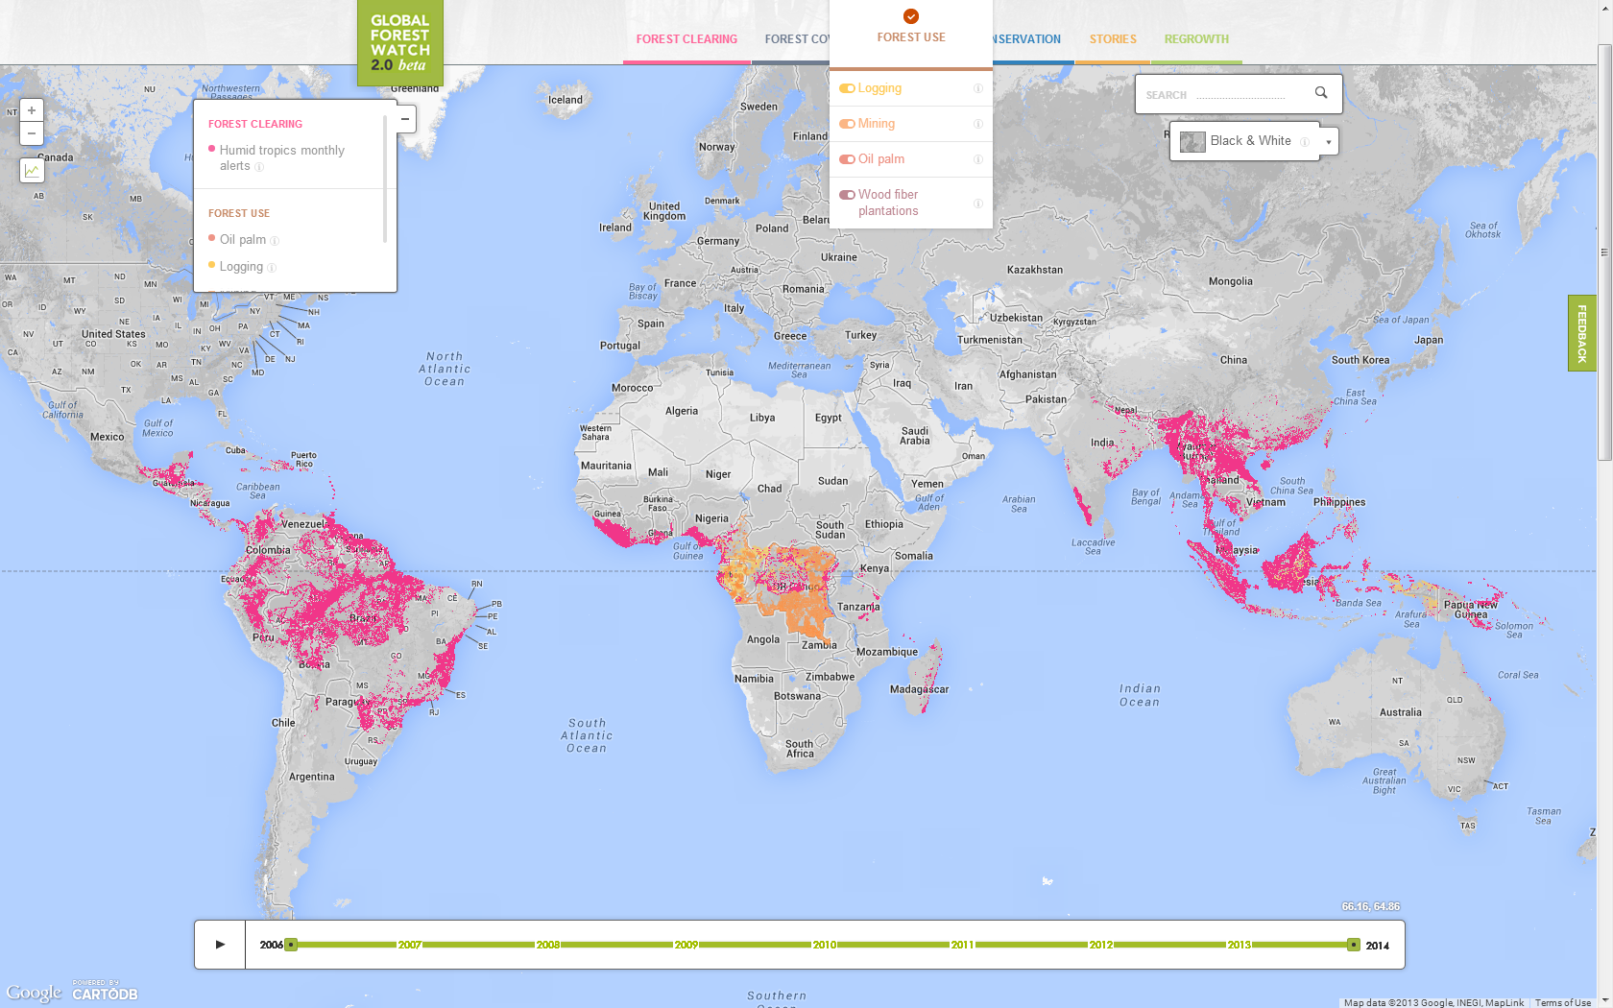
Notes:
Under the forest use menu we have logging, mining, oil palm, and wood fiber concessions. This is official data provided by the government. As you can see, we currently only have this data for Congo Basin countries and Indonesia.

Slide 24
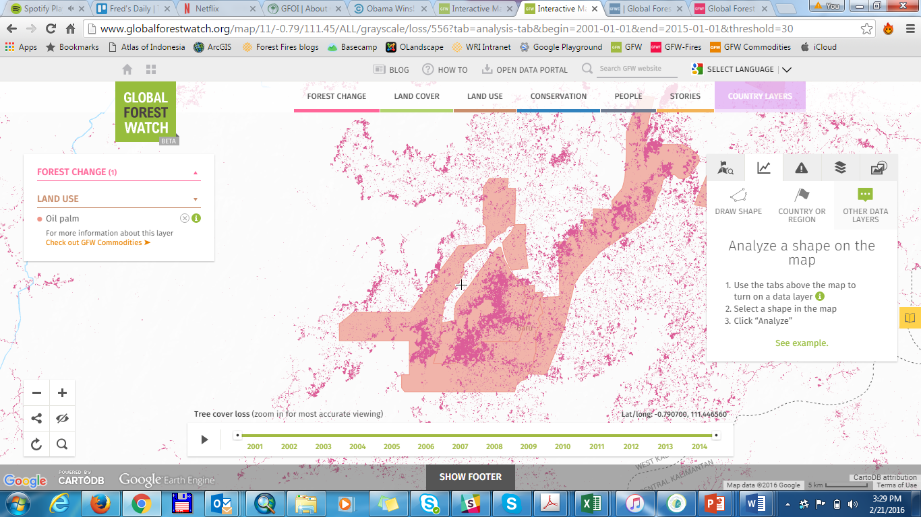

Slide 25


Slide 26
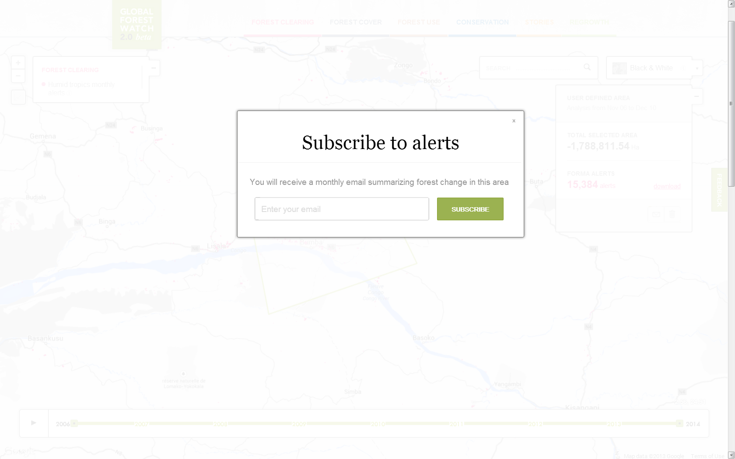

Slide 27
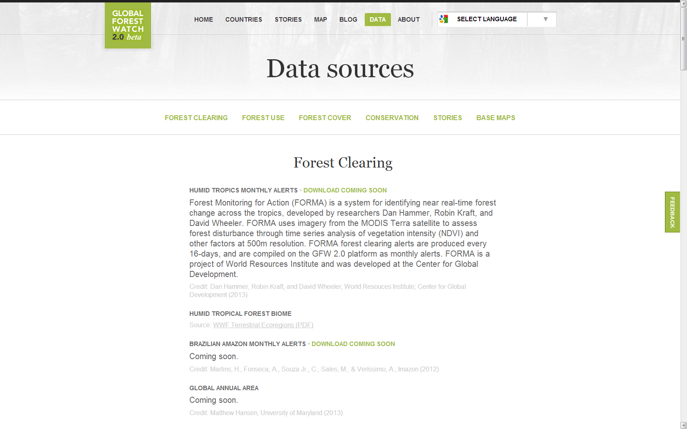

Slide 28
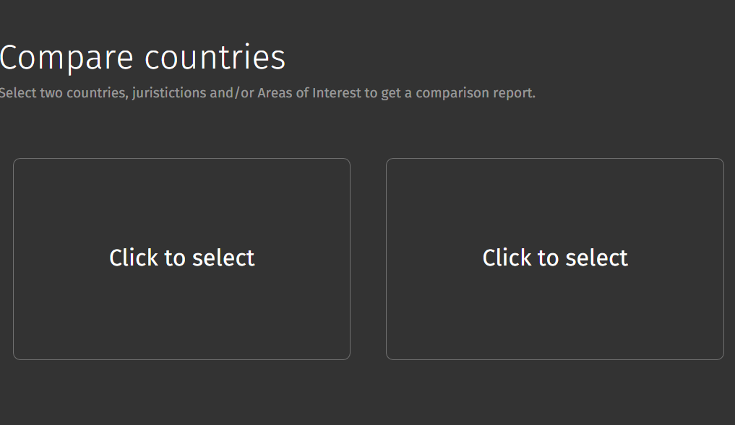
Indonesia
Protected area
Brazil
Protected area

Slide 29
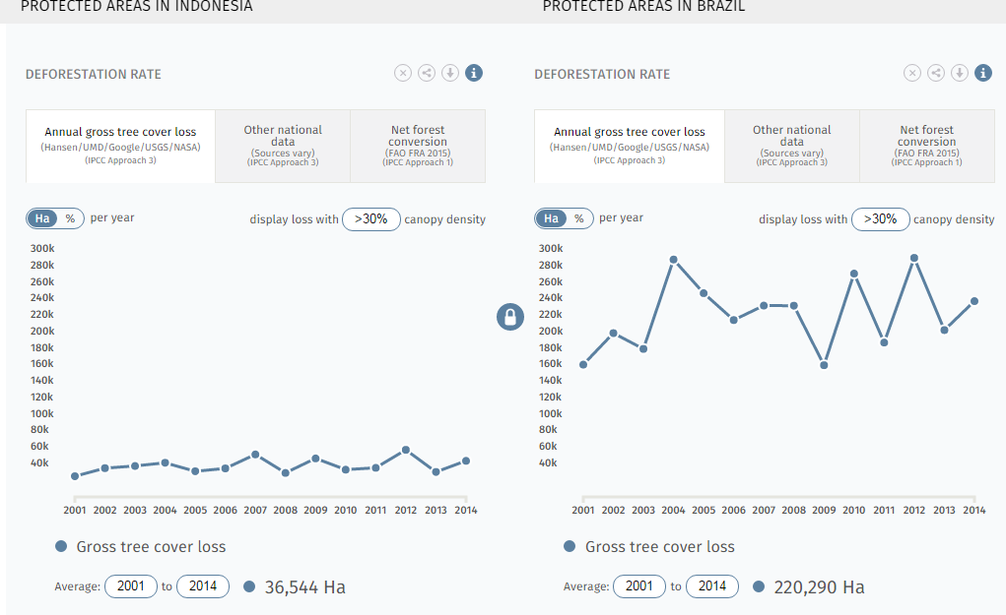

Slide 30
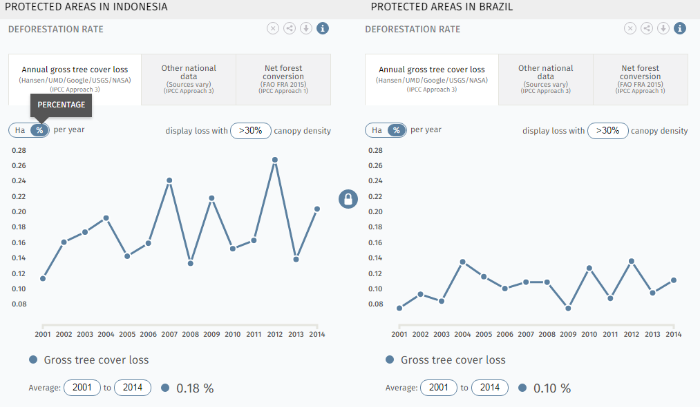

Slide 31
GLAD not national DATA
Country error unknown

Slide 32

Module 2- 28 March 2015
Use of global tree cover and change datasets in REDD+ Measuring, Reporting and Verifying (MRV)
Tree cover is typically only one aspect of forest definition and so is not sufficient by itself to define forest. In addition, tree cover loss is not necessarily deforestation, e.g. in the case of managed forests or areas affected by significant disturbance.
Notes:
But what does the atmosphere see !!!

Slide 34

Methods & Guidance Documentation and Capacity building
Journalist
Data → Information
Action
Planners
Science
Countries
Donors
Coordination of Satellite Data Supply and R&D Plan: As new sensors / capabilities come on-line
- Website
- Visualization, incl Climate, commodities fire
- Data download
- Simple analysis
Country / company engagement: RoC, Liberia,
Indonesia. Unilever, Mars
- Small-grants funds
Research blogs and papers
Commission new datasets: Woodshole carbon, TW Plantation

Slide 35
60+ Partners and Collaborators...
Africa Wildlife Foundation
Agence Française de Développement
Agence Gabonaise d'Etudes et Observations Spatiales
Airbus Defense & Space
Alliance for Zero Extinction
Baker & McKenzie
Blue Raster
Bobolink Foundation
BP-REDD, Indonesia Gov’t
Cargill
CartoDB
Center for Global Development
CIAT, CGIAR
Climate and Land Use Alliance
Conservation International
Danish International Development Agency
Dept. for International Development UK
Digital Globe
Earth Journalism Network
Esri
Food & Agriculture Org, UN
FoodReg
Forest Peoples Programme
Forest Watch Indonesia
Liberia Forestry Development Authority
Global Environment Facility
Global Forest Watch Canada
Global WItness
Google
Gordon & Betty Moore Foundation
Greenpeace
Imazon
INDEFOR
Instituto Nacional de Bosques
IOI Loders Croklaan
IUCN
The Jane Goodall Institute
Ministry of Foreign Affairs , The Netherlands
Ministry of Environment, Nature Conservation and Tourism (DRC)
Ministry of Forest Economy and Sustainable Development (Congo)
Ministry of Forestry and Wildlife (Cameroon)
Ministry of Water, Forests, Hunting and Fishing (CAR)
Mongabay
Muyissi Environnement
NASA Ames Research Center
NASA FIRMS
NASA JPL
Norway International Climate and Forests Initiative
OSFAC
OSINFOR
Planet Labs
Rainforest Foundation UK
Reforestamos Mexico
RESOLVE
Roundtable on Sustainable Palm Oil
SarVision
ScanEx
Swedish Intl. Development Cooperation Agency
The Tilia Fund
Transparent World
UNEP / WCMC
University of Maryland
Unilever
United States Agency for International Development
Vizzuality
Wildlife Conservation Society
Winrock
Woods Hole Research Center
World Resources Institute
Yayasan Puter Indonesia
Zoological Society of London

Slide 36
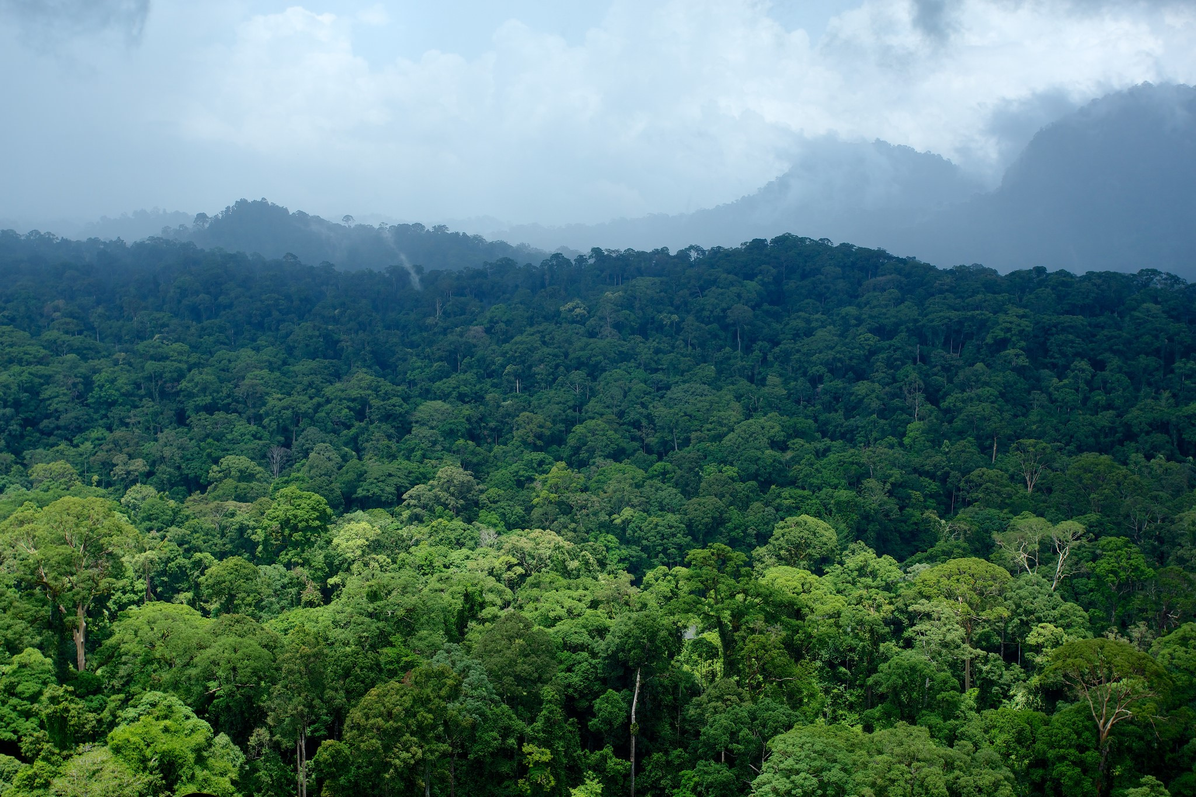

Slide 37
Accessing & Analysing Space Data
Discussion topics
S. Ward (SDCG SEC)
GFOI Plenary
24 Feb 2016, Frascati

Slide 38
Summary of Space Data Support
Regional Space Data Workshops
Space Data Needs Assessments
National historical coverage reports
Ensured ongoing coverage - annual wall-to-wall national coverage using core sensors
Custom acquisition support for specific circumstances (cloud, R&D..)
  SAR, commercial data
Cloud storage, processing and analysis of data - pilot programmes to establish future data architectures:
  Space Data Management System
  Data Cube
Visit http://www.gfoi.org/space-data/

Slide 39
Topics
Are countries aware of the space data support available?
Which countries are ready to apply space data consistent with the GFOI Methods & Guidance for reporting?
We seek feedback on the Space Data Portal and on your perspectives on the Global Data Flows work:
  sdcg-exec@lists.ceos.org
How should we seek to mainstream GFOI outputs in REDD+ and WB activities?
Should CEOS & space agencies partner with other stakeholders in progressing the GFOI Space Data component?

