Slide 1



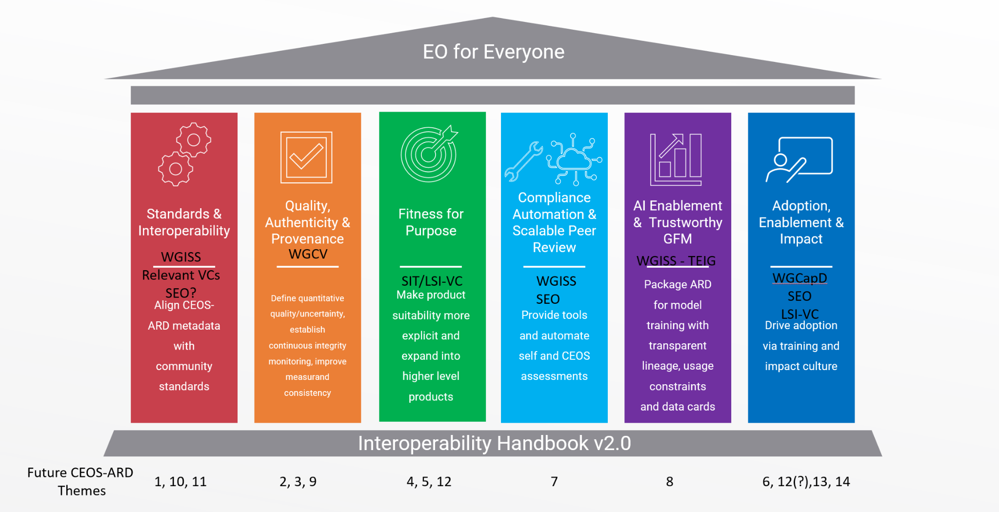
CEOS-ARD Strategy Pillars
Underpinned by CEOS Interoperability Handbook conventions

Slide 2
Compliance Automation & Scalable Peer Review
Reducing the burden of compliance assessments for data providers and assessors, enabling CEOS-ARD to scale across a growing number of providers.
Success Criteria:
CEOS-ARD assessments are largely automated, repeatable, continuous, and embedded in provider pipelines.
Peer review scales sustainably without relying on manual document checks.
Providers experience lower effort and faster turnaround for CEOS-ARD endorsement.
CEOS-ARD governance shifts from gatekeeping to continuous assurance.
Contribute to commercial ecosystem enhancement by enabling independent third parties to undertake compliance assessments.
Outcome Signal: CEOS-ARD can scale to many more providers without slowing down and third parties emerge to provide commercial compliance services.

Slide 3
Initiatives under this pillar could include
Automated validation tools to check metadata and technical compliance against CEOS-ARD specifications, reducing manual effort.
Compliance-as-code to allow providers to integrate these checks directly into their production pipelines, ensuring continuous adherence.
Online self-assessment workflows to replace static Word/PDF forms with structured web submissions, improving efficiency and transparency.
Scalable peer-review processes that include shared decision logs and reviewer training to handle higher submission volumes without compromising rigor.
Clear guidance, templates, and examples that support providers in meeting requirements.

Slide 4
What do we need from Agencies and CEOS to help develop these areas?
Headline: Engagement of agency and CEOS experts
Compliance Automation & Scalable Peer Review
Software and tool developers
Integration of CEOS-ARD assessments directly into production pipelines
Guidance, templates, and examples that support new providers in meeting requirements

Slide 5
Discussion
Discussion objective: Identify Compliance Automation & Scalable Peer Review initiatives and activities we can add to CEOS-ARD Strategy work plan for 2027-2031
What pieces currently exist
What needs further development
Where do we have capacity
Confirm: Compliance Automation & Scalable Peer Review initiatives and activities we can add to CEOS-ARD Strategy work plan for 2027-2031

