Slide 1
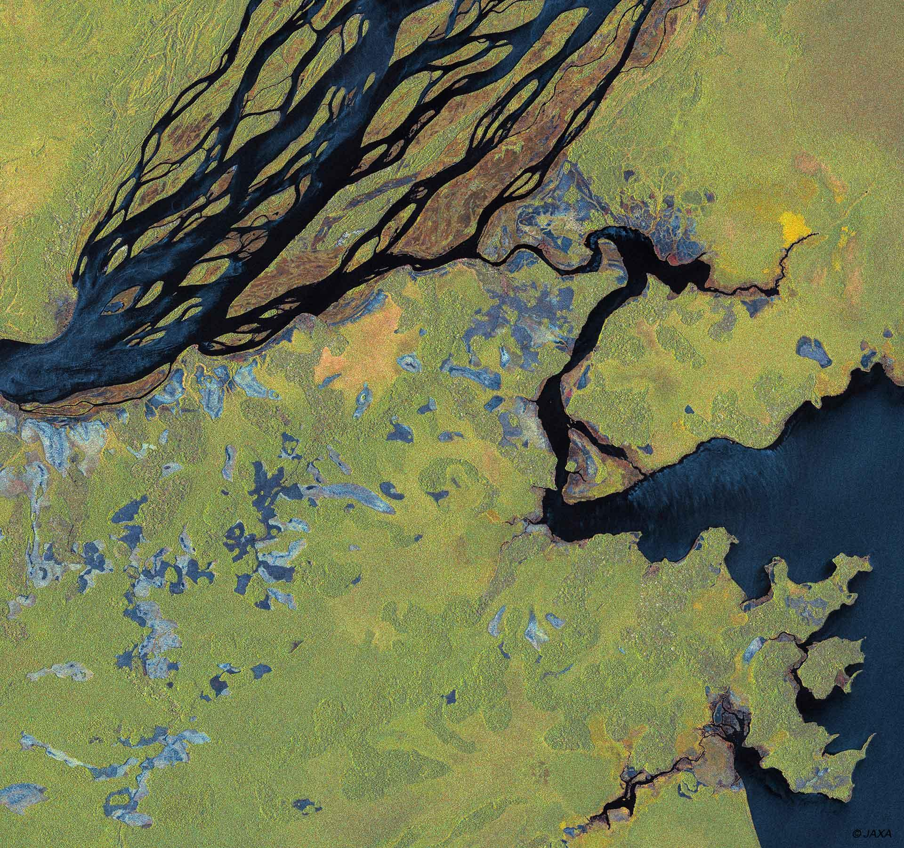

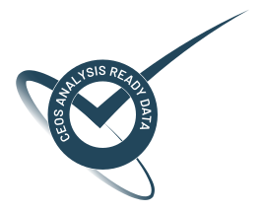
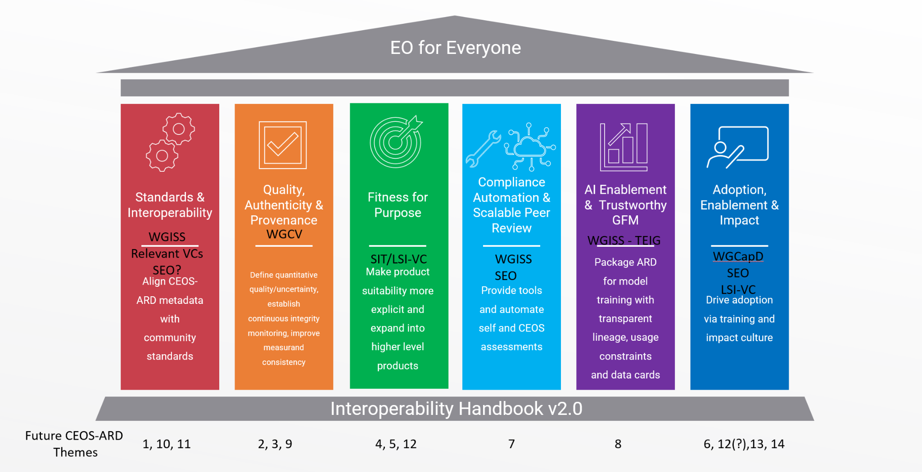
CEOS-ARD Strategy Pillars
Underpinned by CEOS Interoperability Handbook conventions

Slide 2
Adoption, Enablement & Impact
Maximize CEOS-ARD adoption across public procurement, commercial markets, and end-user communities
Success Criteria:
CEOS-ARD is routinely referenced in procurement, funding calls, and operational requirements as a baseline expectation.
CEOS-ARD is recognised as community-driven, being co-developed by CEOS and the broader community.
Derivative and thematic CEOS-ARD products directly support priority user communities (e.g. agriculture, water, biodiversity, disasters).
Commercial providers see CEOS-ARD endorsement as a market differentiator, not a compliance burden.
Training, outreach, and documented case studies clearly demonstrate real-world impact and return on investment.
Growing number of CEOS-ARD compliant datasets and a growing annual volume of CEOS-ARD compliant datasets across common ’data distributor’ platforms based on a 2026 baseline.
Outcome Signal: CEOS-ARD success is measured by use and impact including through increased citations in the scientific and general literature.

Slide 3
Initiatives under this pillar could include
Positioning CEOS-ARD as a procurement baseline to reduce duplication and risk for agencies and vendors.
Expanding CEOS-ARD to thematic and higher-level products to meet evolving user needs in areas like agriculture, biodiversity, and atmospheric monitoring (consider the concept of Interpretation Ready Data (IRD)).
Undertaking stronger commercial engagement can adapt requirements for very-high-resolution data and proprietary constraints, ensuring inclusivity.
Conducting and developing training and outreach programs, supported by multilingual documentation to build capacity and awareness globally.
Systematically capture and document case studies and impact metrics that demonstrate CEOS-ARD’s value to funders and policymakers.

Slide 4
What do we need from Agencies and CEOS to help develop these areas?
Headline: Engagement of agency and CEOS experts
Adoption, Enablement & Impact
Capturing and documenting case studies and impact metrics that demonstrate CEOS-ARD’s value to funders and policymakers
Connections to end users (LSI-VC Forests and Biomass, GFOI, GEOGLAM)
conducting and developing training and outreach programs, supported by multilingual documentation to build capacity and awareness globally (WGCapD?)
Pilot projects that utilise CEOS-ARD and help refine specifications through feedback (WGDisasters?)
Positioning CEOS-ARD as a procurement baseline to reduce duplication and risk for agencies and vendors.
Expanding CEOS-ARD to thematic and higher-level products to meet evolving user needs in areas like agriculture, biodiversity, and atmospheric monitoring
Commercial sector engagement

Slide 5
Discussion
Discussion objective: Identify Adoption, Enablement & Impact initiatives and activities we can add to CEOS-ARD Strategy work plan for 2027-2031
Case studies
Capturing impact and metrics
What pieces currently exist
What needs further development
Where do we have capacity
Confirm: Adoption, Enablement & Impact initiatives and activities we can add to CEOS-ARD Strategy work plan for 2027-2031

