Slide 1
Precision Agriculture
David Clay, Sharon Clay, and Skye Brugler
Editor-in-Chief American Society of Agronomy
SD Endowed Corn Utilization Council Chair Precision Farming
Distinguished Professor in Soil Biogeochemistry
South Dakota State University
Brookings, SD 57007
Cell: 605-690-7635
david.clay@sdstate.edu

Slide 2
Precision Agriculture
Precision Farming can be separated into multiple components that include:
  Data collection
  Decisions
  Implementation
  Measuring impacts
All components are influenced by technology

Slide 3
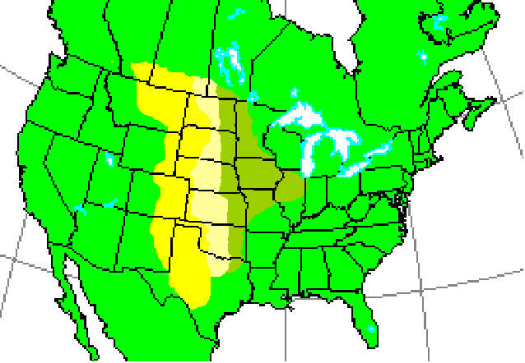
The tools implemented depend on the climate, soils, crops, and management

Slide 4
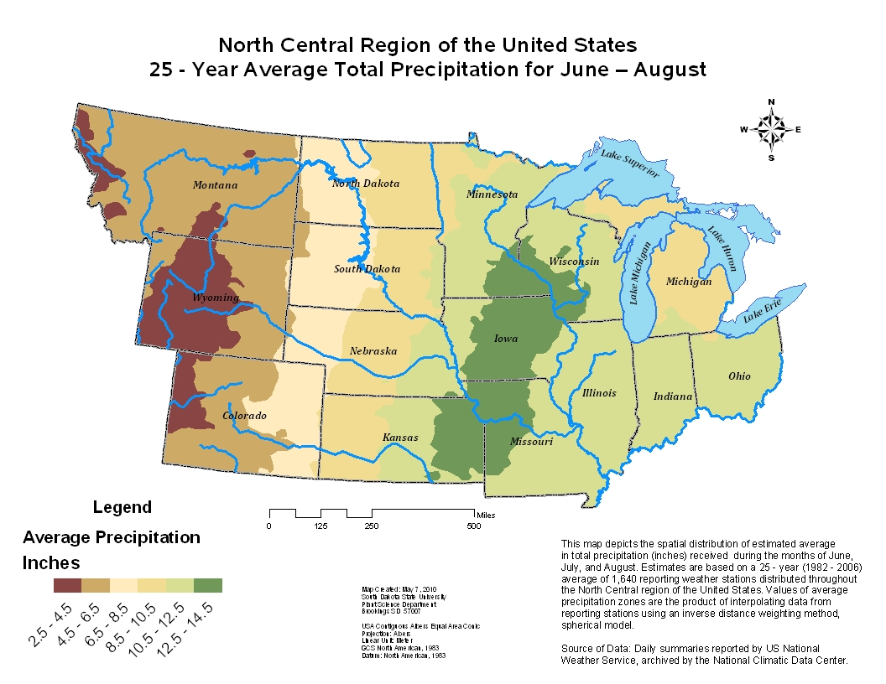
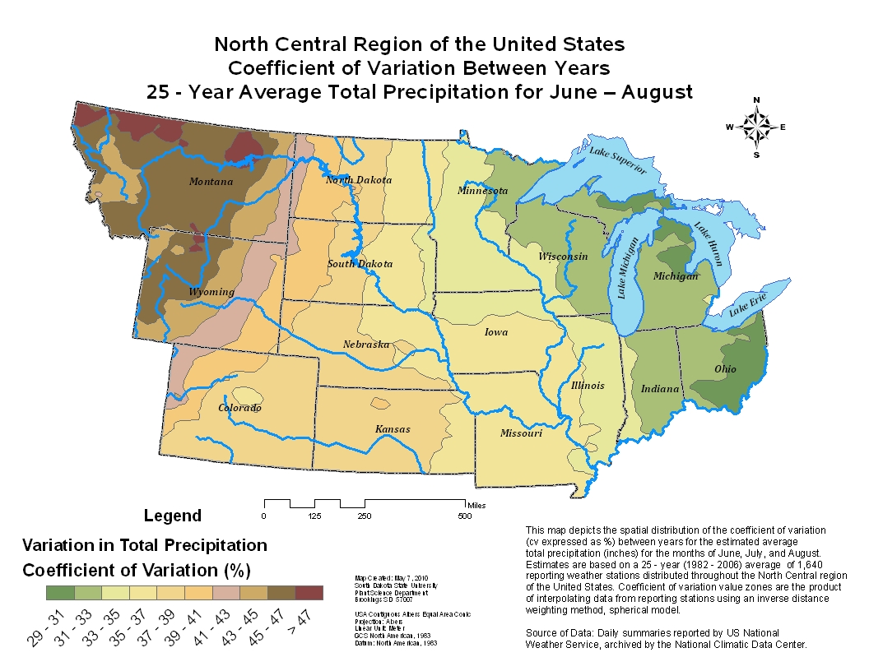
We are challenged by multiple problems including:
climate variability

Slide 5
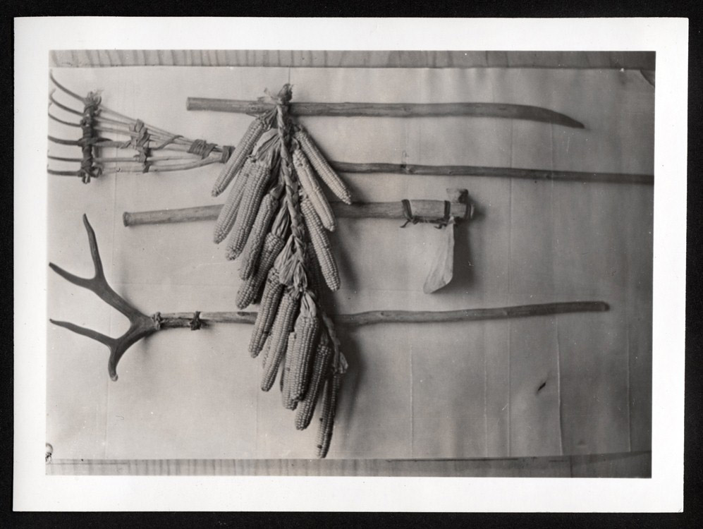
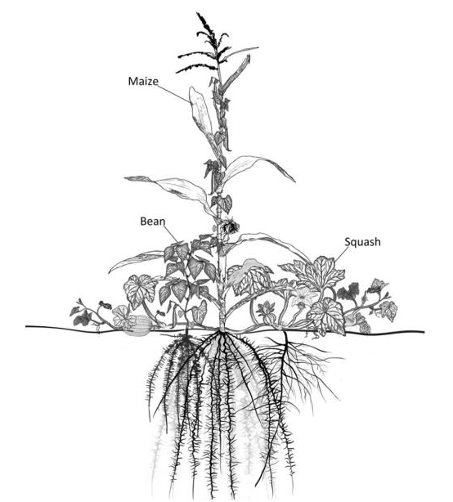
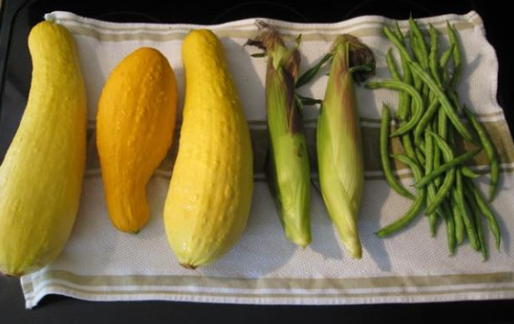
Native Americans produced food by hunting and three sisters
Corn was a very important food source,
It was used as food and for trade.
Fire and was used to help prepare the seed bed and maize was planted in mounds.

Slide 6
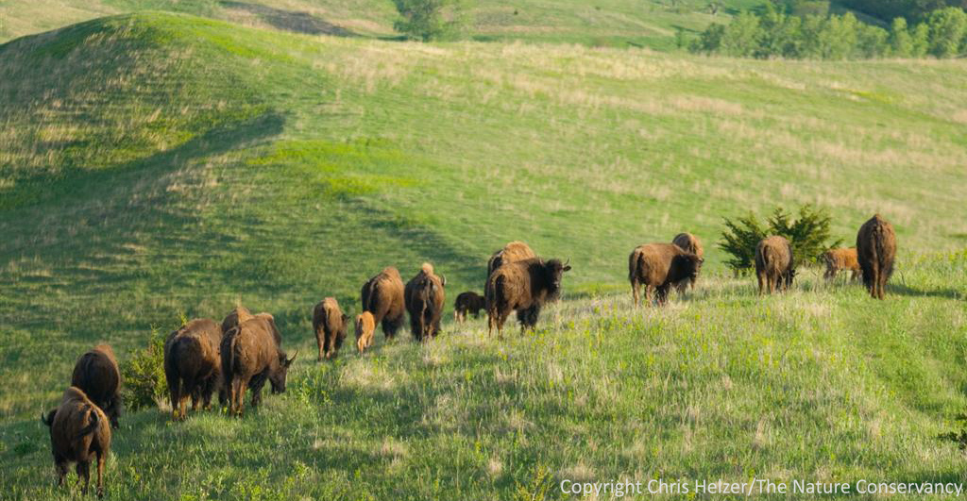
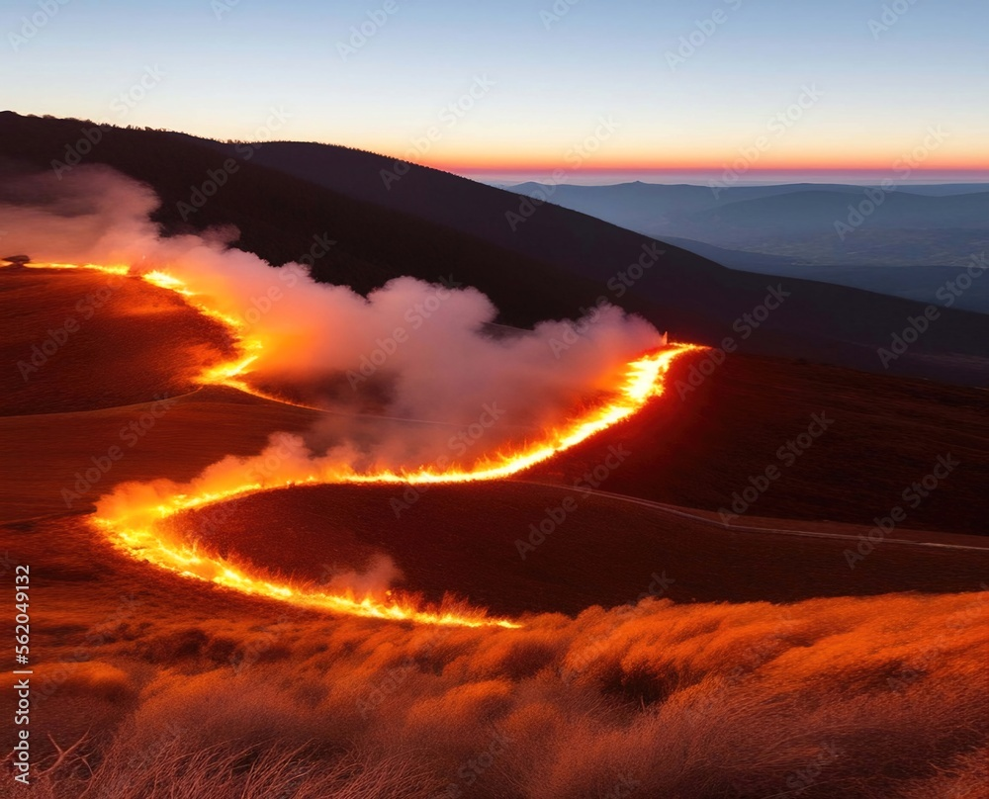

Slide 7
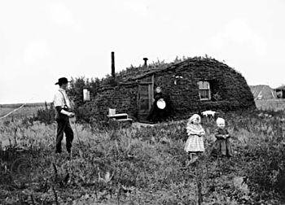
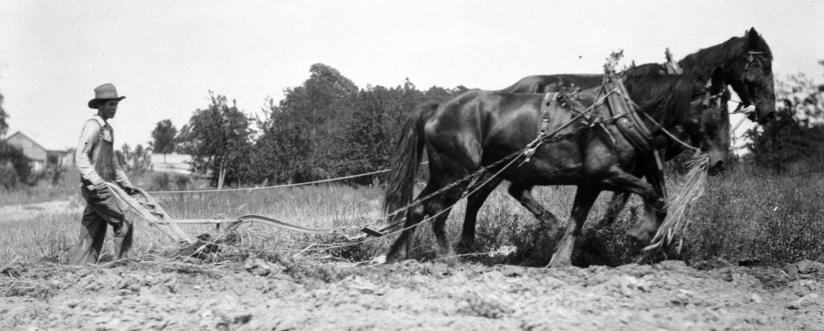
Visit South Dakota in the 1880’s

Slide 8
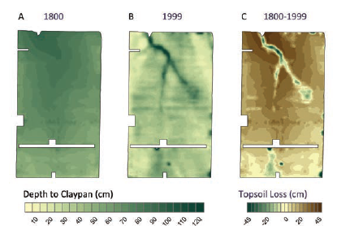
Interactions between management, soil, and weather changed the system.

Slide 9
Soil Fertility; crop rotation
Nutrient maps wren based on
grid sampling conducted in 1999.
lime dust coming off the gravel road that
borders the field on that side.
The highest soil test phosphorus on the
field that aligns with the farm home locations,

Slide 10
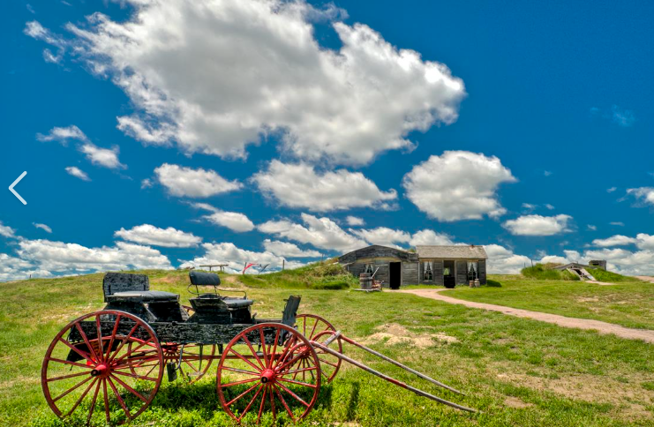
Management induced variability

Slide 11
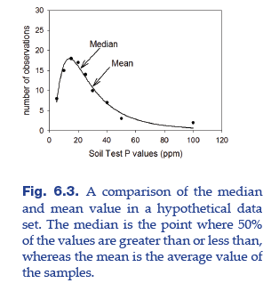
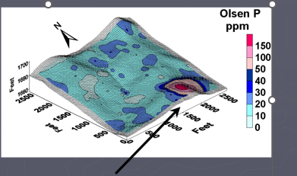
Understand the data

Slide 12
Can we use Precision Tools to Better our Understanding of the System.

Slide 13
Questions
Do you think there is strong relationship between soil nutrients and yield?
How do you think the plants responded to water stress?

Slide 14
Poor relationships between soil test P and yield.
What does this mean?

Slide 15
Detailed measurement and models

Slide 16
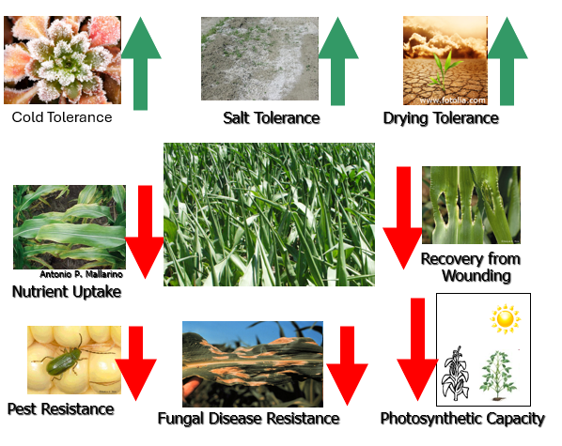
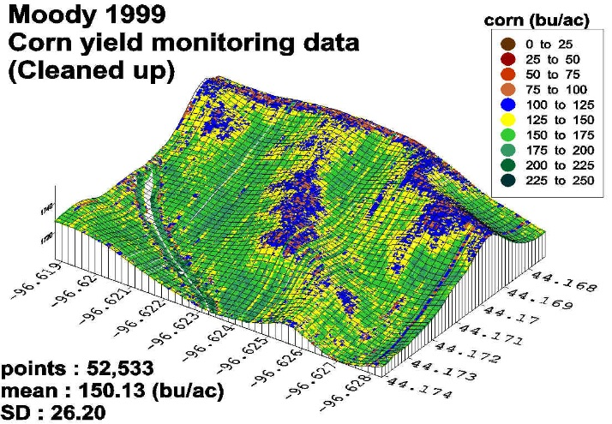
Water impact plant gene expression
In the low yielding area, over 800 genes were differentially impacted.
The Plant Genome, 6(2), plantgenome2012.2011.0029.

Slide 17
Precision farming future
New tools are available to us.
  Molecular biology give us opportunity to identify mechanisms impacting yield
  Dr. S. Clay has been looking why weeds reduce yields and why cover crops reduce nitrous oxide emissions
We can predict crop yields based using AI and crop reflectance
We can do more than assess plant height.

Slide 18
Position managers producers to take advantages of remote sensing (Producer survey).
76% of those surveyed have not used UAV technology
  11 % used the imagery
  6% for applications
  7% for both
Barrier to adoption was unknown financial benefits
We will analyze data collected in the past to conduct to conduct a financial analysis.
If we want to increase use of remote sensing, we need to train N users how to use the data.

Slide 19
New Precision Farming Textbook
1 – An Introduction to Precision Agriculture (David Clay & Skye Brugler)
2– Adoption of Precision Agriculture technology (Bhavna Joshi)
3– The Discovery and Adoption of Precision Agriculture (Harkirat Kaur)
Characterizing and Managing System Variability
4 – Variable Rate Technology: Yield Monitors and Variable Rate Equipment (Ali Mirzakhani Nafchi)
5– Understanding and Identifying Variability within the Cropping System (Sharon Clay)
6 – Soil Variability and Fertility Management (Katsutoshi Mizuta)

Slide 20
New Precision Farming Textbook
1 – An Introduction to Precision Agriculture (David Clay & Skye Brugler)
2– Adoption of Precision Agriculture technology (Bhavna Joshi)
3– The Discovery and Adoption of Precision Agriculture (Harkirat Kaur)
Characterizing and Managing System Variability
4 – Variable Rate Technology: Yield Monitors and Variable Rate Equipment (Ali Mirzakhani Nafchi)
5– Understanding and Identifying Variability within the Cropping System (Sharon Clay)
6 – Soil Variability and Fertility Management (Katsutoshi Mizuta)

Slide 21
Precision Agriculture Basics
Pest and Disease Management
17 – Precision Insect Measurement and Management (Ivan Grijalva)
18– Targeted Weed Management using Precision Agriculture (Anita Dille)
19- Disease Management (Febina Mathew)
On-Farm Data Collection, Management, and Utilization
20 – Yield Monitoring and Mapping (John Fulton)
21– On-Farm Replicated Strip Trials (Peter Kyveryga)
22 – Precision Agriculture Data Management (Ali Mirzakhani Nafchi)
23 – Economics of Precision Farming (Wang Tong)

Slide 22
Precision Agriculture Basics
Pest and Disease Management
17 – Precision Insect Measurement and Management (Ivan Grijalva)
18– Targeted Weed Management using Precision Agriculture (Anita Dille)
19- Disease Management (Febina Mathew)
On-Farm Data Collection, Management, and Utilization
20 – Yield Monitoring and Mapping (John Fulton)
21– On-Farm Replicated Strip Trials (Peter Kyveryga)
22 – Precision Agriculture Data Management (Ali Mirzakhani Nafchi)
23 – Economics of Precision Farming (Wang Tong)

Slide 23
Thank you for your attention: Any questions?

