Slide 1
CEOS WGCV-56 / LSI-VC-19 Joint Meeting
CEOS-ARD PFS Updates for CEOS-ARD Oversight Group Decision
CEOS-ARD Secretariat
Agenda Item A6.1
WGCV-56 / LSI-VC-19 Joint Meeting
Sioux Falls, SD, USA
20-24 April, 2026

Slide 2
Background
Over the last few years, the development of CEOS-ARD PFS and products has identified issues related to the PFS
Issues identified by PFS development teams and product self-assessments have been captured in the CEOS-ARD GitHub Issue Tracker.
These issues have been raised to the CEOS-ARD Oversight Group for resolution as they are shared by multiple PFS.

Slide 3
Discussion format
Objective for today: Agree a resolution for each issue / proposal. If not, then agreement for an actionee to lead a short-term (~1 month) action for conclusion
CEOS-ARD issues and proposals to resolve them are detailed in the following slides, according to:
  Issue
  Context
  Proposal

Slide 4
Measurand / Measurement
  Issue: Proposed revision to metadata requirement 3.1 Measurement (#67)
  Context: This issue was raised by Peter Strobl during the AR PFS v2.0 update, as well as by Anastasia Sarelli during the ST PFS v6.0 update, that ‘measurand’ is the correct term instead of ‘measurement.’ We should align definitions with the CEOS EO Glossary, the Guide to the Expression of Uncertainty in Measurement (GUM), and FIDUCEO Glossary.
  Proposal: Rename requirement 3.1 in all Optical PFS to ‘Measurand’ [patch]
  Question: Should the SAR PFS ‘Backscatter Measurements’ requirement name remain as-is?

Slide 5
Measurand / Measurement
  Issue: Proposed revision to metadata requirement 3.1 Measurement (#67)
  Context: This issue was raised by Peter Strobl during the AR PFS v2.0 update, as well as by Anastasia Sarelli during the ST PFS v6.0 update, that ‘measurand’ is the correct term instead of ‘measurement.’ We should align definitions with the CEOS EO Glossary, the Guide to the Expression of Uncertainty in Measurement (GUM), and FIDUCEO Glossary.
  Proposal: Rename requirement 3.1 in all Optical PFS to ‘Measurand’ [patch]
  Question: Should the SAR PFS ‘Backscatter Measurements’ requirement name remain as-is?
  Proposal: Rename Traceability requirement to ‘Metrological Traceability of the Measurand to SI’ and add a note referring to 3.1 Measurand [#66] [patch]

Slide 6
PFS Versioning
  Issue: Add parameter to capture self-assessment PFS version number in metadata (#41)
  Context: A consistent parameter across all PFS would identify the version of the PFS that self-assessments are made against. The PFS version should feature in the product metadata. The CEOS-ARD PFS for Aquatic Reflectance and SAR contain similar requirements for this.
  Proposal: Add as Requirement 1.0 for all PFS – AGREED BUT IMPLEMENT LATER
  Question: Can this replace Requirements 1.3 and 1.4 in the SAR PFS? (#72)
# | Item | Threshold (Minimum) Requirements | Goal (Desired) Requirements
1.0 | CEOS-ARD Compliance Version | Type and version of CEOS-ARD PFS with which the product is complying is identified. | As threshold.
  Issue: Add support and transparency for older PFS versions (#86)
  Context: Assessments may not always be conducted against the most recent PFS, creating ambiguity for providers, reviewers, and users.
  Proposal: Publish legacy PFS versions on the CEOS-ARD GitHub [GitHub Releases]

Slide 7
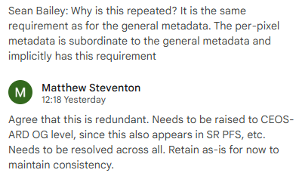
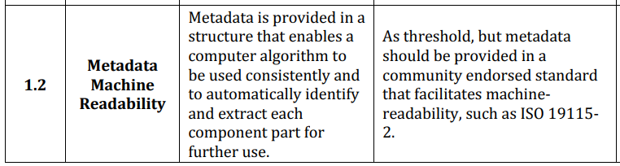
Metadata Machine Readability
  Issue: Redundancy of Machine Readability metadata requirements (#61)
  Context: Metadata machine readability is repeated in General and Per-pixel PFS requirements.
  Proposal: Remove Per-pixel requirement from all PFS [minor]

Slide 8
Geometric Correction
  Issue: Sub-pixel accuracy requirement is too difficult to achieve for high-resolution sensors
  Context: Many providers (public and private) have reported issues reaching Threshold compliance for requirement 4.1.
  LSI-VC-18 feedback suggestion: ‘Perhaps CEOS-ARD maintains sub-pixel requirement for moderate-resolution missions (e.g., ≥5 m), but for high resolution missions (<5 m), define CEOS-ARD compliance as:
  Horizontal geolocation RMSE ≤ 1.0 m (or ≤ 1.5 m CE90), whichever is larger than 0.5 pixel.’
  Proposal: See next slide from Barnes

Slide 9
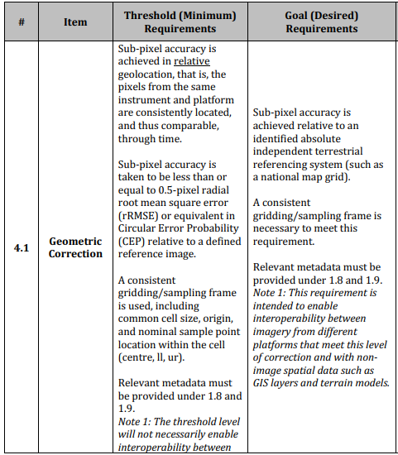
Geometric Correction
Barnes’ proposal::
Adopt an adaptive compliance framework for VHR systems:
1. Maintain Sub-Pixel Requirement
For sensors ≥5 m GSD.
2. Introduce Absolute Accuracy Option for VHR Systems (<5 m GSD)
Allow compliance through an absolute geolocation threshold:
Horizontal geolocation RMSE ≤ 1.0 m (or CE90 ≤ 1.5 m), whichever is larger than 0.5 pixel.
This preserves rigor while aligning with realistic physical limits.

Slide 10
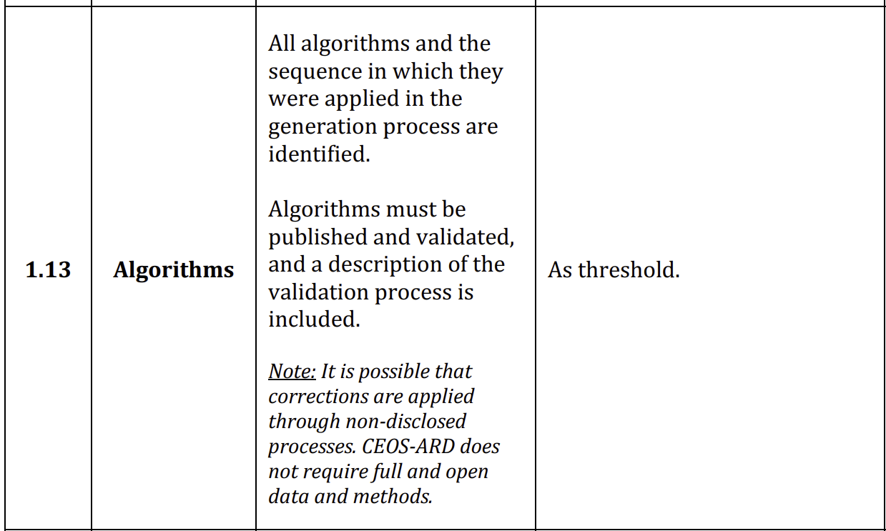
Provision of proprietary documentation
  Issue: Commercial sector cannot provide peer reviewed algorithms (#54)
  Context: Providing peer-reviewed algorithms presents a difficulty for commercial providers for whom proprietary algorithms may be a commercial differentiator. Some have also reported that single DOI landing pages are would be difficult to obtain or not necessary. (#21)
  Proposal: Adopt AR PFS approach
  Sensor calibration
  Algorithms
  ATBD
  Emissivity
  Peer-reviewed and DOI-accessible documentation

Slide 11
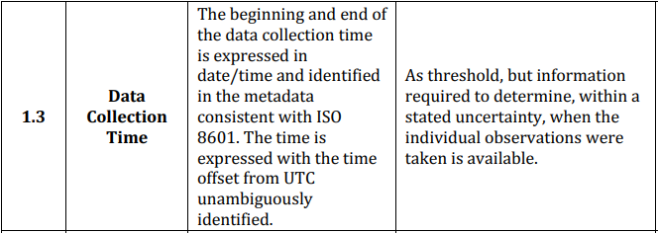
Data Collection Time
  Issue: Unclear requirement on the definition of ‘data collection time.’
  Context: Initial proposal to adopt the AR PFS v2.0 requirement (below). Peter and Siri Jodha noted issues with the ambiguity in the definition of ‘data collection time’, particularly for mosaic datasets.
  Proposal: Peter and Siri Jodha to develop a proposal?

Slide 12
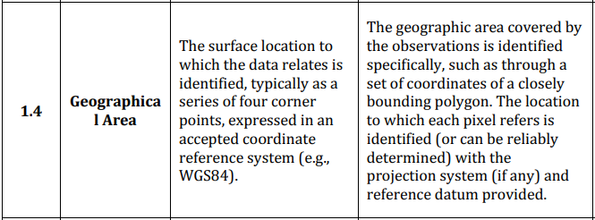
Geographical Area
  Issue: Sub-pixel accuracy requirement is too difficult to achieve for high-resolution sensors (#56)
  Context: AR PFS comments (Heidi Dierssen): The Threshold description describes 'surface location', yet the Goal describes 'geographic area'. If these terms are equivalent, the main difference between Threshold and Goal is whether you have four corner points or a bounding polygon.
  Proposal: Peter to develop in TMSG?

Slide 13
Remove Terrain Illumination Goal requirement
  Issue: Terrain Illumination Goal Requirement Removal? (#80)
  Context: Surface Reflectance Quality and Consistency Team are suggesting the removal of the Terrain Illumination Goal requirement from the SR PFS. Awaiting additional formal adjustments to the other Goal CEOS-ARD requirements would be useful before formally determining if requirement 2.12 would be removed from a future SR PFS.
  Proposal: remove requirement from SR and NLSR PFS (req 2.12), as well as the reference to it in SR PFS req 3.3.

Slide 14
Per-pixel Metadata data type
  Issue: Include data type in all per-pixel requirements (#82)
  Context: From the AR PFS v2.0 update, Siri Jodha noted ‘datatype for each [per-pixel requirement] should be specified. it's not always clear whether a numerical value, free text or a boolean is needed
  Proposal:

Slide 15
Processing Chain Provenance
  Issue: Make provision of processing chain provenance information a Threshold requirement (#58) (#50)
  Context: Users would want full transparency on the processes used, so we suggest making the existing Goal requirement applicable at the Threshold level instead. If you don’t know anything about the processing that’s been done, then it’s not ARD. Currently a threshold requirement for optical PFS.
  Proposal:
  Note: Consider approach taken by SAR PFS ‘Source Data Attributes’?

Slide 16
Per-pixel uncertainty
  Issue: Uncertainty can vary by pixel, how can a provider give just one value? (#84)
  Context: Can a single uncertainty estimate can apply to all pixels in collection? Uncertainty might vary by surface type (e.g. desert, forest, unresolved waterbodies, etc.) so how can one value apply to an entire collection?
  Proposal:

