Slide 1
LSI-VC-19
Submission for CEOS-ARD SAR endorsement by LSI-VC:
Composite Backscatter
[CB]
Ake Rosenqvist, JAXA/soloEO
Agenda Item L5.2
Sioux Falls, SD, USA, 20-24, 2026

Slide 2
Composite Backscatter [CB]
Composite Backscatter [CB] (SAR PFS v1.3)
  Previously referred to as Multi-Source Backscatter (MSB)
  Other SAR PFSs (e.g. NRB mosaics, InSAR) also accommodate multi-source input → Composite Backscatter agreed to be a less ambiguous name
  Definitions:
    Composite product: Product where samples (or pixels) are generated from more than one input data source, e.g. by local resolution weighting or by backscatter averaging.
    Mosaic product: Product generated from more than one input data source and where a pixel value in the product uniquely corresponds to the pixel value of one of its input data sources.

Slide 3
Composite Backscatter [CB]
What is Composite Backscatter?
  Previously referred to as Multi-Source Backscatter (MSB)
  Other SAR PFSs (e.g. NRB mosaics, InSAR) also accommodate multi-source input → Composite Backscatter agreed to be a less ambiguous name
  Definitions:
    Mosaic product: Product generated from more than one input data source and where a pixel value in the product uniquely corresponds to the pixel value of one of its input data sources.
    Composite product: Product generated from more than one input data source and where a pixel value in the product is generated by e.g. by local resolution weighting or by backscatter averaging. The product pixel value does not correspond to a single data source.

Slide 4
Composite Backscatter [CB]
What is Composite Backscatter?
Composite Backscatter generated via weighted averaging
  Pixel weighting derived from the NRB Scattering Area image
  Pixel values not unique to one source data take
Combination of data from ascending and descending passes
→ improved spatial resolution and near-elimination of radar shadow, foreshortening, and layover
Enables combination of data acquired by different sensors
→ better wide-area temporal resolution
Certain per-pixel metadata is not defined for composite (e.g. local incident angle, scattering area)
Instead: optional local quality map(s) can be included

Slide 5
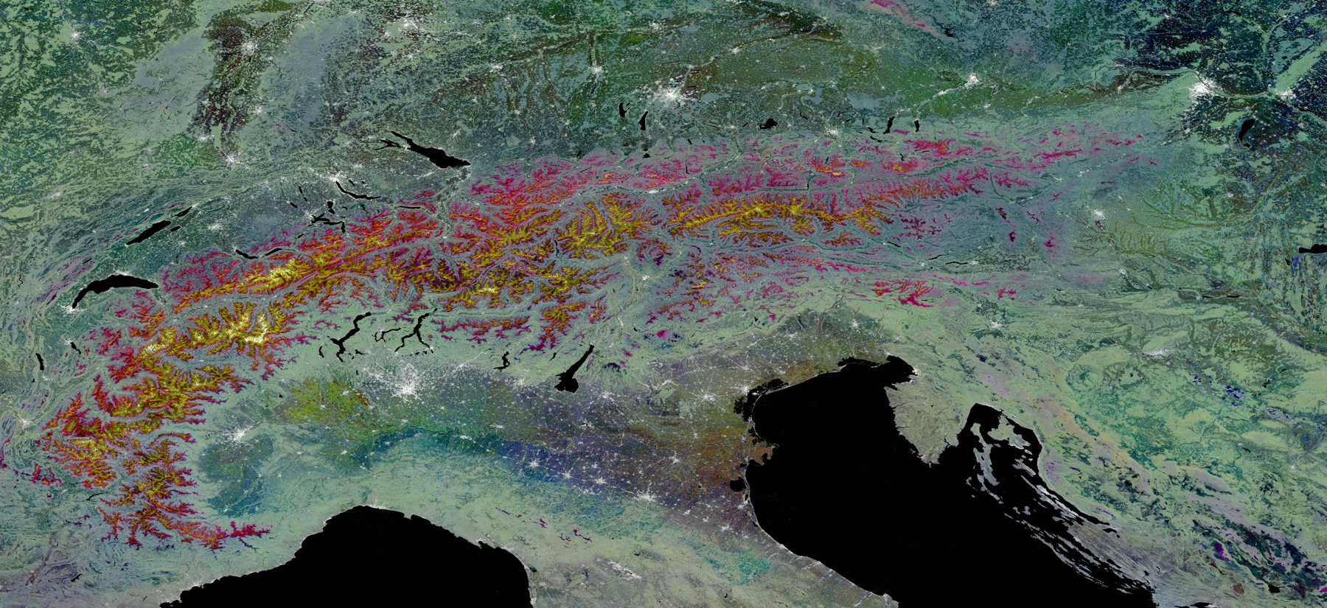

Composite Backscatter [CB]
Sentinel-1A & -1B IW Backscatter Composites 2018 VH: Feb 24-Mar 7, April 1-12, May 1-12; -23dB (black) to -6dB (white)
2018 VH-pol.
Red: Dry in Feb, Wet in Apr/May
Yellow: Dry in Feb & Apr, Wet in May
White: High mountain snow,
Dry in Feb/Apr/May
Processing D. Small, UZH, Switzerland

Slide 6
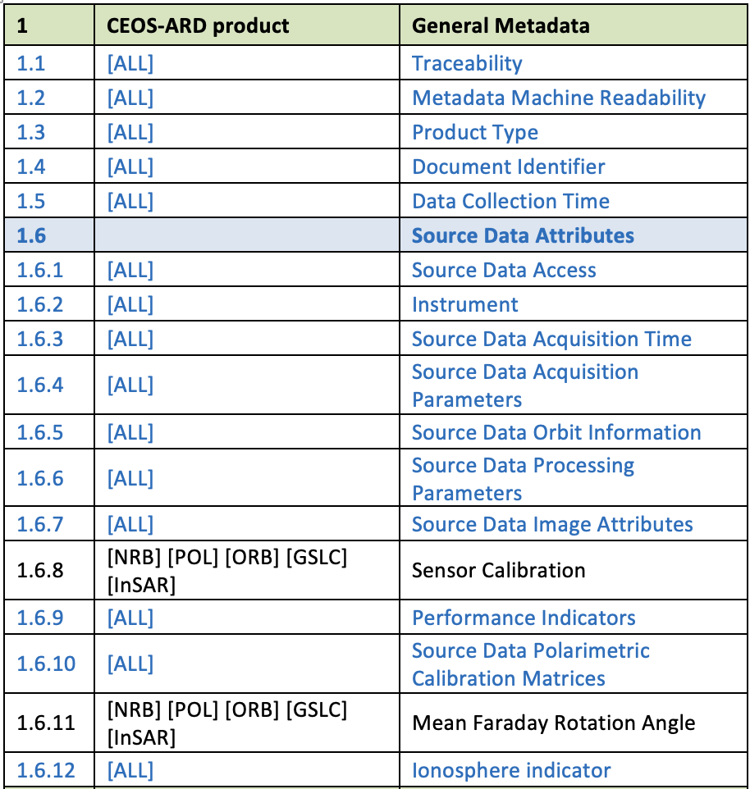
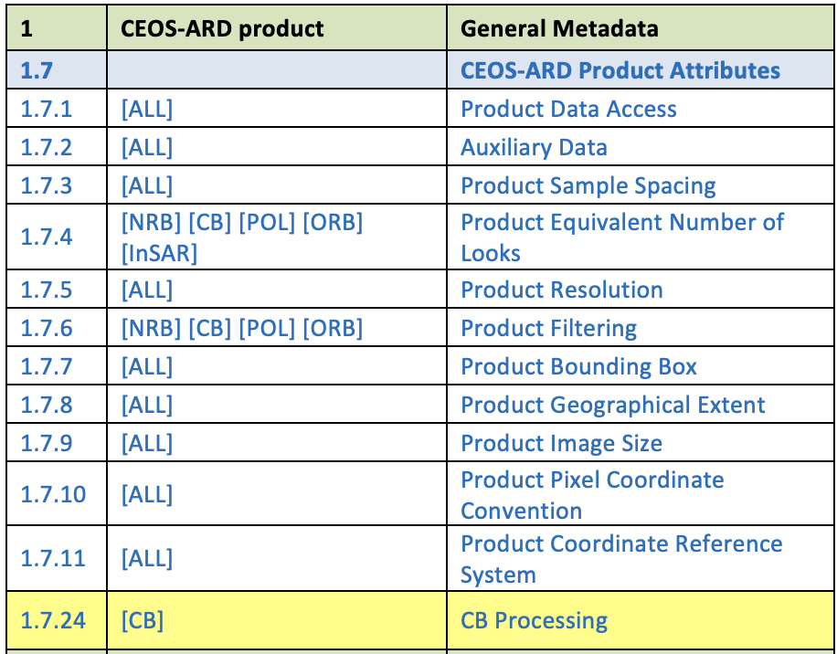
[CB] Summary of requirements

Slide 7
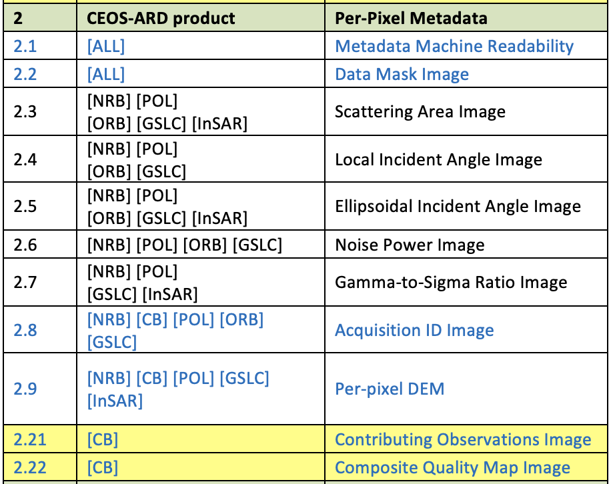
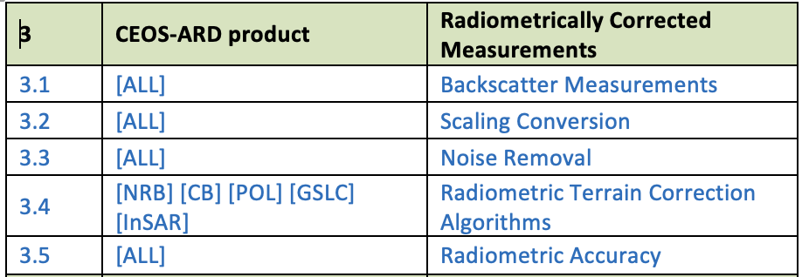
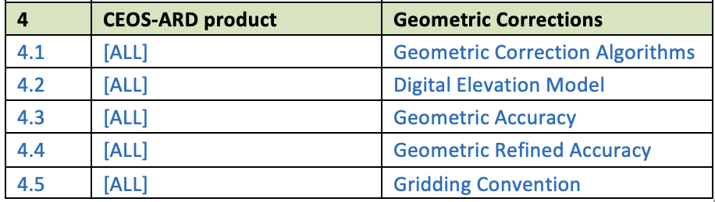
[CB] Summary of requirements

Slide 8
Composite Backscatter [CB]
Aye or Nay…

