Slide 1
Monitoring fires from space
Dr. Nicolas YOUNES
Bushfire Research Centre of Excellence
Prof. Marta YEBRA
Director Bushfire Research Centre of Excellence

Slide 2
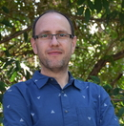
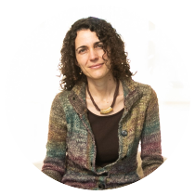
Who are we?
Dr. Nicolas
Prof. Marta

Slide 3
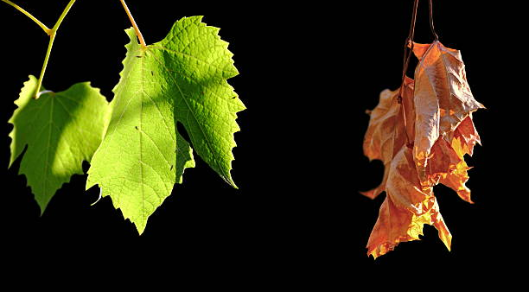
A)
B)
What will catch fire faster?
https://www.istockphoto.com/photo/alive-and-dead-leaves-gm488180301-39161756

Slide 4
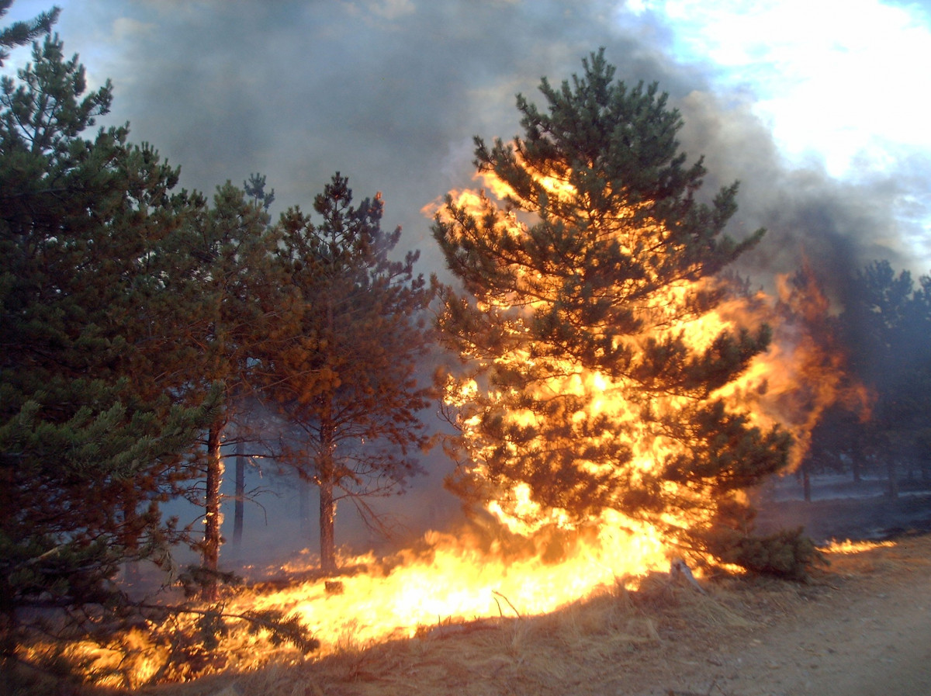
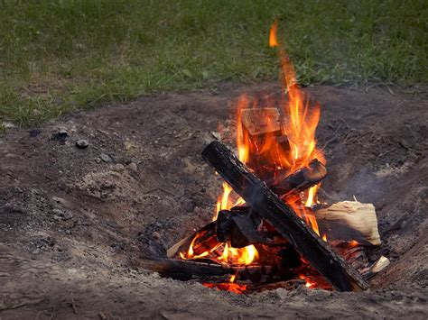
A)
B)
What will be hotter?
wildfire
candle
https://mendhamfd.org/backyard-campfires-what-you-need-to-know/ https://get.pxhere.com/photo/tree-pine-fire-bonfire-explosion-flare-disaster-event-wildfire-geological-phenomenon-1129350.jpg

Slide 5
Agenda
01 | Wildfires
02 | Satellites to detect wildfires
03 | Satellite resolutions
04 | Satellite orbits
05 | Design your own satellite!
06 | Wrap up

Slide 6
Wildfires
01

Slide 7
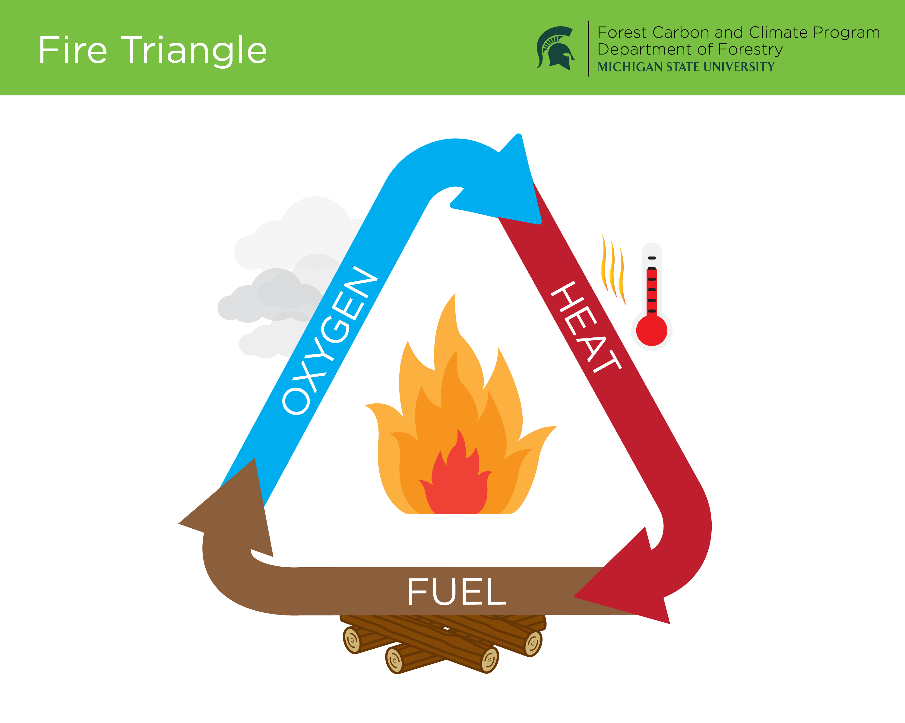
WILDFIRES
Wildfires need 3 things
Fuel = things that can burn (e.g. trees, grass, shrubs)
https://www.canr.msu.edu/fccp/FCCP-ORL/FireTriangle%20(1).png

Slide 8
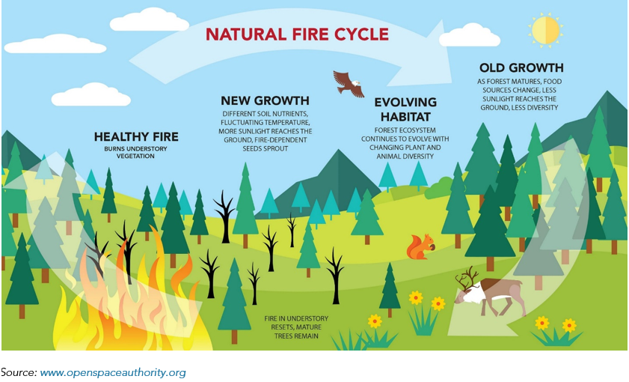
WILDFIRES
Many ecosystems depend on fire to stay healthy
https://ww2.arb.ca.gov/resources/documents/frequently-asked-questions-wildfire-emissions
Notes:
Indigenous peoples have used fire to manage land for thousands of years. They set controlled burns to improve soil quality and reduce the risk of massive, accidental blazes. These traditional practices maintain a balance between human safety and forest health.

Slide 9
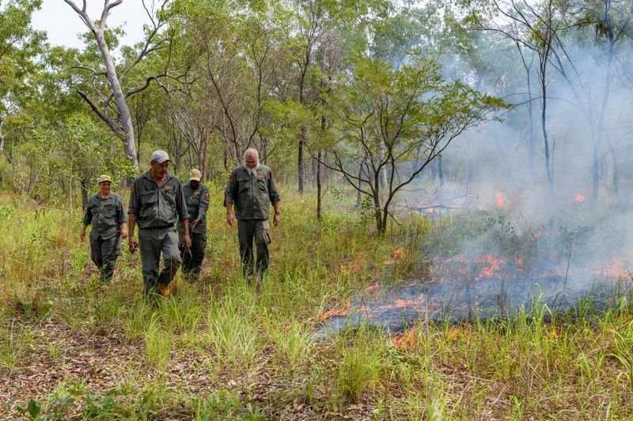
WILDFIRES
Fire and cultures are related
Kakadu’s Traditional Owners, in Bininj/Munguy
https://parksaustralia.gov.au/news/kakadu-cultural-burns/
Notes:
Indigenous peoples around the world have used fire to manage land for thousands of years. They start small fires to improve soil quality and reduce the risk of large fires.
These traditional practices maintain a balance between human safety and forest health.

Slide 10
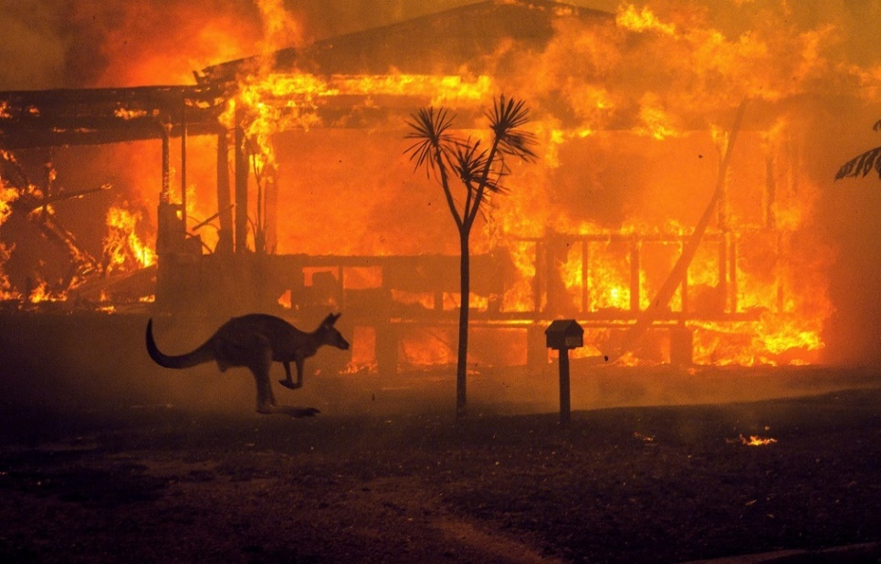
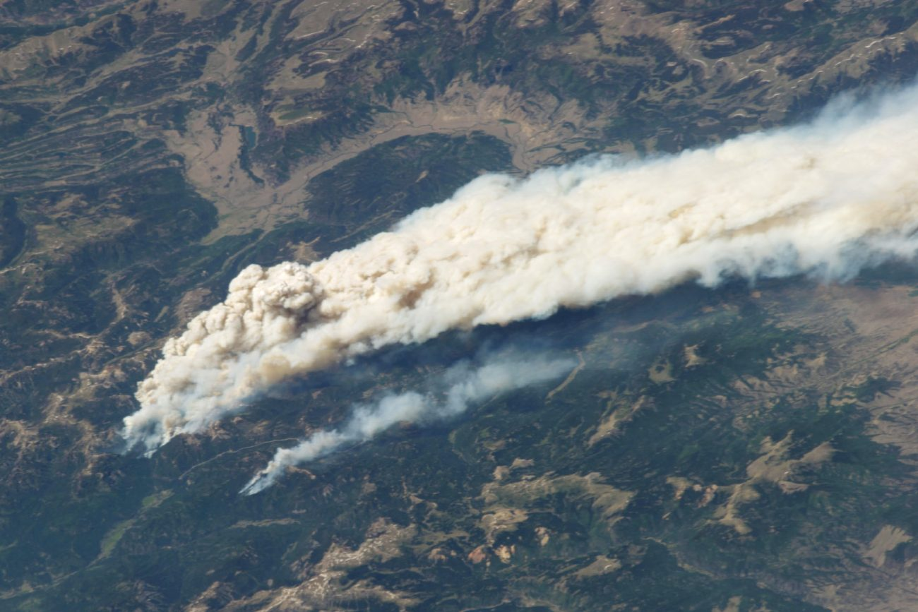
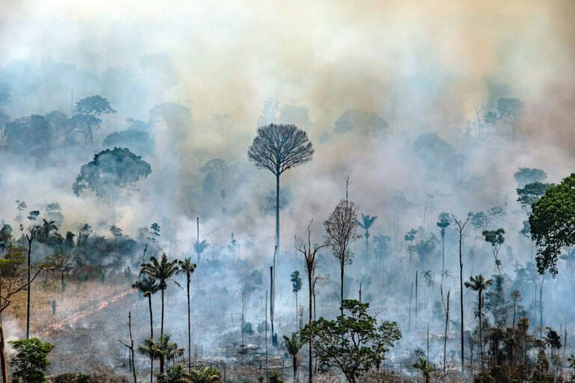
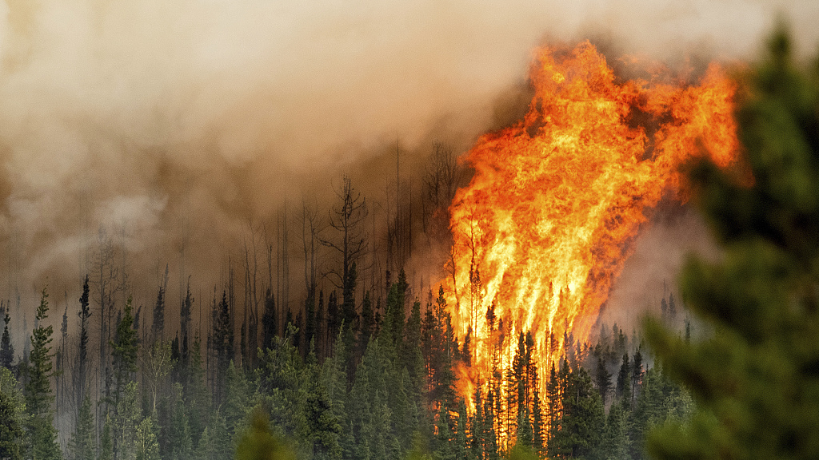
WILDFIRES
Climate change increases the chance and size of fires.
Notes:
Climate change is making wildfires more intense and frequent.
When fires get out of control, they cause damage to our cities and towns, smoke from wildfires reduces air quality making us sick, and can damage the natural environment.
As temperatures rise and landscapes dry out, satellites provide the constant surveillance needed to track these increasingly frequent fires. They offer a global view that helps us detect outbreaks in remote areas and monitor changes in real time.

Slide 11
Satellites help us detect fires
02

Slide 12

SATELLITES AND WILDFIRES
Satellites can ‘see’ these two things
Fuel = things that can burn (e.g. trees)
https://www.canr.msu.edu/fccp/FCCP-ORL/FireTriangle%20(1).png
Notes:
https://science.nasa.gov/missions/landsat/guardian-landsat-on-firewatch/:

Slide 13
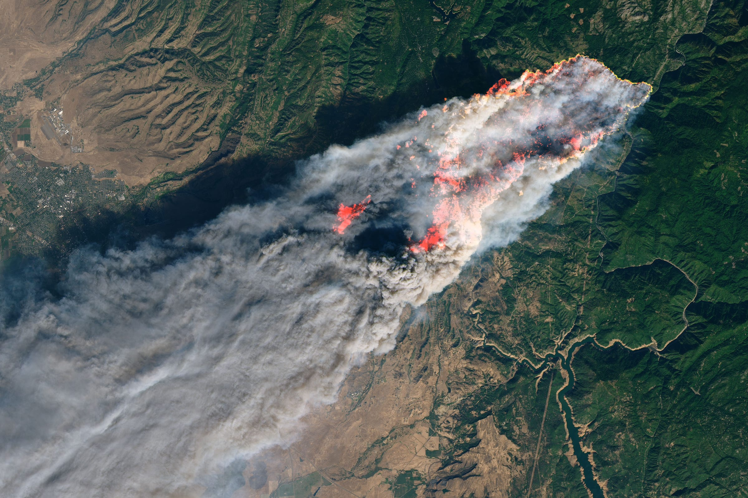
SATELLITES AND WILDFIRES
Fuel and heat!
https://external-content.duckduckgo.com/iu/?u=https%3A%2F%2Fstatic2.businessinsider.com%2Fimage%2F5be9b522da27f8505d3312cd-2400%2Fcamp-fire-california-satellite-image-nasa-8nov2018.jpg&f=1&nofb=1&ipt=51ca200561a8c705bc3651a1a71cc65b1163dc3c9bfa612be90a1484b2a2a573

Slide 14
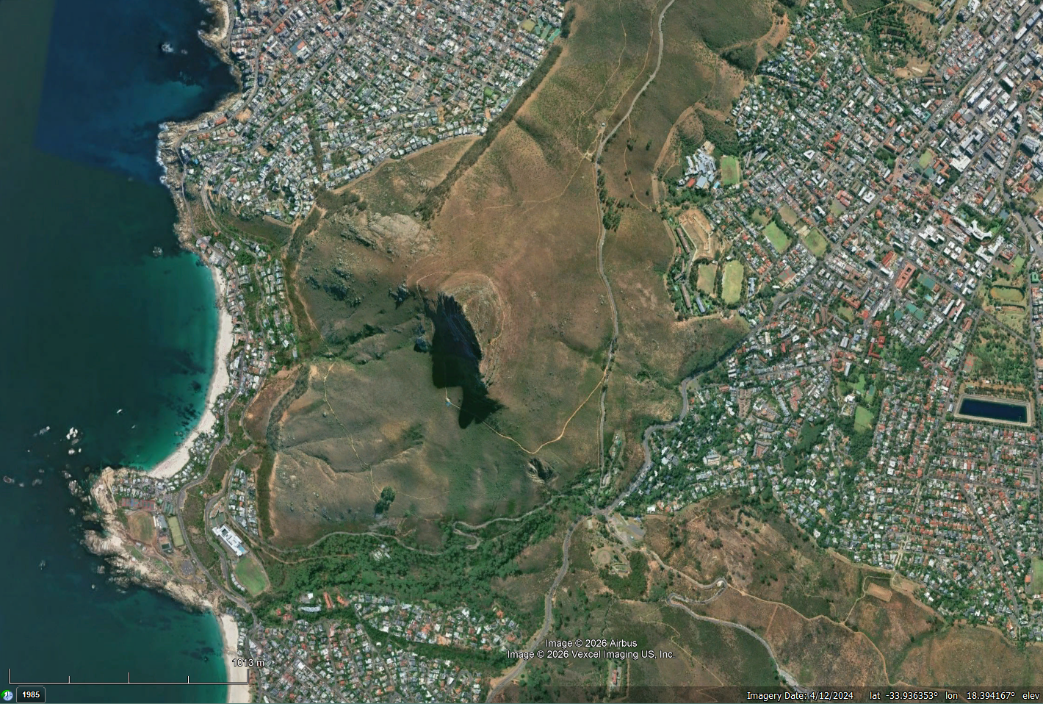
SATELLITES AND WILDFIRES
How many types of fuel can you count?
Lions head peak, South Africa

Slide 15
SATELLITES AND WILDFIRES
Summary
Satellites can ‘see’ fuel and heat
Satellites can see different fuel types
Dry vegetation burns more easily.

Slide 16
Satellites - spatial resolution
04

Slide 17
SPATIAL RESOLUTION
Spatial resolution refers to the area covered by each pixel in an image
Or, how many meters does a pixel cover on the ground

Slide 18
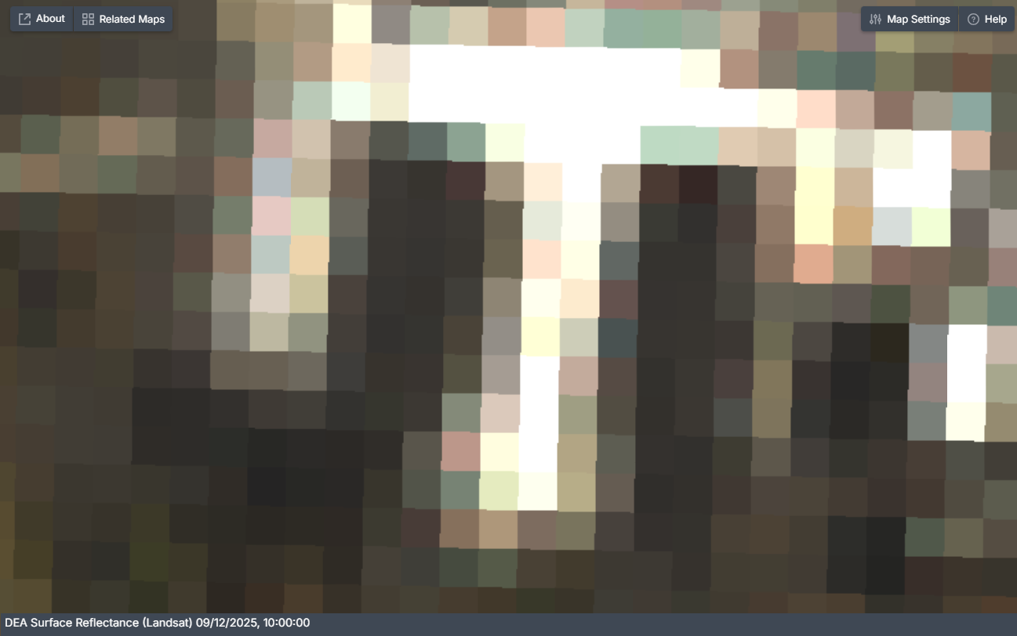
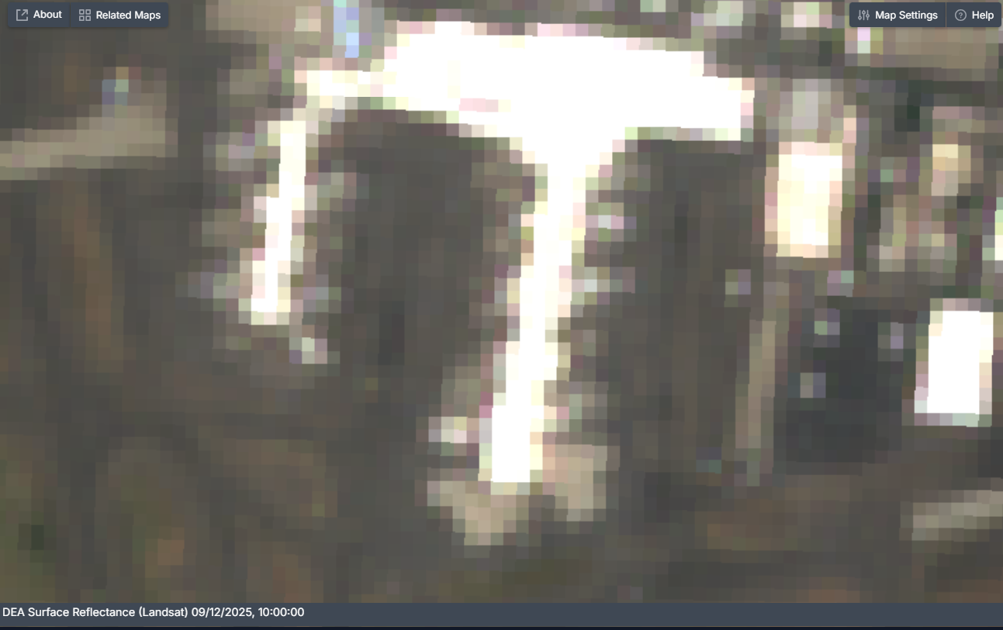
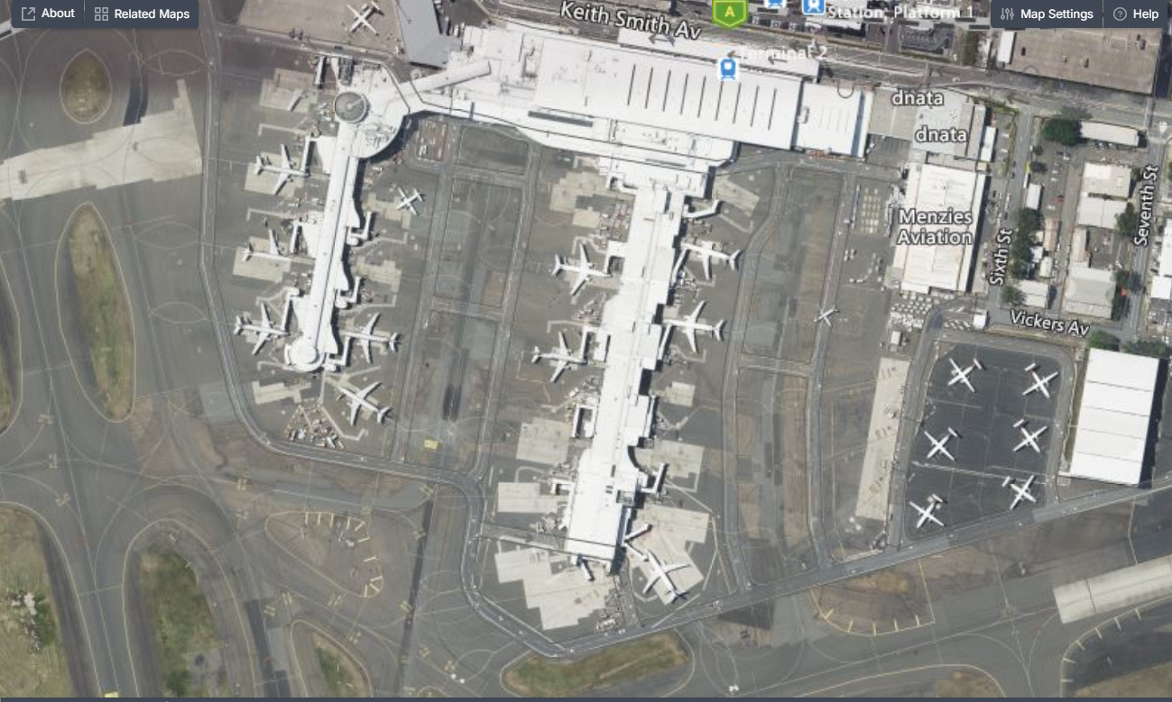
SPATIAL RESOLUTION
What can you see?
100 m
100 m
100 m

Slide 19
SPATIAL RESOLUTION
1 pixel = 30 m
1 pixel = 10 m
1 pixel = 0.1 m
Lower resolution
Higher resolution

Slide 20
SATELLITES AND WILDFIRES
Summary
Satellites have different resolutions.
Each pixel may represent a small or large area.

Slide 21
Satellites - spectral resolution
04

Slide 22
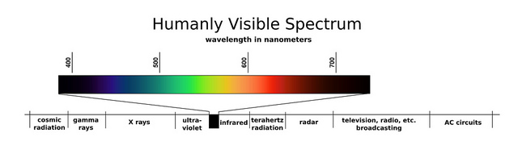
SPECTRAL RESOLUTION
Satellites capture visible through infrared radiation.
But where does the radiation come from?
https://science.nasa.gov/asset/webb/the-electromagnetic-spectrum-ems/

Slide 23
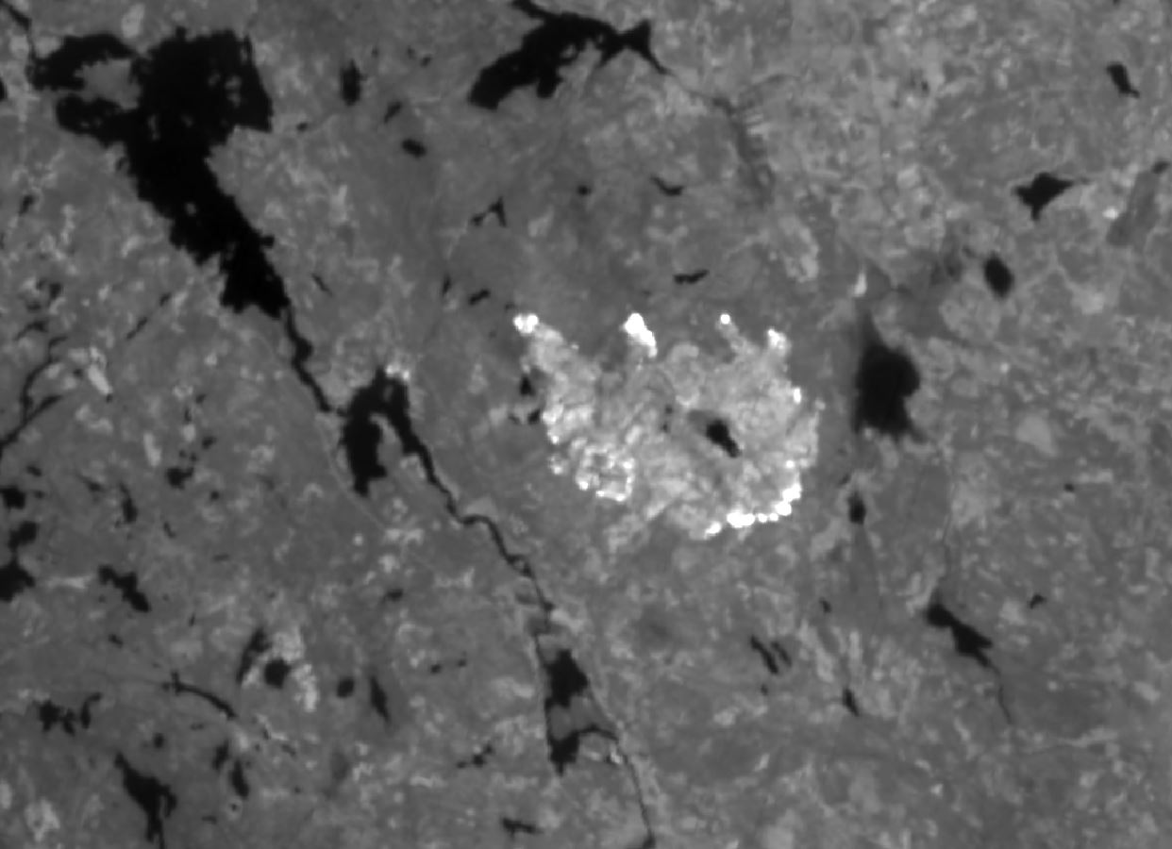
WILDFIRES
Radiation from fire
Västmanland, Sweeden 2014
https://digital-geography.com/forest-fire-tracking-landsat-8/

Slide 24
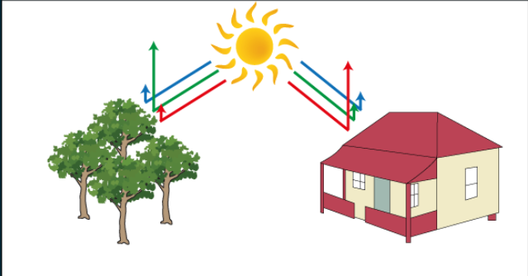
SPECTRAL RESOLUTION
Sunlight interacts with all materials on Earth’s surface.
Each material absorbs and reflects specific wavelengths (or regions) of light.
https://rscal.maitec.com.au/specsigs/index.html

Slide 25
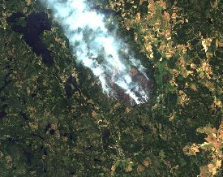
WILDFIRES
Radiation from sun
Västmanland, Sweeden 2014
https://digital-geography.com/forest-fire-tracking-landsat-8/

Slide 26
WILDFIRES
Radiation from fire
Radiation from sun
Västmanland, Sweeden 2014
https://digital-geography.com/forest-fire-tracking-landsat-8/

Slide 27
SATELLITES AND WILDFIRES
Satellites can ‘see’ these two things
Fuel = things that can burn (e.g. trees)
https://www.canr.msu.edu/fccp/FCCP-ORL/FireTriangle%20(1).png
Notes:
https://science.nasa.gov/missions/landsat/guardian-landsat-on-firewatch/:

Slide 28
SATELLITES AND WILDFIRES
Thermal wavelengths
Visible and infrared wavelengths
https://www.canr.msu.edu/fccp/FCCP-ORL/FireTriangle%20(1).png
Notes:
https://science.nasa.gov/missions/landsat/guardian-landsat-on-firewatch/:

Slide 29
SATELLITES AND WILDFIRES
Summary
Satellites can ‘see’ heat from active fires (temperature).
They can also see different types of vegetation that can burn.

Slide 30
Satellites - temporal resolution
04

Slide 31
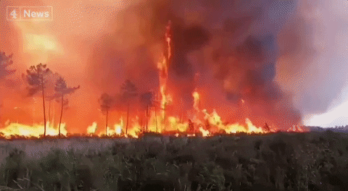

TEMPORAL RESOLUTION
How fast do trees grow?
How fast do fires spread?

Slide 32
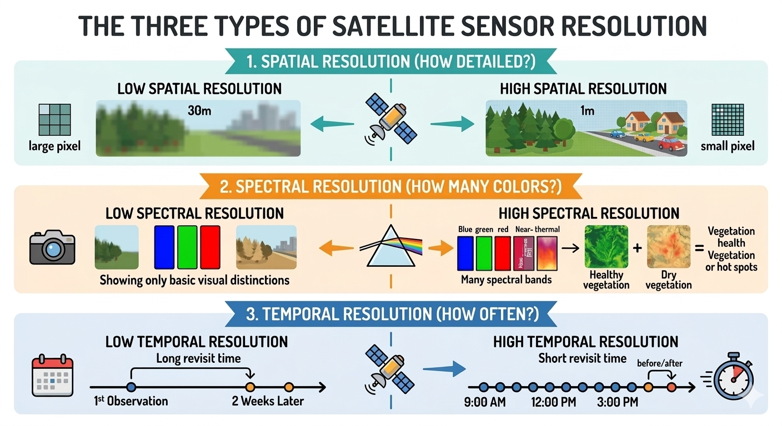
TEMPORAL RESOLUTION
Low resolution
High resolution

Slide 33
SATELLITES AND WILDFIRES
Fires travel fast (every hour).
Vegetation changes over days
https://www.canr.msu.edu/fccp/FCCP-ORL/FireTriangle%20(1).png
Notes:
https://science.nasa.gov/missions/landsat/guardian-landsat-on-firewatch/:

Slide 34
SATELLITES AND WILDFIRES
Summary
Satellites can ‘see’ the same region every few minutes, or every few weeks.

Slide 35
Satellite orbits
05

Slide 36
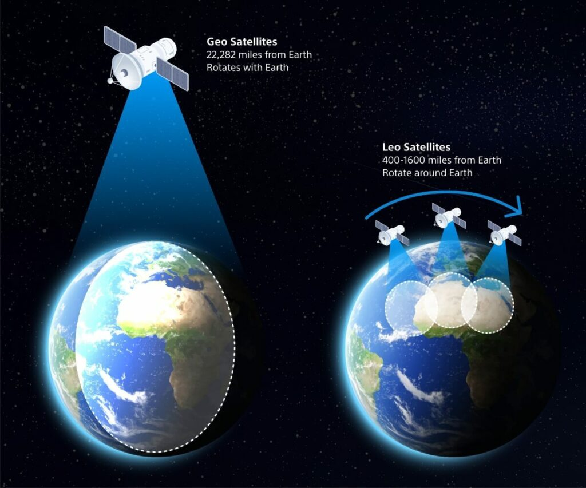
SATELLITE ORBITS
The orbit refers to how far from Earth is the satellite.
https://altair.sony-semicon.com/blog/what-are-non-terrestrial-networks-how-are-they-revolutionizing-coverage/

Slide 37
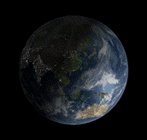
SATELLITE ORBITS
GEOstationary:
Far away
Low spatial resolution
High temporal resolution
Hovers over a single point
https://media1.giphy.com/media/v1.Y2lkPTc5MGI3NjExNG41cDZoZW8ydDZhcTJkejZtY2tqbnVqeTRtc3U3bWtxOW03aHlldSZlcD12MV9pbnRlcm5hbF9naWZfYnlfaWQmY3Q9Zw/DuJmk1yRUd1Di/giphy.gif

Slide 38
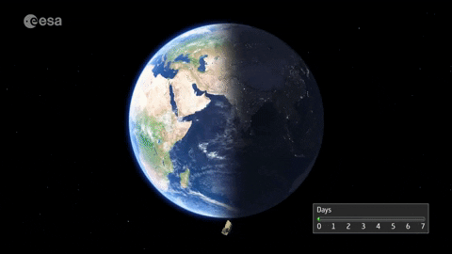
SATELLITE ORBITS
LEO:
Close to Earth
High spatial resolution
Low temporal resolution
Can see all Earth every few days
https://media3.giphy.com/media/v1.Y2lkPTc5MGI3NjExdmgzcmQxYjVlYjZzbmhvdHh1dGlpYnd0djd4ZWdwMzJvNmY4aWRyMyZlcD12MV9pbnRlcm5hbF9naWZfYnlfaWQmY3Q9Zw/1hBVgVAst7sZAQRdWl/giphy.gif

Slide 39
SATELLITES AND WILDFIRES
GEO orbit
LEO orbit
https://www.canr.msu.edu/fccp/FCCP-ORL/FireTriangle%20(1).png
Notes:
https://science.nasa.gov/missions/landsat/guardian-landsat-on-firewatch/:

Slide 40
SATELLITES AND WILDFIRES
Summary
Satellite orbits determine
How frequently you can ‘see’ a fire
The spatial resolution of your satellite
How much area of Earth you can see every time.

Slide 41
What can we do with the data?
06

Slide 42
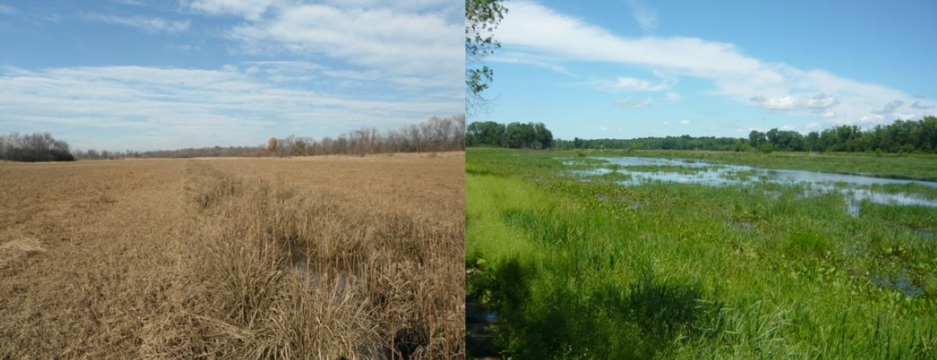
A)
SATELLITES AND WILDFIRES
Which one is more likely to burn?
B)

Slide 43
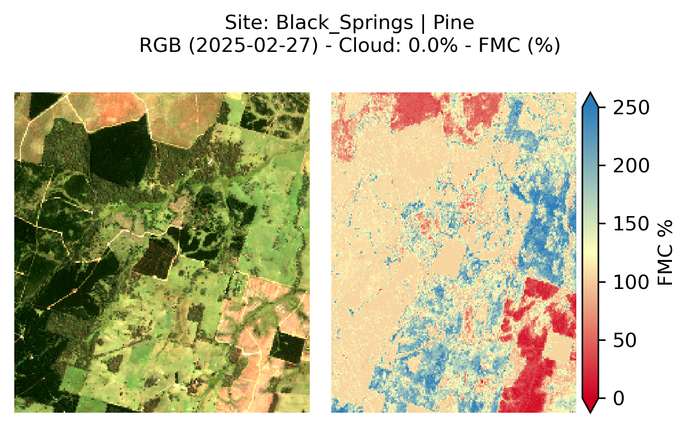
SATELLITES AND WILDFIRES
We can see where dry fuels are
Healthy vegetation
Dry vegetation

Slide 44
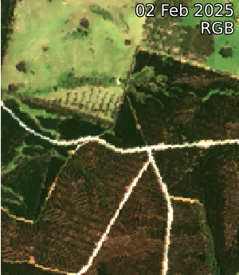
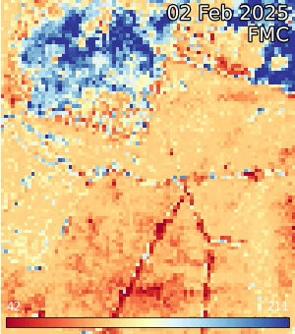
Healthy vegetation
Dry vegetation

Slide 45
DESIGN YOUR OWN SATELLITE
Live demo

Slide 46
Design your own satellite
07

Slide 47
DESIGN YOUR OWN SATELLITE
AIM:
Design a satellite!
One design per group
25 minutes

Slide 48
DESIGN YOUR OWN SATELLITE
What will the satellite measure? Active fires or vegetation fuel?
Spatial resolution
Spectral resolution
Temporal resolution
Orbit
Create a list of groups or people who might use the data from your satellite.

Slide 49
What will the spatial resolution be?
What will the temporal resolution be?
What will the spectral resolution be?
What are the trade-off between the resolutions?
Think of this like the pixel size in a digital photo; smaller pixels show sharper details like individual trees, while larger pixels blur whole city blocks together. High-resolution satellites capture small areas with high detail, while low-resolution ones capture vast areas like entire continents but with low detail. Which one is best for this application?
Temporal resolution measures how often a satellite returns to the same spot on Earth. High temporal resolution means a sensor captures images every few hours to track a fire. Low temporal resolution might only provide one update every week or two, which works for monitoring slow changes like forest dryness.
Spectral resolution defines how many specific colors or light wavelengths a sensor can detect. Sensors with high spectral resolution split light into many narrow bands to distinguish between subtle features, such as healthy trees versus dry, flammable scrub. Lower spectral resolution captures broader chunks of the rainbow, which helps identify general land shapes but misses these fine details.
A satellite capturing sharp details like individual trees must stay closer to Earth, and many take weeks to return to that spot. In contrast, satellites that stay far away see whole continents constantly and can provide frequent updates. Which one would work best in this case?

Slide 50
How will this satellite help your community?
What else would your satellite ‘see’?
How will you check that the satellite data is ‘true’?
How will the satellite get power and energy?
Do you see yourself using satellites data in the future? If yes, how could you use it?

Slide 51
Using the answers from above, draw what the data will look like
Draw a sketch of what your satellite look like

Slide 52
Wrap up
08

Slide 53
REMOTE SENSING OF WILDFIRES
What have we learnt today?

Slide 54
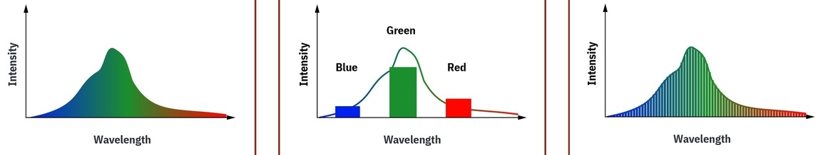
SPECTRAL RESOLUTION
NATURE
MULTISPECTRAL SATELLITE
HYPERSPECTRAL SATELLITE

Slide 55
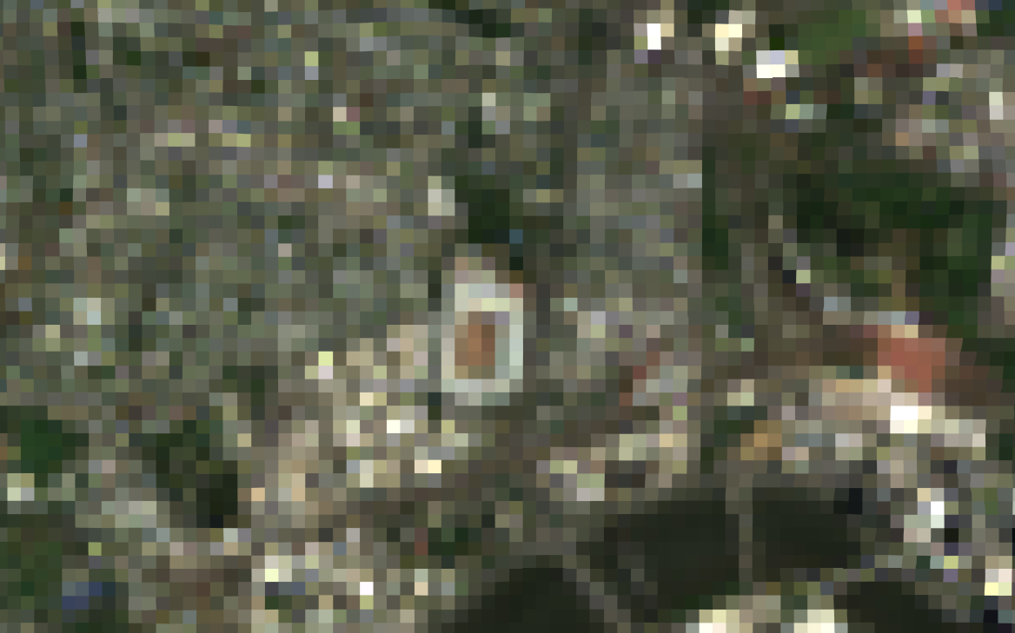
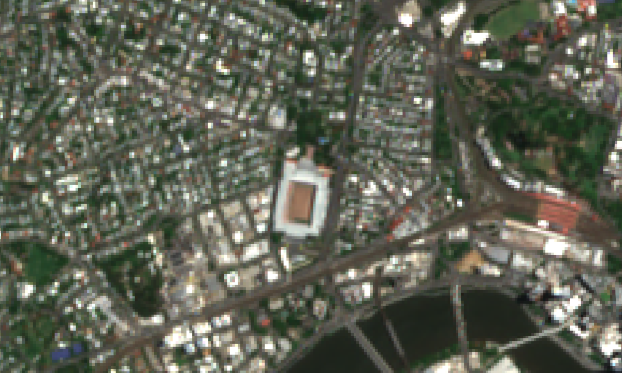
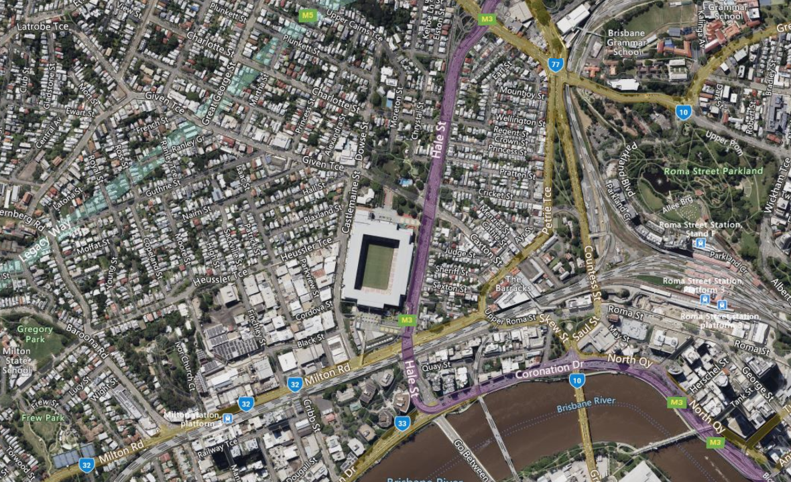
SPATIAL RESOLUTION

Slide 56
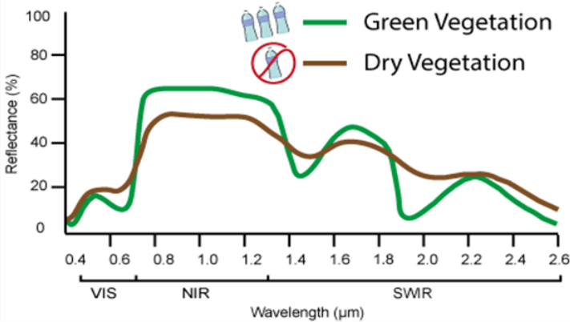
SATELLITES AND WILDFIRES
To detect fuel, use the infrared wavelengths
https://www.canr.msu.edu/fccp/FCCP-ORL/FireTriangle%20(1).png
Notes:
https://science.nasa.gov/missions/landsat/guardian-landsat-on-firewatch/:

Slide 57
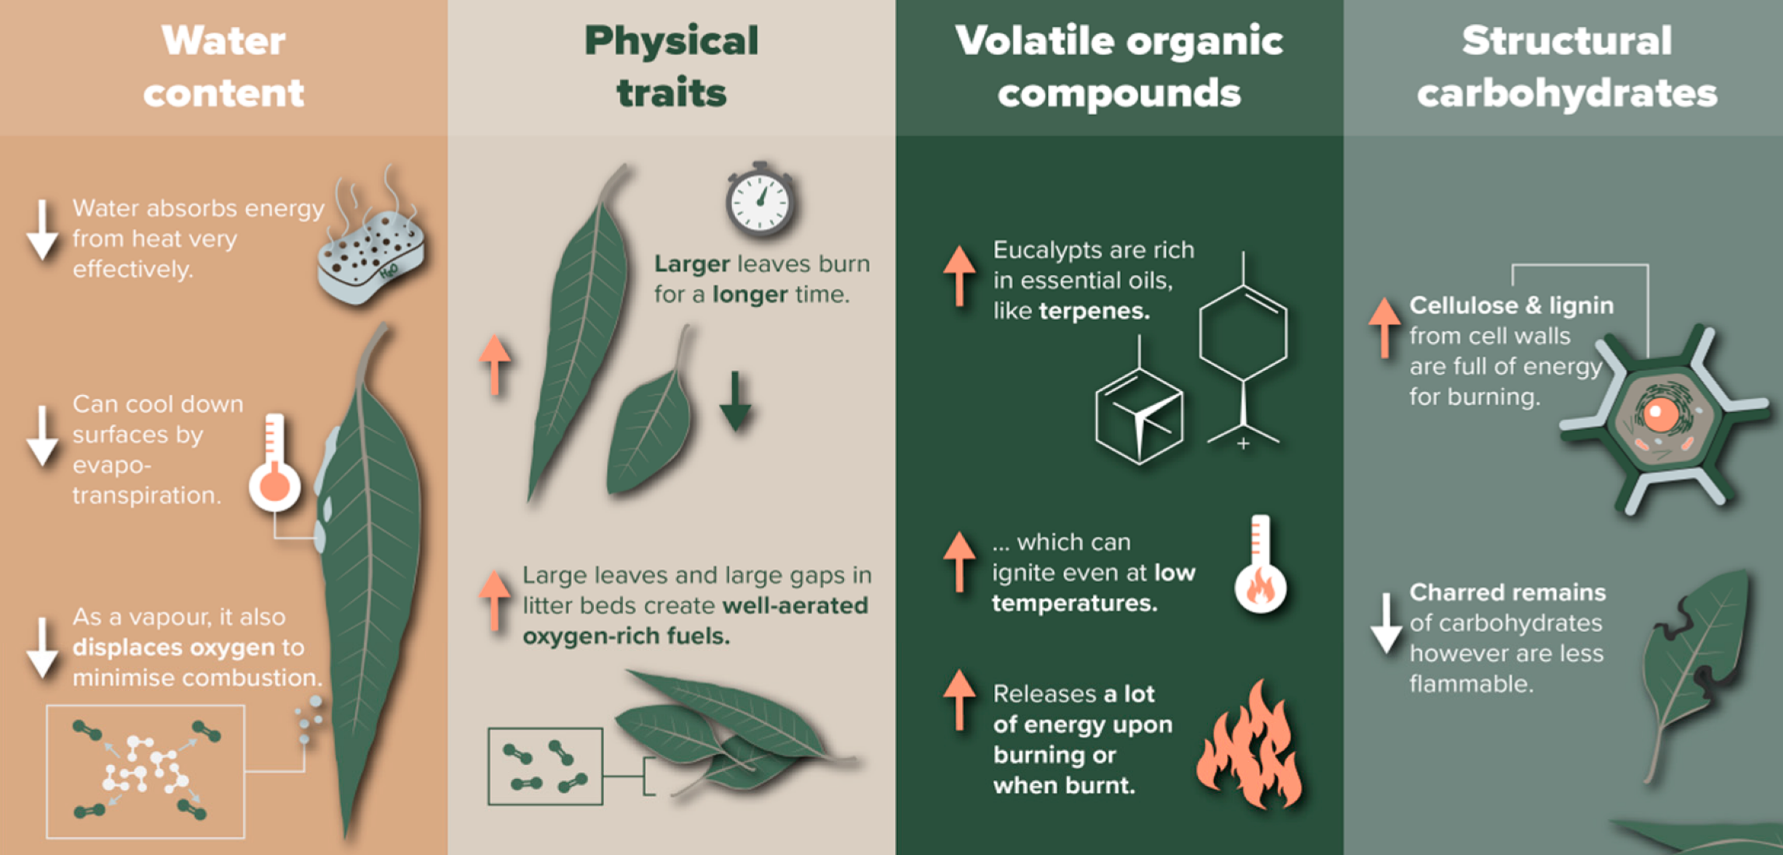
SATELLITES AND WILDFIRES
What makes vegetation more likely to burn?

Slide 58
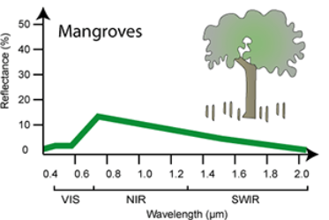
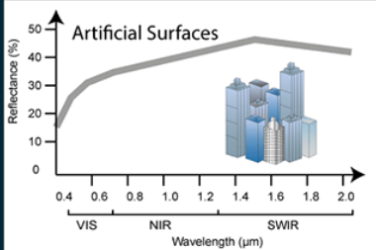
SPECTRAL RESOLUTION
Vegetation absorbs blue, red wavelengths, and reflects green and near infrared.
https://rscal.maitec.com.au/specsigs/index.html

Slide 59
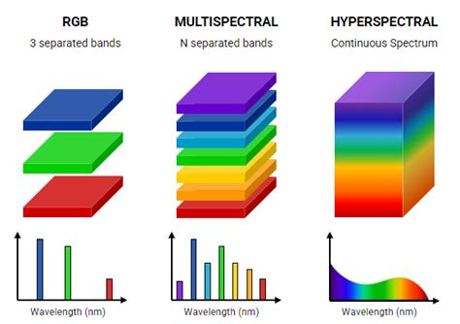
SPECTRAL RESOLUTION
The spectral resolution: number of colors (wavelengths), and regions of the spectrum (visible or thermal) satellites ‘see’.
Low resolution
High resolution

Slide 60
SPECTRAL RESOLUTION
Most satellites are multispectral and capture 6 – 20 wavelengths (colors)

