Slide 1
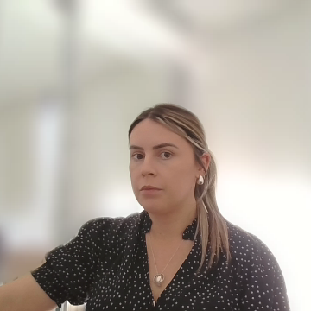
Principles of Aquatic Remote Sensing
Gemma Kerrisk | February 2026
Experimental Scientist

Slide 2
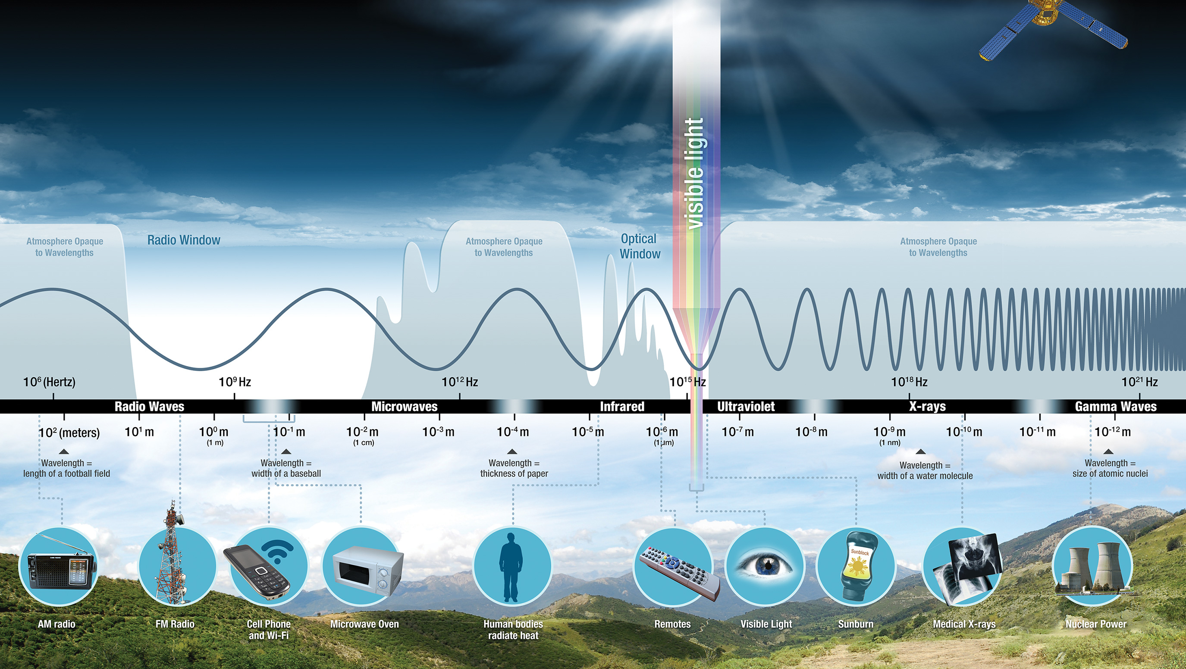
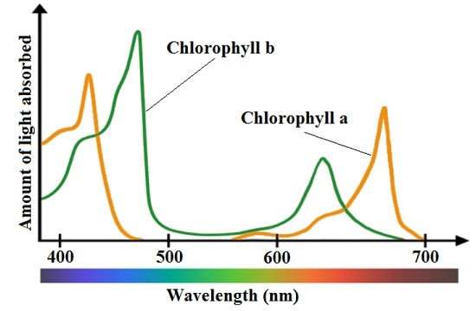
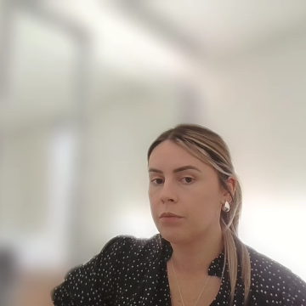
What Technology makes it possible for us to monitor Water Quality remotely?
Electromagnetic Spectrum Radiometers:
Sensors that record colour intensity: visible light
Sensors that record Thermal Infrared Radiation (TIR) energy
National Aeronautics and Space Administration, Science Mission Directorate. (2010).
Notes:
The electromagnetic spectrum is the complete range of energy waves that travel through space as light.
• These waves vary by their wavelength and energy: from very long, low-energy radio waves to very short, high-energy gamma rays.
• In between are microwaves, infrared, visible light, ultraviolet, and X-rays.
• Visible light is only a small part of the spectrum: the portion our eyes can see as colours from blue to red.
• Even though we can’t see most of the spectrum, there are sensors are designed to detect many of these invisible wavelengths.
• Each part of the spectrum carries different information about the Earth’s surface and environment.
• This is what makes remote sensing possible — by measuring energy across different wavelengths, we can observe and analyse natural systems from a distance.
The electromagnetic spectrum = all types of light energy. For aquatic remote sensing, we mainly use:
Visible light (400–700 nm)
Near-infrared (NIR)
Shortwave infrared (SWIR)

Slide 3
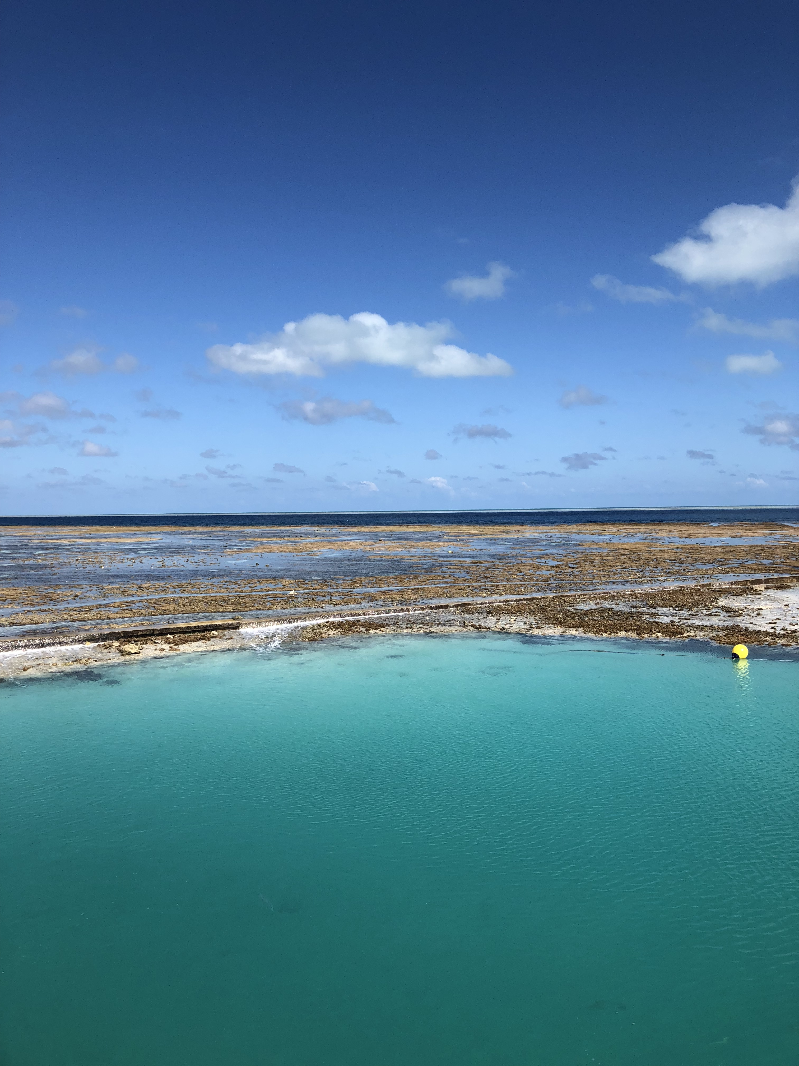
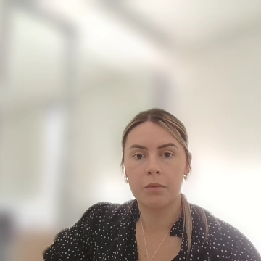
Light interactions with water
Sensor
Water leaving radiance
Reflection (glint)
Transmission
Surface
Water column
Scattering
sediments, particles, algae, chlorophyll, coral, sand, CDOM
Absorption
Notes:
When sunlight reaches water, it can:
Reflect off the surface (glint)
Enter the water and:
Be absorbed
Be scattered back out
Different substances affect light differently:
Chlorophyll absorbs blue & red → reflects green
Sediments scatter more light → water looks brighter/turbid
Organic matter absorbs blue → water appears brownish
👉 The light that comes back out is called water-leaving radiance
This is what sensors measure.

Slide 4
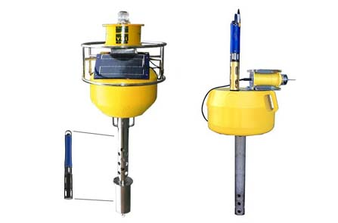
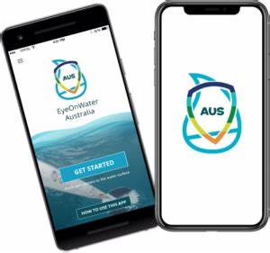
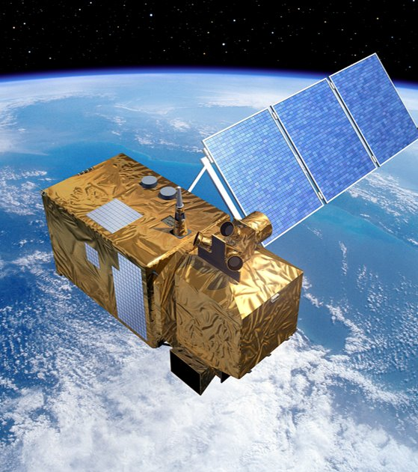
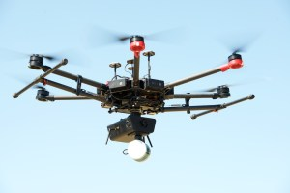
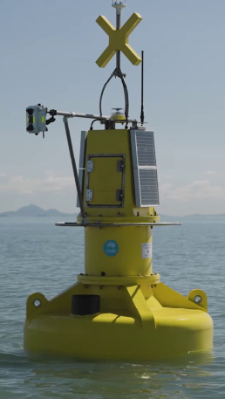
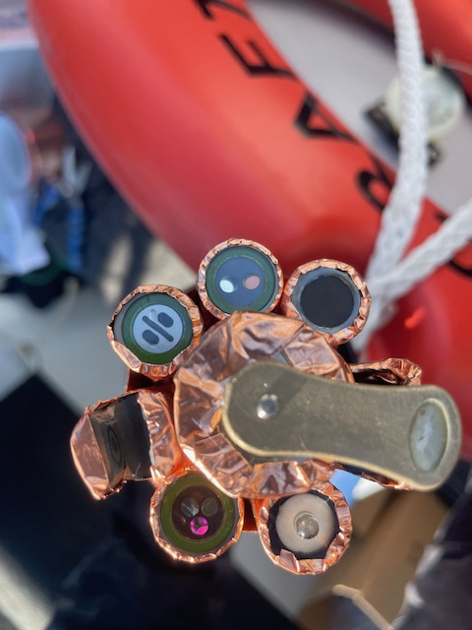
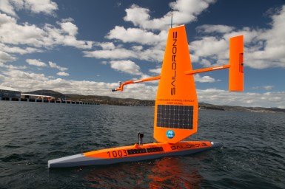
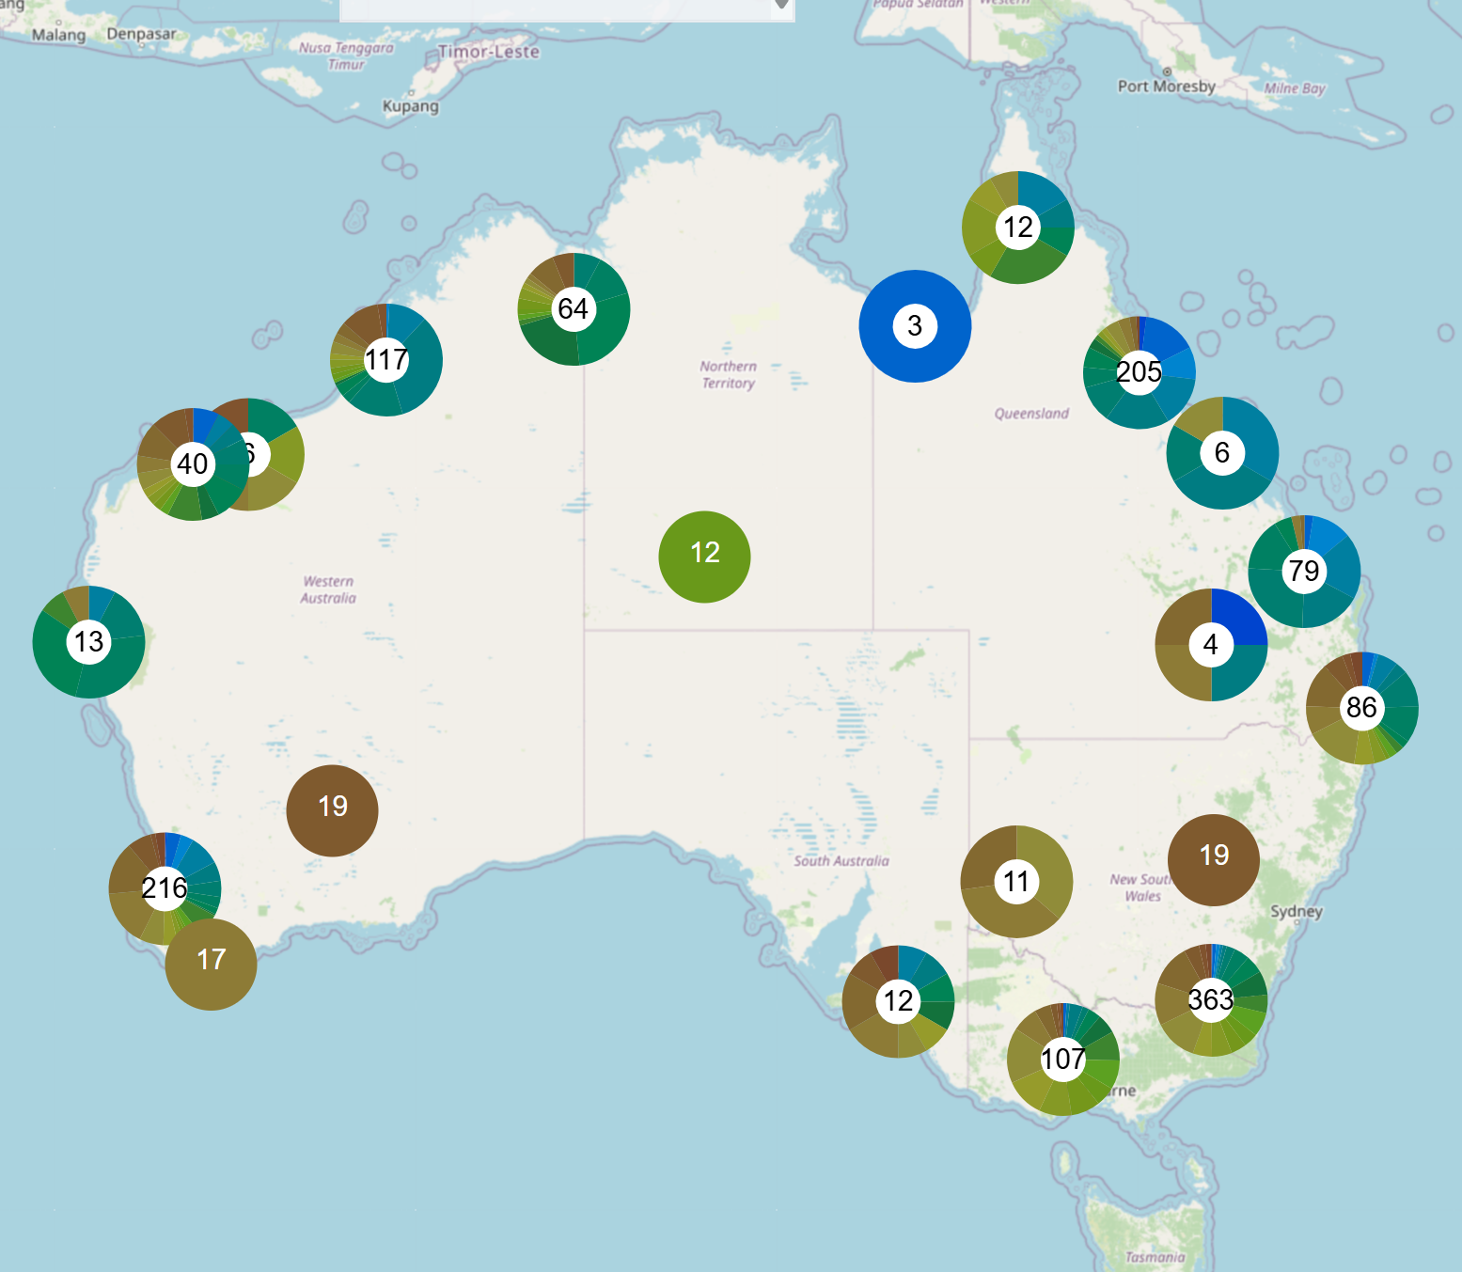
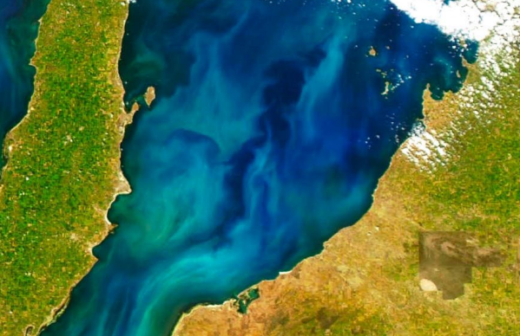
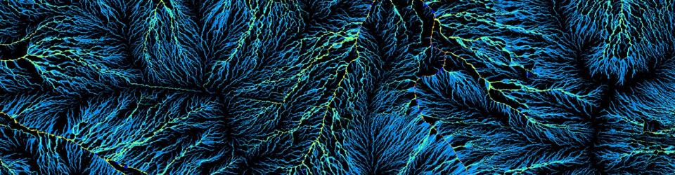
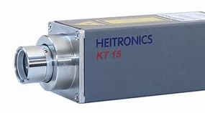
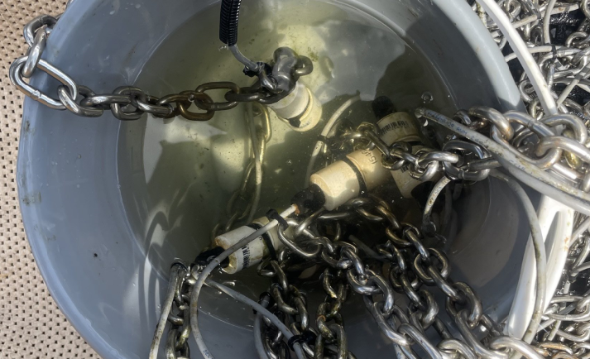
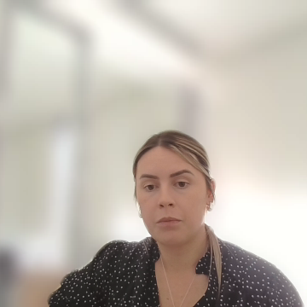
How we measure WQ – radiometers & sensors?
research.csiro.au
research.csiro.au
heitronics.com
ysi.com
In-water sensors on remote installations
research.csiro.au
Satellite imaging
Above surface radiometers on remote installations
Citizen science observations
Notes:
Satellite sensors
Look down at Earth
Measure reflected light in specific wavelength bands
Provide:
Large-scale coverage
Frequent monitoring
Limitations:
Affected by clouds
Atmospheric interference
Lower spatial detail for small water bodies
2. Airborne & drone sensors
Fly closer to the surface
Higher resolution
Good for targeted studies
3. In-water & above-water radiometers
Examples:
Above water: measure sky light + water-leaving light
In water: measure how light changes with depth
Used to:
Validate satellite data
Understand detailed optical processes
👉 These are often called hyperspectral radiometers because they measure many narrow wavelengths.

Slide 5
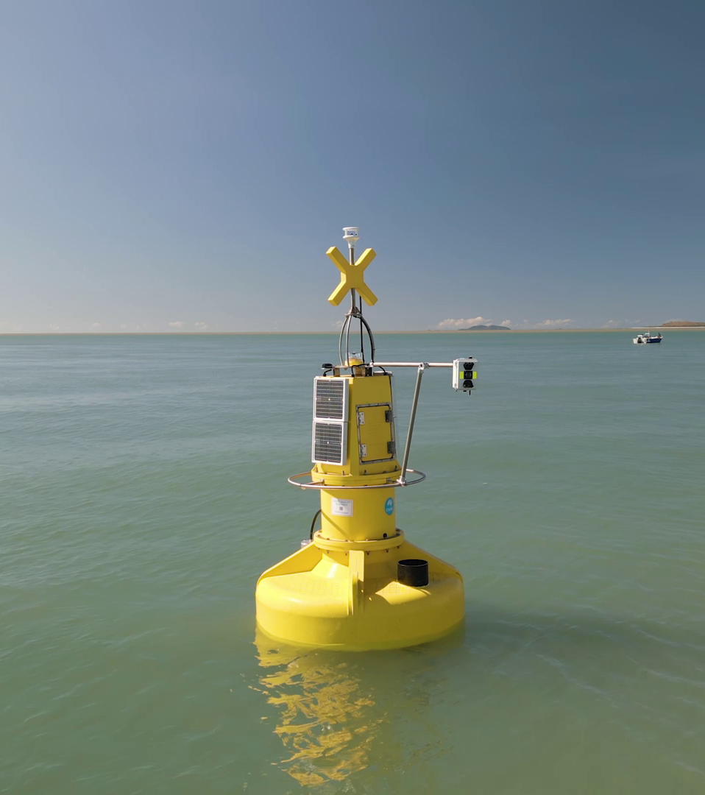
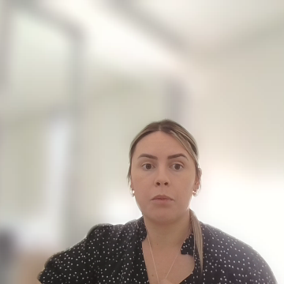
Bringing it together
The basic workflow of aquatic remote sensing:
Sunlight hits water
Light interacts with water constituents
Modified light leaves the water
Sensors measure that light
Algorithms convert it to:
Chlorophyll concentration
Turbidity
Water clarity
Organic matter
Aquatic remote sensing = using light physics to understand water properties remotely.
Notes:
The basic workflow of aquatic remote sensing:
Sunlight hits water
Light interacts with water constituents
Modified light leaves the water
Sensors measure that light
Algorithms convert it to:
Chlorophyll concentration
Turbidity
Water clarity
Organic matter
Key takeaway:
Aquatic remote sensing = using light physics to understand water properties remotely. “By understanding how light behaves across the electromagnetic spectrum and how water modifies that light, we can monitor aquatic environments accurately, efficiently, and at scales impossible with traditional sampling alone.”

