Slide 1
Committee on
Earth
Observation
Satellites
Viewing Earth
    Serving Society
CEOS Overview
January 2024

Slide 2

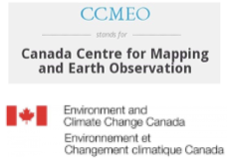
CEOS Membership
The Committee on Earth Observation Satellites (CEOS) was stablished in 1984 under aegis of the G7 Economic Summit of Industrial Nations Working Group on Growth, Technology, and Employment
Now in its fourth decade,
CEOS comprises
34 Members
(Space Agencies) and
30 Associates
(UN Agencies, Phase A programmes or supporting ground facility programmes)
All of whom contribute to CEOS on a ‘best efforts’ and voluntary basis.

Slide 3
CEOS Members and Associates
Agenzia Spaziale Italiana (ASI), Italy
Canadian Space Agency (CSA), Canada
Centre National d’Etudes Spatiales (CNES), France
Centro para Desarrollo Tecnólogico Industrial (CDTI), Spain
China Center for Resources Satellite Data and Applications (CRESDA), China
Chinese Academy of Space Technology (CAST), China
Comisión Nacional de Actividades Espaciales (CONAE), Argentina
Commonwealth Scientific and Industrial Research Organisation (CSIRO), Australia
Deutsches Zentrum für Luft-­‐und Raumfahrt (DLR), Germany
European Commission (EC)
European Organisation for the Exploitation of Meteorological Satellites (EUMETSAT)
European Space Agency (ESA)
Geo-­‐Informatics and Space Technology Development Agency (GISTDA), Thailand
Indian Space Research Organisation (ISRO), India
Instituto Nacional de Pesquisas Espaciais (INPE), Brazil
Japan Aerospace Exploration Agency / Ministry of Education, Culture, Sports, Science and Technology (JAXA/MEXT), Japan
Korea Aerospace Research Institute (KARI), Republic of Korea
Korea Meteorological Administration (KMA), Republic of Korea
National Aeronautics and Space Administration (NASA), USA
National Institute of Environmental Research (NIER), Republic of Korea
National Oceanic and Atmospheric Administration (NOAA), USA
National Remote Sensing Center of China (NRSCC), China
National Satellite Meteorological Center / China Meteorological Administration (NSMC/CMA), China
National Space Research Agency of Nigeria (NASRDA), Nigeria
Netherlands Space Office (NSO), Netherlands
Russian Federal Service for Hydrometeorology and Environmental Monitoring (ROSHYDROMET), Russia
Roscosmos State Cooperation for Space Activities (ROSCOSMOS), Russia
South African National Space Agency (SANSA), South Africa
State Space Agency of Ukraine (SSAU), Ukraine
TÜBİTAK Space Technologies Research Institute (TÜBİTAK UZAY), Turkey
United Arab Emirates Space Agency (UAESA), UAE
United Kingdom Space Agency (UKSA), UK
United States Geological Survey (USGS), USA
Vietnam Academy of Science and Technology (VAST), Vietnam
MEMBERS (34)
ASSOCIATES (30)
Agence Gabonaise d'Études et d'Observations Spatiales (AGEOS), Gabon
Agencia Espacial Mexicana (AEM), Mexico
Australian Bureau of Meteorology (BoM), Australia
Belgian Federal Science Policy Office (BELSPO), Belgium
Canada Centre for Mapping and Earth Observation (CCMEO), Canada
Earth System Science Organisation (ESSO), India
Environment and Climate Change Canada (ECCC), Canada
European Centre for Medium-range Weather Forecasts (ECMWF)
Geoscience Australia (GA), Australia
Global Climate Observing System (GCOS)
Global Geodetic Observing System (GGOS)
Global Ocean Observing System (GOOS)
Global Terrestrial Observing System (GTOS)
International Science Council (ISC)
Intergovernmental Oceanographic Commission (IOC)
International Ocean Colour Coordinating Group (IOCCG)
International Society of Photogrammetry and Remote Sensing (ISPRS)
Malaysian Space Agency (MYSA), Malaysia
Norwegian Space Agency (NOSA), Norway
Polska Agencja Kosmiczna (POLSA), Poland
Portuguese Space Agency (Portugal Space), Portugal
South African Council for Scientific and Industrial Research (CSIR/SAC), South Africa
Swedish National Space Agency (SNSA), Sweden
United Nations Economic and Social Commission for Asia and the Pacific (ESCAP)
United Nations Educational, Scientific and Cultural Organization (UNESCO)
United Nations Environment Programme (UNEP)
United Nations Food and Agriculture Organization (FAO)
United Nations Office for Outer Space Affairs (UNOOSA)
World Climate Research Programme (WCRP)
World Meteorological Organization (WMO)

Slide 4
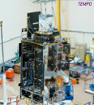

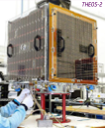

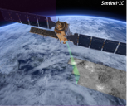

CEOS Agency Missions
As of October 2021, CEOS Agencies were operating 224 missions, approved 73, and have plans for another 77.
Upcoming launches for 2023 include:
  TEMPO (NASA)
  Kondor-FKA N1 (ROSKOSMOS)
  HY-1E, -3A, -3B (NSOAS / CAST)
  THEOS-2 & -2A (GISTDA)
  NORSAT-TD (NOSA / NSO / ASI / CNES)
  LOTUSat-1 (VAST)
  Ionosphera-M N1 & N2 (ROSKOSMOS / ROSHYDROMET)
  Sentinel-1C (ESA / COM)
  TROPICS (NASA)
  …. and more

Slide 5
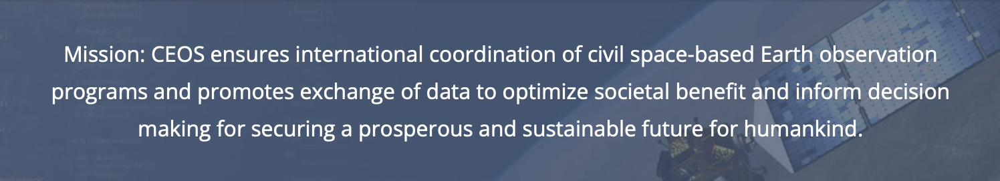
CEOS Mission & Primary Objectives
  Primary Objectives:
To optimise global societal benefit from space-based Earth observation missions
To serve as the focal point for sustained international coordination among space-based Earth observation programs, remote sensing experts, and activities
To promote complementarity and compatibility for the benefit of data user communities worldwide

Slide 6

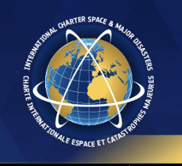


CEOS Long-term Priorities
Ensure that climate observation requirements identified by the Global Climate Observing System (GCOS) – and implications of the Paris Climate Agreement – are addressed.
Ensure, in the context of the Sendai Framework for Disaster Risk Reduction 2015-2030, that CEOS Agency data are made available in support of disaster risk reduction and that CEOS continues engagement with UN agencies and authorities.
Ensure that space-based Earth observation data and products are integral to the success of the next decade of the Group on Earth Observations (GEO), and that CEOS contributions to, and engagement in, GEO governance and leadership are further enhanced.
Systematically engage in and contribute to global efforts on the critical challenges that face humanity in support of the UN 2030 Agenda for Sustainable Development.

Slide 7
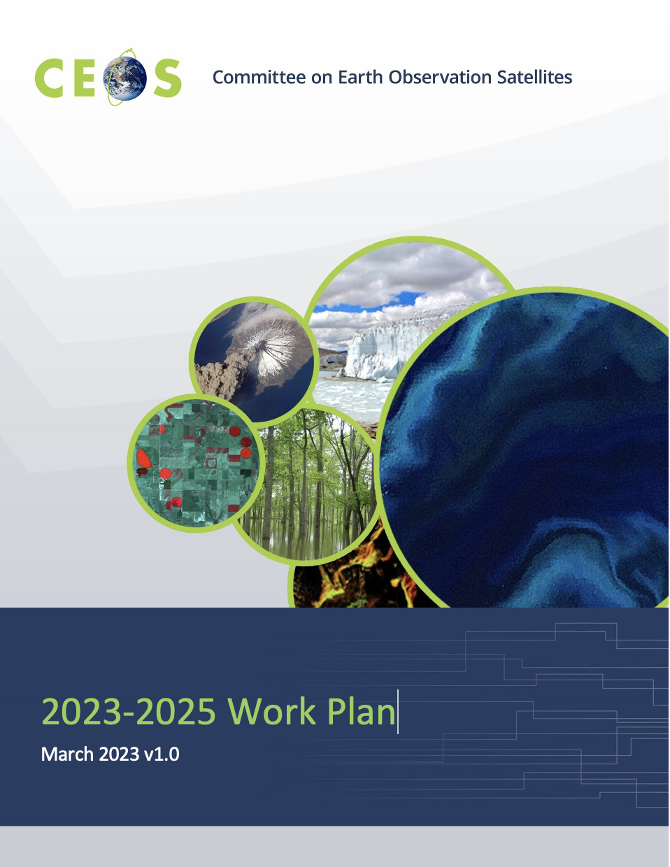
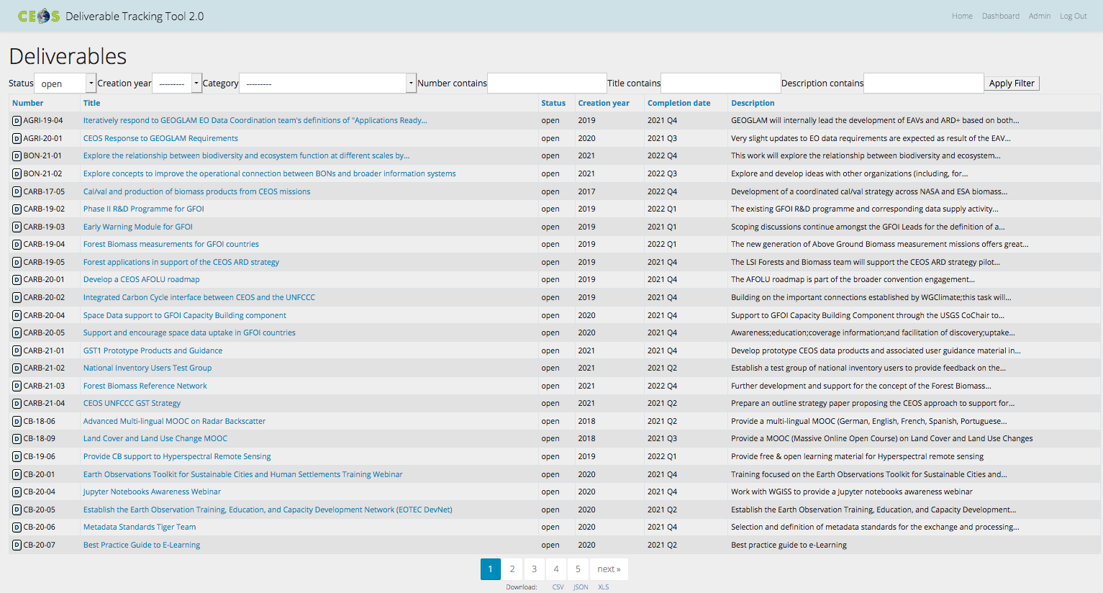
CEOS Work Plan
3-year plan re-evaluated and updated annually by all CEOS entities and presented for formal endorsement in Q1 of each calendar year.
CEOS undertakes rigorous work planning, monitoring and implementation of its activities, all of which ensure CEOS’s internal accountability and external credibility.
The Work Plan informs the spectrum of deliverables that CEOS membership agree to undertake.
CEOS deliverables are reconciled and tracked with a dedicated CEOS deliverable tracking tool.
The CEOS 2023-2025 Work Plan defines 130 deliverables.
http://deliverables.ceos.org/

Slide 8
CEOS Work Plan: Expected Outcomes
The CEOS Work Plan’s Expected Outcomes reflect ongoing and emerging priorities as characterised by internal decision making & external commitments (focusing on improved EO systems coordination and enhanced data access for key global programmes and initiatives) in the following areas:
  CEOS and the ‘New Space’ agenda
  Climate Monitoring, Research, and Services
  Carbon Observations in Support of Climate Science and Policy
  Observations in Support of the Global Stocktake of the UNFCCC
  Data Quality
  Data Discovery, Access, Preservation, Usability & Exploitation
  Capacity Building and Data Democracy
  Observations for Disasters
  Observations for Water and Oceans
  Observations for Land
  Observations in Support of the United Nations Sustainable Development Goals
  Advancement of the CEOS Virtual Constellations

Slide 9
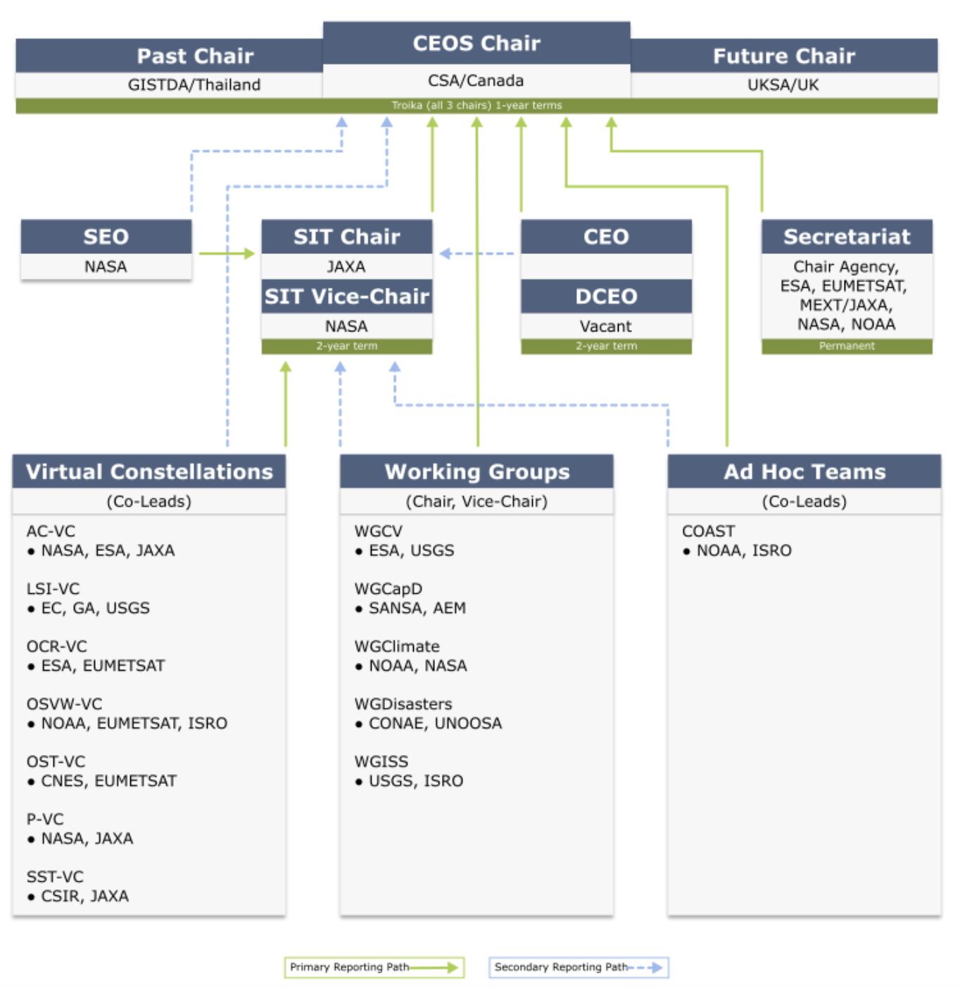
CEOS Organisational Structure
This organogram depicts the CEOS organisational structure, including the paths by which each CEOS entity reports to leadership.
Secondary reporting paths reflect augmented leadership arrangements that are normally put in place at the discretion of the entity charged with primary leadership responsibility.

Slide 10
CEOS Plenaries
Plenary | Year | Venue | Host |  | Plenary | Year | Venue | Host
1st | 1984 | Washington DC, USA | NOAA |  | 20th | 2006 | Buenos Aires, Argentina | CONAE
2nd | 1986 | Frascati, Italy | ESA |  | 21st | 2007 | Kona, Hawaii, USA | USGS
3rd | 1988 | Ottawa, Canada | CSA |  | 22nd | 2008 | George, South Africa | CSIR
4th | 1990 | Sao Jose dos Campos, Brazil | INPE |  | 23rd | 2009 | Phuket, Thailand | GISTDA
5th | 1991 | Washington DC, USA | NASA/NOAA |  | 24th | 2010 | Rio de Janeiro, Brazil | INPE
6th | 1992 | London, UK | BNSC |  | 25th | 2011 | Lucca, Italy | ASI
7th | 1993 | Tsukuba, Japan | MEXT/NASDA |  | 26th | 2012 | Bangalore, India | ISRO
8th | 1994 | Berlin, Germany | DARA |  | 27th | 2013 | Montreal, Canada | CSA
9th | 1995 | Montreal, Canada | CSA |  | 28th | 2014 | Trömso, Norway | EUMETSAT
10th | 1996 | Canberra, Australia | CSIRO |  | 29th | 2015 | Kyoto, Japan | JAXA
11th | 1997 | Toulouse, France | CNES |  | 30th | 2016 | Brisbane, Australia | CSIRO
12th | 1998 | Bangalore, India | ISRO |  | 31st | 2017 | Rapid City, USA | USGS
13th | 1999 | Stockholm, Sweden | EUMETSAT |  | 32nd | 2018 | Brussels, Belgium | EC
14th | 2000 | Rio de Janeiro, Brazil | INPE |  | 33rd | 2019 | Hanoi, Vietnam | VAST/VNSC
15th | 2001 | Kyoto, Japan | MEXT/NASDA |  | 34th | 2020 | Virtual | ISRO
16th | 2002 | Frascati, Italy | ESA |  | 35th | 2021 | Virtual | NASA
17th | 2003 | Colorado Springs, USA | NOAA |  | 36th | 2022 | Biarritz, France | CNES
18th | 2004 | Beijing, China | NRSCC |  | 37th | 2023 | Chiang Rai, Thailand | GISTDA
19th | 2005 | London, UK | BNSC

Slide 11







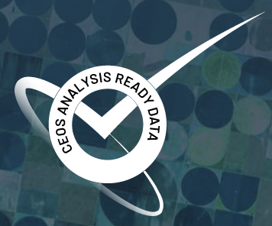











Engage with CEOS!
https://ceos.org
@ceosdotorg
@socialceos
https://www.linkedin.com/groups/6724186/

Slide 12
Thank you!

