Slide 1
Session 6 – GEO Advocacy Satellite Observation Continuity – CEOS Perspective
Viewing Earth
Serving Society
GEO Work Plan Symposium
6 May 2015

Slide 2
Who We Are
Mission
CEOS ensures international coordination of civil space-based Earth observation programs and promotes exchange of data to optimize societal benefit and inform decision making for securing a prosperous and sustainable future for humankind.
Established in 1984 under auspices of G-7 Economic Summit of Industrialized Nations
Focal point for international coordination of space-related EO activities
Optimize benefits through cooperation of members in mission planning and in development of compatible data products, formats, services, applications, and policies
Exchange policy and technical information to encourage complementarity and compatibility among space-based EO systems currently in service or development, and the data received from them
Operates through best efforts of Members and Associates via voluntary contributions
31 Members (Space Agencies), 24 Associates

Slide 3
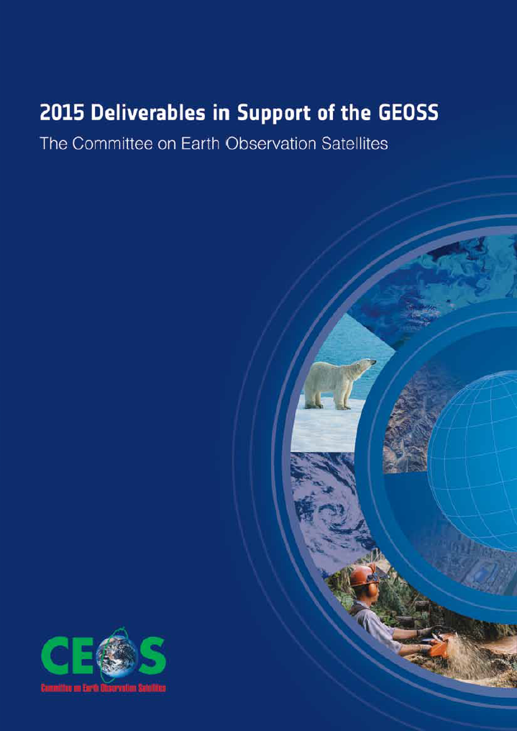
CEOS and GEO
A Strong Partnership
CEOS is a GEO Participating Organization
The establishment of GEO in 2005 was a strong focus for coordination among the EO community and provided additional impetus and direction for CEOS
CEOS is recognized as the space component of GEO, with responsibility for implementation of the space segment of the Global Earth Observation System of Systems (GEOSS)
Integrate observing systems to benefit from the increased number and distribution of observations of any given event
Minimize data gaps – toward a comprehensive, coordinated, and sustained GEOSS
The 55 agencies of CEOS, relying on 131 satellites, have aligned much of their resources and capacity in support of GEO’s commitments to the international community, supporting a wide range of its activities.

Slide 4
Addressing Observational Gaps
CEOS addresses observational gaps by:
coordinating space-based, ground-based, and/or data delivery systems to meet a common set of requirements within a specific domain.
leveraging inter-Agency collaboration and partnerships.
developing observation strategies to sustain the routine collection of critical observations and plan for continuity of satellite missions and of datasets over long periods.
Domain-Related Mechanisms
Virtual Constellations
Atmospheric Composition
Land Surface Imaging
Ocean Colour Radiometry
Ocean Surface Topography
Ocean Surface Vector Wind
Precipitation
Sea Surface Temperature
Initiative-Related Mechanisms
GEOGLAM
GFOI
Disaster Risk Management (flood, seismic and volcano pilots)
Tools
Such as CEOS Visualization Environment
(COVE) for searching, analyzing and visualizing actual and potential satellite sensor coverage.

Slide 5
Ensuring satellite observational continuity requires clear...
Global mandates – who does what, establishing boundaries and non overlapping mandates
Requirements – what are the required measurements
Justification – why do you need those measurements
Prioritisation – what has the biggest impact
Optimisation – valuing what we have first
Coordination – better integration with in-situ
Evidence – success stories, metrics of data use
Support along value chain – value-added information providers, end users communities engagement
Liaison and linkages – bridge user communities, funding agencies

