Slide 1

AfriGEOSS - An Initiative to Implement GEOSS in Africa
Andiswa Mlisa
Osamu Ochiai
GEO Secretariat
MEDINA Workshop, 11 December 2014, Brussels, Belgium

Slide 2
AfriGEOSS‘s Mission Statement
Enhance Africa’s capacity for producing, managing and using Earth observations data and information, by developing & implementing a coordination framework, considering:
  national,
  regional (Economic Regions + other sub-regional Institutions) and
  continental and global coordination
Expected results:
  Improvement of Africa’s participation in GEOSS development
  Improvement of actual production, use and management of available Earth observations data and information for decision making.
  Enhancement of existing efforts
  Minimasation of duplication of efforts

Slide 3
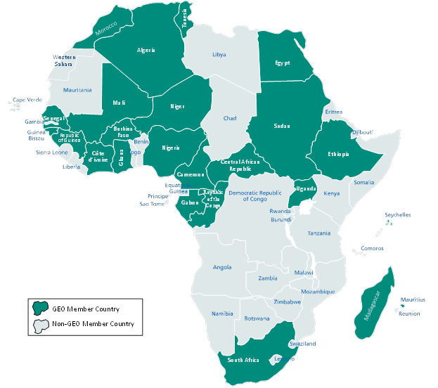





African Membership in GEO
24 Member States
7 Participating Organisations

Slide 4
Strategic Recognition & Support
Africa-European Union Strategic Partnership, 4th EU-Africa Summit, Roadmap 2014-2017
  Africa’s contribution to GEO
The Joint Meeting of SADC Ministers of Science, Innovation & Technology and Education & Training, Maputo, Mozambique, 16 – 20 June 2014
  Supports partnership between the Secretariats
  SADC Member states to consider joining GEO and report back at next Ministerial meeting
The World Meteorology Organisation (WMO), 66th Executive Council (in WIGOS Document), Geneva, June 2014
  collaboration and coordination with WMO Integrated Global Observing System (WIGOS)

Slide 5
Coordination Framework
The coordination framework is proposed to address geographical representation, political representation and functional (activity) areas.
Two different but cooperating components:
A standing Coordination Network of national and regional focal points, ensuring systematic geographical representation;
A dedicated coordination structure, referred to as the AfriGEOSS Management Arrangement, constitutes the continental coordination layer and covers the political representation and functional areas.
The GEO Africa Caucus will provide oversight of the coordination framework.

Slide 6
Coordination Network
The main function of this network is to ensure continuous, two-way communication from national to regional to continental levels, and vice versa. The Coordination Network will serve to:
Engage all national institutions & stakeholders, leading to a national coordination mechanism;
Provide linkages between AfriGEOSS coordinated activities and national activities;
Provide national contacts as may be required by the AfriGEOSS Management (especially the Coordination Team); and
Undertake communication and outreach activities at the national level, such as dissemination of information.

Slide 7
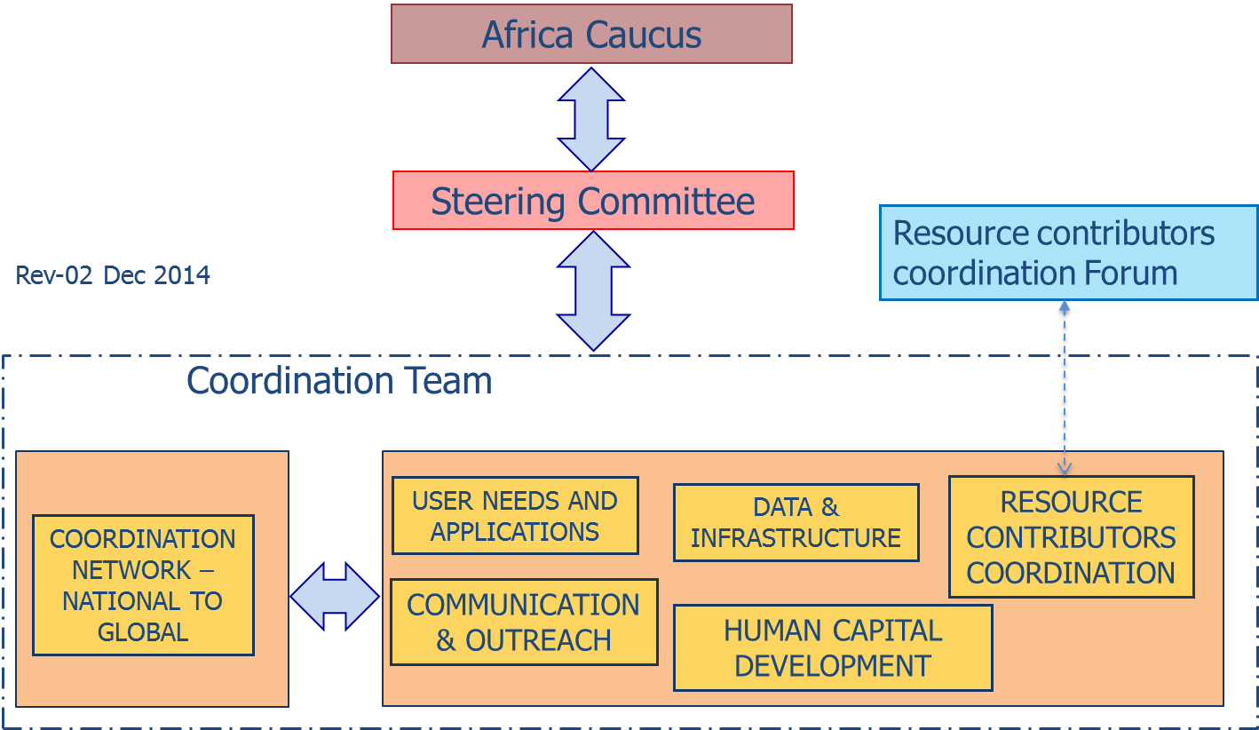
AfriGEOSS Management Arrangement

Slide 8
User Needs and Applications
Identification of user needs and coordination of the development and demonstration of related applications aimed at meeting the user needs.
recurring periodic review of user needs on the basis of the inputs provided by the coordination network;
progressive inclusion of specific projects into the AfriGEOSS framework by creating relationships with on-going initiatives; and
bringing together new actors to define and implement new activities.
Expected to cover the nine GEO SBAs and the thematic areas identified in the African Space Strategy
Example of initial relationships:
GlobWetland Africa, Working Group for Land Cover for Africa, Monitoring of Environment & Security in Africa (MESA), Towards Bioenergy Atlas for Africa (BAfA), TIGER and GEOSS African Water Coordination Cycle Initiative (AfWCCI), WIGOS and the GEO Global Initiatives
Contributions to the World conference of disaster risk reduction, participation at the Preparatory Committee Sessions (Egypt, Gabon, Madagascar and South Africa delivered statements calling for use of EO and GEOSS to support Disaster Risk Reduction)

Slide 9
Data and Infrastructure
Support Africa in achieving open and affordable access to EO data – satellite data acquisition ground stations network, operational use of EO data and information; collaboration on systems development and ICT infrastructure;
Earth observation satellite data over Africa
  Building on existing capabilities and satellites
  Satellite missions under considerations (starting from missions with open and free data access (SPOT World Heritage Programme - proposal to process data for Africa: AGEOS, NARSS, SEOS-OI and SANSA; LANDSAT; Sentinels; CBERS; STRM).
  Initiative supported by 11th Eumetsat User Forum in Africa Recommendations #33 and #34
Co-located / shared ground
  build synergies with other initiatives to share infrastructure component, synergies with Square Kilometre Array (space science astronomy)

Slide 10
Human Capital Development
Coordination and collaboration to strengthen national and regional capacity-building networks.
Work of the Institutional Development and Individual Capacity Building Task (ID-02) and the Committee on Earth Observation Satellites (CEOS) Working Group on Capacity Building and Data Democracy.
  Welcome the development of the GEOCAB Portal
Expected to be led and implemented by national and regional training centres
Initial meeting held at the AARSE 2014 conference
  Collate and review studies on HCD requirements in Africa
  Undertake a gap analysis of HCD in Africa
  Coordinate and undertake activities that address the gaps

Slide 11
Resource Contributors Coordination
Aims at providing the necessary framework not only for African countries and organizations but also for international partners to access and leverage on-going local and international bilateral and multilateral EO-based initiatives across Africa, thereby creating synergies and minimizing duplication for the benefit of the continent.
Initial engagements and activities:
AfriGEOSS side event - Sharing & Celebrating Succeses session, November 2014
  Nertherlands Space Office (Agriculture call;
  European Commission (various funding mechanisms)
  EuroGeoSurveys and USGS
8th GEO European Projects Workshop, June 2014
Support consortiums
  2 consortiums submitted Horizon 2020 proposals on land cover and ecosystems
  2 consortiums submitted proposals under the ESA INNOVATOR III on climate services and agriculture
  Water Coordination Platform – Horizon 2020 (in preparation)

Slide 12
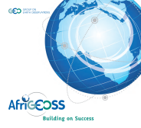
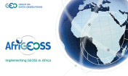
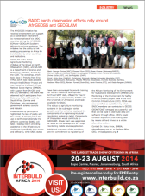
Communication and Outreach
Raise awareness and continuously engage all stakeholders, using the existing networks and through specific measures such as AfriGEOSS website, exhibitions, promotion material, side events, and a periodic GEOSS in Africa conference.
Monthly teleconference
Bilateral meetings and teleconferences
  Presentations, panel discussions, side events, exhibitions
  10 Workshops and Conferences
http://www.earthobservations.org/afrigeoss.php

Slide 13

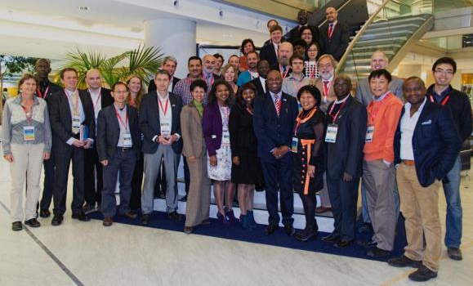
AfriGEOSS & Capacity Building Side Event
Institutions database
  Institutional mandates and capabilities
  Requirements for strategic partnerships
  Capacity building programmes
  Funding mechanisms

Slide 14
THANK YOU
amlisa@geosec.org
www.earthobservations.org

