Slide 1

NASA Agency Perspective
Committee on Earth Observation Satellites
David Crisp, NASA/JPL
CEOS Chair Priority Workshop on GHG Monitoring
European Commission Joint Research Centre,
Ispra, Italy
18-19 June 2018
Copyright 2018 California Institute of Technology. Government sponsorship acknowledged.

Slide 2


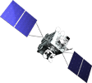


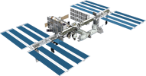

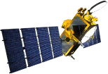

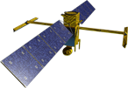
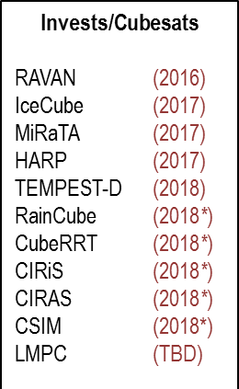



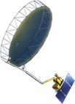




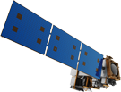


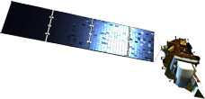

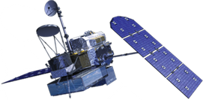

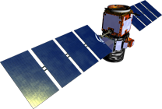

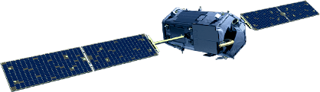
Earth Science Missions
FY17 and Decadal Program of Record
Landsat 9
PACE
GeoCARB
ISS Instruments
LIS, SAGE III
TSIS-1, OCO-3, ECOSTRESS, GEDI
CLARREO-PF
TROPICS (6)
MAIA
Sentinel-6A/B
NI-SAR
JPSS-2 Instruments
OMPS-Limb
SWOT
TEMPO
✔
GRACE-FO (2)
✔
✔
Formulation
ICESat-2
NISTAR, EPIC
(DSCOVR / NOAA)
(2019)
Implementation
CYGNSS (8) (2019)
Primary Ops
Extended Ops
SMAP (>2022)
Landsat 7
(USGS) (~2022)
QuikSCAT (2017)
SORCE,
TCTE (NOAA) (2017)
Suomi NPP (NOAA) (>2022)
Terra (>2021)
Landsat 8
(USGS) (>2022)
Aqua (>2022)
CloudSat (~2018)
CALIPSO (>2022)
GPM (>2022)
Aura (>2022)
OSTM/Jason-2
(NOAA) (>2022)
OCO-2 (>2022)
06.26.17
Notes:
MISSIONS w/ years and cube sats; FY17
06/26: GPM status from primary to extended
5/23: removed TSIS-2
Fleet - Earth Science Division - Missions (with color key; Gemtone version; editable)
Current at of April 18, 2017
Credit: NASA/J. Mottar
------------------------------
SLIDE INFO
April 18, 2017 – Changed LIS and SAGE III to green, Removed EO-1
January 24, 2017 – Removed Rapidscat, changed CYGNSS to green
August 25 – Ianson approved, Denning change on NISAR, changed yellow to orange implementation given KCP-C
July 22 – Denning change per Ianson: move TROPICS (12) with MAIA and EVM-2 and delete separate icon and name
July 21 - Denning changes per Freilich/Ianson:
Fixed misspelling of e in Sentinel and corrected it to not be all caps
Separated each ISS mission on its own line
Put MAIA and EVM-2 on own as new, taking MAIA off PACE
Change RBI to Orange
July 13-14 Mottar added TROPICS icon and name. Denning made the following changes (had discussed w Freilich to do when these passed KCP-B and into implementation) changed yellow to orange for:
OCO-3, SWOT, TSIS-1, GEDI
April 29 per Freilich, Denning made these changes:
-Put MAIA with PACE
April 26 per Ianson information on 4/22, Denning made these changes:
TSIS-1 orange changed to yellow as still in formulation (until if successful KDP-C June 8)
GEDI orange changed to yellow as still in formulation (until if successful KDP-C June 9
changed order put ECOSTRESS before TSIS-1
April 22 Changed JPSS-2 (NOAA) to yellow for Formulation (confirmed w Carolyn Mercer and Ariel Pavlick (OCE embed with master tables)) as it had been in orange Implementation. Chart sent to Ianson and Neeck for check.
CORRECTION DENNING PER RIVERA Feb 18, 2016
Changed misspelling of “Sentinal” to “Sentinel”
UPDATE DENNING PER FREILICH DECISIONS FEB 12, 2016
Changed OCO-3 to Formulation color and moved lower in list
Changed RBI to Formulation color
Changed GEDI to Implementation color and moved to line above it
Added TSIS-2 in Formulation color
UPDATE DENNING PER FREILICH DECISIONS FEB 4, 2016
Changed “Altimetry FO (Formulation in FY16) to “Sentinal-6A/B”
On Landsat 9, removed comma and TIRFF
Change I was going to make – “NISTAR, EPIC (NOAA’s DSCOVR) to green primary ops was already corrected
Dec. 15, 2015 – Updated: TEMPO changed to Implementation phase; NISTAR, EPIC changed to Primary Ops phase; ; OCO-3 and ECOSTRESS changed to Implementation phase; Aquarius removed; slide now fully editable. JMottar
May 18, 2015 – Added to SMD Multimedia Library.
May 18, 2015 – Updated the outdated 2014 version: TRMM was removed; NISTAR, EPIC (NOAA's DSCOVR) were added; SMAP icon was updated; moon at top left was removed; color key moved to top left.-JMottar
ID: I-EA-15-0040 (image)
ID: SL-EA-15-0068 (slide)

Slide 3
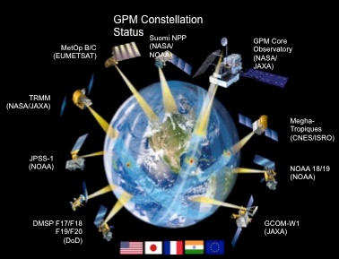
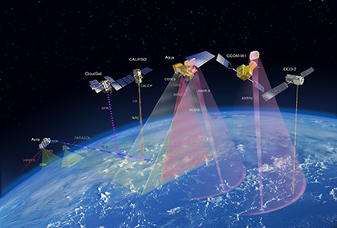
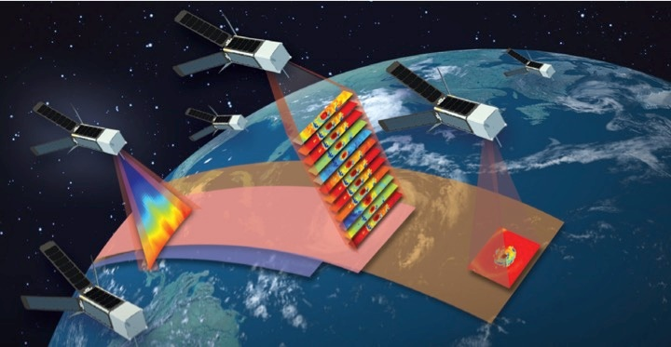
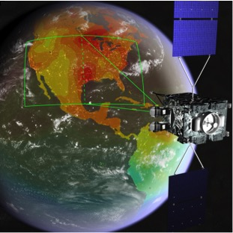
NASA Observing System Innovations
Notes:
NASA has a history of supporting innovative measurement approaches
Coordinated constellations of satellites to deliver time-critical global measurements (GPM fleet)
Constellations to collect a comprehensive suite of measurements for studying the Earth as a system (A-Train)
Constellations of micro-satellites and cubesats for enhancing coverage and repeat frequency
Geostationary satellites (TEMPO, GEMS) for time-resolved observations of diurnal variations in critical environmental variables

Slide 4
2017 Decadal Recommendations for Flight
Endorsed completion of Program of Record
Encouraged portfolio integration rather than mission-specific solutions
Identified 5 ”Designated” observables for mandatory acquisition (Aerosols; Clouds, Convection, & Precipitation; Mass Change; Surface Biology & Geology; Surface Deformation & Change) – all cost-constrained, not necessarily single-focus, all will likely have competed portions
Introduced a new competed “Explorer” flight line with $350M cost constraint, 3 observables to be chosen by ESD from among 6 identified
Recommended “Continuity Measurement” demonstration strand ($150M full mission cost constraint) for existing Venture-class program – first will be radiation budget to mitigate RBI cancellation, ~3 initiated within the decade
Encouraged international partnerships
Called for “Incubator Program” between Technology and Flight to mature specific technologies for important – but presently immature – measurements (preparation for next Decadal)
NASA is exploring a full range of commercial/private sector partnerships – data buys, hosting, … .
Notes:
The 2017 NASA Earth Science Decadal Survey sets the course for NASA’s programs over the next decade

Slide 5
NASA Greenhouse Gas Program of Record

Slide 6
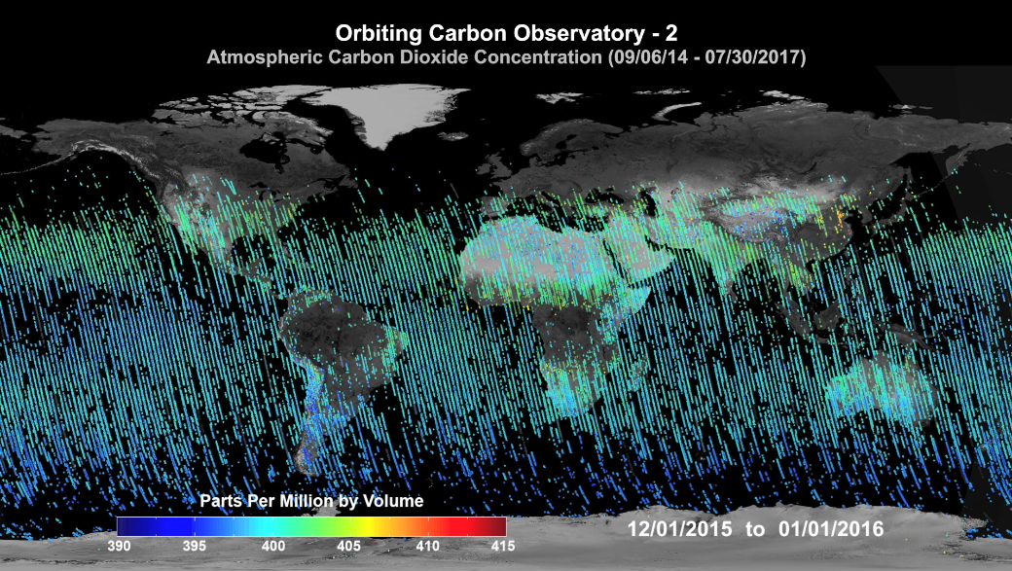
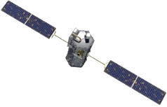
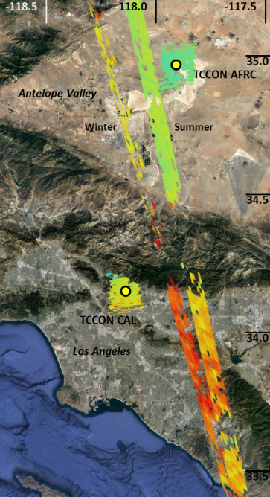

NASA Orbiting Carbon Observatory-2 (OCO-2)
OCO-2 was launched in July 2014
Since then, it has been collecting about one million soundings / day
About 85000 of these are sufficiently cloud free to yield estimates of X_{CO2} with single sounding random errors near 0.5 ppm and regional scale biases < 1 ppm
These data describe the CO₂ distribution with unprecedented resolution, and coverage
These data have been used to study emission from compact sources (cities, power plants) the tropical carbon cycle response to the 2015-2016 El Niño
50km

Slide 7
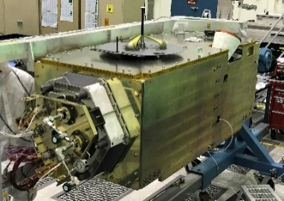
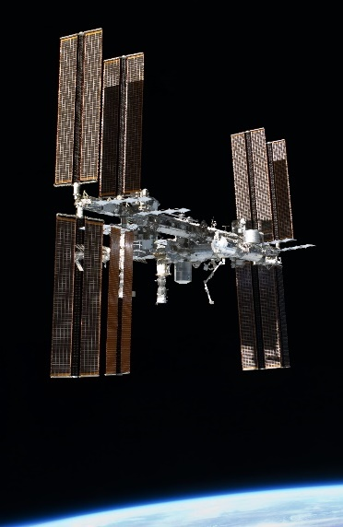
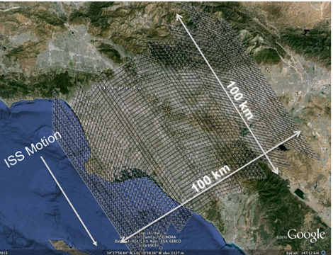
The NASA Orbiting Carbon Observatory-3 (OCO-3)
In 2019, OCO-2 will be joined by OCO-3, which will be deployed on the Japanese Equipment Module Exposed Facility on the International Space Station, ISS
OCO-3 integrates the OCO-2 flight spare spectrometers with an agile pointing mechanism.
That pointing mechanism, combined with the low inclination orbit of the ISS will facilitate new types of investigations of CO₂ sources and sinks
  acquisition of 100 km x 100 km “snapshots” of large urban areas and other targets
OCO-3 has completed its pre-launch testing
Once installed on the ISS, OCO-3 measurements will provide continuity for OCO-2 CO₂ and SIF data and provide new opportunities for studying the atmospheric carbon cycle

Slide 8
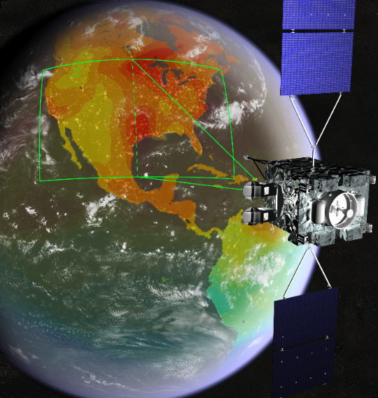
The NASA GeoCarb Mission*
In December 2016, NASA selected the Geostationary Carbon Cycle Observatory (GeoCarb) as the second complete mission in the NASA Earth Ventures series.
GeoCarb will be the first mission to acquire spatially resolved observations of greenhouse gases and solar induced chlorophyll fluorescence (SIF) at high spatial resolution (5 to 10 km) from geostationary orbit (GEO).
GeoCarb will fly on a commercial communications satellite and carries an imaging grating spectrometer
  O₂ (765 nm) CO₂, (1610 and 2060 nm), methane (CH₄) and carbon monoxide (CO; 2300 nm)
It will launch is 2022 and be stationed between 75° and 100° West longitude in 2023.
It will map these properties over North South America two or more times each day.
“ Pre-Decisional Information -- For Planning and Discussion Purposes Only

Slide 9
Contributions from NASA Earth Science Data Analysis Programs
NASA’s Earth Science Mission Operations & Data analysis and Research & Analysis Programs are also making critical contributions to GHG science
Improved remote sensing retrieval algorithms for X_{CO2} and X_{CH4}
  More accurate descriptions of gas absorption and aerosol scattering
  Optimized to more fully exploit the information content of solar GHG spectra
Support for vicarious calibration and validation
  Vicarious calibration campaigns and solar and lunar standards
  NASA’s ground based TCCON validation sites
Carbon Cycle Observing System Simulation Experiment (OSSE) initiative
  Advanced modeling and data assimilation used in coordinated OSSEs to:
    Assess/improve spatial resolution and accuracy of horizontal & vertical transport
    Improve methods for assimilation of ground-based, aircraft, and space based data
    Develop methods to validate fluxes on local, national, and regional scales
    Assess performance requirements and observing strategies of GHG satellites
    Improve understanding of CO₂ interannual variability through assimilation of biomass and atmospheric carbon (OCO-2, MOPITT) leveraging CMS-Flux

