Slide 1
WMO Integrated Global Observing System AND The physical architecture for climate monitoring from Space
Werner Balogh
WMO Space Programme Office
Workshop on EC CEOS Priority on GHG Monitoring
EC Joint Research Centre, Ispra, Italy
18 June 2018

Slide 2
Contents
WMO Integrated Global Observing System
  What is WIGOS
  Observing Components
  Need for WIGOS , Design Principles and Integration
  Implementation
  Rolling Review of Requirements
  WIGOS Vision 2040
Physical Architecture for Climate Monitoring from Space
  Background
  Logical and Physical View
  Present Status
  Way Forward

Slide 3
Part 1:
WMO Integrated Global Observing System (WIGOS)

Slide 4
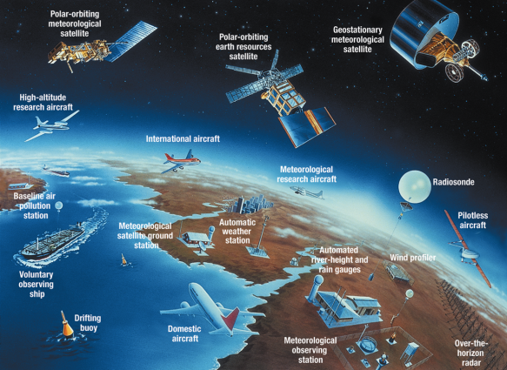
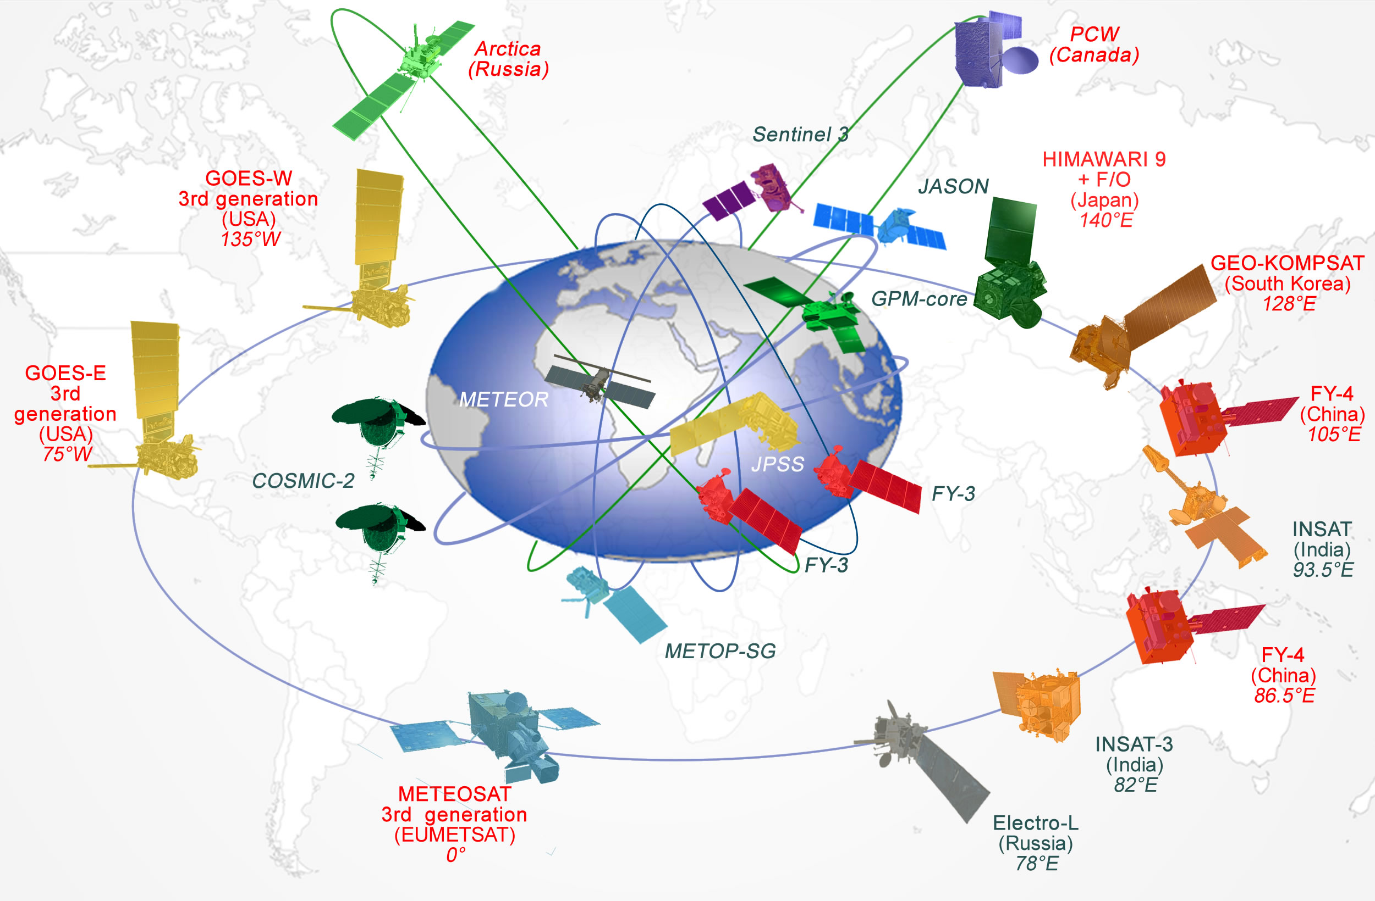
WMO Integrated Global Observing System
World Weather Watch (WWW), established in 1963.
Need to upgrade observation system in response to societal changes, addressing weather, water, climate and environmental issues:
  WMO Integrated Global Observing System (WIGOS)
  WMO Information System (WIS)
A common regulatory and management framework.

Slide 5
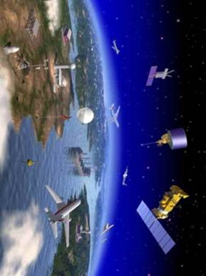
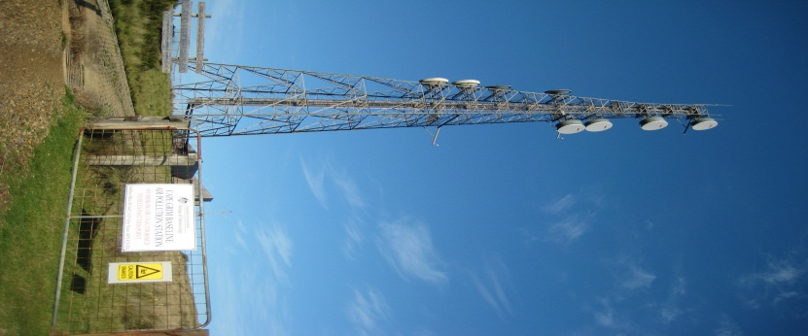
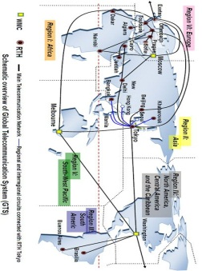
WMO Integrated Global Observing System
World Weather Watch
GAW
WIGOS
GCW
Hydro OS
GOS
GCOS
Partners
GDPFS
Co-sponsors
WMO Information System -WIS
GTS

Slide 6
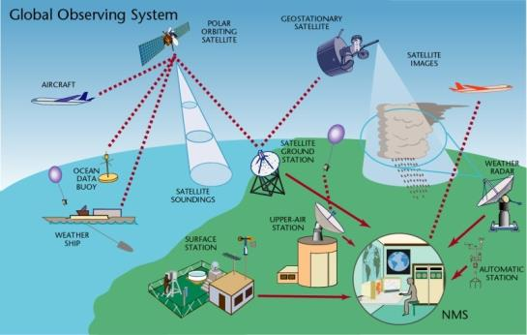
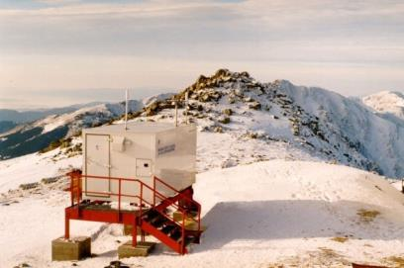
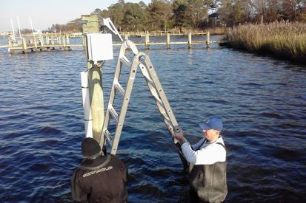
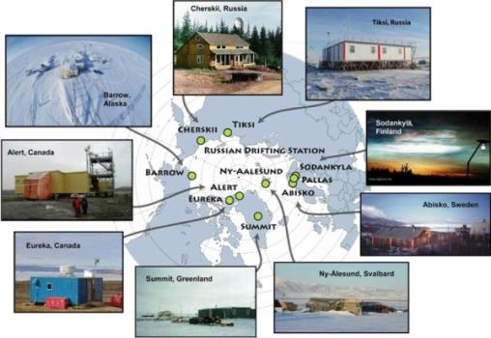
Observing Components of WIGOS
Global Observing System (WWW/GOS)
Observing component of Global Atmospheric Watch (GAW)
WMO Hydrological Observations (including WHYCOS)
Observing component of Global Cryosphere Watch (GCW)
Global Climate Observing System (GCOS)
…

Slide 7
Why WIGOS?
Broader mandates of National Meteorological and Hydrological Services (NMHSs).
  Climate monitoring, climate change, mitigation
  Air quality, atmospheric composition from urban to planetary scales
  Oceans
  Cryosphere
  Water resources
Technical and scientific advances.
Economic realities.

Slide 8
WIGOS Design Principles
An Observing System
Designed to requirements.
  Rolling Requirements Review (RRR)
  Observing Systems Capability Analysis and Review Tool: OSCAR/Requirements, OSCAR/Space, OSCAR/Surface
Making use of synergies by considering all observational needs.
  Based on the WMO Application Areas
Integrating the space and surface-based observing system.

Slide 9
WMO Application Areas
1) | Global numerical weather prediction
2) | High-resolution numerical weather prediction
3) | Nowcasting and very short range forecasting
4) | Seasonal and inter-annual forecasting
5) | Aeronautical meteorology
6) | Forecasting atmospheric composition
7) | Monitoring atmospheric composition
8) | Atmospheric composition for urban applications
9) | Ocean applications
10) | Agricultural meteorology
11) | Hydrology
12) | Climate monitoring
13) | Climate applications
14) | Space weather

Slide 10
WIGOS Integration
Integrated network design across national borders.
Integrated across disciplines through multi-purpose networks for multiple application areas.
Integrated across organizational boundaries.
Integrated across technological boundaries.
Integrated across different levels of performance:
  Crowd-sourced data (unknown data quality)
  Standard networks (operational data quality)
  Reference networks (high quality data)

Slide 11
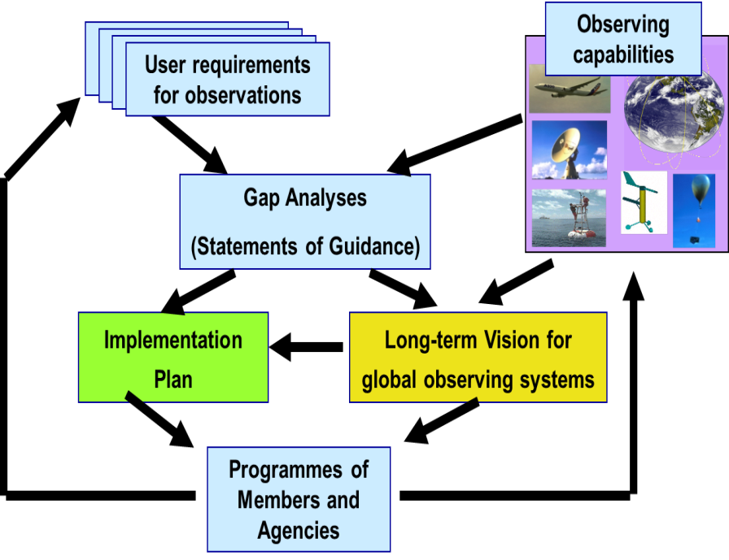
Rolling Review of Requirements (RRR)

Slide 12
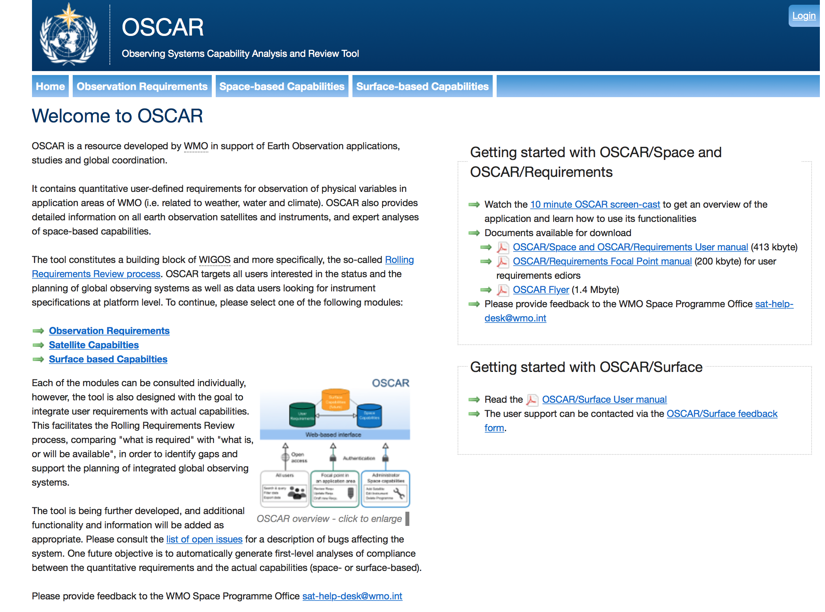
Observing System Capability Analysis and Review Tool

Slide 13
OSCAR and RRR
OSCAR/Space
OSCAR/Surface
OSCAR/
Requirements

Slide 14
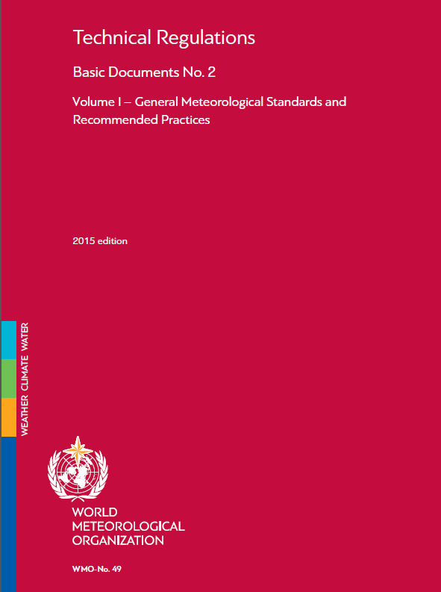
WIGOS Reference Documents

Slide 15
WIGOS Reference Documents

Slide 16
WIGOS Vision 2040
Serves as a reference for WMO Members and other observing system operators, providing context and expected boundary conditions relevant for observing system developments.
Informs the long-term planning of satellite agencies about expected evolution of user requirements.
Informs planning efforts of users of observations regarding systems development and required computing and communication capabilities.

Slide 17
WIGOS Vision 2040
Chapter I: Context, purpose and scope
Chapter II: Space-based WIGOS components
Chapter III: Surface-based WIGOS components

Slide 18
Space-based WIGOS Components
Tier 1: Backbone system with specified orbital configuration and measurement approaches.
  Basis for WMO Member commitments, responding to the critical data needs; similar to the current CGMS baseline with addition of newly mature capabilities.
Tier 2: Backbone system with open orbit configuration and flexibility to optimize the implementation.
  Basis for open contributions of WMO Members, responding to target data goals.
Tier 3: Operational pathfinders, and technology and science demonstrators.
  Responding to R&D needs.
Tier 4: Additional capabilities.
  Contributed by WMO Members and third parties including governmental, academic or commercial initiatives.

Slide 19
WIGOS Vision 2040
First draft presented to the 46th session of the Coordination Group for Meteorological Satellites (CGMS-46).
Coordinated with CGMS baseline:
  WMO will conduct gap analysis (4-year cycle).
  CGMS will conduct risk assessment (annually).
Briefing on status to WMO Executive Council this week and final round of consultations.
Approval by 18th session of the World Meteorological Congress in 2019.

Slide 20
Part 2:
Physical Architecture for
Climate Monitoring from Space

Slide 21
Background
WMO Resolution 19 (Cg-XVI) called for the Development of an Architecture for Climate Monitoring from Space (2011)
  As a “major initiative of the WMO Space Programme”, and
  “invites CEOS, CGMS, GCOS, GEO and WCRP to collaborate with the WMO Space Programme on the development of the Architecture”.
Notes:
Document contains description of logical view composed of four pillars and contains general views on the physical view.

Slide 22
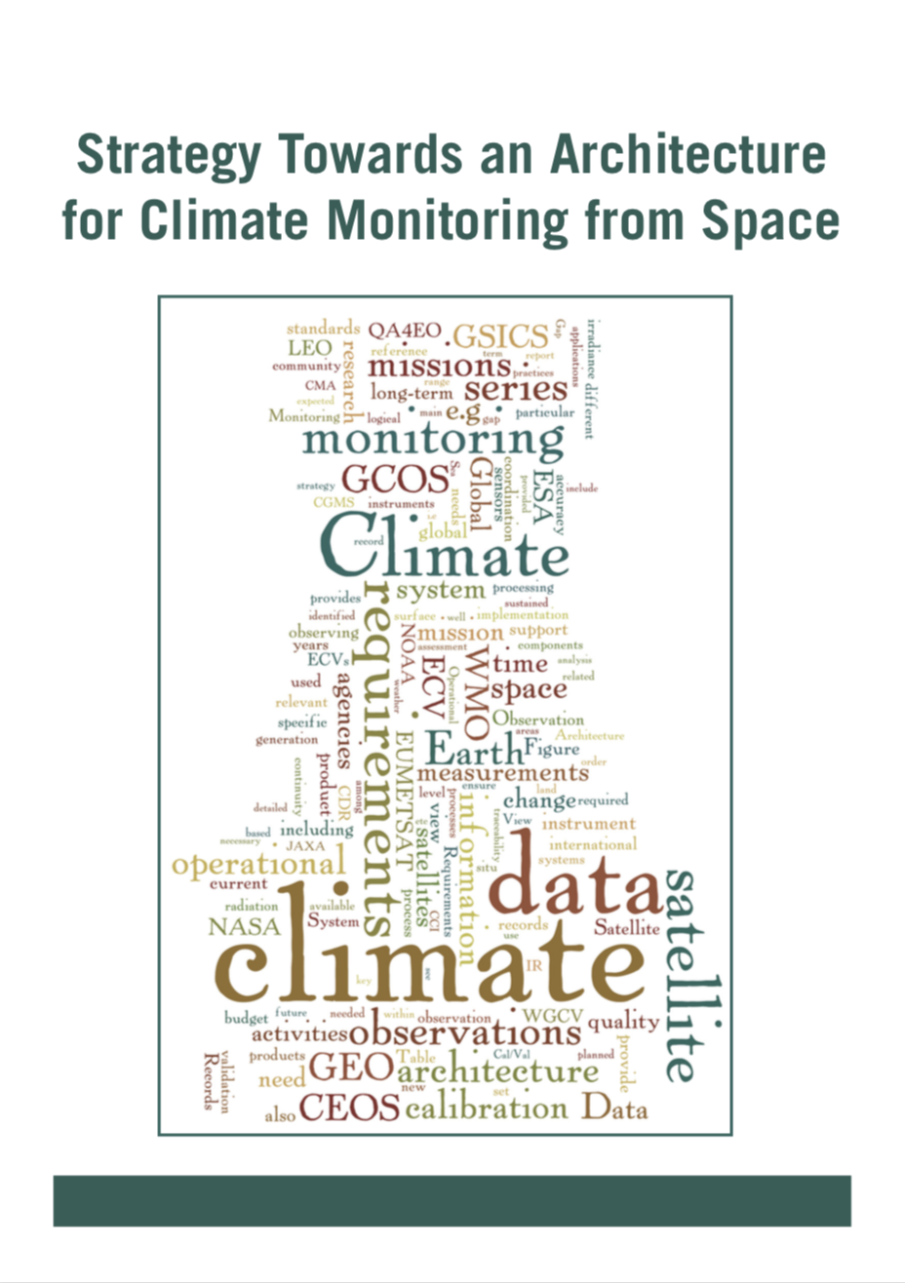
Climate Monitoring Architecture
Strategy Towards an Architecture for Climate Monitoring from Space (2013)
  Terminology
  Logical View
  Implementation Roadmap
http://ceos.org/document_management/Working_Groups/WGClimate/WGClimate_Strategy-Towards-An-%20Architecture-For-Climate-Monitoring-From-Space_2013.pdf.

Slide 23
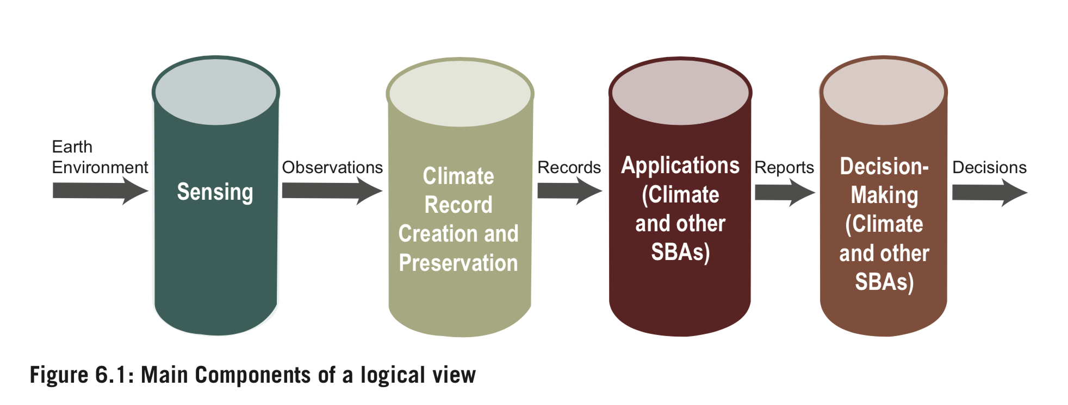
Logical View
The Logical View is based on 4 Pillars

Slide 24
Physical View
Physical View of the Architecture for Climate Monitoring from Space to consist of:
  Existing/planned missions, datasets, and key user organizations, agencies, coordination mechanisms (“who does/plans/needs what”);
  A commitment by agencies, mechanisms, and activities to fulfil the functions identified in the logical Architecture;
  Regular action by all stakeholders to the Architecture to address/fill gaps where these have been identified and validated.
Notes:
Document was a available in 2013. As a consequence out of this strategy a joint CEOS/CGMS WG on Climate was established. WGClimate was of the opinion to first generate an inventory on the present and future availability of ECVs.

Slide 25
Present Status
WMO has proposed an Architecture for Climate Climate Monitoring based on a virtual constellation composed of virtual sub-constellations.
The sub-constellations are responsible for providing the observations to derive a single ECV or a group of ECVs.
The virtual sub-constellations belong to either CEOS members or CGMS members or a combination of both.
However, this concept did not find support from CEOS and CGMS members.
Notes:
Make reference to WORKSHOP on ECV inventory use for climate monitoring, 27-29 November 2018.

Slide 26
Present Status
Many elements of the physical view for climate monitoring from space are in place today:
  GCOS (Requirements)
  CEOS/CGMS Working Group Climate
  ECV Directory
  WIGOS/CGMS Baseline
  Gap Analysis Process (WMO RRR)
  Risk Analysis Process
The physical view is not yet described.
Defining and reaching consensus on the physical view will be important for efficient and effective climate monitoring from space.

Slide 27
Way Forward
To reach consensus on the physical view of the architecture for climate monitoring from space by describing its present status and by “Putting names to the logical view”.
WMO proposes to gather a small Task Team composed of representatives of stakeholders in the architecture to describe the architecture.
Document to be submitted to the 18th World Meteorological Congress.

Slide 28
https://www.wmo.int/pages/prog/www/wigos/index_en.html

