Slide 1


Working Group on Calibration and Validation (WGCV)
Plenary Report
Greg Stensaas, USGS

Slide 2

WGCV meetings
WGCV-33
  May 16-20, 2011 in Moscow, Russia; hosted by ROSCOSMOS
  Very successful meeting, extensive Russian support
WGCV-34
  February 6-10, 2012 in Brisbane, Australia; hosted by TERN-AusCover;
  Australian Gov’t initiative in EO and Cal/Val infrastructure
  Finalized 5-year WGCV work plan (see CEOS Website)
WGCV-35
  Joint meeting with WGISS, September 23-28, 2012; hosted by ISRO in Hyderabad, India
  Vice-chair elected from DLR, Dr. Albrecht von Bargen
Future WGCV meetings
  WGCV-36, May 12-17, 2013 to be hosted by Academy of Opto-Electronics, CAS, Shanghai, China
  Need support for WGCV-37, Feb 2014 and WGCV-38, Sep 2014
2
Notes:
Many excellent joint efforts with WGISS to move CEOS cal/val/QA and satellite interoperability forward using CWIC/IDN, quality parameter definition, and metadata reviews

Slide 3
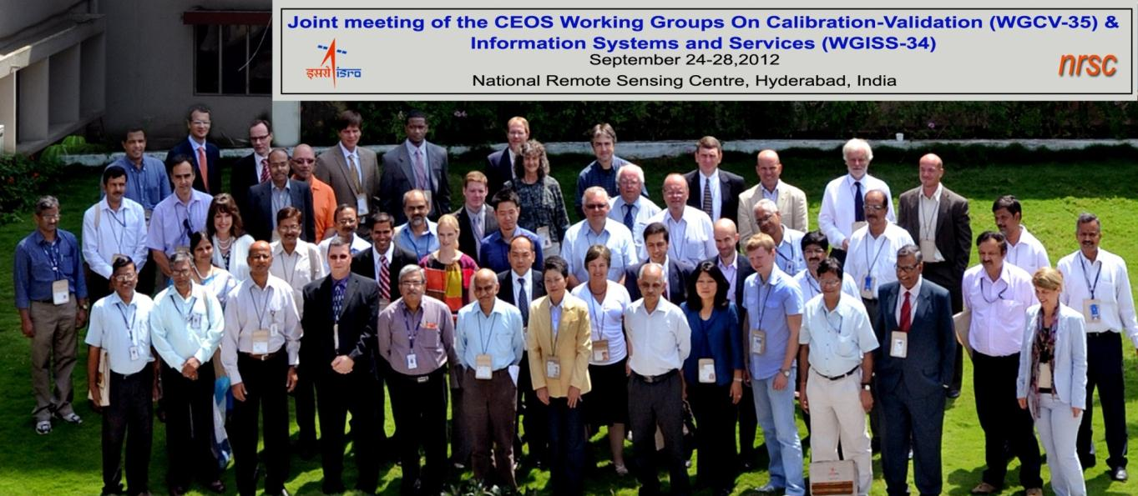
WGCV-WGISS Joint Meeting
Very successful, comments “best joint-meeting we’ve had”
  ISRO was an excellent host and provided exceptional participation and interaction
  WGCV proposed 11 ideas for joint-efforts
3

Slide 4
WGCV WGISS Joint efforts
  Agreed upon 7 joint-efforts:
Evaluate data quality metadata fields for sensors/products and suggest metadata requirements
CEOS WGCV Test Site information access in CWIC/IDN
Develop CEOS Quality Indicators
Define ECV quality information and implementation process for metadata and associated documentation
Identify key players from VCs to support WGCV/WGISS tasks
Update current and develop new CEOS Showcases
  DEM Quality Information System (DEMqis) proposed
Continue to work with WGISS on data and information access
4

Slide 5
CSS action/implementation
Working with strong WGCV supporters from China and Russia to help define key members for other VCs and WGs
Communication across CEOS
  WGCV has defined points of contact to interact with each WG and VC
  WGCV has sent an email to all VCs, WGs, and Task Leads requesting Cal/Val requirements and needs
    Will update 5 year plan as appropriate, and present changes to CEOS management
    Working with SIT to support enhancement of CEOS communication and management processes
5

Slide 6
WGCV subgroups
The WGCV is supported by 6 subgroups that represent key communities / domains
  Through their own dedicated meetings, these sub-groups focus on issues relevant to their communities and report back through the WGCV
  Sub-groups provide recommendations on Cal/Val and QA4EO processes and have identified test sites for all CEOS agencies to use
6

Slide 7
WGCV CEOS Actions
CEOS 24-12: CEOS agencies encouraged to consider taking on responsibility for QA4EO secretariat and website maintenance
UKSA/NPL has accepted a 2 year term for QA4EO SEC and support
CEOS 24-13: WGCV will provide a list of CEOS endorsed reference sites over which CEOS Member Agencies should collect and provide information in order to facilitate interoperability and underpin internationally harmonised calibration/validation. The list will also include recommended resource requirements for active agency support of site instrumentation and maintenance
The CEOS recommended Cal/Val sites and processes are available on the Cal/Val portal and being put into CWIC/IDN.
WGCV requests that CEOS member agencies routinely acquire data over these sites where applicable and support the maintenance of any instrumentation required on site.
Resource requirements for the instrumented sites are required by agencies; New recommendation provided in following slides
7

Slide 8
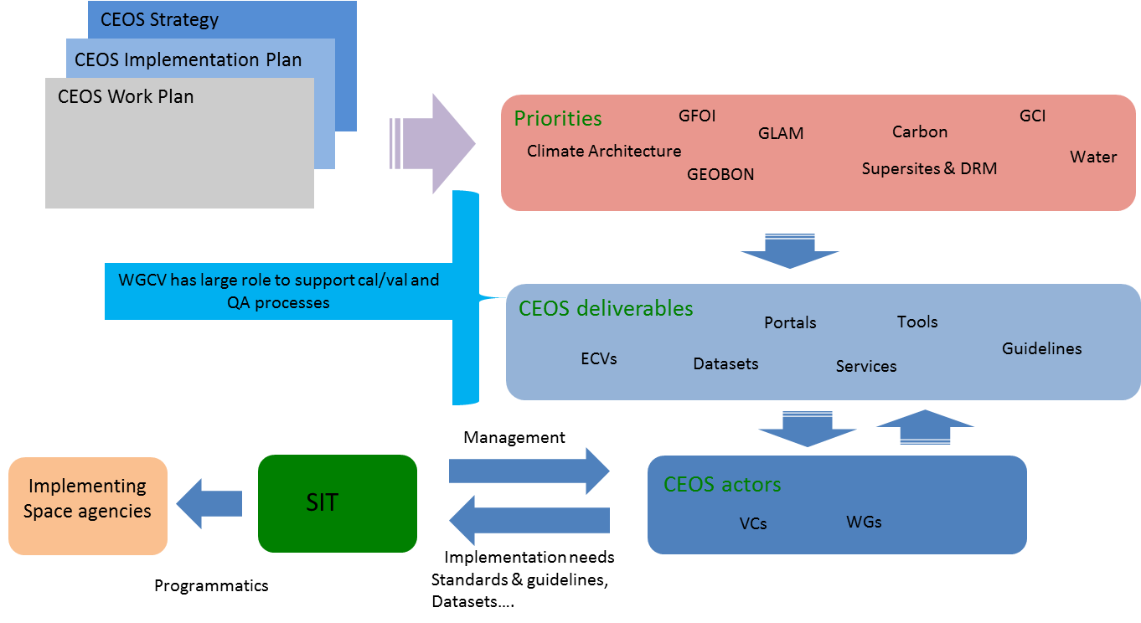
Cal/Val/QA across CEOS
8

Slide 9
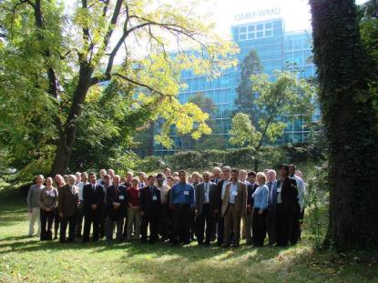
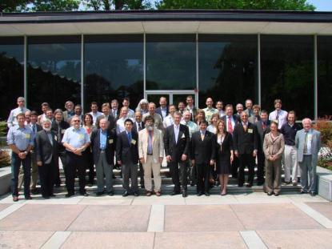
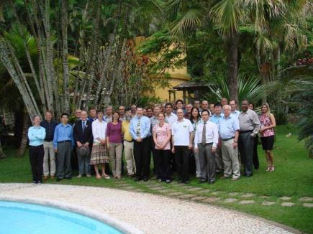
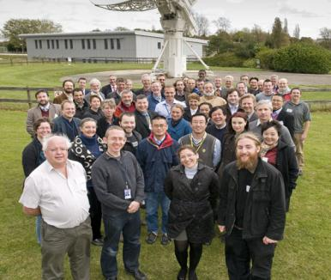
QA4EO Implementation
  Developed QA4EO Framework under GEO Task DA-09-01a: GEOSS QA Strategy, Now IN-02-C1
Geneva, WMO, Oct. 2007
Guiding principles
Gaithersburg, NIST, May 2008
Establishing an operational framework
Antalya, TÜBİTAK, Sept. 2009
Facilitating Implementation
Oxfordshire, UK, RAL, Oct. 2011
Providing Harmonized QI in EO Data
9

Slide 10
GEO QA4EO IN-02 Tasks
  WGCV led IN-02: Earth Data Sets, C1: Advances in Life-cycle Data Management efforts:
IN-02-C1_2: Use Dome-C as prototype and developing continued and on-going methodology to tie into the Cal/Val portal enhancement as a reference for Landnet sites.
  Completed 3rd successful DOME-C campaign including using a SAR sensor (RADARSAT-2) and Bi-directional Reflectance Distribution assessment
IN-02-C1_3: Develop a CEOS Quality Assurance Framework for Earth Observation (QA4EO) and implement processes and structure for CEOS data and information.
  QA4EO Framework and Draft CEOS Implementation Plan Completed
IN-02_4: Develop Cal/Val Portal and post-launch test sites to assist implementation of QA4EO for GEOSS.
  Portal support continues via ESA and CEOS Recommended Test Sites define by WGCV SGs
IN-02_5: Enabling Data and Information Interoperability and Harmonization in CEOS and GEO. Develop an architecture and constituent elements needed for implementation of an operational system to insure the long term interoperability.
  Working joint efforts with WGISS and WGC to support implementation in CEOS
  WGCV led IN-02: Earth Data Sets, C2: Regional and Global Datasets:
IN02-C2_01: Global fused 30m including coastal zone bathymetry and onshore DTMs.
  Tasks identified at ISPRS2012 and partial funding being sought as part of DEMqis
10

Slide 11
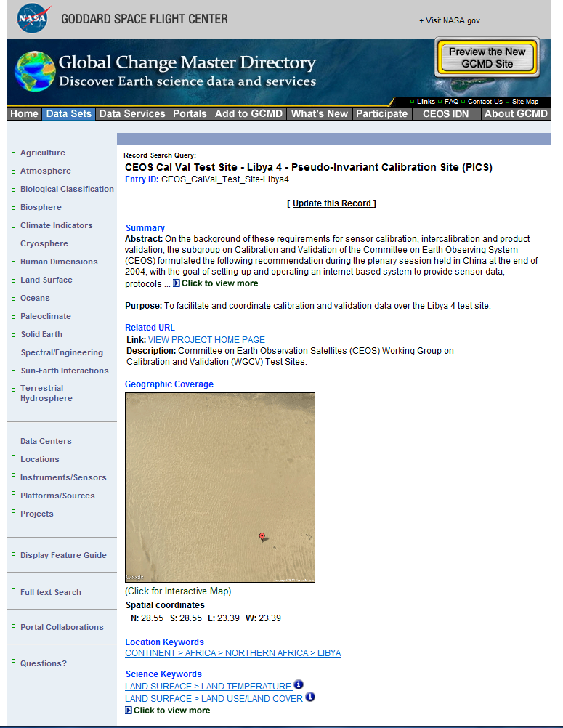
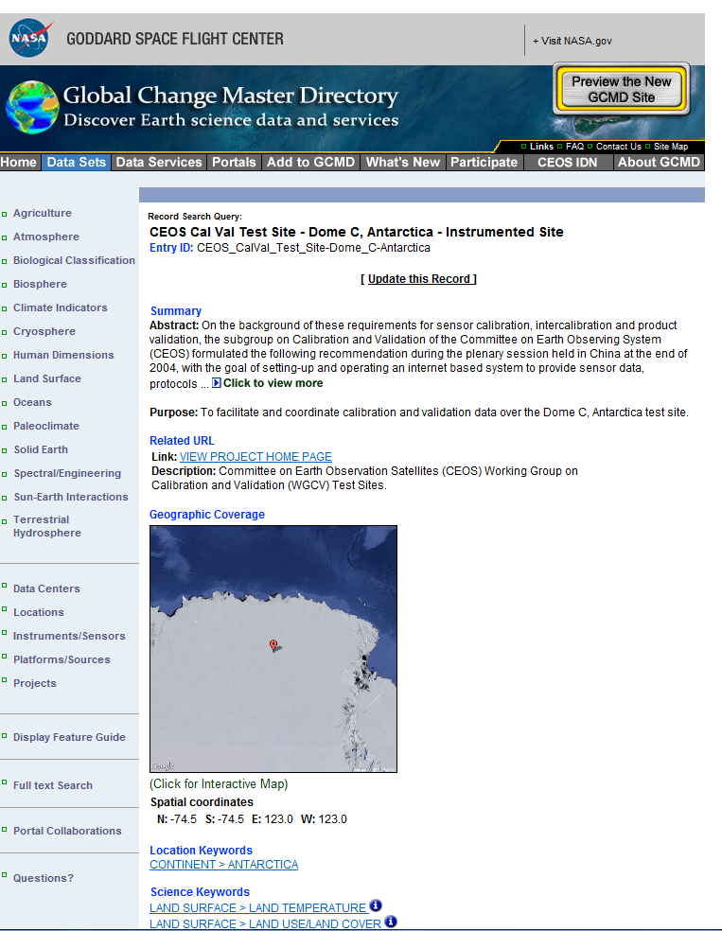
CEOS Cal/Val Test Sites in IDN
CEOS Pseudo-Invariant Calibration Site (PICS) - Libya 4
CEOS Instrumented Site - Dome C, Antarctica
11

Slide 12
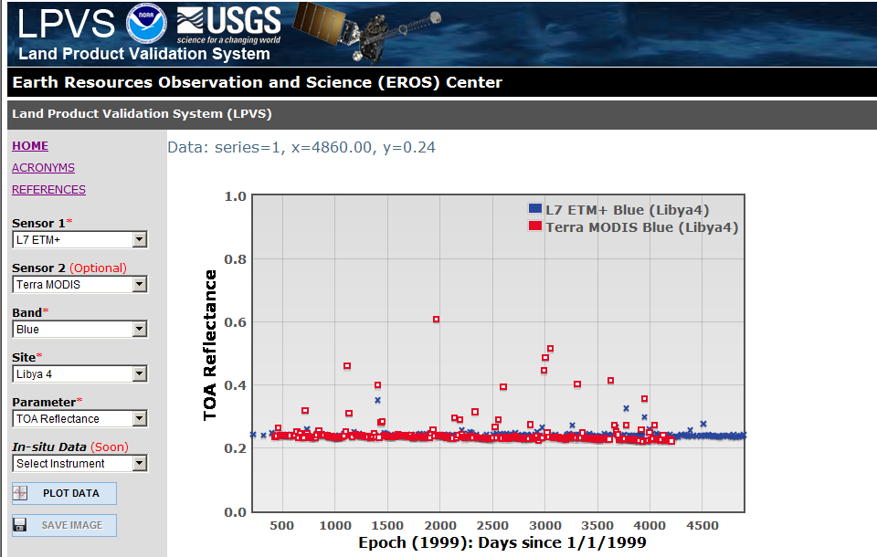
Data trending over CEOS Sites
12

Slide 13
CEOS QA4EO Showcases
At the Joint WGCV/WGISS meeting in 2010 is was agreed to define a set of showcases to exemplify QA4EO implementation for CEOS. This activity was approved at CEOS-24.
Three focus areas were agreed upon:
  “Forest Carbon Tracking”
  Changed showcase from "Air Quality" to "Climate; e.g., ozone"
  “Global Elevation”
  Resource and support are needed via GEO Tasks and CEOS member agencies to update and finish current showcases
  New Proposed Showcase - DEM Quality Information System (DEMqis)
13

Slide 14
WGCV Recommendations
  CEOS WGCV recommends that CEOS plenary consider, General:
    Reviewing and approving WGCV 5-year plan (on WGCV web page)
    Providing agency support in developing and maintaining recommended instrumentation at the CEOS Cal/Val test sites, and acquiring data routinely over them
    Provide free access to a set data acquired over these sites to CEOS member agencies for calibration purposes, preferably via CWIC
    Provide resources and support for ground networks and field campaigns
    Agencies provide point of contact for WGCV and its subgroups
    Provide support to lead and encourage widespread implementation of QA4EO principles within future (and where possible current) activities of CEOS agencies facilitated by the new UKSA QA4EO Secretariat.
14

Slide 15
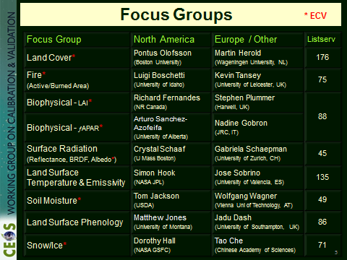
WGCV Recommendations
  CEOS WGCV recommends that CEOS plenary consider, SAR SG:
Agency support for CEOS SAR test sites in India and Australia
Recommend that CEOS organizations obtain and provide calibration data over SAR test sites
  CEOS WGCV recommends that CEOS plenary consider, LPV SG:
Recommend that agencies provide nomination for LPV Subgroup Vice Chair
Recommend that CEOS agencies provide support for LPV Focus Groups
Recommend that agencies collect and make data available over LPV test sites as part of a regular acquisition plan
Note: WGCV LPV very closely aligned with Land ECV products and there is strong need to work with Working Group on Climate
15

Slide 16
WGCV Recommendations
  CEOS WGCV recommends that CEOS plenary consider, MSSG:
  Recommend agencies contact WGCV and MSSG Chair with potential co-chair candidates, and interested participants to the sub-group
  CEOS WGCV recommends that CEOS plenary consider, TMSG:
  Agencies should be encouraged to fund the set-up of global test sites over continental shelves where “bathymetry” truth is available for (a) clearwater (e.g. Australian bight); (b) turbid water regions (e.g. English channel) for evaluation of spaceborne visible and SAR methods respectively for bathymetry retrieval
  Agencies are encouraged to provide through WGISS WPS services (e.g. bare earth retrievals, river catchments, data fusion engines) as well as WMS of their spaceborne DEM products including QI using the internationally agreed ICEDS color LUT for elevation and a to-be-agreed CLUT for QI
16

Slide 17
WGCV Recommendations
  CEOS WGCV recommends that CEOS plenary consider, IVOS SG:
Develop WGCV and WG-C task force to establish consistent interpretation of GCOS ECV requirements and analysis methodology for accuracy and stability monitoring
For satellite based OC measurements, agencies to commit to long term support of CEOS reference test sites for oceans; e.g., OC Buoys MOBY, BOUSSOLE, (Kavaratti - ISRO) and develop Aeronet-OC network
Resources are required to enable comparisons of radiometers used for validation of 1) SST and 2) OC to be organized in 2014 (preparations to commence in 2013) in support of VCs and climate
To underpin validation of satellite based SST measurements and help mitigate data gaps for climate records, agencies to support the deployment of a set of traceably calibrated drifting buoys at a cost of ~$300k
Agencies support set up and long-term maintenance cost of autonomous SI traceable instruments for the CEOS land test sites (LANDNET) (minimum of 5) and establishment of infrastructure to enable coordination and dissemination of information to satellite operators
17

Slide 18
WGCV Recommendations
Minimum Sites: At least 5 CEOS LANDNET Sites
Minimum Specification of equipment on site:
Master and nodes (1 node per ~300 m²)
Multispectral: Min 10 channels
Cost varies based on site size and characteristics
Costs for minimum set of instruments would be $50K
Need annual long term maintenance and data connectivity (~ 0.5 person year for 20+ years)
Regular traceability and comparisons (appropriate facilities and reference standards)
Full-up Site
Minimal Instrumented Site - Many sites could omit the atmospheric aerosol measurements
Reference: CEOS WGCV IVOS, K. Thome, NASA
18

Slide 19
WGCV Recommendations
  CEOS WGCV recommends that CEOS plenary consider, IVOS SG:
Agencies are encouraged to regularly collect data over CEOS sites and provide access to the data via the CEOS Cal/Val portal or some other accessible database
Encourage agencies to provide consistent minimal acquisition metadata in the header files; e.g., view angles, time, solar angles, etc., to support comparisons needed for data quality and interoperability
Resources are needed to identify global MTF Cal/Val test sites and establish webpages, similar to the USGS Worldwide test site catalog
Agencies are encouraged to ensure full PSF/MTF pre-flight characterization of the sensor and provide results to the user community
Two new thematic groups (Geo-spatial quality and Geo-image quality) have been established within IVOS. Agencies are encouraged to participate
19

Slide 20
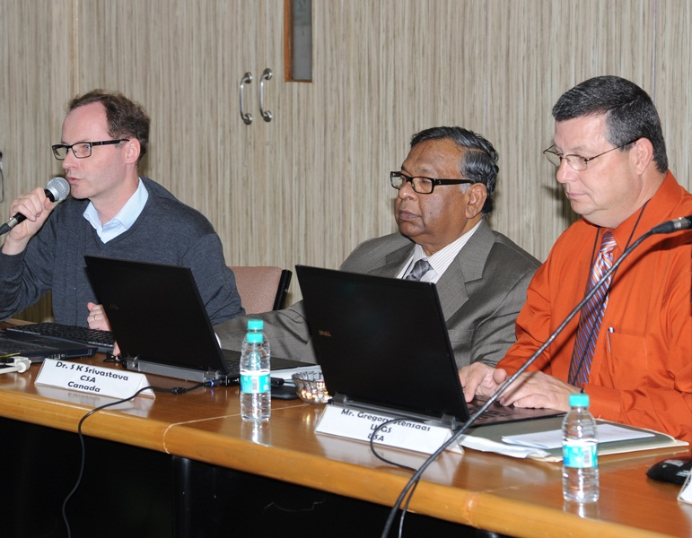
WGCV Transition
Albrecht von Bargen,
DLR
Gregory Stensaas, USGS
Gregory Stensaas from USGS completes his two-year term as WGCV Chair (2010 – 2012)
Satish Srivastava from CSA (the former WGCV vice-chair) becomes the new Chair (2012 – 2014)
Albrecht von Bargen from DLR was elected as the new WGCV vice-chair (2012 – 2014). Albrecht will become WGCV chair in 2014
Satish Srivastava, CSA
WGCV-35, ISRO, Hyderabad, India
Thank you for the opportunity to serve as the WGCV chair!
l learned much from you and truly enjoyed talking and working with many of you!
20

