Slide 1
Endorsement of the
CEOS Acquisition Strategy for GEOGLAM Phase 1
CEOS Work Plan Section 6.1
G Dyke
CEOS ad hoc Working Group on GEOGLAM

Slide 2
Contents
CEOS Background and Context
GEOGLAM IP and Phasing
Strategy Overview
Next Steps
Call for Plenary Endorsement

Slide 3
CEOS ad hoc WG on GEOGLAM
The CEOS ad hoc Working Group on GEOGLAM was created at SIT-27 (March 2012, Outcome #8)
In response to request for CEOS support to GEOGLAM – coordination role
Asking for continuation of mandate, to be discussed under agenda item #26

Slide 4
Background and Context
2013 CEOS Work Plan Section 6.1
  “6.1: Decision on whether and how CEOS Agencies may provide coordinated data acquisition support to the GEO Global Agricultural Monitoring (GEOGLAM) initiative.”
SIT-28 Action
  “28-34: The ad hoc team on GEOGLAM to continue their efforts towards a better understanding of the resources required to support GEOGLAM requirements – and report to CEOS Plenary, including any proposed next steps”
2013 Draft Plenary Objective
  “11. To endorse the GEOGLAM Phase 1 Space Data Acquisition Strategy”

Slide 5
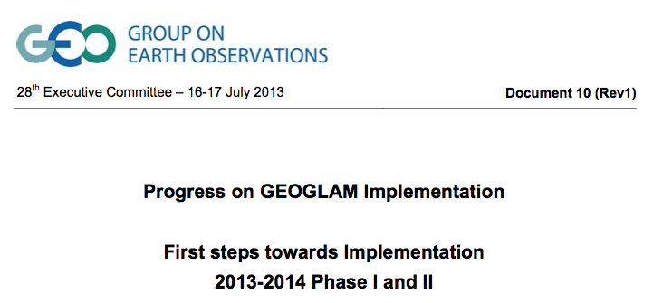
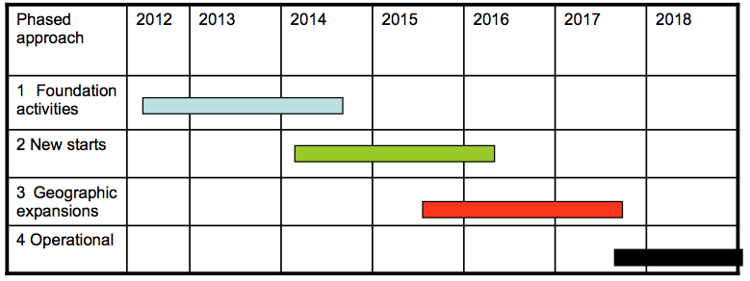
GEOGLAM IP and Phasing
The GEOGLAM IP was endorsed by GEO ExCom in July
Proposes a phased approach
Scope of CEOS to addressed Phase
1 “foundation
activities”

Slide 6

Strategy
In response to 28-34, the CEOS Acquisition Strategy for GEOGLAM Phase 1 has been developed
Presented for
endorsement
by CEOS Plenary
Scope for CEOS support:
2013-2015 (to cover Phase
1 crops ending in 2015)
Coverage area of approximately 1.3 million km² over 20 countries

Slide 7
Strategy Highlights
Address the minimum space data provision necessary for GEOGLAM Phase 1 countries
As agency data policy allows, provide access to the resulting data archives for national agricultural forecast information systems

Slide 8
Strategy Highlights
Responds to current GEOGLAM IP, but anticipates future phases and capacity
Adapts to changes by planning further revisions and editions
Support for the development of a sampling strategy has been included in order to trial approaches to mitigate the burden of future global-scale acquisitions

Slide 9
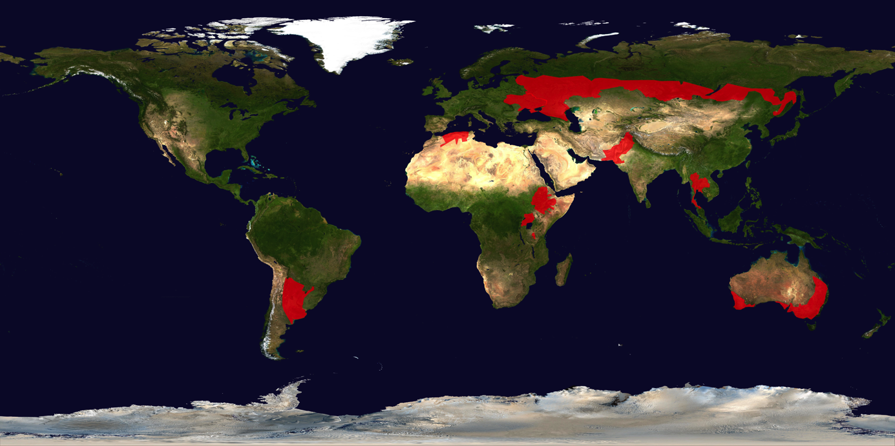
Cropland Extent Coverage
Phase 1: Wheat, Corn, and/or Soy
Cropland Extent

Slide 10
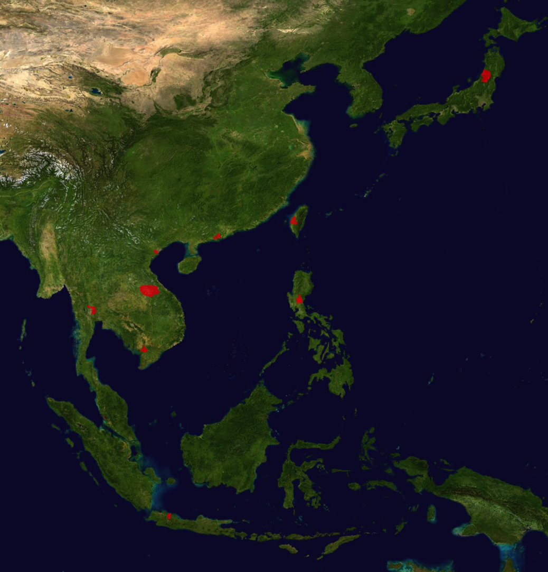
Sampling Coverage
Phase 1: Rice
Sampling (200 x 200 km)
Phase 1A: 4 regions
Phase 1B: +6 regions

Slide 11
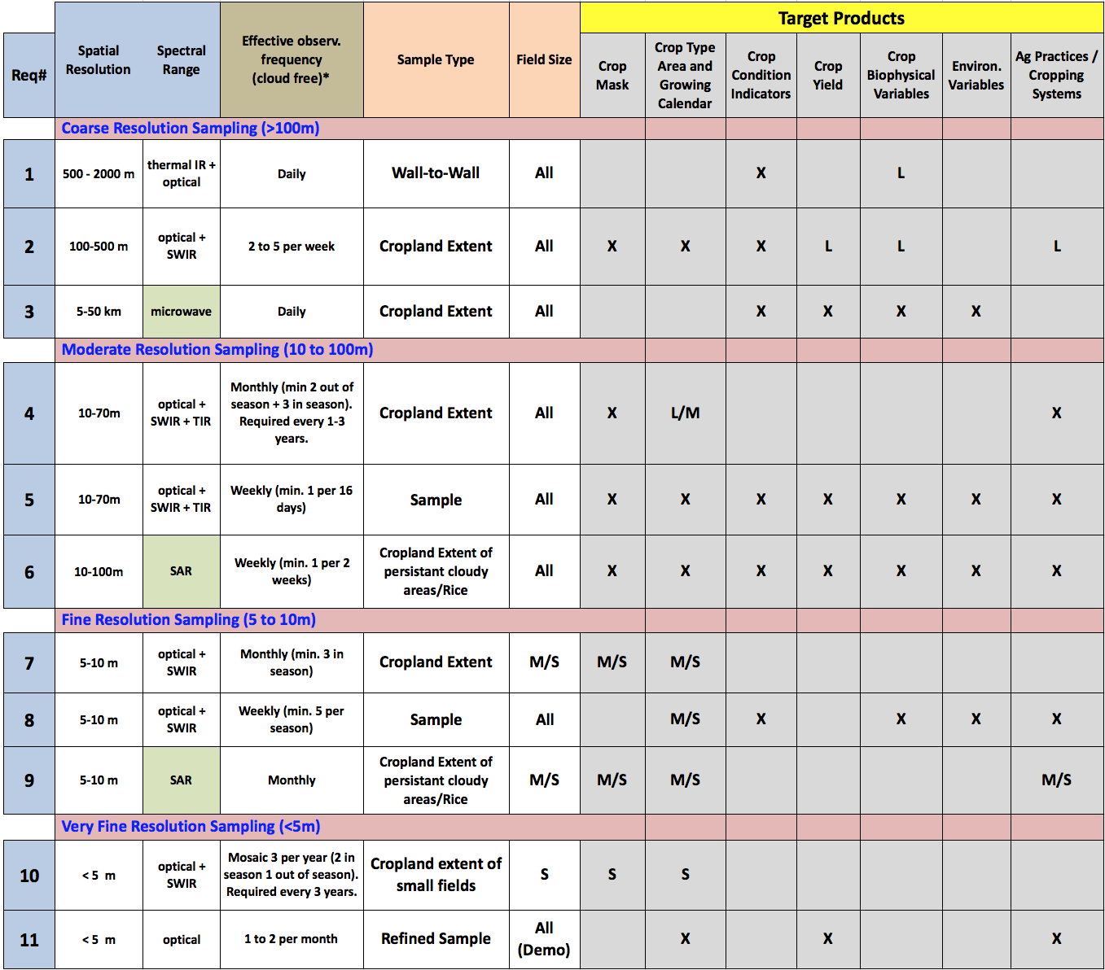
Requirements from Target Products
Target Products
Crop Mask; Crop Type, Area, and Growing Calendar; Crop Condition; Crop Yield; Crop Biophysical Variables; Environmental Variables; Ag Practices / Cropping Systems
Requirements:
1 through 11
By resolution: > 100m; 10-100m; 5-10m; <5m

Slide 12
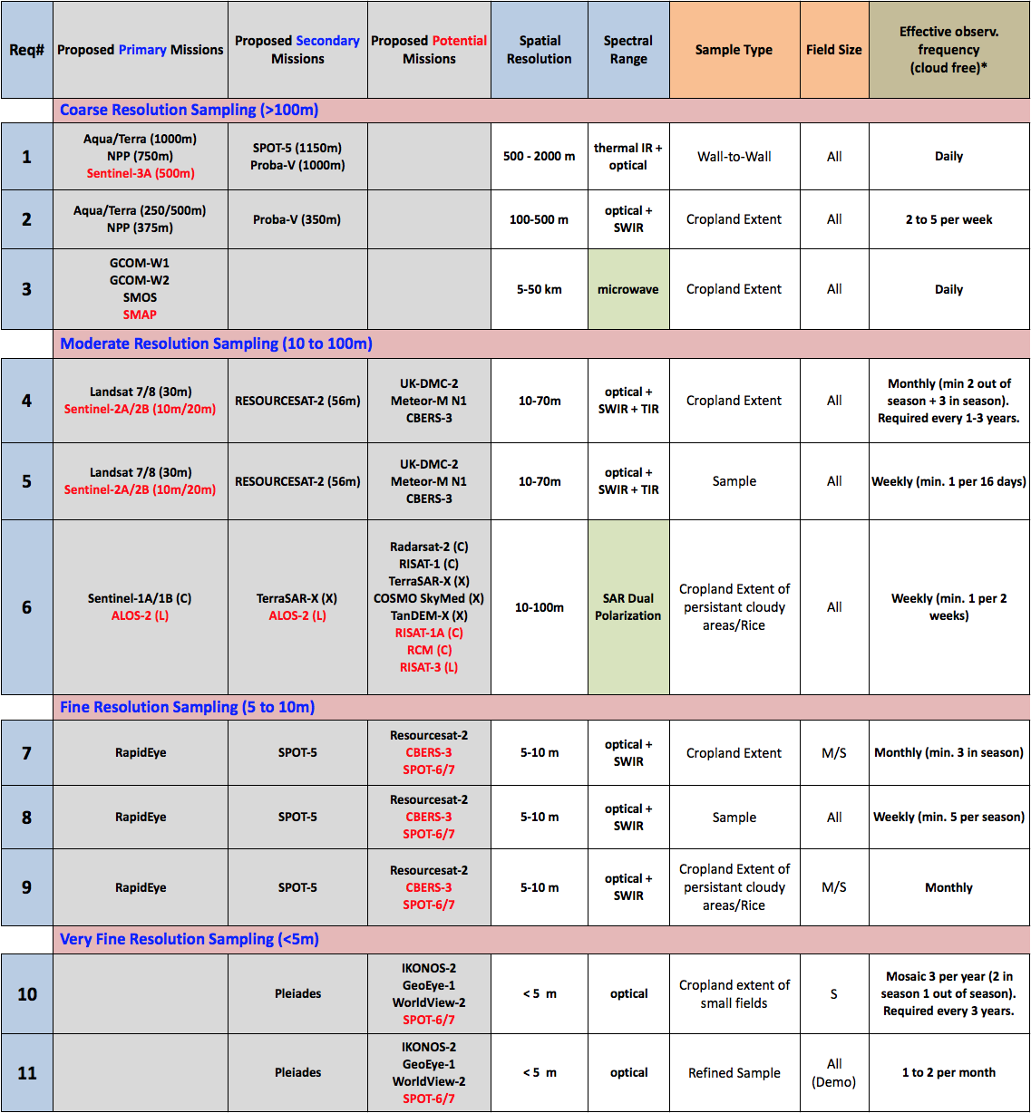
Data Streams from Requirements
Requirements:
1 through 11
By resolution: > 100m; 10-100m; 5-10m; <5m
Primary
Secondary
Potential

Slide 13
Primary, Secondary and Potential
 | Role | Access
Primary | Primary Source for Target Products | Optimally free and open Free for R&D (Phase 1-3). Fee-based for operational phase is possible.
Secondary | Secondary Source for Target Products Evaluated in case Core unavailable and for sampling | Optimally free and open Free or small cost for R&D (Phase 1-3). Fee-based for operational phase is possible.
Potential | To be assessed in Phase 2/3 Tracked but not utilised in Phase 1

Slide 14








Phase 1 Data Streams
Primary
> 100m
GCOM-W
MODIS
10-100m
Landsat
RADARSAT-2 (P1-3)
Sentinel-1
5-10m
RapidEye
Secondary
> 100m
Proba-V
S-NPP
SMOS
SPOT (VEG)
10-100m
ResourceSat-2
RISAT-1
TerraSAR-X
5-10m
SPOT (HRG)
Potential
> 100m
Sentinel-3 (P2-3)
SMAP
10-100m
ALOS-2
CBERS-3
Sentinel-2 (P2-3)
< 5m
Pleiades

Slide 15
Implementation
Call for CEOS agencies to have existing related agency and national initiatives liaise with the ad hoc Working Group
Coordinate adjustment of acquisition plans if required
Facilitate the acquisition of free “evaluation data” from selected missions for preliminary phases

Slide 16
Implementation
Have iterated the strategy with the Primary data supply agencies and they are in support
Ensure synergies with GFOI and existing acquisition strategy for CEOS

Slide 17
Next Steps
Ad hoc Working Group to coordinate implementation of the Strategy
  Provide an update to SIT-29 (April 2014, Tolouse, France)
Provisionally target an update to the Strategy for the 28th CEOS Plenary (October 2014, Tromso, Norway)
  Update on Phase 1 implementation, and potentially propose a Strategy to address GEOGLAM Phase 2
Confirm continuation of the CEOS ad hoc Working Group on GEOGLAM to continue to manage CEOS support and interactions with GEOGLAM

Slide 18
Discussion and Endorsement
Questions?
Discussion.
Call for endorsement of CEOS Acquisition Strategy for GEOGLAM Phase 1

