Slide 1
JAXA Agency Report
Agenda Item: 37
Shizuo YAMAMOTO, JAXA

Slide 2
Japan’s New Basic Plan for Space Policy
Basic Principles
Expansion of Space Utilization
Securing Autonomy
Priority Issues
National Security and Disaster Management
Industrial Development
Progress in Frontier Areas Including Space Science
Four social infrastructures for expanding the use of space and securing autonomy
Positioning Satellite
Remote Sensing Satellite
Communications and Broadcasting Satellite
Space Launching Transportation System
Notes:
A new Basic Space Plan was formulated in Janurary this year.
There are three priority areas, national security and disaster, industrial development and space sciences.

Slide 3
JAXA’s Next Decade Activities
Second Decade of JAXA
Establishment of JAXA
<Oct. 2003>
JAXA’s 10th Anniversary
<Oct. 2013>
Technical Demonstration
Solutions by Innovative Technology
Achievement of Technical Bases
Development and Leadership of Technology
Developing JAXA’s Strength
Accumulation of Application Research
Provision of Value to Society
Notes:
This october marked JAXA’s10 year anniversary.
Dr. Okumra, JAXA President, announced new JAXA philosophy to provide value to sociery by innovative technology.

Slide 4
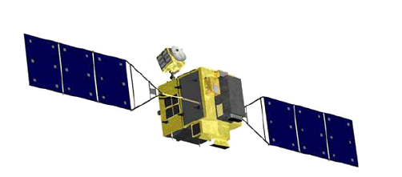
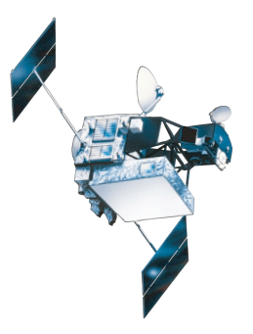
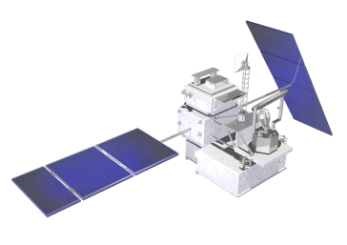
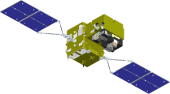
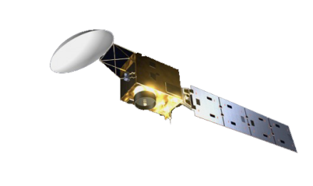
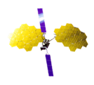
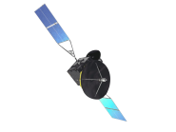
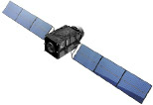
JAXA EO Program (Mid-term plan)
Target | Sensors | 2005 | 2006 | 2007 | 2008 | 2009 | 2010 | 2011 | 2012 | 2013 | 2014 | 2015 | 2016 | 2017 | 2018
Disaster/ Resource | SAR Optical
Climate Change/ Water Cycle Global Warming | Precipitation Radar Microwave Radiometer
 | Optical Sensor Cloud Radar
 | Spectrometer
Communi-cation | Mobile Communication Wideband Internetworking
 | Data Relay
Navigation | Quasi-zenith
JFY
ALOS-2 (SAR)
PALSAR
Next
Generation（Optical）
ALOS
PRISM, AVNIR2 (Optical)
TRMM/PR
GPM/DPR
Aqua/AMSR-E
GCOM-W/ AMSR2
GCOM-C/ SGLI
EarthCARE/CPR
GOSAT
GOSAT-2
ETS-VIII
Next-generation
WINDS
DRTS
DRTS Follow-on
QZSS
Operation
Development
Research
Notes:
This slide shows that flight schedules of our satellite programs. In this mid-term from 2013 to 2017, five satellites will be launched. In this Japanese Fiscal Year, ALOS-2 with L-band SAR and GPM Core Observatory with DPR will be launched. EarthCARE satellite, that is joint program with ESA, will be launched in 2015, and then GCOM-C and GOSAT-2 will be launched.

Slide 5
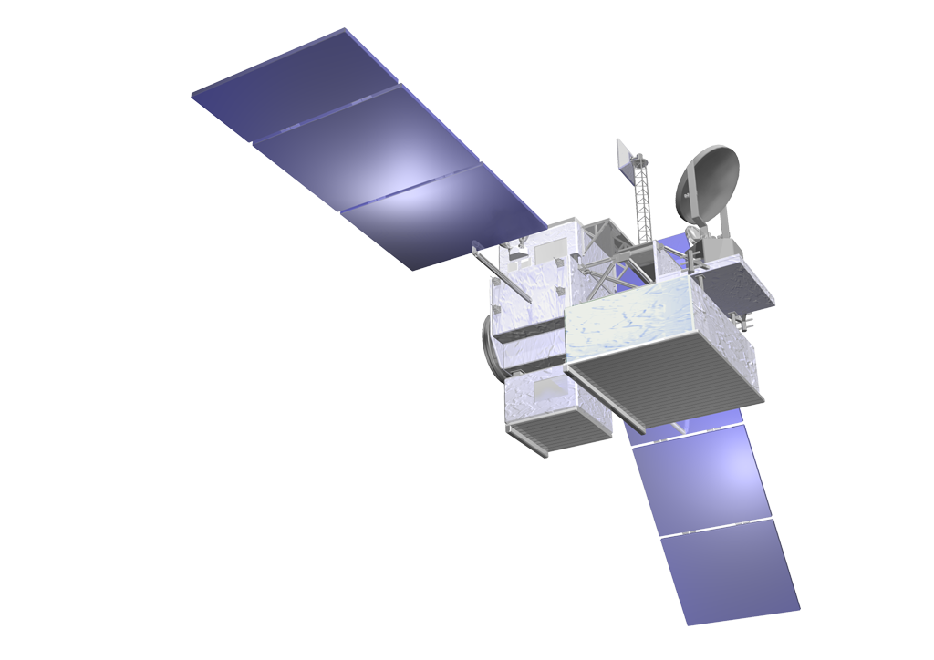
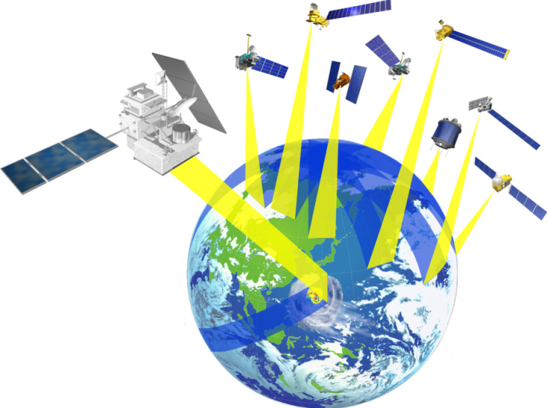
Global Precipitation Measurement (GPM)
To be launched in 2014
Core Satellite (JAXA, NASA)
Dual-frequency Precipitation Radar (DPR)
GPM Microwave Imager (GMI)
GMI (Microwave Imager)
Improve accuracy of weather forecasts
Improve water resource management
KuPR: 13.6GHz radar (phased array)
KaPR: 35.5GHz radar (phased array)
Item | GPM Dual-frequency Precipitation (DPR) |  | TRMM Precipitation Radar
Abbreviation | KuPR | KaPR | PR
Swath Width | 245 km | 120 km | 245 km
Horizontal Resolution | 5 km |  | 5 km
Observation Range | Upto 19km |  | Upto 15km
Minimum Detect Ze (Rainfall Rate) | < 18 dBZ (< 0.5 mm/hr) | < 12 dBZ (< 0.2 mm/hr) | < 23 dBZ (< 0.7 mm/hr)
Core
Satellite
Constellation
Satellites
Notes:
We plan to launch GPM early next year.
We had many typhoons in Japan this year.
The satellite will be ready to monitor next season typhoons and huriccanes in the world.

Slide 6
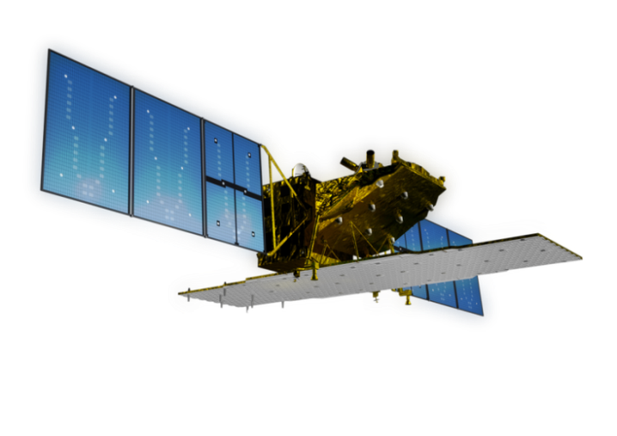
The Advanced Land Observing Satellite-2 (ALOS-2)
"DAICHI-2"
L-band SAR (PALSAR-2)
Wide-swath (Max 490km)
Right-and-left looking
High-resolution (1-3m)
To be launched in 2014
Objectives
Disaster monitoring of damage areas
National land and infrastructure management
Effective monitoring of cultivated areas
Solution of Global Environment Issues, etc
Notes:
JAXA is planning new satellites as a post-ALOS mission, ALOS-2 and next generation optical satellite. ALOS-2 will carry L-band SAR, and next generation optical satellite will carry Panchromatic imager with wide-swath and high-resolution.

Slide 7
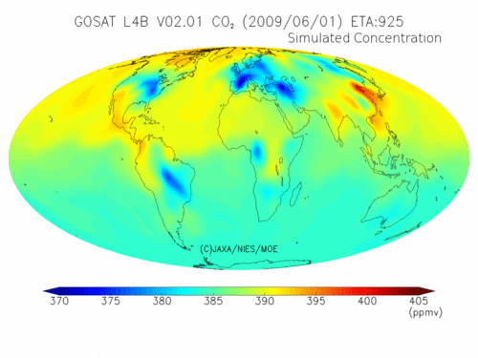
Animation of daily mean of CO₂ concentration
(June 2009 - May 2010, at 800 m altitude)
From NIES GOSAT User Interface Gateway (GUIG)
Notes:
This show CO2 concentration animation based upon GOSAT and in-situ data. Daily data are now available. From this data, we could understand that syberia sinks CO2 more than thought, and CO2 concentration varies from year to year.

Slide 8
JAXA’s High Priority Areas
JAXA will be 2015 CEOS Chair and will place priorities on the following areas.
Disaster
Plan to join CEOS DRM Pilots
Harmonize Sentinel Asia planning with Recovery Observatory study
JAXA to lead a task force to prepare strategies for UN WCDRR in Sendai, March 2015 to position satellite-based DRR in HFA2(2015-2025)
Ocean
Contribute to GEO Blue Planet through CEOS COVERAGE (CEOS Ocean Variables Enabling Research and Applications for GEO)
Partnership with JAMSTEC
Data applications
Ensure end use by end users and ultimate benefits for citizen
Plan to produce 2015 CEOS report on satellite data applications and solution services
Notes:
JAXA will be 2015 CEOS Chair. We are considering the three priority areas toward 2015. They are disaster, ocean and data applications. We would like to take advantage of CEOS activities to promote applications and value to society.

Slide 9
APRSAF-20
Theme:
“Values from Space:
20 Years of Asia-Pacific Experiences”
Dates and venue:
3-6 December, 2013, Hanoi
Co-organizers:
VAST MEXT JAXA
APRSAF Activities:
- SAFE Workshop
- Kibo-ABC Workshop
- Poster Contest
- Water Rocket Event
- Industrial Exhibition
9

