Slide 1
CNES SIT chair planning
Agenda item: 39
Pascale Ultré-Guérard

Slide 2
CNES will endeavour to balance two objectives: managing change while continuing to deliver on CEOS “core business”
Two main themes :
Implementation of CSSII recommendations
Manage the evolution of CEOS as described in the documents approved at this plenary
Implement the processes agreed on
Support GEO in showing concrete progress
Continuity in the development of programmes
Improve access to space based EO data

Slide 3
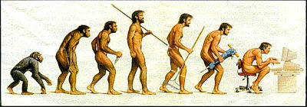
CSSII Outcomes
Evolution not revolution!

Slide 4
CSSII Outcomes
CSSII process has converged
Process has clarified many aspects of CEOS operations
Yesterday’s adoption of documents formalises this
Key points
Organisation’s objectives and goals
Internal organisation and reporting lines for WGs and VCs (CEOS Chair/ SIT Chair)
Decision making (how decisions are made, who decides what, when )
CEOS calendar of major meetings
There remain a few loose ends to tie up …

Slide 5
Support to GEO
Continued high priority for CEOS activities supporting GEO
Climate, Disasters, GFOI, GEOGLAM
Working group priorities
Including on-going work in WGISS & SEO on improving description of and access to space based EO data through the Virtual Constellations

Slide 6
CNES SIT Chair team
SIT Pascale Ultré-Guérard (chair)
Steven Hosford
WGISS Richard Moreno (chair)
Jérôme Gaspéri
CEOS support Mireille Paulin
Danielle Barrère (meetings/logistics)
WGCalVal Patrice Henry
WG Climat, PVC Philippe Veyre
OSTVC, OCRVC Juliette Lambin (OST co-chair)

Slide 7
CNES SIT Chair team
ACVC, CTF Carole Deniel
GEOGLAM Gérard Dedieu
Health PoC Cécile Vignolles
External:
VC interface Jean-Louis Fellous
Meetings/general support Stephen Ward and George Dyke
and last but not least, we would like to have a SIT Vice-Chair (TBF)

Slide 8
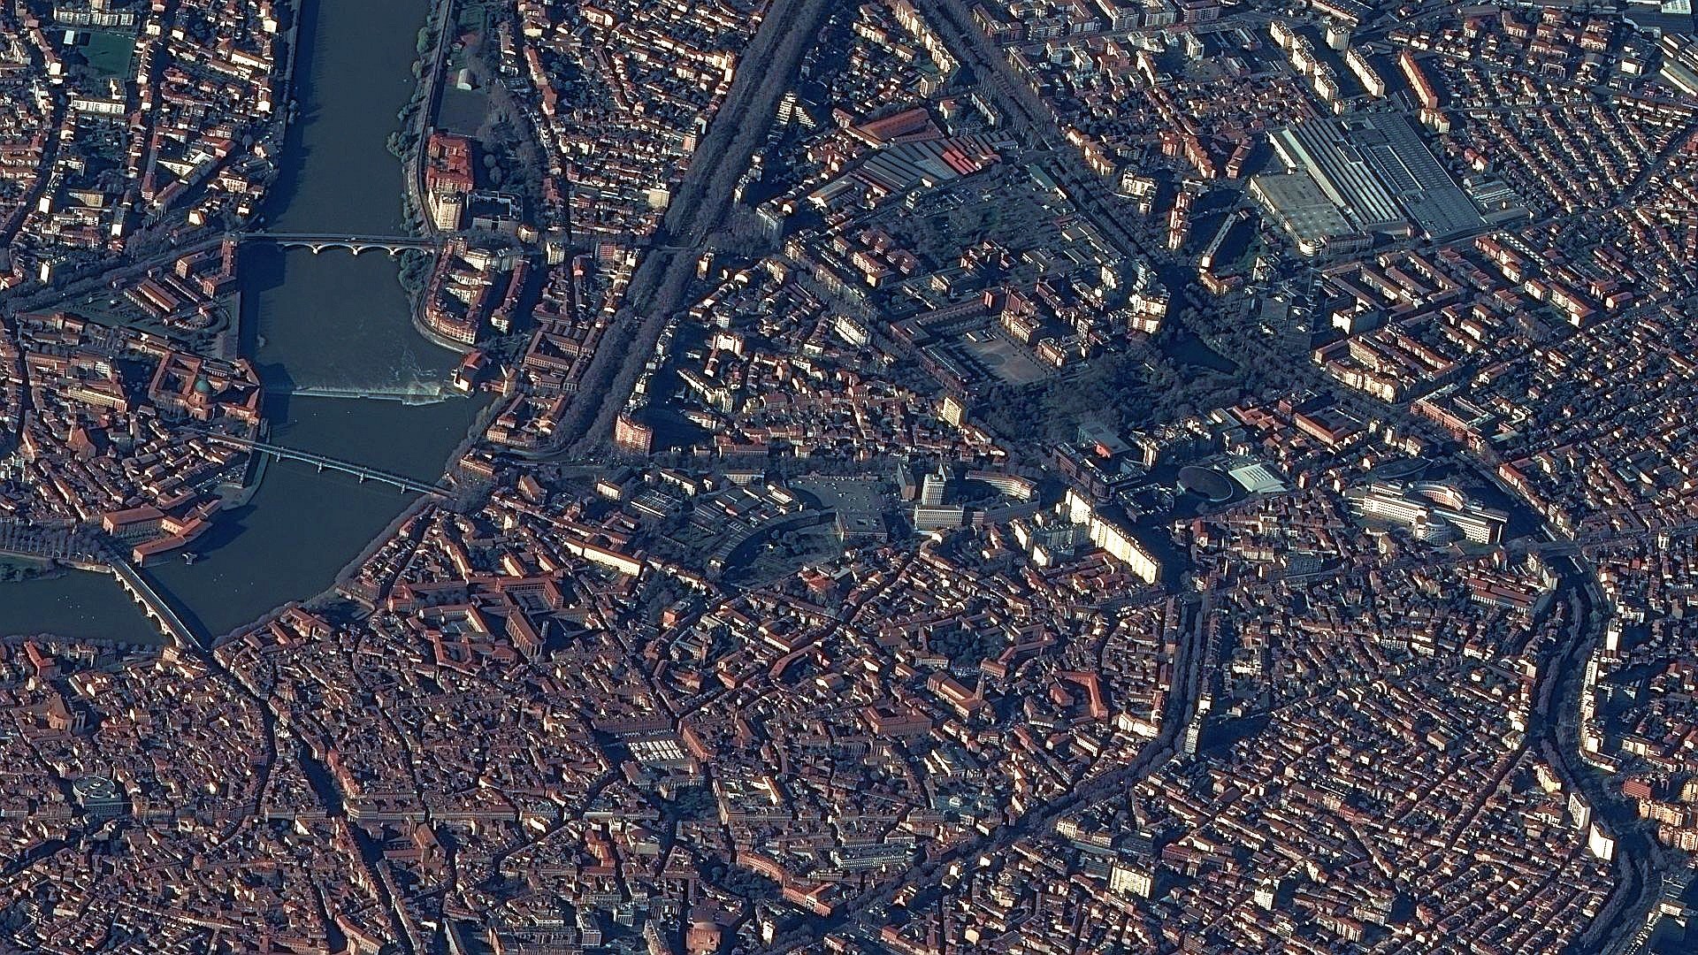
Next major step
Cnes as in-coming SIT Chair is pleased to host the next SIT meeting in Toulouse from 8th to 10th of April 2014
CAREFUL!! Registration information required end of january!

