Slide 1
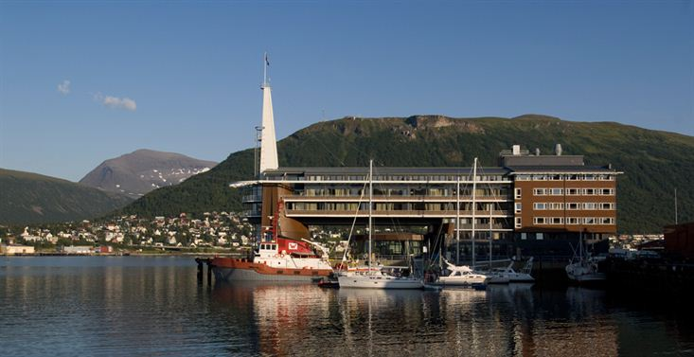

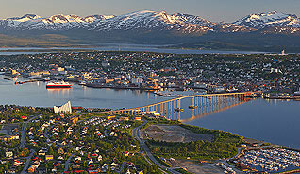
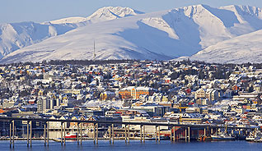
28th CEOS Plenary Session
Barbara J. Ryan
GEO Secretariat
CEOS Plenary, Agenda Item 7
Tromsø, Norway
28-30 October 2014

Slide 2
GEO Objectives
Improve and Coordinate Observation Systems
Advance Broad Open Data Policies/Practices
Foster Increased Use of EO Data and Information
Build Capacity

Slide 3
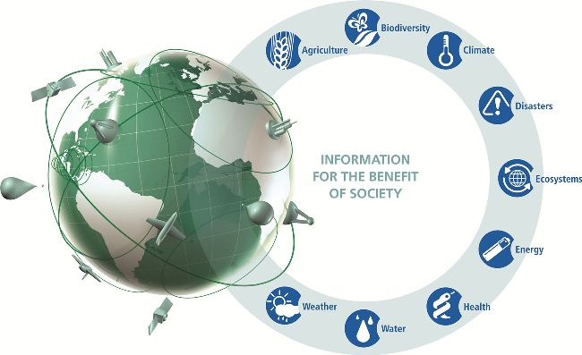
A System of Systems

Slide 4
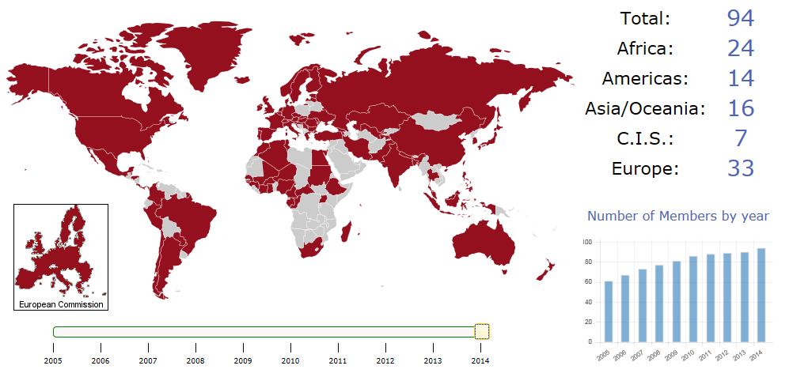
GEO Today
Member Countries
+ 77 Participating Organizations + 10 candidates

Slide 5



































































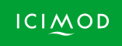




77 Participating Organizations

Slide 6
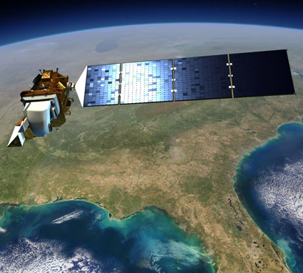
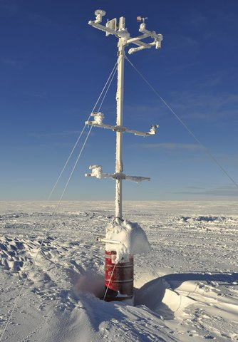
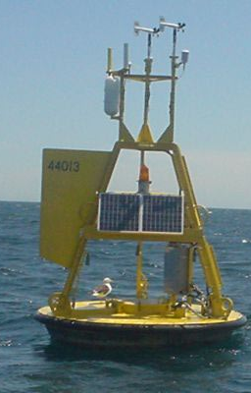
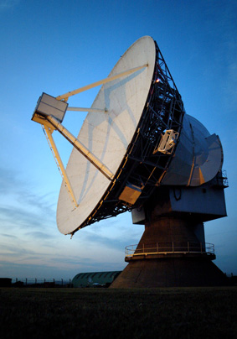
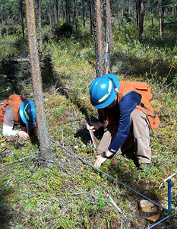
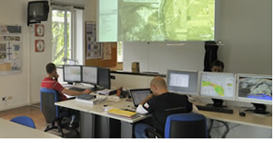
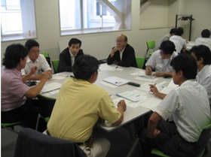
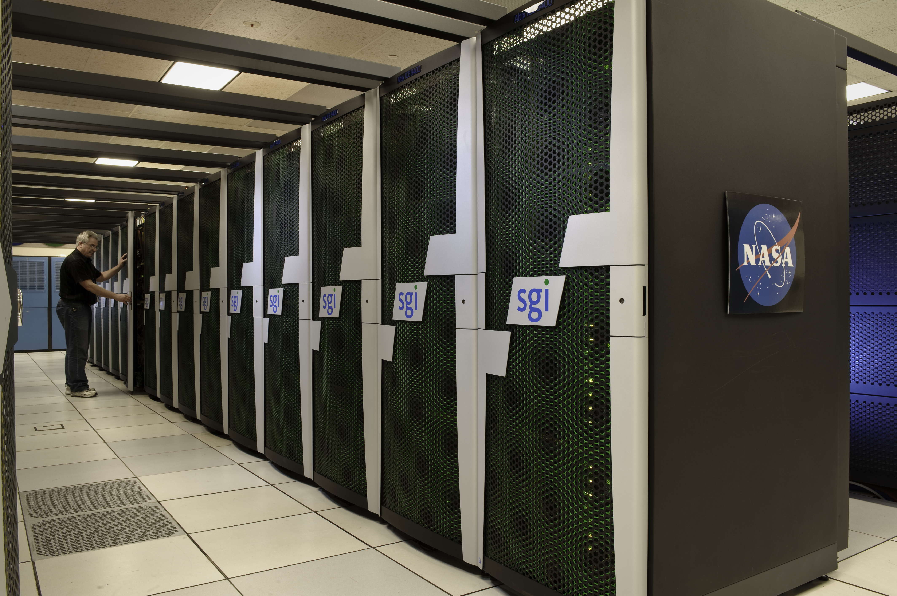
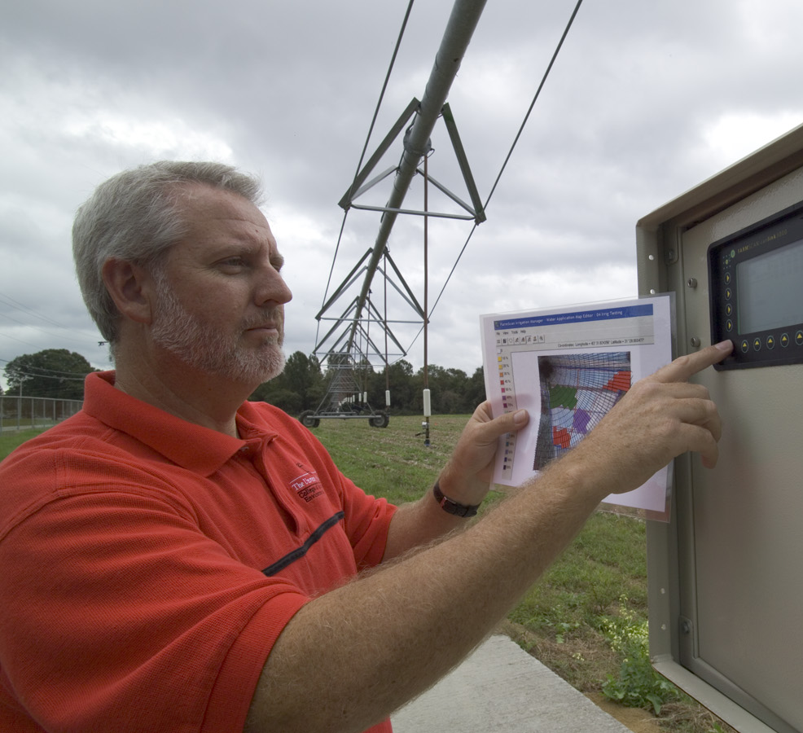
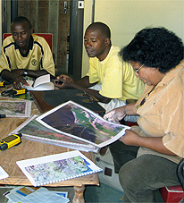
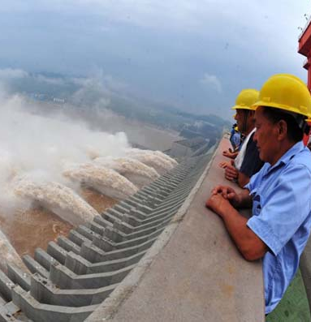
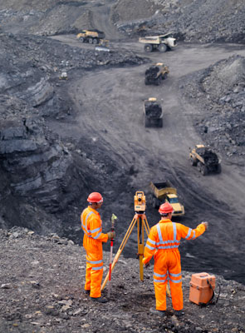
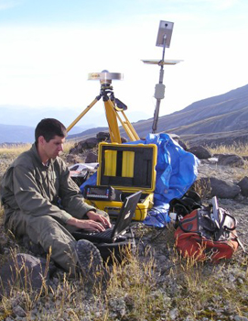
A broad Commercial Sector spans the entire information value chain
Data
providers
Value-Added providers
Downstream
users

Slide 7
Engagement Strategy with Commercial Sector
Private Sector Think Tank (Oct 2013) laid foundation
Two-pronged approach moving forward:
  Increasing Small and Medium Enterprise (SMEs) engagement in GEO (data providers/value-added providers) -- Collaboration with Members and POs to create regional initiatives
  Developing specific downstream user engagements
Notes:
Moving forward in terms of engaging with commercial industry –
The Private Sector Think Tank held last October laid an excellent foundation for strategic engagement with this sector
The Think Tank was designed based on extensive interviews with representatives of numerous companies and industry sectors. The workshop was specifically intended to include both individuals who were intimately familiar with GEO, (including Vice Admiral Lautenbacher, an early GEO leader – as well as two of GEO’s most engaged volunteers) and representatives from industry who were not at all familiar with GEO.
The perspective we gained from those latter individuals was especially valuable in laying out the way forward for interacting with commercial industry.
That way forward is following two paths –
One - finding the most effective means of engaging with specific communities, especially those that have a large SME presence
And two - pursuing targeted conversations with specific companies, beginning with some of those that participated in the Think Tank.
As noted in the paper and discussed previously with ExCom – one of the strongest messages delivered by the Think Tank participants was that GEO must focus on individual industry clusters, rather than attempt to hold the same conversation with the entire commercial sector. Therefore, any forums or workshops GEO puts together should be targeted by industry group.
In addition, GEO’s experiences to date strongly suggests that those forums should be regionally focused and developed in close collaboration with Member governments and POs who can identify potential participants among lists of government contractors and/or organization members.

Slide 8
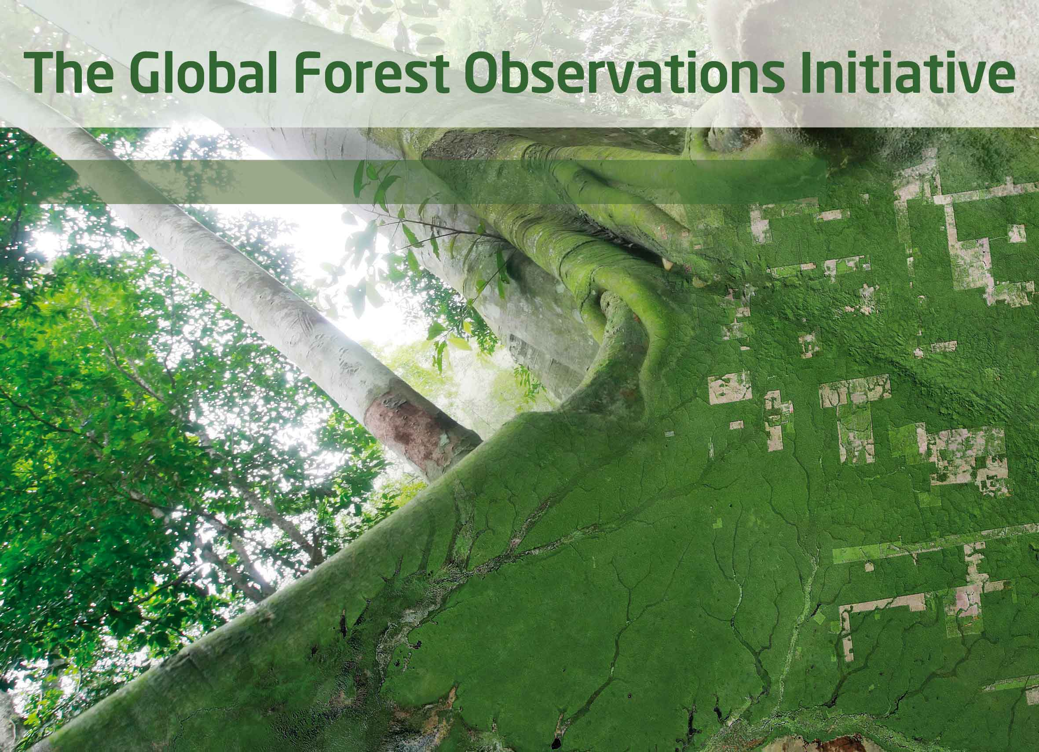
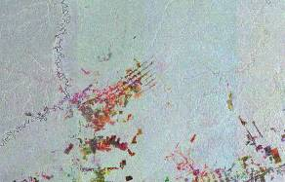
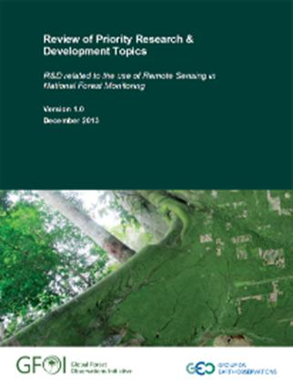
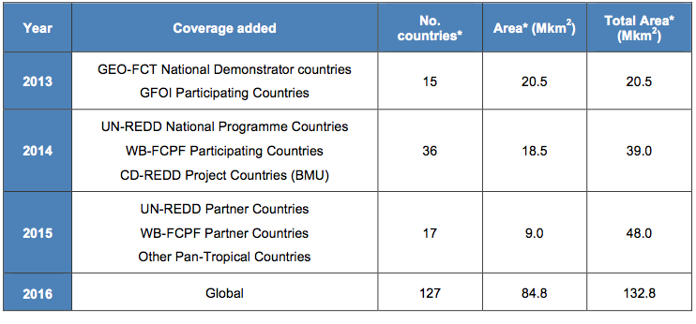
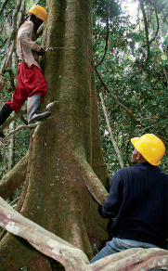


GFOI acquires core satellite data
GFOI reviews and promotes research and development needed to implement national forest monitoring
GFOI provides capacity building in coordination with others such as UN-REDD. Supports the use of satellite and ground data to monitor forests, estimate carbon stocks and greenhouse gas emissions
GFOI Methods and Guidance:
Use of Satellite and Ground data for national forest monitoring and estimation of carbon stocks and greenhouse gas emissions

Slide 9
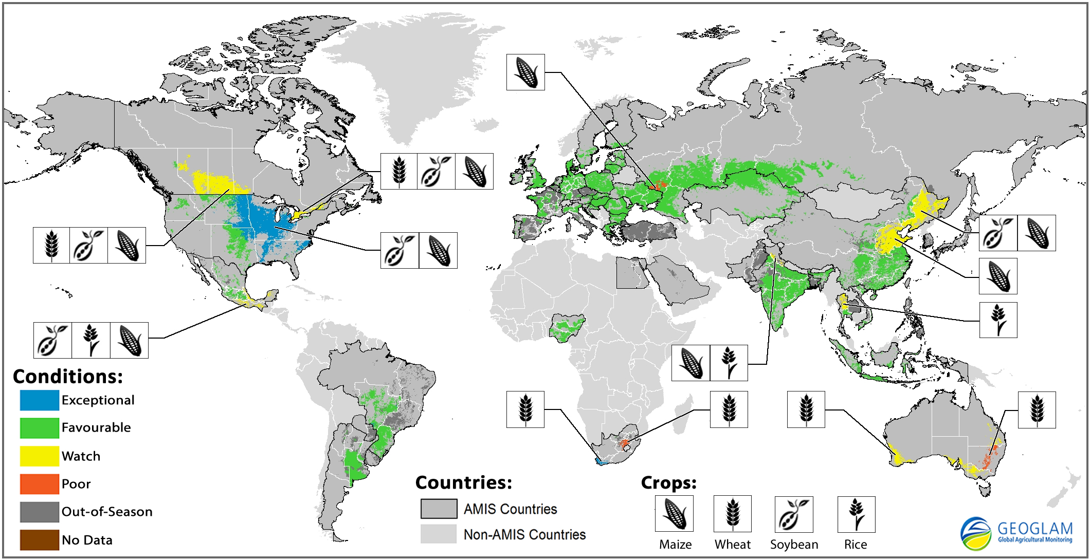
GEOGLAM: What’s New?
Strong GEOGLAM-AMIS collaboration with G20 support
  Delivering monthly
  Crop Monitor to AMIS
  1 Year Operational – new results presentation
Synthesis of Crop Condition – Sep 2014
Emerging collaboration
  Countries at Risk: Early Warning Crop Monitor (EWCM) + Link with UN Secretary General High Level Task Force on Food Security Crisis
Links with CEOS
  Data requirements well-defined; data management services under evaluation
  Progress on provision of SAR imagery (RadarSat2, Sentinel-1, ALOS-2..), in particular for rice monitoring (AsiaRiCE and JECAM) and SDMS for AsiaRiCE
  GEOGLAM-JECAM and AsiaRiCE request for multiple user data licenses – enhancing data access among JECAM sites and AsiaRiCE sites

Slide 10
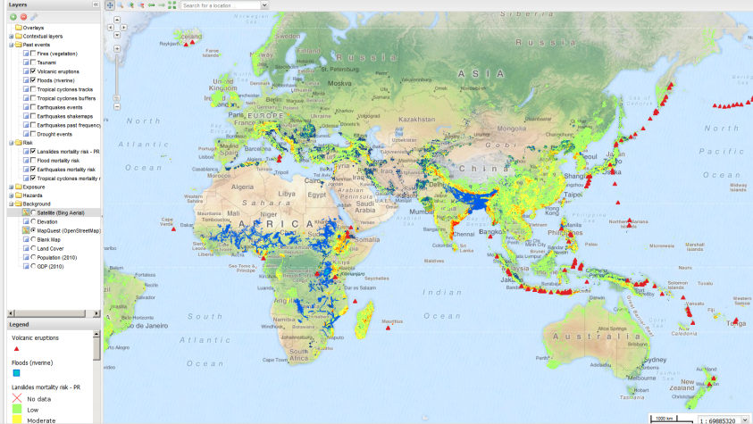
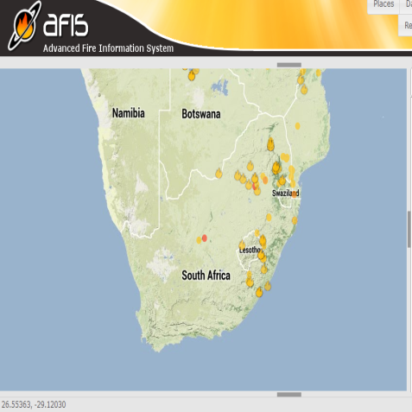
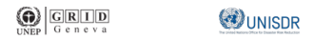
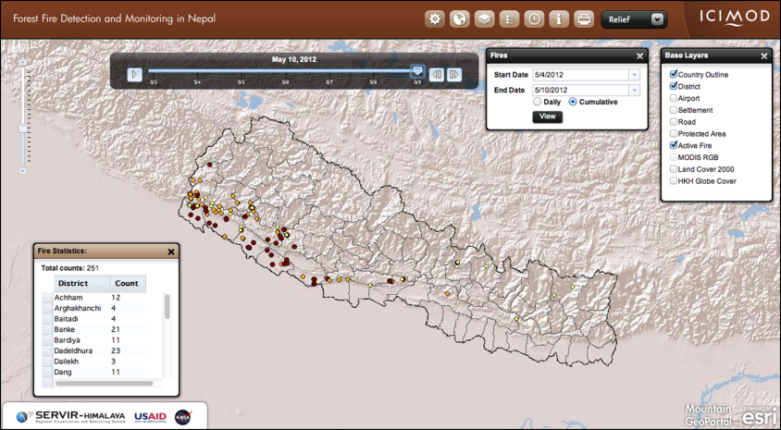
Disasters
Rapid & Open Disasters Information
(Canada, EC, Italy, South Africa, Turkey, USA, CEOS, EPOS, ESA, GEM, ICIMOD, UNISDR, UNEP)
* Global Risk Data Platform
* Fire Information (AFIS)
* SERVIR-Himalaya
(Nepal, Bangladesh)
* CEOS Pilots (Floods,
Volcanoes & E-quakes)
* Universal access –
Int’l Charter
* European Supersites

Slide 11

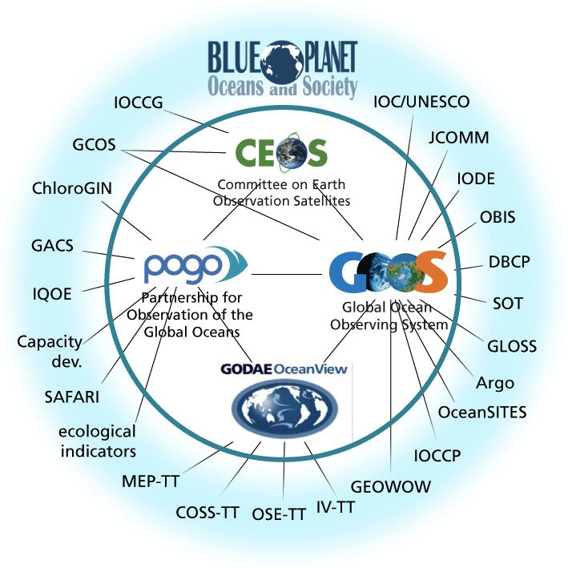


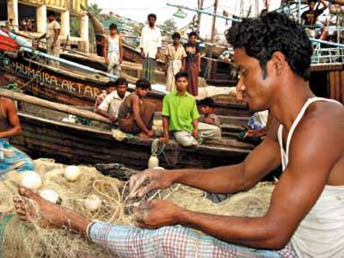




Bridging Ocean Communities
(Canada, EC, UK, USA, CEOS, GCOS, GOOS, IOC, POGO, UNESCO, WMO)
* Ocean database (OBIS;
33 million species)
* Coastal and shelf-seas
forecast coordination
* Blue Planet White Paper
* Workshops on fishery apps
* Scholars trained (POGO)
* New Transatlantic Initiative

Slide 12
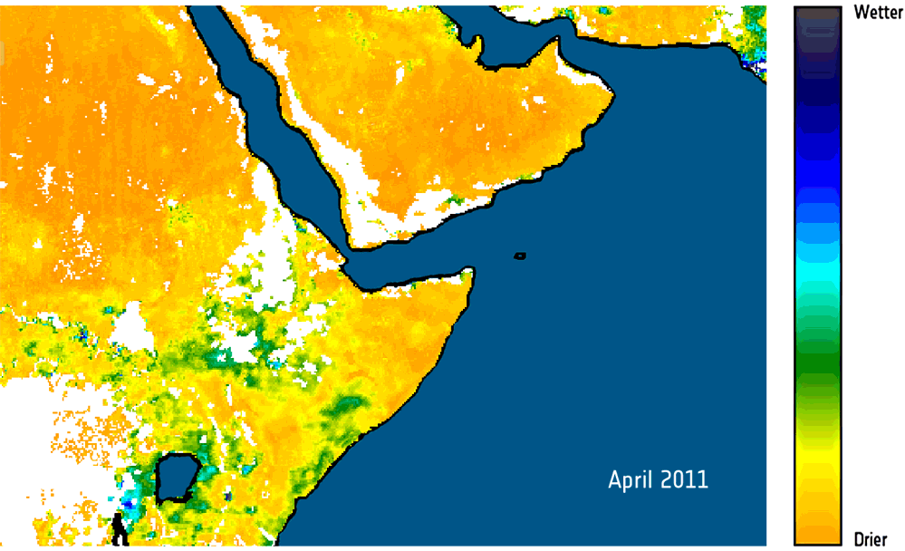
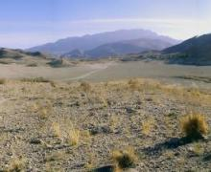
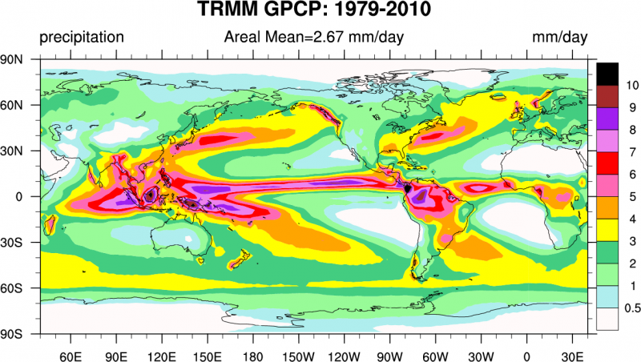
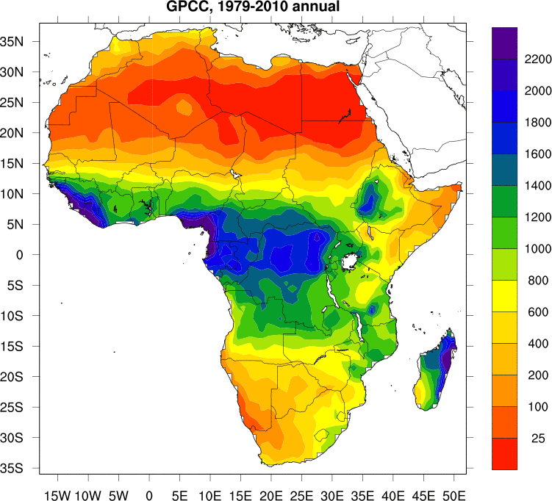
Water
Actionable Water Information
(Austria, EC, Germany, Japan, USA,
CEOS, ESA, WCRP, WMO)
Soil Moisture (SMOS, ESA)
* Global high-res precipitation
datasets 1979-2010
* New SMOS products & soil
moisture datasets 1978-2010
* Satellite data validation
* Global Drought Information
System underway
* Asian/African Water Cycle
Initiative
Precip

Slide 13
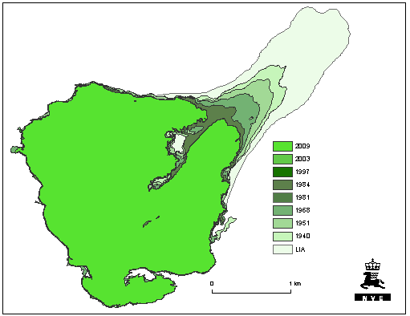
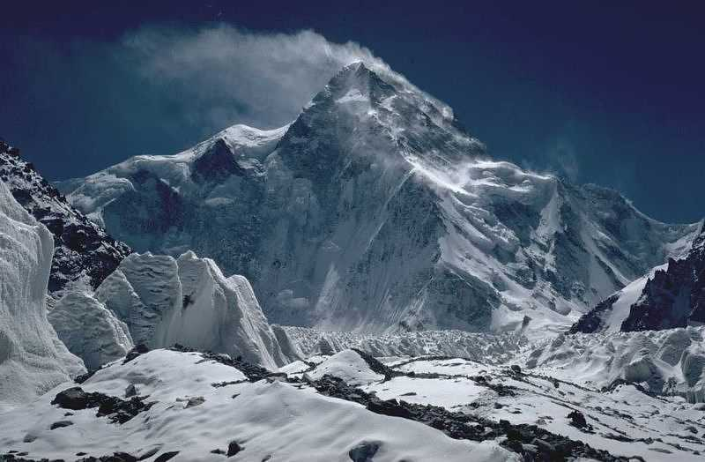
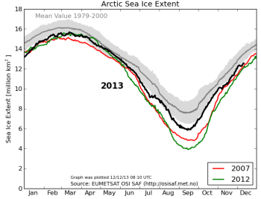
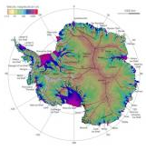
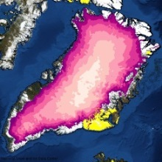
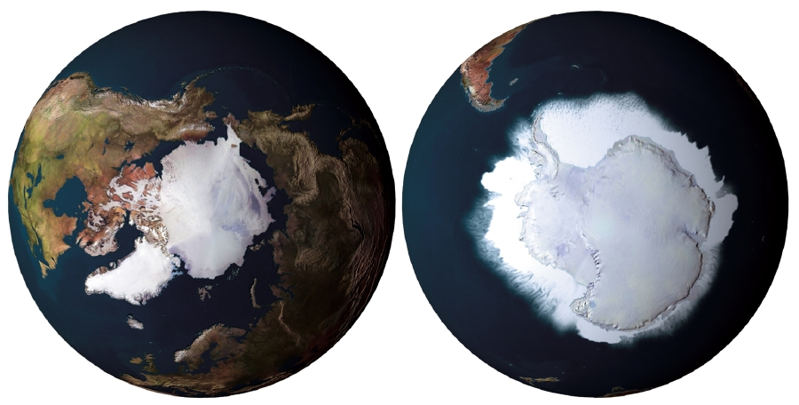








Cold Regions
Cold Regions Information
(Canada, China, Denmark, Germany, India, Italy, Japan, Norway, Switzerland, USA, ICIMOD, WMO)
* Building momentum
* Many partners incl.
GCW, NSIDC, CrDAP
SAON, CryoClim, CCIN
* Third Pole Env Database
* CryoClim monitoring service
* Access to cold region info
through GEOSS Portal

Slide 14
AfriGEOSS
AfriGEOSS Implementation Plan for approval by GEO-XI
Working Group includes: Gabon, Ghana, Egypt, Madagascar, Morocco, Nigeria, Senegal, South Africa, AARSE, EIS Africa, RCMRD and UNECA
6 Areas of Activity
    Regional and Continental Coordination
    User Needs and Applications
    Data and Infrastructure
    Human Capital Development
    Resource Mobilisation
    Communication and Outreach
Demonstrate, with activities, connected to the GEO Work Plan, how AfriGEOSS can add value to existing continental efforts

Slide 15
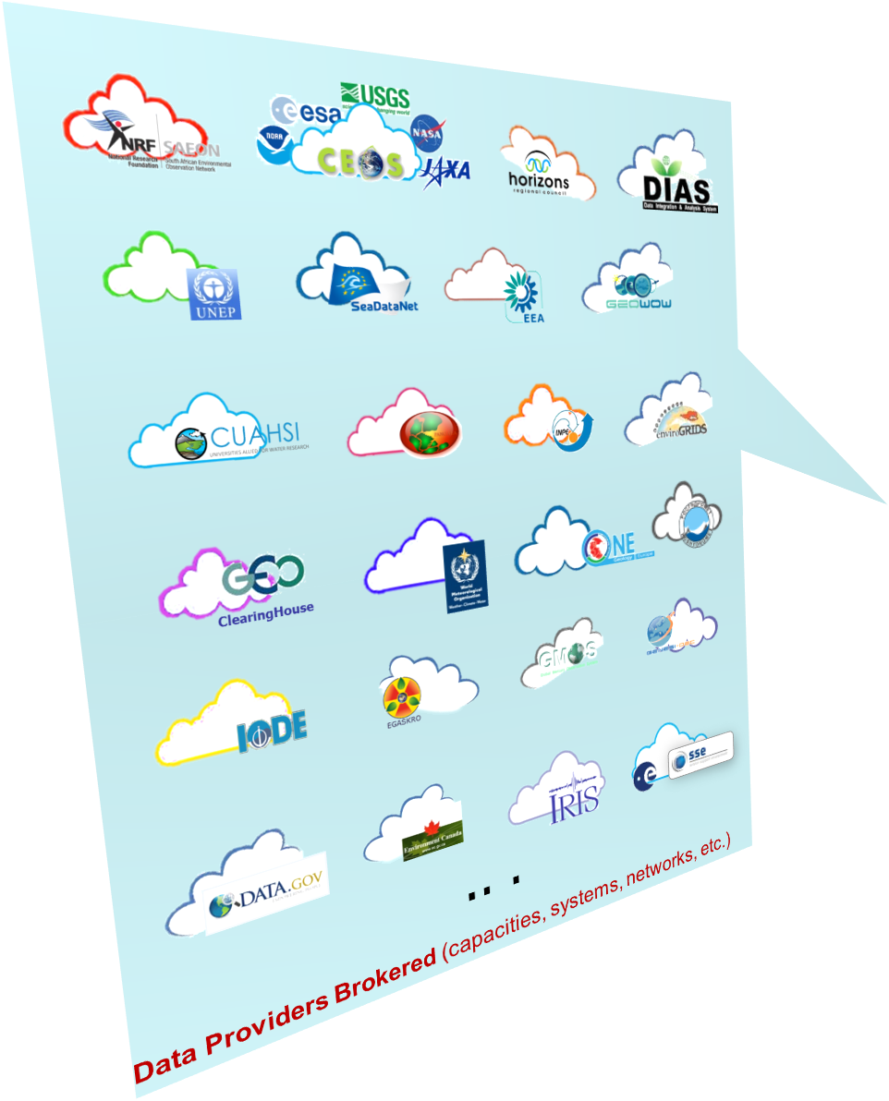
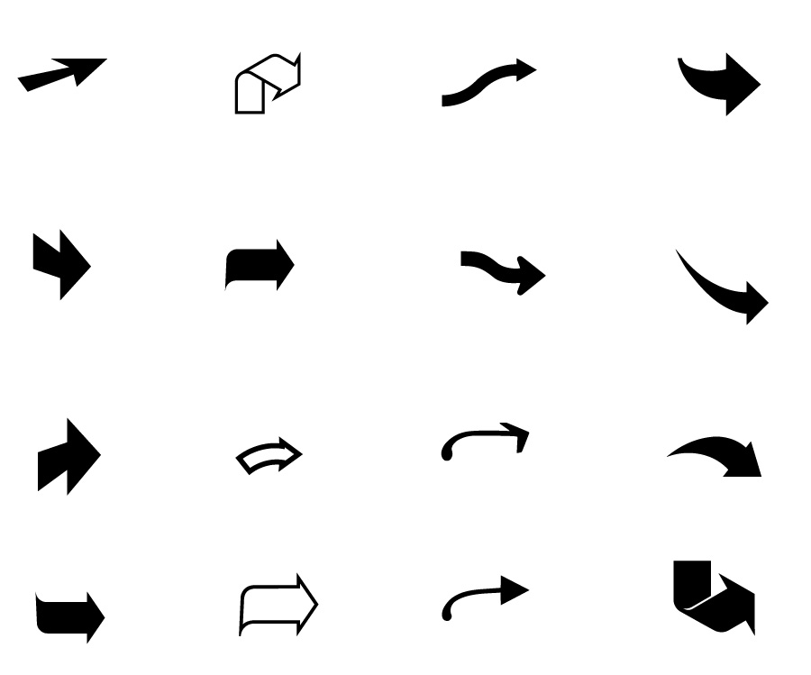

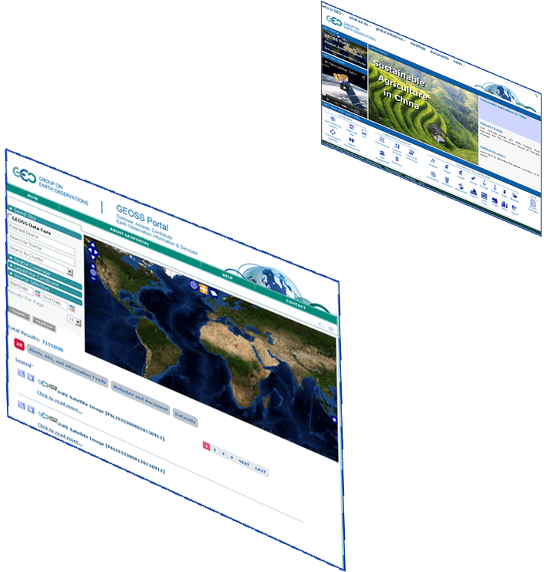




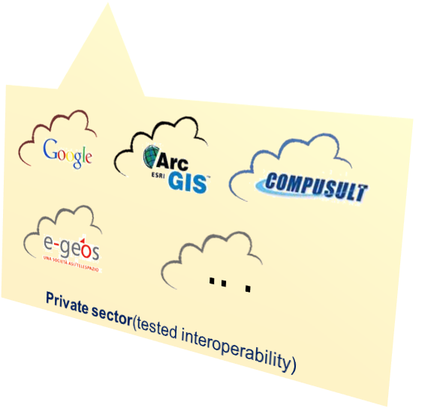
GEOSS Common Infrastructure
GEO Web
GEOSS Portal
GEO
DAB
Notes:
Added GEOSS Clearinghouse, IDN, and CWIC, moved NOAA, added JAXA

Slide 16

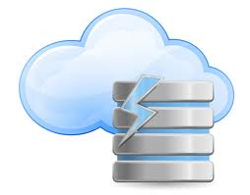










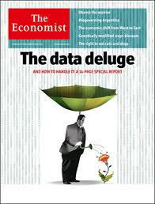
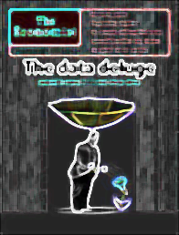
Current Assets
More than 35 brokered data providers – capacities, systems, Communities
.. .
Publish
About 14 Million (2 Million GEOSS Data Core) potentially Discoverable and Accessible resources (mix of data collections, datasets and individual images)
.. .
Contain [source: data providers]
.. .
More than 75 Million (more than 50 Million GEOSS Data Core) potentially Discoverable and Accessible resources (e.g. satellite scenes, raingauge records)
Resources
Notes:
As of today, we have currently brokered 20 providers already.
Through the GEOSS Portal, totally 7Million resources can be potentially discoverable and accessible and of which 1.2Million are GEOSS DataCORE.
These number contains different level of mixed of data collections, datasets and/or individual images.
Those number contains more than 65Million individual resources which includes each satellite scene, raingauge record and many other types of data.
And of which 50 Million are GEOSS DataCORE.
In the last plenary in Iguaz Brazil, we reported 15Million individual resources accessible.
Even at that time, It was a huge increase the number of resources since several years. And now since that time, more than 50Million individual data brokered and are being available.
This contribution mainly came from CEOS space agencies.
We are getting recognize GEO will face so called Data Deluge (Big Data Flood) or already facing.
16

Slide 17


Open worldwide to any non-commercial entity, individual or team (students, scientists and developers) wanting to unleash the power of Earth Observation data
to allow us all to make smarter decisions.
Be inspired, unleash the power and win cash prizes ($20,000 USD).
www.geoappathon.org
@geosec2025 #geoappathon

Slide 18

GEO-XI Plenary
13-14 November 2014
Geneva
Thank you to Espen Volden & ESA
and Kerry Sawyer & NOAA
Welcome (back) to Osamu Ochiai & JAXA
and Marie-Josee Bourassa & CSA
Welcome to Gary Geller & NASA
http://www.earthobservations.org

