Slide 1
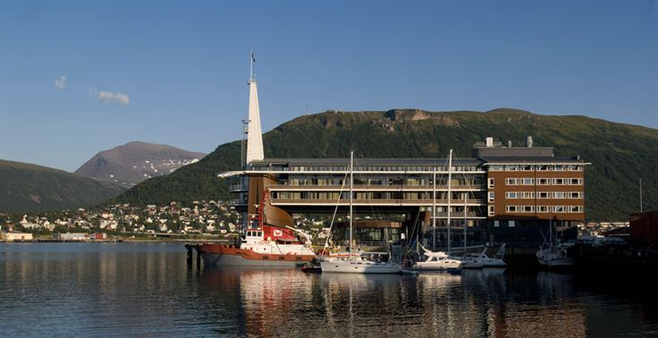
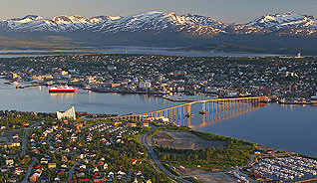
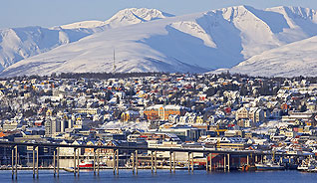
28th CEOS Plenary Session
Alain Ratier
EUMETSAT
CEOS Plenary, Agenda Item 28
Tromsø, Norway 28-30 October 2014

Slide 2
Climate Symposium - Overview
“Climate Research and Earth Observation from Space – Climate Information for Decision Making”
Organised by EUMETSAT and WCRP, on 13-17 October, in Darmstadt, Germany, with support of EU, ESA and other CEOS agencies
Around 500 participants from 50 countries, representing over 200 organisations, with another 500 following remotely via “live-streaming”
Opening speeches from German Space Minister, Brigitte Zypries, other high-level German officials, Michel Jarraud, WMO Secretary-General and Barbara Ryan, GEO Director
For those who missed it: full proceedings, including streaming and presentations, can be found at:
http://www.theclimatesymposium2014.com

Slide 3
Climate Symposium - Programme
Programme established by an international Science Programme Committee, structured around the 6 “Grand Science Challenges” of WCRP:
Clouds, Circulation and Climate Sensitivity
The Changing Water Cycle
Cryosphere in a Warming World
Ocean Circulation and Regional Sea Level Rise
Prediction and Attribution of Extremes: from Climate to Weather
Regional Climate Variability and Change: Enabling Climate Services
These Grand Challenges were placed in the context of the 5th Assessment Report of the IPCC presented in the Opening Session by Thomas Stocker (IPCC Vice-Chair)

Slide 4
Climate Symposium – Programme
Dedicated sessions on each Grand Challenge addressed the specific need for, and role of, Climate Observations from Space
Round table involving high-level representatives from the Energy, Transport and Insurance sectors addressed the needs of decision makers for climate information
CEOS agencies had the possibility to present showcases using the NASA Hyperwall kindly provided by NASA – ESA, NASA, JAXA, JMA, NSC, EUMETSAT and NOAA availed of this opportunity

Slide 5
Climate Symposium – Programme
A dedicated Early Career Scientist Programme promoted dialogue with senior scientists/representatives of space agencies: coffee break discussions and poster awards
The Symposium concluded with:
A presentation of the findings of each Grand Challenge session
An introduction of the Architecture for climate monitoring from space and the CEOS-CMS JWG on Climate
A final round table moderated by GCOS, where representatives of operational and research space agencies and of the European Commission had the opportunity to offer a preliminary response

Slide 6
Climate Symposium – Some Outcomes
Consensus that the thermodynamic aspects of the Grand Challenges are generally better understood than the dynamic aspects: circulation is a common uncertainty across several Grand Challenges
The broad range of needs and priorities formulated by the research community for space-based observations can only be fulfilled through international cooperation, in particular through the Architecture for Climate Monitoring from Space coordinated by the CEOS-CGMS WG on Climate

Slide 7
Climate Symposium – Some Outcomes
Links between Grand Challenges and their needs/ priorities for space-based observations and Climate Data Records should be further developed
Grand Challenges need to be more explicitly traced to associated Societal Benefits
This could support decisions on the funding of new observation systems

Slide 8
Climate Symposium – Some Outcomes
The unique potential of the combination of multi-satellite operational programmes and research missions was highlighted, noting that:
The continuation of the high precision ocean altimetry measurements, expected from the Sentinel-6/Jason-CS mission, is a top priority of several Grand Challenges
Some research missions (e.g. GRACE, Active atmospheric sounding, GPM…) need to be continued beyond one single satellite to consolidate understanding of key climate processes or brought to operational status

Slide 9
Climate Symposium – Next Steps
A consolidated set of outcomes of the Symposium will be formulated by the Science Programme Committee
Need to consider the most appropriate process for conveying relevant outcomes to COP-21 in Paris at the end of 2015 and to GCOS

