Slide 1
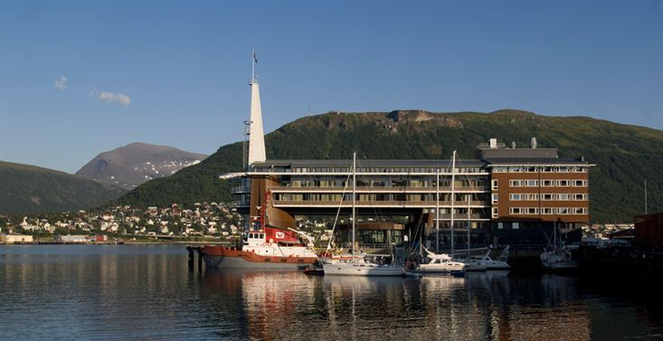
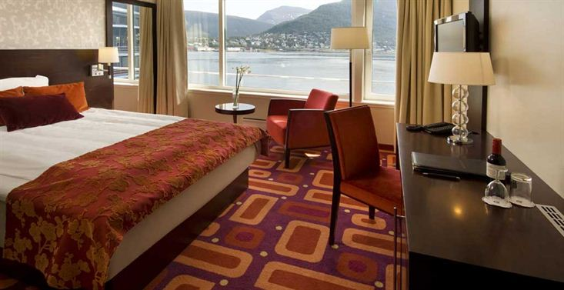
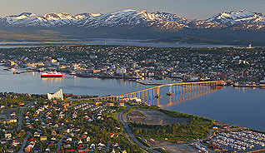
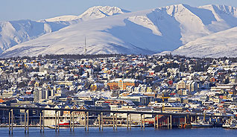
28th CEOS Plenary Session CEOS Preparations for SBSTA-41
John Bates, Chair CEOS-CGMS Working Group on Climate
NOAA
CEOS Plenary, Agenda Item 29
Tromsø, Norway 28-30 October 2014

Slide 2
CEOS Input to SBSTA-41
Input to UNFCCC Subsidiary Body on Scientific and Technological Advice – Research and Systematic Observations (SBSTA-41 RSO)
CEOS was invited to present following our presentation at SBSTA-27 in 2012
The SBSTA expressed its appreciation to CEOS for its update on progress made by space agencies providing global observations in their coordinated response to relevant needs of the Convention. It noted the importance of continuing and sustaining satellite observations on a long-term basis, and the role of CEOS in promoting full and open data sharing, in order to support the work under the Convention. It invited CEOS to provide, by SBSTA 41, an updated report on progress made by space agencies providing global observations in their coordinated response to relevant needs of the Convention.
SBSTA-41 meets at the United Nations Climate Change Conference in Lima, Peru 1-6 December 2013

Slide 3
CEOS Input to SBSTA-41
Content was provided to UNFCCC 7 October
Written summary of COES-CGMS climate activities
Summary of Architecture for Climate Monitoring Report and update of formation of the Joint WGClimate and work plan
Summary of CEOS Strategy for Carbon Observations from Space
A one-page summary presented by the CEOS Chair National Delegation (JAXA, hence the Japanese WMO Permanent Representative delegation) at the opening session of SBSTA-41 on 1 December
Draft of summary is being reviewed

