Slide 1
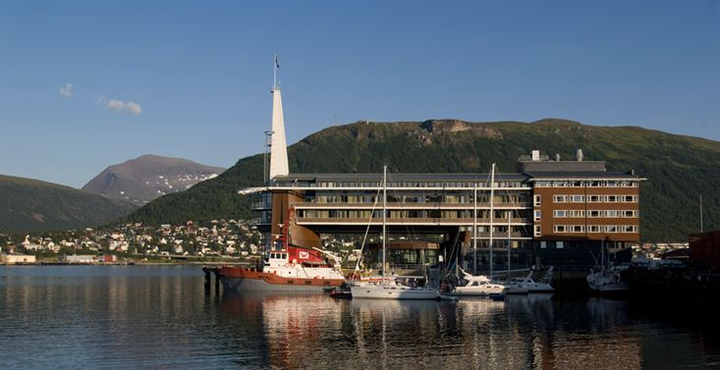
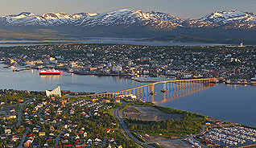
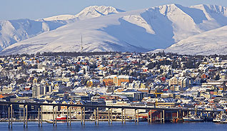
Extension of Mandates of Ad Hoc Initiatives
Kerry Ann Sawyer
CEOS Executive Officer (NOAA)
CEOS Plenary, Agenda Item 36
Tromsø, Norway 28-30 October 2014

Slide 2
Governance and Processes Document
In the event that the permanent mechanisms…are judged to be insufficient for CEOS to undertake a particular activity, the capability exists for the Plenary to create Ad Hoc Teams. The Plenary assigns short-term objectives to each Ad Hoc Team and defines the team lifetime when the team is created. The primary reporting path for an Ad Hoc Team is either to the CEOS Chair or to the SIT Chair, as designated by the Plenary according to the purpose and function of the Ad Hoc Team. Annually, the Plenary reviews all Ad Hoc Teams for continuation, termination, or transition to a permanent mechanism.
Satellites, understanding below from above

Slide 3
Continuation
Ad Hoc Space Data Coordination Group (SDCG) for the Global Forest Observation Initiative (GFOI)
Created 2011
CONTINUATION
Reports to CEOS Chair
SDCG Leads: Ake Rosenqvist (NSC) (until 31 Dec – then vacant), Frank Martin Seifert (ESA), Eugene Fosnight (USGS) (retiring)
SDCG Exec: Stephen Ward and George Dyke (Dept Envt, Aus)
CEOS Ad Hoc Working Group on GEOGLAM
Created 2011
CONTINUATION
Reports to CEOS Chair
Leads: Brad Doorn (NASA) and Selma Cherchali (CNES)
GEOGLAM Exec: George Dyke (CSIRO) and Brian Killough (NASA)
Previously endorsed under Agenda 20
CEOS - Viewing Earth, Serving Humanity

Slide 4
Endorsement? Cessation?
Ad Hoc Carbon Strategy Implementation Study Team (CSIST)
Created April 2014
ENDORSEMENT or CESSATION; mandate and term was expected to be complete but per discussion, should continue until SIT-30
Report to SIT Chair
Leads: Stephen Briggs (ESA) and Kerry Sawyer (CEO)
Inspiring Earth Future from space

Slide 5
Endorsement
Ad Hoc Water Strategy Implementation Study Team (WSIST)
Created September 2014
ENDORSEMENT
Reports to SIT Chair
Leads: TBD
Serving humanity, society, and industry

Slide 6
Any New Ad Hoc Teams??
CEOS, an Earth ahead

