Slide 1
Committee on Earth Observation Satellites
AGEOS
Gabonese Agency for Studies and Observations from Space
Aboubakar Mambimba Ndjoungui
Project Manager
aboubakar.mambimba@ageos.ga
Plenary Agenda Item #3
29th CEOS Plenary
Kyoto International Conference Center
Kyoto, Japan
5 – 6 November 2015

Slide 2
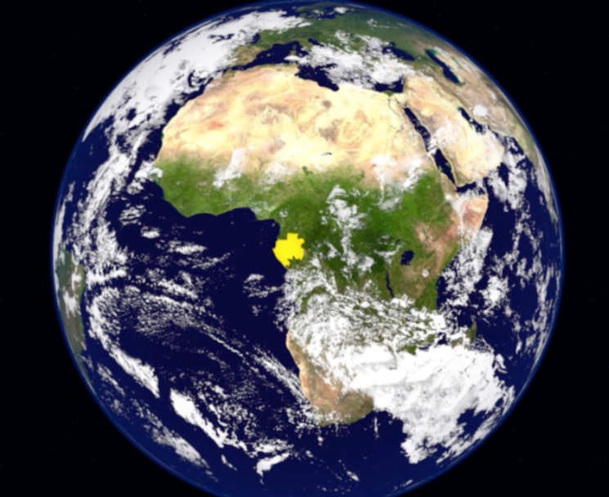
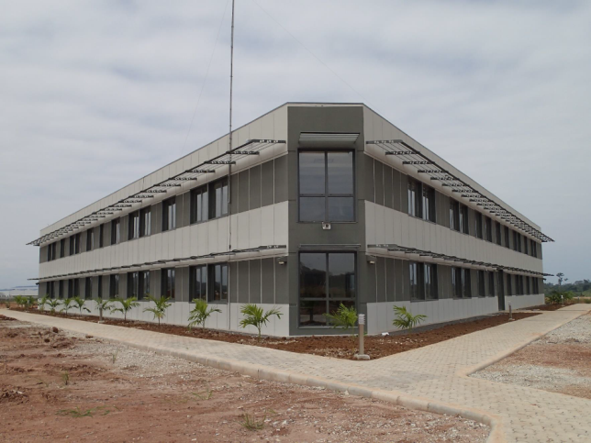
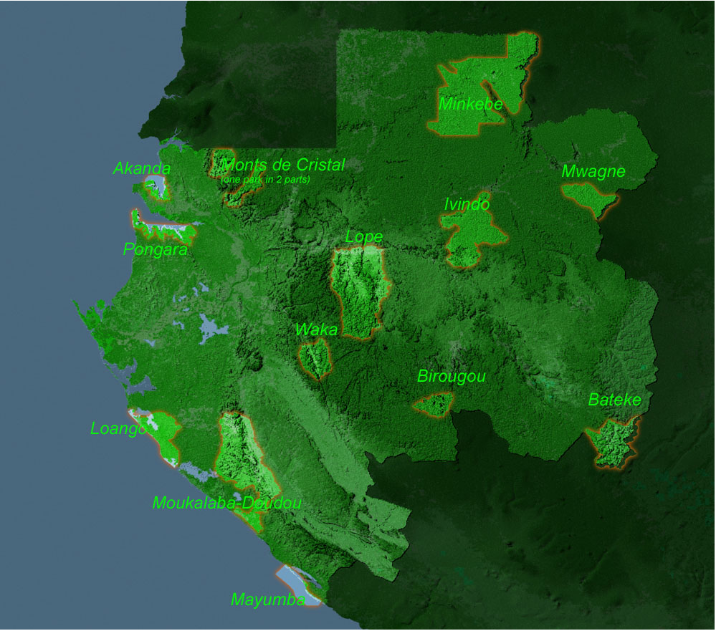
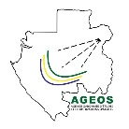
Agenda
- AGEOS overview
- Qualification for participation in CEOS
- AGEOS contribution in CEOS activities
AGENDA
AGEOS
QUALIFICATION
CONTRIBUTION
Gabonese Agency for Studies and Observations from Space - www.ageos.ga

Slide 3
AGEOS overview
AGENDA
Why « AGENCE GABONAISE D’ETUDES ET D’OBSERVATION SPATIALES » ?
International commitment about the rainforests countries within the framework of UNFCCC to reduce the GHG emissions (Bali roadmap - 2007)
Lack of satellite up to date (NRT) data availability : how to measure the forest covers change?
Lack of capacities in many African countries to use EO technology and data, specifically in Central Africa,
Assessment and Monitoring of public policy for sustainable development.
AGEOS
QUALIFICATION
Gabon decided to create in February 2010 its space agency.
CONTRIBUTION
A.G.E.O.S
Gabonese Agency for Studies and Observations from Space - www.ageos.ga

Slide 4
AGEOS overview
AGENDA
AGEOS is a public agency
Its missions are as follows :
to establish a national space infrastructure (GS);
to provide satellite data to climate change impacts assessment;
to provide satellite data to public and private sectors for natural resources and land use monitoring for a sustainable development ;
to promote, at the national and international level, research activities, innovation, development and training in the field of EO applications;
to submit to the government the national space policy and strategy for the next 10 years.
AGEOS
QUALIFICATION
CONTRIBUTION
Gabonese Agency for Studies and Observations from Space - www.ageos.ga

Slide 5
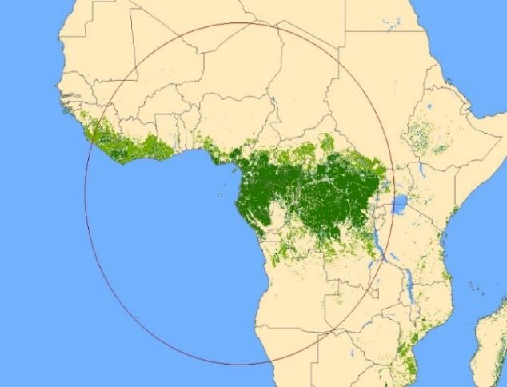
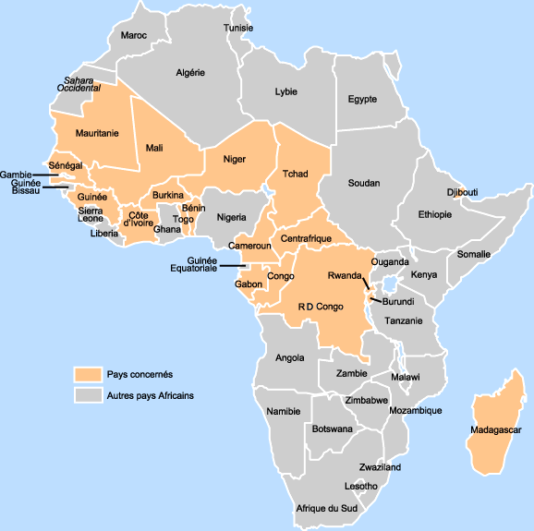
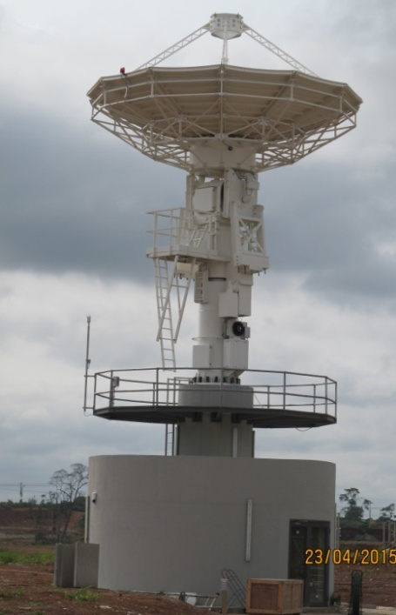
AGEOS Ground station
X band antenna 7.30 m (optical and SAR mission, 23 countries cover, plot about 2800 km);
RS regional centre for direct receiving, processing and archiving data;
Data distribution infrastructure GEOportal : www.ageos.ga;
Main applications : Forest, Maritime surveillance, Urban monitoring, Fresh water resources monitoring, Land use Land cover, assessment of public policy, support to decision makers;
AGENDA
AGEOS
QUALIFICATION
CONTRIBUTION
Gabonese Agency for Studies and Observations from Space - www.ageos.ga

Slide 6
Qualification for participation in CEOS
International cooperation :
GEO member since 2010;
MOU with USGS for Landsat 8 direct receiving and assessment of Landsat data quality in close collaboration with Landsat Cal/Val team;
MOU with ESA on many technical topics (AfriSAR campaign in Gabon – Cal/Val for geodetic imaging mission for BIOMASS satellite, capacity building);
MOU with NASA for Cal/Val SAR instruments over Gabon forest, NASA NISAR and NASA GEDI mission;
Focal point of AfriGEOSS initiative in central Africa region;
Member of AU space policy and strategy working group.
AGENDA
AGEOS
QUALIFICATION
CONTRIBUTION
Gabonese Agency for Studies and Observations from Space - www.ageos.ga

Slide 7
Qualification for participation in CEOS
National and sub regional EO activities :
Development of operational service for Forest monitoring, pollution, illegal fishing, piracy, natural hazards, urban planning and Land user and Land cover for national needs and guinea gulf countries in the objective of sustainable development;
Capacity building for many technical administrations on the use of EO data for value added product and information;
Implementation of a sea rescue service in Gabon exclusive economic zone;
Free data policy for optical data;
R&D in EO fields in close collaboration with african and european universities.
AGENDA
AGEOS
QUALIFICATION
CONTRIBUTION
Gabonese Agency for Studies and Observations from Space - www.ageos.ga

Slide 8
AGEOS contribution in CEOS activities
AGEOS is setting up its EOQC operational service to assess EO data and products quality and accuracy in long-term : We request to participe in the Working Group on Calibration and Validation (WGCV);
In 2010 Gabon had created the National Climate Council which work in climate change challenge; EO data and products are important to assess and anticipate the CC effects. We request to bring our experience by join the Working Group on Climate (WGClimate);
All the industries in Gabon are located a long the sea and the majority of the cities are in the flood zones. Due to a lot of rains, some areas suffered major damage. With EO data and in situ data, we can predict the risk of disasters and avoid the loss of life. We request to work in Working Group on Disasters (WGDisasters);
AGENDA
AGEOS
QUALIFICATION
With our little experience in EO data format, we think that CEOS EO data format must be consolidate : We request to work in the Working Group on EO data format.
CONTRIBUTION
Gabonese Agency for Studies and Observations from Space - www.ageos.ga

Slide 9
AGENDA
The effective use of EO data is essential for the understanding and the implementation of the solutions to developing countries problems. The data must be distributed free of charge to facilitate their use. For AGEOS what is important is the information extracted from the data. We propose our participation in the WGCapD.
AGEOS
QUALIFICATION
Thank you for your attention
CONTRIBUTION
Gabonese Agency for Studies and Observations from Space - www.ageos.ga

