Slide 1
Committee on Earth Observation Satellites
Request for Associate Membership
Mexican Space Agency
Plenary Agenda Item # 3
29th CEOS Plenary
Kyoto International Conference Center
Kyoto, Japan
5 – 6 November 2015

Slide 2
Mexico in Figures
Population: 120 Millions Land Area: 2.0 Million km²
Exclusive sea economic zone: 3.3 Million km² Coastline: 11,000 km
Mexico-US border: 3,200 km GDP $1.3 Trillion USD Economy no. 14th

Slide 3
About the Mexican Space Agency
AEM is a governmental organization that started operations in November 2011;
In terms of development of the space segment, AEM is expected to advance its own capability to design and build small Earth Observation (E.O.) satellites by 2018 in cooperation with international agencies, institutions and companies, including ground segment and geographical information systems (GIS);
By 2030 it is expected that Mexico will have developed its capacities for designing, constructing and launching space systems for small payloads;
For items 2 and 3 above, regional needs -Latin America- will be priviledged but also global applications, specially climate change, and disaster management for which communication satélites are also crutial infraestructure.

Slide 4
CONT…
Mexico has already significant ground segment activities, such as the operations of the ERMEX and ERIS ground stations which receive and process data from several satellites;
AEM is currently on definition and feasibility phase in the design of ground segments, in addition to the infrastructure that is currently operational in the country;
The International Academy of Astronautics (IAA), has recognized Mexico as an important player in coordinating international space activities in Latin America through its space agency (AEM);

Slide 5
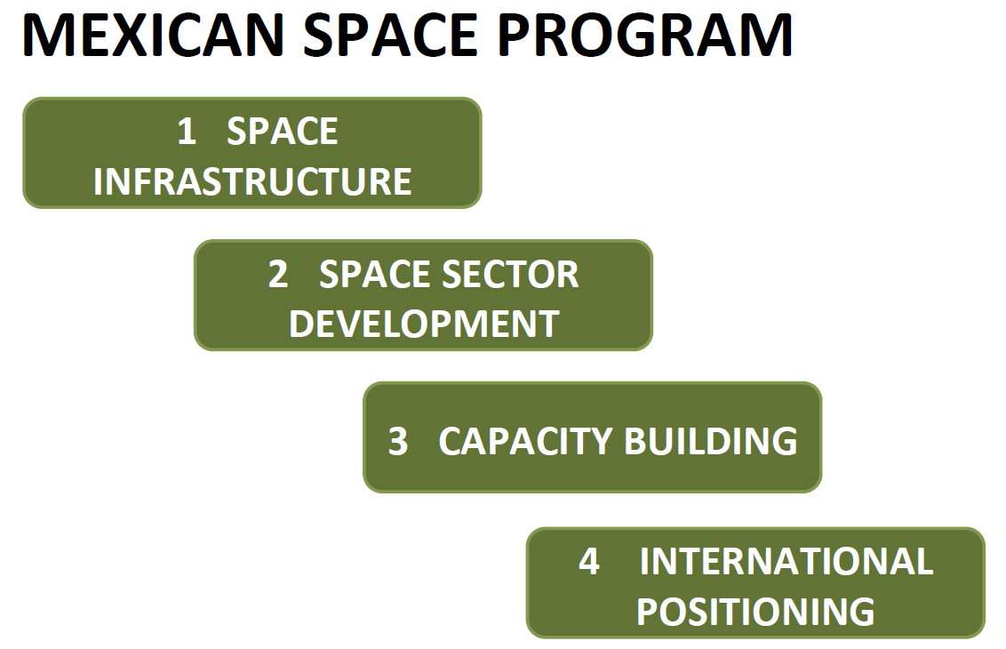

Slide 6
Contributions to CEOS activities
To promote and coordinate space based E.O. activities in the region through international cooperation;
AEM has the potential to strengthen the space activities in the region;
AEM is willing to share technical information locally generated, related to Earth Observation, and to work jointly with other CEOS agencies to develop projects.

Slide 7
The main contributions of AEM to CEOS are:
Working Groups:
WGCapD
AEM plans to engage with WGCapD initiatives by contributing to the organization of different joint capacity building, education and training projects throughout Latin America.
WGClimate
For AEM climate change and disaster management is a top priority matter, and is ready to engage in this group by collaborating in the generation of Climate Date Records, as well as involving the Mexican Meteorology Institutes in this activities.
WGDisasters
AEM has already started to increase and strengthen satellite Earth observation contributions to the various Disaster Risk Management phases and is also informing decision makers and major stakeholders in Mexico on the benefits of using satellite Earth Observations and the corresponding ground infrastructure.

Slide 8
Virtual Constellations:
AEM will develop its future space missions in a virtual constellation scheme, collaborating with other CEOS Agencies to bridge observational gaps;
AEM will encourage the use of the actual ground segment of the country to address collaboration opportunities that benefit all actors.
Ad Hoc Teams:
AEM is willing to actively contribute with existent and future CEOS adhoc Teams;
To promote in the Latin America region to the recommendations that emerge of such groups;
Examine the results of each group and search for applications in Mexico and Latin America.

Slide 9
Expectations from CEOS
Boost the Agency´s international exposure;
Enhance collaboration with other agencies;
Having first hand information to understand the current developments worldwide for the planning of future mexican space missions;
Involve local professionals in the capacity building projects offered by CEOS mem- bers;
Foster networking of experts and users towards better access and sharing of data, tools and resources;
Contribute to the participation of Latin American countries.

Slide 10
Mexico and Space - 2030
Space as an enabler of solutions to social needs
Space as an opportunity for industrial development
Own satellites, designed for national needs in a L.A. perspective
Space instrumentation for scientific research
International space actor, important player in Latin America
Participation in international spatial projects
Outreach to the population

Slide 11
Thank you!
Julio Castillo
Director of Space Security
Mexican Space Agency
castillo.julio@aem.gob.mx

Slide 12
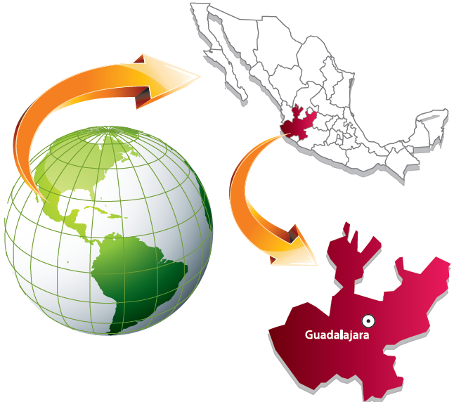
IAF - IAC 2016

