Slide 1
Committee on Earth Observation Satellites
CEOS WG Disasters Report
Ivan Petiteville, ESA
Plenary Agenda Item # 18
29th CEOS Plenary
Kyoto International Conference Center
Kyoto, Japan
5 – 6 November 2015

Slide 2
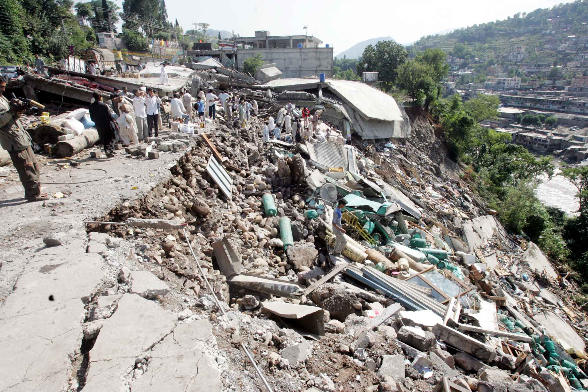
CEOS Activities in Support to DRR
Single Hazard:
Floods, Seismic Hazards & Volcanoes Pilots
Multi-Hazard:
Geohazards Supersites & Natural Laboratories
Recovery Observatory Pilot
Port-au-Prince January 13, 2010. ©REUTERS/Carlos Barria For more information see: http://en.tengrinews.kz

Slide 3
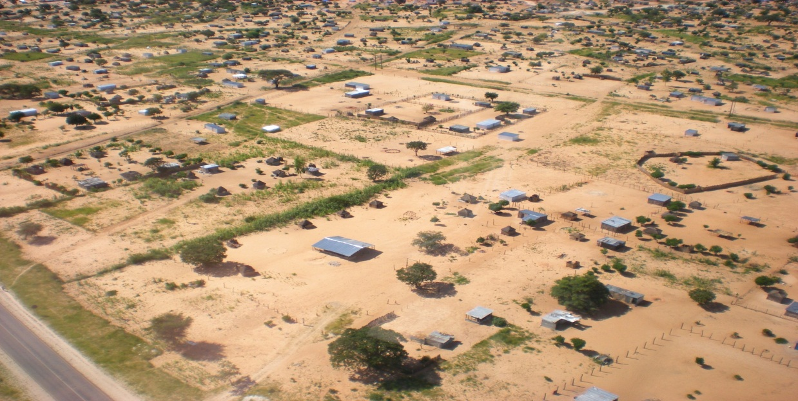
Single Hazard Pilot Projects
Series of on-going end-to end projects (end in 2017) to demonstrate benefits of satellite EO to ALL DRM phases, with strong user involvement
Floods, Seismic Hazards and Volcanoes are progressing very well with several positive feedback from end users.
Ready to start a new pilot focused on landslide following a multi-hazard and multi-sensor approach.
NASA staff with two Namibian agents (Namibian Department of Water Affairs and Forestry) and one villager
Courtesy NASA.
Notes:
A multi agency team has explored the value of a multi-hazard landslide pilot, which includes
- Primary triggers from other hazards (wildfires, rainstorms, earthquakes, volcanoes, permafrost degradation, sedimentation, high stream flows, and inundation) and man-made development activity;
- Secondary cascading hazards from slope failures, mudslides, diverted or blocked streams, dam burst floods, debris flow, displacement waves and tsunamis; and
- Infrastructure impacts such as damaged roads-rail lines and utilities

Slide 4
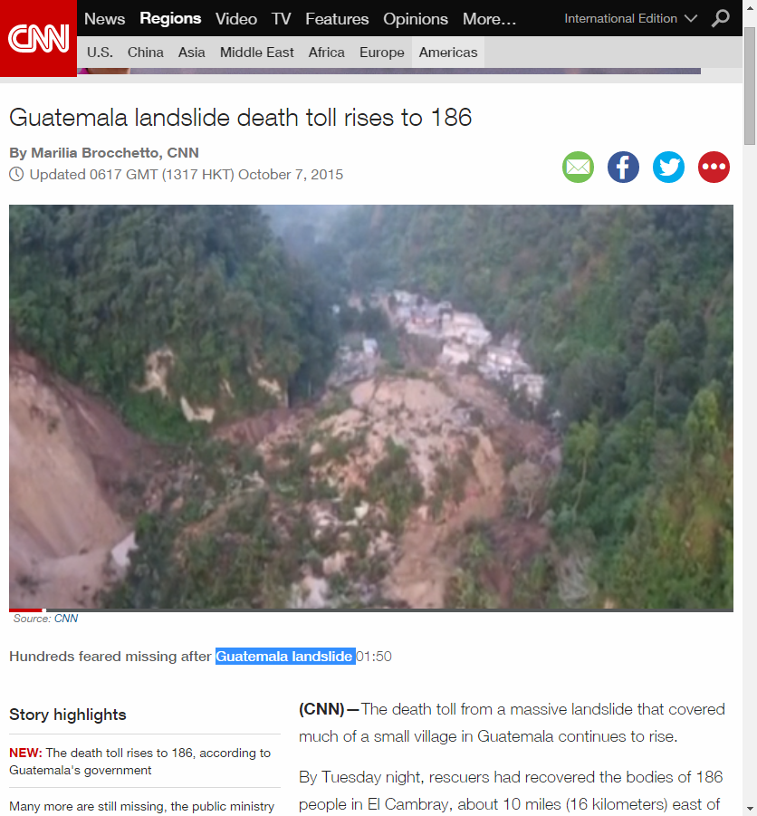
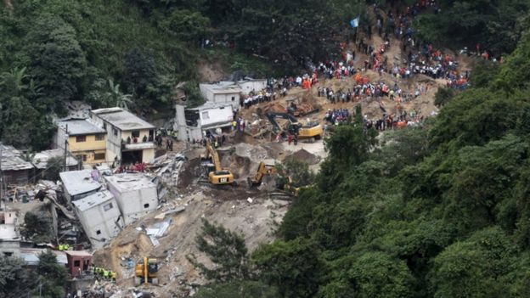
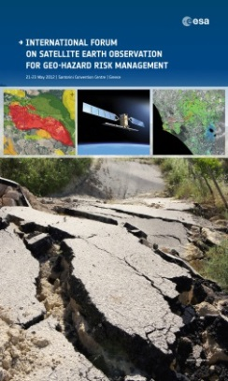
Why Landslides ?
Several CEOS agencies (NASA, USGS, ESA, CSA, ASI) are or have been involved in various landslide research projects (optical, radar and precipitation based methods).
Pooling satellite assets in coordinated framework offers broader range of observations to support research.
Take advantage of newly available (e.g. Sentinel-1 and 2, ALOS-2) and planned EO missions (e.g. the NASA-ISRO Synthetic Aperture Radar, NISAR).
High priority needs and objectives from user community already formulated during the Santorini conference (2012)

Slide 5
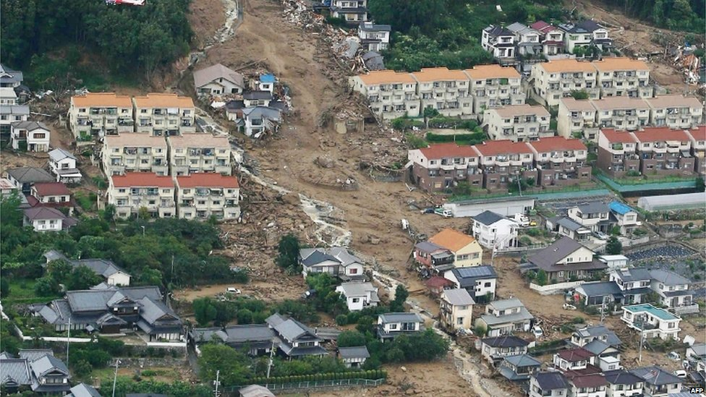
Landslide Pilot – Who are the Users ?
Landslides Pilot users are typically:
Scientists
Civil Protection Authorities
Organisations with a mandate in DRR
Policy Makers & Planners
Citizens
Other end–users
Landslide-prone areas identified by preliminary contacts (national users, international organisations e.g. UNITAR, UN ESCAP, etc):
Africa (Uganda, Burundi, Rwanda)
Latin America (Central America/Caribbean)
North America (USA, Canada)
Europe (Italy, Spain, Switzerland, Greece)
South Asia (Nepal, Bhutan)
Major landslide near Hiroshima, Japan (72 deaths, 2 missing), August 2014. Credit: AFP

Slide 6
Landslides Pilot: Goal
To demonstrate the effective exploitation of satellite EO to the full cycle of landslide DRM at global to regional and to local scales.
Characteristics
Multi-hazard (geohazard and hydromet hazard) and multi-sensor approach to disaster resilience and risk reduction.
Multi-hazard approach and synergy with current Pilots:
Earthquake, volcano and flood inducing cascading effects such as landslide and debris flow.
Enhanced coordination and sharing of satellite acquisitions and data / products with current pilots.
Notes:
Key message regarding the new pilot :
- it's about multi-hazard and multi-sensor approach to disaster resilience and risk reduction
- the multi-hazard tactic is to advance data fusion, integration and analysis, leveraging existing pilots as they end their 3 years. Starting with the new pilot we will look at earthquake, volcano and flood inducing cascading effects such as landslide and debris flow.

Slide 7
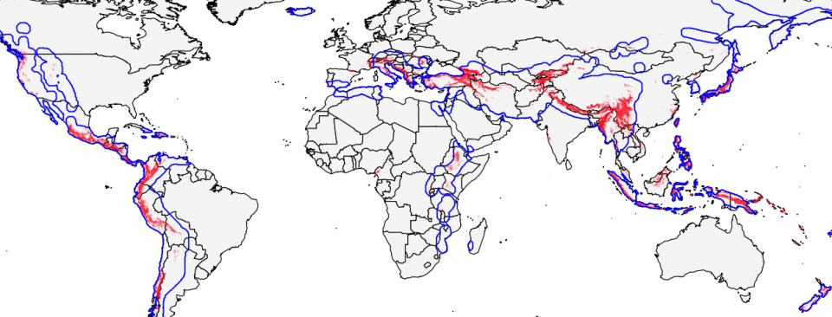
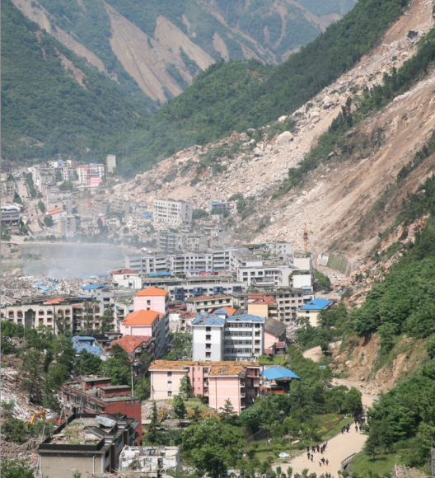
Landslide priorities and Seismic hazards
Priority areas (red): comparison with priority areas of CEOS Pilot on seismic hazards (blue)
Large overlap overall.
Identical observation requirements (e.g. concerning INSAR).

Slide 8
CEOS Objectives
Leverage and exploit existing imagery, technology for processing data, and expertise provided for the other three pilots, where applicable, for rapid development and application within landslide/multi-hazard pilot activities;
Improve coordination and sharing of satellite acquisitions and data products in support of landslide management across the existing flood, seismic, and volcano pilots to maximize utility of CEOS contributions;
Demonstrate the value of satellite EO in the context of integrated landslide management practices.
Capture and exploit lessons learned from existing pilots (volcanoes, earthquakes, floods) including the participation of key contributors and end users of these pilots.

Slide 9
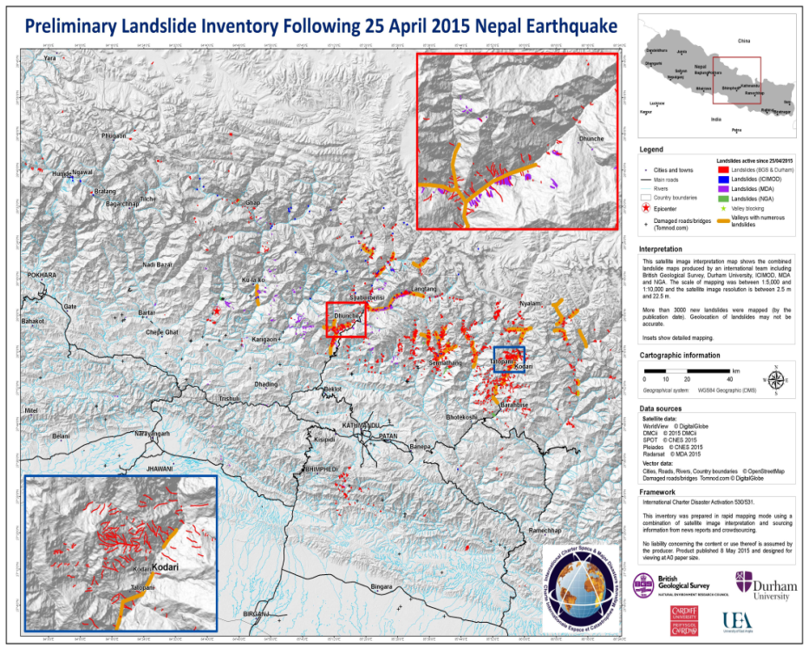
Objectives of the Landslides Pilot (2/3)
Objective A:
Establish effective practices for merging different EO data (e.g. optical and radar) to better manage landslide detection, mapping and monitoring.
Objective B:
Create integrated products & services for those practices such as landslide inventories, to support the full DRM cycle for multi-hazard and cascading landslide events.
Notes:
Satellite interpretation map is a combination of landslide maps produced by an international team by British Geological Survey, Durham University, ICIMOD, MDA and NGA
Satellite data from : WorldView, DMCii, SPOT, Pleiades and Radarsat

Slide 10
Objectives of the Landslides Pilot (3/3)
Objective C:
Test the pilot in multi-hazard risk regions / conditions, including areas exhibiting:
high relief and complex topography,
intense or prolonged precipitation,
earthquake potential, and
socio-economic and social vulnerability.
Exploit the experience, the lessons learned from existing pilots (i.e., seismic hazards, floods, volcanoes).
Objective D:
Engage and partner with brokers and end users to understand user and service requirements, user expectations, and to get their feedback throughout the activities defined in objectives A-C.

Slide 11
Key Pilot Outputs & Deliverables
Objective A: Report on “Recommended practices for the combined exploitation of SAR and Optical imagery and technologies for landslide detection, mapping and monitoring”.
Objective A-B: Report on “Effective methodologies and strategies for considering multi-hazard and cascading aspect of landslides through interactions with the volcano, flood and earthquake pilots”.
Objectives B-C: Landslide event inventory and activity maps produced using optical and SAR imagery and technologies, and their combination, for selected case studies / geographical areas.
Objective D: Report on “End user engagement strategies” and characterize “Enablers and challenges or barriers to effective transfer of information, knowledge and technologies”.

Slide 12
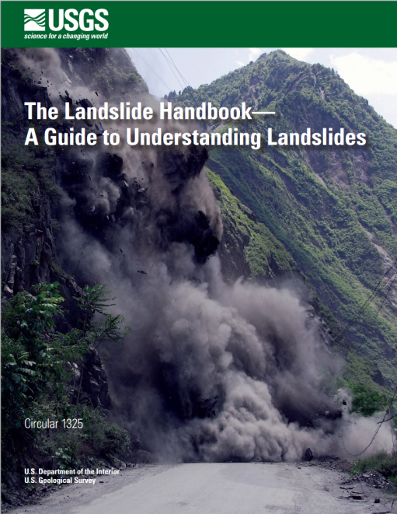
Landslides Pilot Team
Several agencies interested to cooperate on landslides, induced by geohazards and hydromet hazards:
ASI, CAS, CNES, CNR (Italy), CSA, ESA, GFZ (Germany), NASA, NRCAN (Canada), NRSC (India), USGS, U. Oregon, U. Washington
NOAA, and DLR (to be confirmed)
Potential User Implementation Leads:
UNESCO
Regional End User Groups e.g. ICIMOD(Nepal), RCMRD(Africa)
3 co-Leads: Dalia Kirschbaum (NASA), Fausto Guzzetti (Director of Italian Research Institute for Geo-Hydrological Protection – CNR - Italy) and Jonathan Godt (USGS)
Plenary to endorse creation of multi-hazard landslide pilot team
Notes:
PG Diwakar at National Remote Sensing Center NRSC
Sigrid Roessner (GFZ): have investigated the potential of InSAR times series analysis to identify landslide related slope deformations using TerraSAR-X (Motagh et al., 2013) and ALOS/PALSAR (Teshebaeva et al., 2015) data. Regionally we have been focusing on an area of high landslide activity in Southern Kyrgyzstan with a dominance of complex deep-seated landslides which occur more or less constantly without major triggering events (Roessner et al., 2005). Since a large area of more than 10.000 km2 is affected our goal has been the development of methods/strategies for large-area landslide monitoring to support the establishment of systematic multi-temporal landslide inventories including the already existing knowledge on past landslide activity (Golovko et al., 2015). Currently we are investigating the transferability of our methodological experience to the analysis of landslide processes triggered by the Nepal earthquake. In the future we want to focus on exploring the synergetic use optical and radar remote sensing data for integrated landslide monitoring.

Slide 13
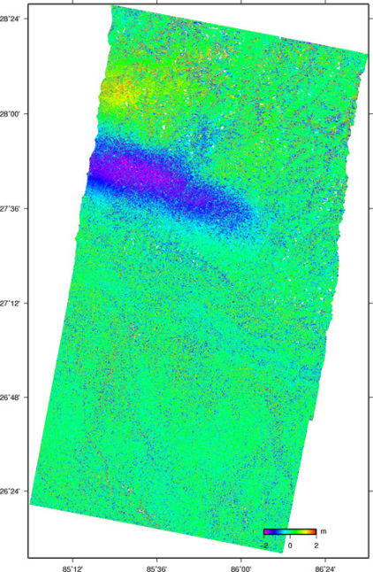
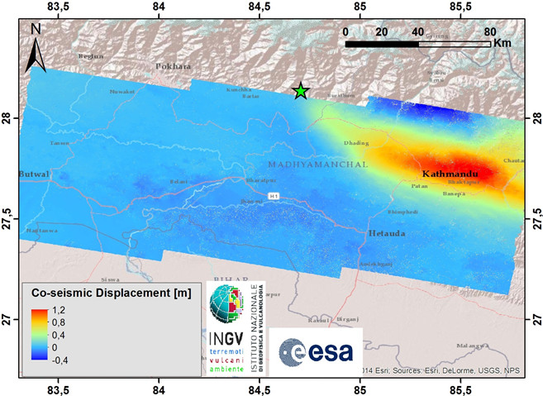
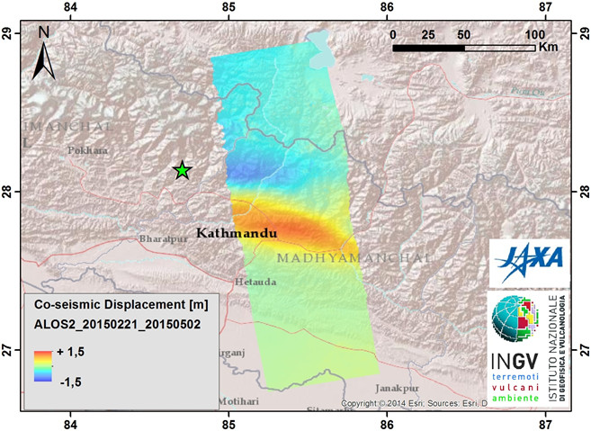
Multi Hazard Pilot Projects –
Supersites
Data delivered to all Supersites incl. last ones endorsed by CEOS :
Tungurahua & Cotopaxi volcano (Ecuador) | COSMO-SkyMed and TerraSAR X
Taupo volcanic zone (New Zealand) | TerraSAR X and RADARSAT-2
Nepal earthquakes | +600 images from COSMO-SkyMed, TerraSAR X, RADARSAT-2, Sentinel-1 and ALOS-2)
RADARSAT-2
interferograms
(©NRCAN)
Coseismic displacement field (25 Apr. 2015,)
M 7.8 Gorkha, Nepal Earthquake, Sentinel-1
images (Apr. 17 and Apr. 29, 2015).
Same product with ALOS2 images,
(Feb. 21 and May 2, 2015)
Notes:
Stakeholders actively engaged or being engaged
GFDRR/World Bank and UNDP have joined RO Oversight Team. Discussion with Red Cross.
EC being approached through “Copernicus EMS”

Slide 14
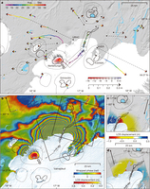
Extension of Hawaii & Iceland Supersites
Biannual Reports provided for both supersites.
Outreach:
Hawaii: 19 peer-reviewed journal articles and
3 presentations to international conferences.
Iceland: Nature article (Jan. 2015) on
“Segmented lateral dyke growth in a rifting
event at Bárðarbunga volcanic system, Iceland ”
and 46 presentations to international conferences.
Data used:
Hawaii: ENVISAT, RADARSAT-1/2, ALOS-1/2, TerraSAR-X, Cosmo-SkyMed, Sentinel-1
Iceland: ERS1/2 (145/1160 images), Envisat (339), Radarsat-­2 (125), Cosmo-­Skymed (840), TerraSAR-­‐X (451)
Plenary to endorse the extension of both Hawaii and Iceland
F Sigmundsson et al. Nature 000, 1-5 (2014) doi:10.1038/nature14111
Notes:
For SIT-31 meeting (18-20 April 2016):
========================
1. Project proposal to be consolidated
2. Intended commitments for data provision from each contributing space agencies
3. Intended contribution from practitioners.

Slide 15
Multi Hazard Pilot Projects –
Recovery Observatory
RO TEAM:
Space agencies: CNES, ASI, DLR, ESA, JAXA, NASA
DRM Stakeholders: UNDP, UNOSAT, World Bank/GFDRR.
Copernicus EMS Risk and Recovery interested to join.
Other partners: CURBE (Univ. of Cambridge), COPE (Univ. of Copenhagen)
STATUS:
Recovery Observatory ready for triggering since early 2015.
Collaboration attempted on Cyclone Pam (Vanuatu –Lessons Learned Report with recommendations).
Possible further collaboration (Post Disaster Needs Assessments (PDNA) before RO?) late 2015 to establish operational linkages.
Significant progress made in past few months on End user product definition, Infrastructure and Licensing issue.
RO Triggering procedure updated. To be endorsed by Plenary
Notes:
Stakeholders actively engaged or being engaged
GFDRR/World Bank and UNDP have joined RO Oversight Team. Discussion with Red Cross.
EC being approached through “Copernicus EMS”
Winston Churchill : "Success is the ability to go from one failure to another with no loss of enthusiasm."

Slide 16
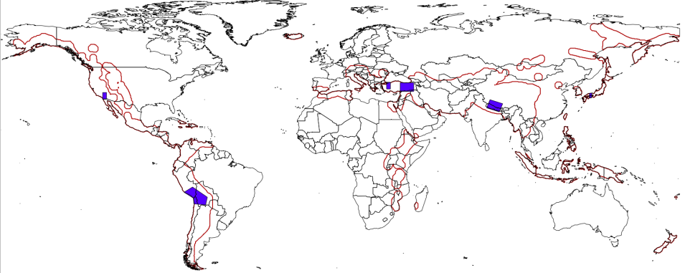
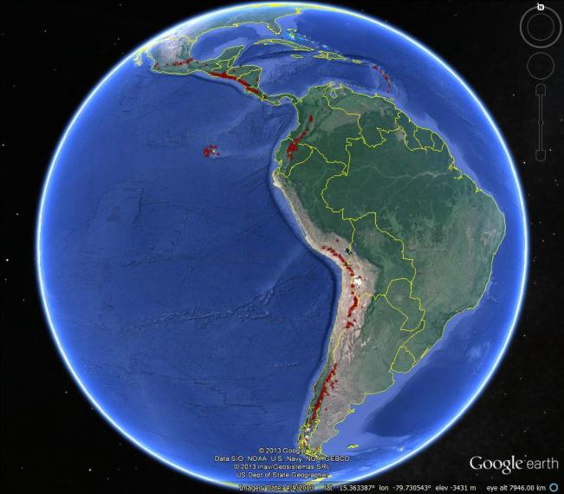
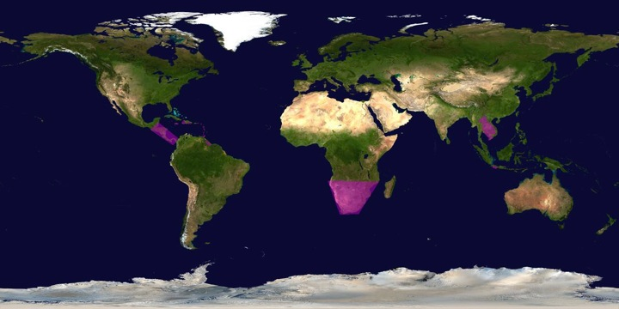
Some Pilots’ Success Stories
Both global and regional activities.
SEISMIC HAZARDS
VOLCANOES
FLOODS

Slide 17
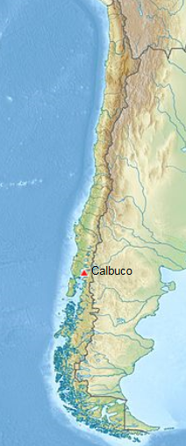
Volcanoes: Calbuco, Chile
After 43 years of quiescence, Calbuco, Chile, began erupting on 22 April 2015, with very little warning.
Large amount of ash (more than 0.1 km3) with significant impact on air traffic on Chile and Argentina. Several thousand people were evacuated from villages closest to Calbuco .
Ash was tracked using data from the pilot and was communicated to VAAC in Buenos Aires.
SAR data used to characterize co-eruption surface deformation, which helps to constrain the location of the magma body that fed the eruption.
Other interferograms constrain the deformation to have started no more than 1.5 days before the eruption, and to have lasted no more than 1 day.
Partner agencies: SERNAGEOMIN (Chile); Buenos Aires Volcano Ash Advisory Center (Argentina); University of Bristol (UK); Cornell University (USA); NOAA (USA)
Notes:
Preliminary model of the deflation indicates that the source is located about 5 km SW of the volcano’s summit at a depth of 9.3 km beneath the surface, with a volume changes of ~0.045 km³. This source geometry and strength is consistent with recordings from a tiltmeter located 4 km W of the volcano.

Slide 18
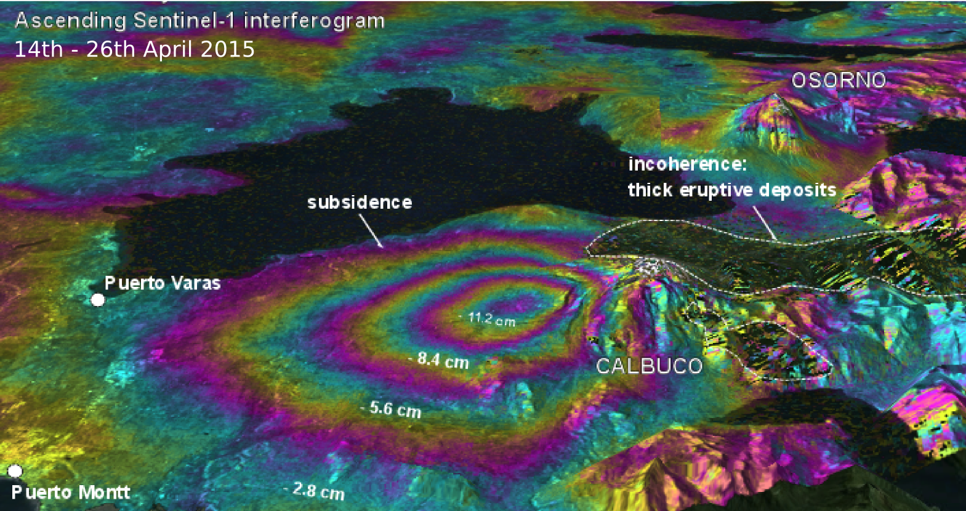
Volcanoes: Calbuco, Chile
Perspective view of deformation at Calbuco as determined from a Sentinel-1a interferogram
Coeruptive ascending Sentinel-1 interferograms show deflation with a maximum line of sight change of 12 cm located on the west flank of the volcano.

Slide 19
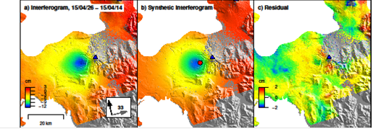
Volcanoes: Calbuco, Chile
Observed (left), modeled (center), and residual (right) deformation at Calbuco from a Sentinel-1a interferogram spanning April 14–26, 2015. Deformation can be approximated by a source at ~9 km depth beneath the volcano’s west flank.
Observatorio Volcanológico de Los Andes del Sur (OVDAS) used this source model to validate their tilt meter records

Slide 20
Volcano Pilot: User Communities in Latin America
SERNAGEOMIN, Observatorio Volcanológico de Los Andes del Sur (OVDAS) Chile;
Observatorio San Calixto, Bolivia;
Instituto Geofísico del Perú;
Instituto Geofísico de la Universidad Nacional de San Agustín, Peru;
Instituto Geofísico, Escuela Politécnica Nacional, Ecuador;
Servicio Geológico Colombiano, Colombia
Buenos Aires Volcanic Ash Advisory Center, Argentina
Instituto nacional de sismología, vulcanologia, meteorología e hidrologia, (NSIVUMEH), Guatemala
Instituto Nicaraguense de Estudios Territoriales (INETER), Nicaragua

Slide 21
Floods Pilot: How Data Are Being Exploited
Products used by: National end users, Civil protection agencies, World Bank,
Red Cross, World Food Program, River Commissions (Kavango, Zambezi,
Mekong)
Geographic Area | Products | Value Added Partner
Haiti | Flood extent maps, flood risk maps, landslide maps, flash flood guidance / threat maps, integrated risk assessment platform | SERTIT, CIMA, INGV, Altamira, CIMH, RASOR FP7, NOAA/HRC
Other Caribbean islands, Central America | Flood damage maps, change detection products, co-registered map overlays | CATHALAC, CIMH, NASA/GSFC
Namibia | Flood extent maps, flood warning products, co-registered map overlays | Namibia Hydrology Dept, Namibian Water Authority, NASA
Zambezi basin | Flood extent maps, flood forecast models, flood hazard maps, flood depth forecasts | Lippmann Institute (PAPARAZZI, HAZARD, WATCHFUL), DELTARES, NASA/JPL
Mekong | Flood extent maps, flood risk maps, flash flood guidance / threat maps | Mekong River Commission, NASA, NOAA/HRC, USGS, University of South Carolina, Texas A&M
Java (Bandung, Jakarta, Cilacap) | Flood risk maps, subsidence maps tied to flood risk, tsunami risk maps (Cilacap only), flood extent maps | SERTIT, Deltares, CIMA, Altamira, INGV, RASOR FP7

Slide 22
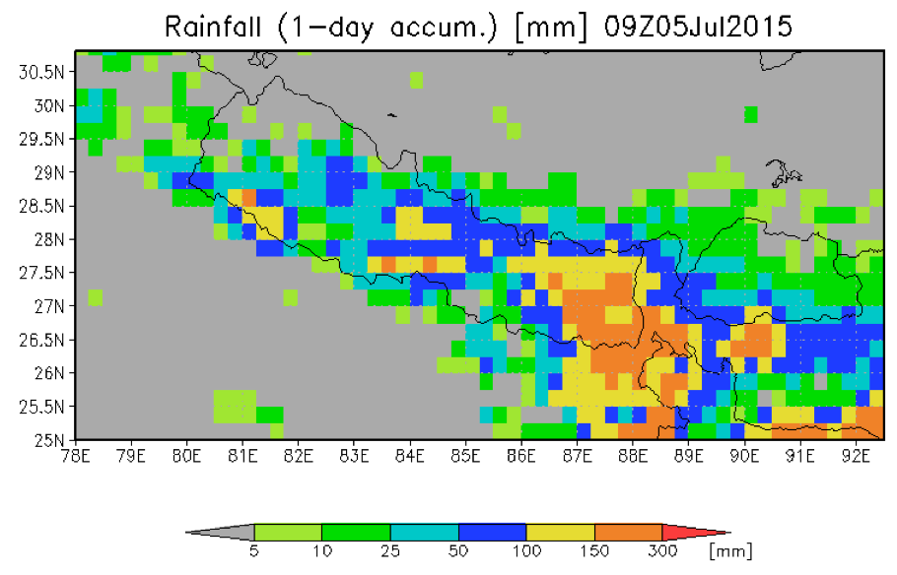
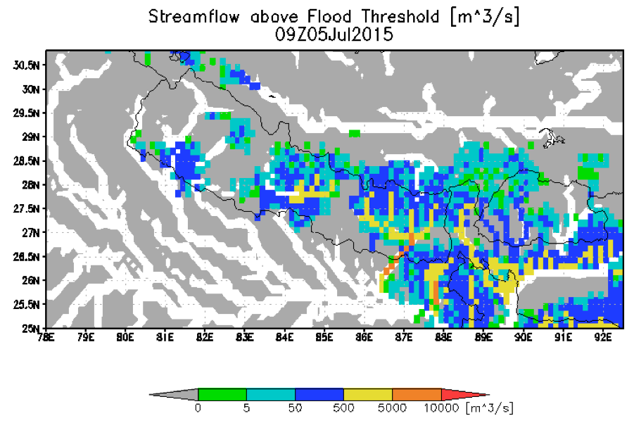
Floods Pilot: Obj. A Global Component : GFMS
GFMS cited by UN World Food Program:
"The Global Flood Monitoring System (GFMS) provides one key step further by indicating how an excess rainfall event will impact river flow, and also whether there is a potential for flooding downstream away from the heavy rain event," said E.Niebuhr, World Food Program. "We check the GFMS nearly every single day to monitor current flood concerns, and also to assist in discovering new flood events that may not have been reported yet or are developing”.
Nepal Department of Hydrology and Meteorology and ICIMOD used GFMS data after the Nepal earthquake

Slide 23
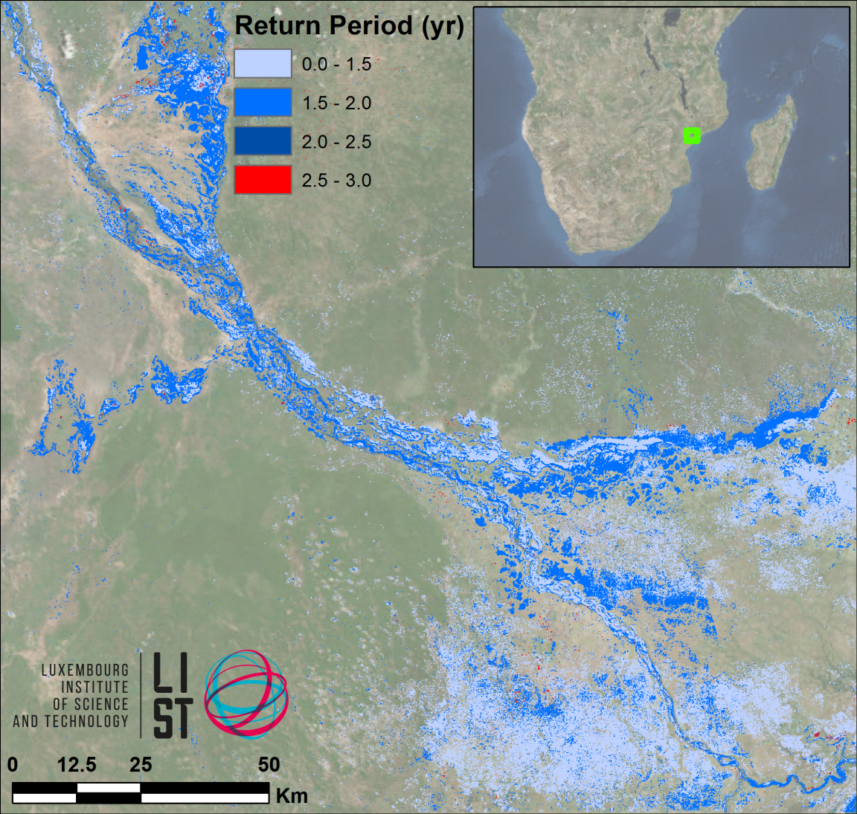
Floods Pilot: Obj. B - Southern Africa
LIST flood hazard maps determine flood severity by comparing flood extent in a SAR image with computed extent / return period from simulated historic floods
The UN World Food Programme has shown interest

Slide 24
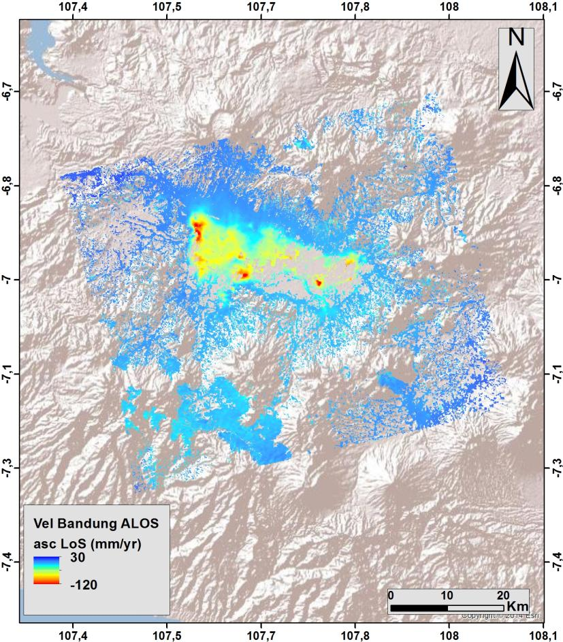
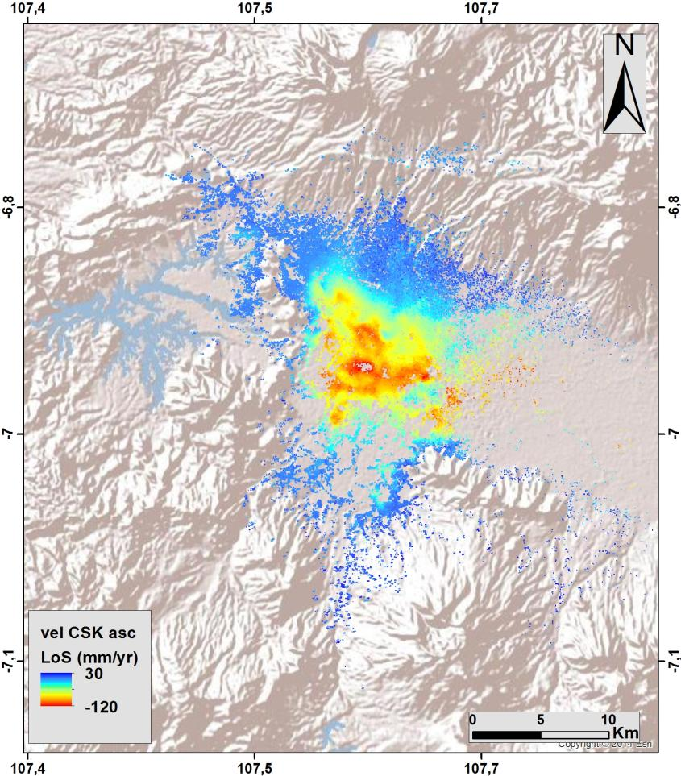
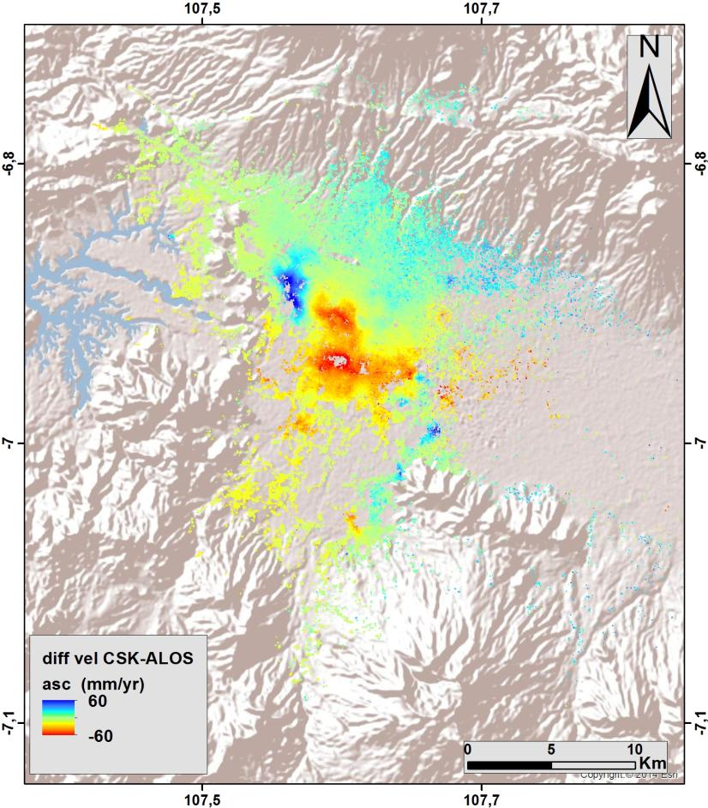
Floods Pilot: Obj. B - South-East Asia
ALOS ascending (2007-2011)
CSK ascending (2013-2015)
Difference (CSK-ALOS)
(red = increased rate of subsidence)
Notes:
Using ALOS and CSK data, INGV calculated the changing rate of subsidence (2007-2015) in an urban flood plain in Bandung, Indonesia, with a view to improving risk assessment for long-term flood projections (RASOR Project).

Slide 25
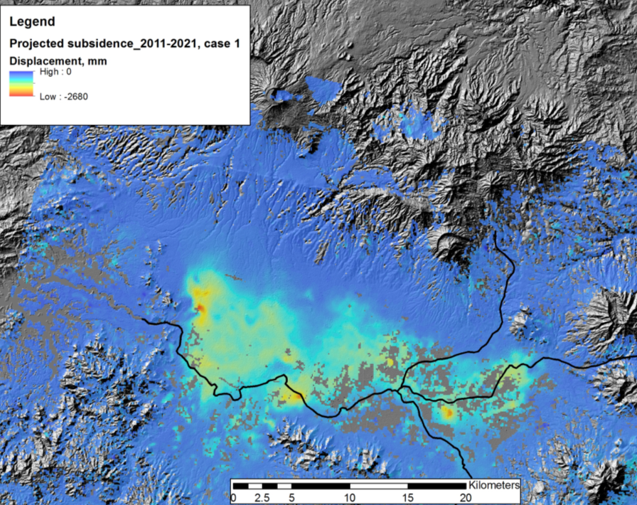
Floods Pilot: Obj. B - Subsidence Projection
Other Activities:
Consultations on new pilot
products with UN, World Bank, and ICRC
Asian Disaster Preparedness
Center (ADPC, Bangkok
Thailand) to setup instance of
flood modeling and monitoring
processing and distribution
software installed under
cooperation with SERVIR and
USAID Oct-Nov 2015
Projected total subsidence by 2021 of up to 2.2 m along main drainage areas.
© INGV
25
Notes:
RASOR project showing subsidence impact on flood hazard in the Bandung area in West Java, Indonesia.

Slide 26
Floods Pilot: Obj. B - Texas
Data provided: EO-1, ASTER, COSMO-SkyMed, Sentinel-1, and LANDSAT, plus high-resolution GFMS forecasts
Users: FEMA, US Forest Service, EPA, Texas Water Development Board and Texas Commission on Water Quality, plus briefings by UT-Austin personnel to Texas Emergency Operations Center and Governor’s Emergency Management Council
Feedback from Theresa Howard and Gordon Wells (UT-Austin):
“The imagery offered a detailed view of inundation impacting agriculture in rural areas, which is information that can be difficult to obtain from other sources. The imagery also helps to fill in the coverage gaps between stream gages that are monitored for current and forecast conditions.”

Slide 27
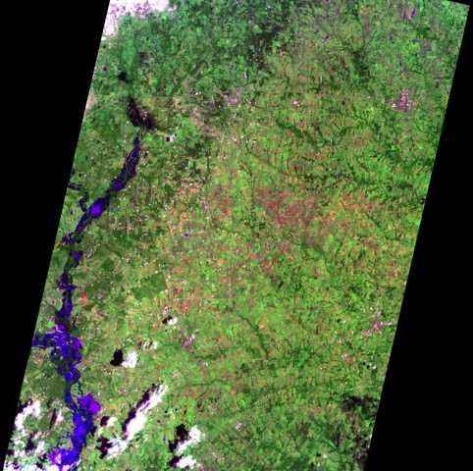
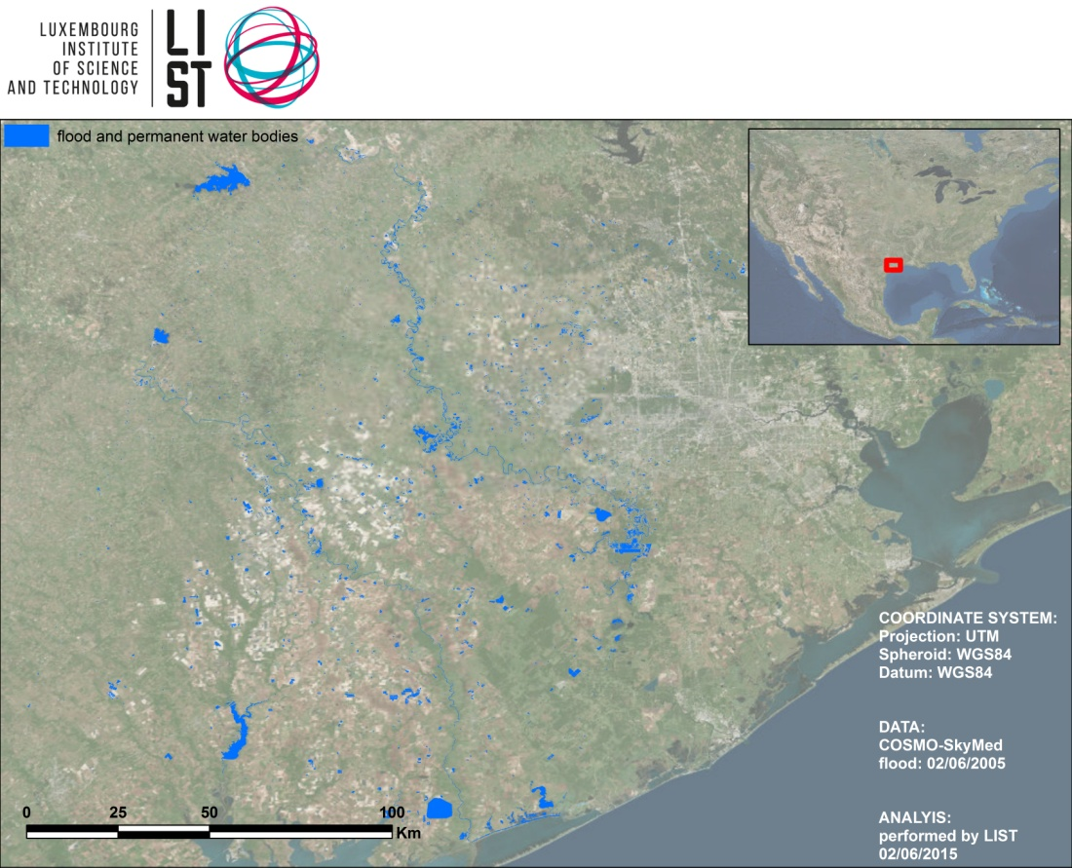
Floods Pilot: Obj. B - Texas
COSMO-SkyMed, 2 June 2015 as processed and analyzed by LIST
EO-1, 1045 CDT 27 May 2015
Imaged processed by Texas partners

Slide 28
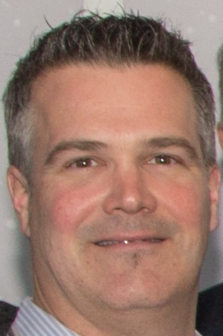
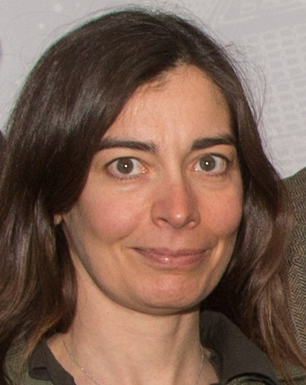
Incoming Chair & vice-Chair
New Chair is Stéphane Chalifoux (CSA)
For 2 years ….
New proposed Vice-Chair is
Simona Zoffoli (ASI)
Will become Chair in 2 years.
Plenary requested to endorse that
nomination

Slide 29
4 years of WG Disasters …
ESA’s initial proposal for CEOS
coordinated action on DRM
Nov. 2011, CEOS Plenary
Feb. 2012, ESA
1st meeting of 10 agencies
Strategic plan to “Ensure the
positioning of EO from Space
in the post-2015 HFA”
Oct. 2012, CEOS Plenary
Selection of 3 single-hazard Pilots:
Floods, Seismic Hazards, Volcanoes
Dec. 2012
May 2013, NASA
Consolidation of 3 initial Pilots and
proposal of Recovery Observatory
Nov. 2013, CEOS Plenary
WG Disasters creation

Slide 30
Some important milestones
Mar. 2014, CSA
1st meeting of new WG Disasters
WG Structure & Organisation,
Action Plan for 3rd WCDRR
Apr. 2014, SIT
whole 2014 – begin 2015
Jun. 2014
Data delivery to Pilots initiated
Aug. 2014
First results from Pilots !!!
Preparations for 3rd WCDRR
Mar. 2015, 3rd WCDRR,
Sendai, Japan
Positive & Promising outcomes
for satellite EO …. Explicit mentions
in “Sendai Framework for Disaster Risk Reduction 2015-2030”.

Slide 31
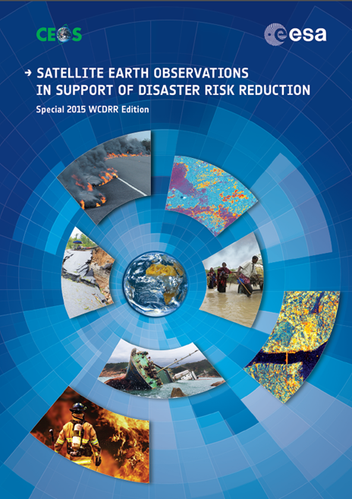
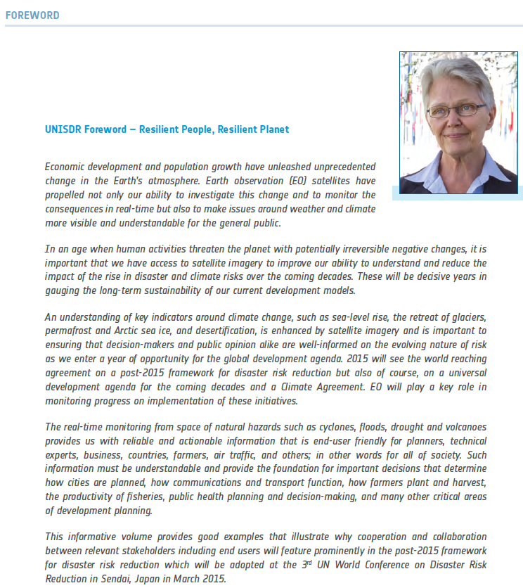
Some figures over 4 years ….
Increasing number of Supersites: 7 permanent and 4 event supersites supported by space agencies
Active Participation to several international events (e.g. Global Platform on DRR, AGU, EGU, IDRC Davos, 3rd WCDRR, Asian ministerial conference on DRR, ISRSE, …)
28 telcons + 10 meetings
6 papers written at WG level to major conferences & journals
Several scientific articles by pilots members.
CEOS EO Handbook Special WCDRR Edition (80 pages).
Notes:
UNISDR: UN Office for Disaster Risk Reduction
UNISDR is led by Margareta Wahlström, the United Nations Special Representative of the Secretary-General for Disaster Risk Reduction

Slide 32
CEOS Activities in Support to DRR
Disaster Component # 5 of the CEOS 2015-2017 Work Plan deals with the CEOS Pilots
Activities are progressing quite well with all Objectives reached and Deliverables produced as originally planned
Current GEO Disasters components will be rearranged in GEO Transitional 2016 WP.
GEO-DARMA proposed by CEOS as new GEO initiative for 2016.
Issues preventing progress:
None as of today

Slide 33
Decisions @ CEOS Plenary
Required steps and/or decisions by Plenary:
Endorse the creation of a new Pilot on Landslides
Endorse nomination of new vice-Chair (S.Zoffoli, ASI)
Endorse the updated RO triggering procedure
Endorse the two-year extension of both Hawaii and Iceland permanent supersites.

Slide 34
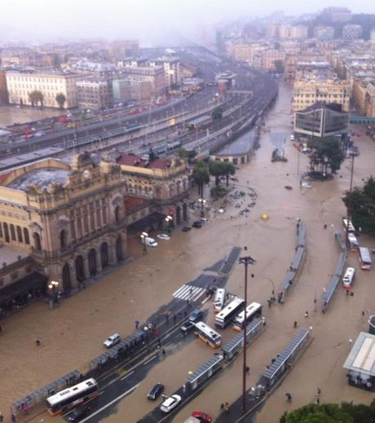
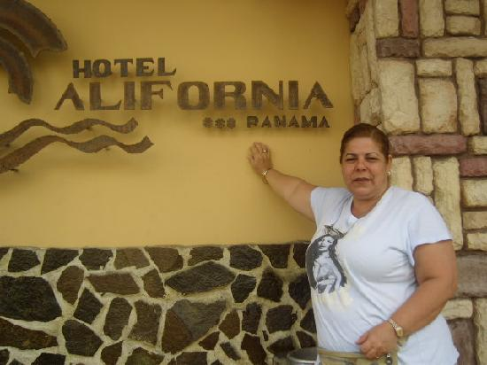
Thank you !!!
Flood at Genoa Brignole Train Station (Italy, Nov. 2011)

