Slide 1
Committee on Earth Observation Satellites
Working Group on Capacity Building and Data Democracy
SANSA
Agenda Item 23
29th CEOS Plenary
Kyoto International Conference Center
Kyoto, Japan
5 – 6 November 2015

Slide 2
Presentation Outline
Working Group activities in 2015
Key highlights
Future activities
WGCapD Leadership post 2015

Slide 3
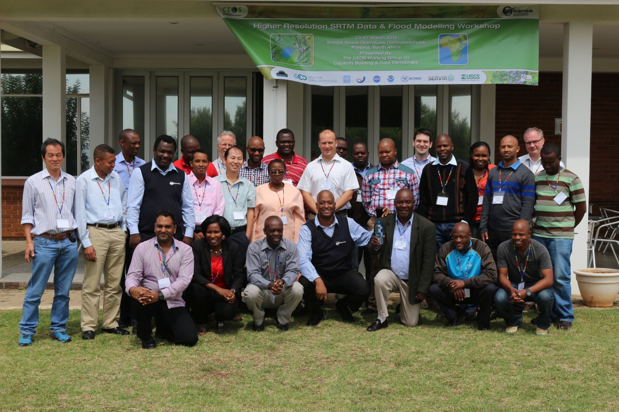
SRTM Workshop, Pretoria, South Africa
Pretoria 23-27 March, 2015
23 -27 March, 2015
22 participants,
18 from outside South Africa.
Sponsors are SWF, GEO Secretariat, and UNOOSA

Slide 4
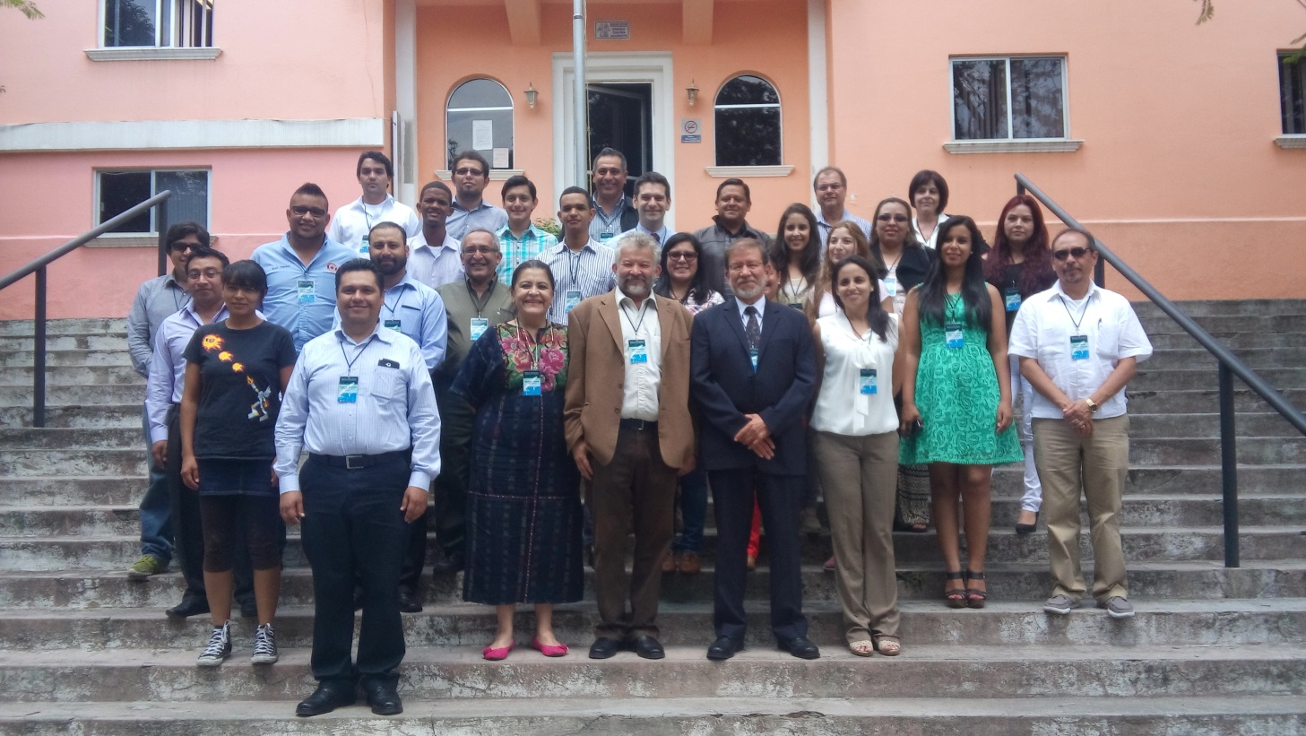
SRTM Workshop , Puebla, Mexico
Puebla, 25 -29 May, 2015
Attended by 27 participants from 11 countries in Latin America
Sponsors are MCTP, SWF, GEO Secretariat, CRECTEALC, and INAOE

Slide 5
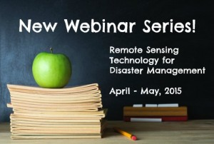
Webinar Series
Webinar Series on Remote Sensing Technology for Disaster Management
(INPE and ISRO)
http://ceos.org/meetings/wgcapd-distance-education-2015/
Comprehensive series of 8 introductory webinars that address the use of remote sensing technology for DM.
What makes this course unique?
Offered free of charge
Provides access to expertise from space agencies around the world
Links participants to a global network of experts and policymakers
Creates awareness about CEOS and the International Charter for Space and Major Disasters
Provides access to datasets and useful tools available from CEOS Members
Builds skills on Disaster Management (DM)

Slide 6
Webinar Series
Introductory webinars on the use of remote sensing technology for Disaster Management
Total of 145 students registered
46 students representing 19 countries successfully completed the course as shown below.
INPE, NASA, USGS, University of Waterloo, International Space University,
ESA, ISRO, INAOE/CRECTEALC, CEOS CEO and CEOS SEA.

Slide 7
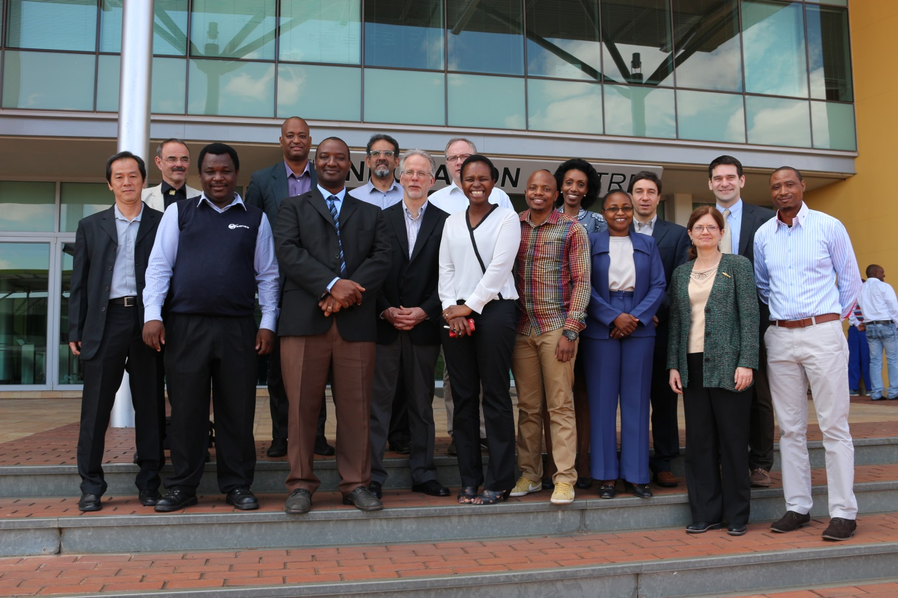
Annual Meeting
4th WGCapD Annual Meeting , Pretoria, SOUTH AFRICA
Pretoria 18-20 March, 2015
Present DLR, NASA, ESA, USGS, INPE, NOAA, UNOOSA, RCMRD, and SANSA.
ISRO, GEO, VLab (WMO-CGMS), SWF, NASA-SEO, NOAA, CRECTEALC (Mexico) and IRD attended virtually

Slide 8
Future Activities
1. GEO XII Plenary / GEO Ministerial
Mexico City, Nov 9 – 13, 2015
Assisting SEO with CEOS Exhibition Booth
Focus #1: Missions launched by CEOS since the last GEO Ministerial Summit (January 17, 2014)
Focus #2: New datasets released by CEOS
Focus #3: Major contributions from CEOS to GEO (support of GEO flagships and SBAs)
Themes: Climate change, disaster response, deforestation, and food security
Represent CEOS at the AfriGEOSS and AmeriGEOSS Side meetings

Slide 9
2. GeoCaB Portal
MoU between
the Université de Genève (UNIGE), Geneva, Switzerland, SANSA, IRD, Centre Régional Africain des Sciences et Technologies de l’Espace, en Langue Française, affiliated to UN ­(CRASTE-LF), Rabat, Morocco, Consiglio Nazionale delle Ricerche (CNR), Roma, Italy, Aristotelio Panepistimio Thessalonikis (AUTH), Greece,
University of Twente, Faculty ITC (ITC), Enschede, the Netherlands, HCP international (HCP). Amsterdam, the Netherlands and the Secretariat of the Group on Earth Observations (GEOSec),Geneva, Switzerland
for the purposes of
establishment and maintenance of the GEO capacity building resource facility (GEOCAB)
WGCapD role is anticipated to support the initiative by contributing CEOS capacity building activities as far as is possible

Slide 10
3. School Labs, Kenya Cube and SAR
School labs (ESA and DLR)
Kenya Cube training support (SEO and CEO Chair team)
Capacity building in SAR --- build upon SANSA/JICA/RESTEC/JAXA training activities in South Africa

Slide 11
4. 5th Annual meeting
Next meeting : NASA Langley, Virginia, US
March 29-31, 2016
Thanks to Kim and team for supporting the meeting

Slide 12
Welcoming and inviting new members
“Satellite Earth Observation provides the single most powerful source of information for understanding and managing human impact on the planet, but remains worthless if not “inside the decision loop” of users, clients, policy makers, regulators”
Capacity building and increase in data access remains the key mechanism to close the loop between space technology and its society benefits
Coordinating/Collating CEOS CapD activities gives CEOS more visibility above and beyond individual agencies

Slide 13
Endorsement of Dr Senthil Kumar as vice Chair WGCapD
Eric Wood (USGS) has completed his tenure as WGCapD Chair
Jane Olwoch (SANSA), has naturally assumed the
role of the Chair
ISRO has officially supported their candidate for the role of WGCapD vice Chair
We ask CEOS Plenary to endorse Dr Senthil Kumar (ISRO/IIRS) in the role of Vice chair of CEOS WGCapD

Slide 14
Thank you
Eric Wood
Jane Olwoch
.

