Slide 1

Committee on Earth Observation Satellites
Update on
German EO Programme
Klaus Schmidt, DLR, German Space Administration
Agenda Item #30
29th CEOS Plenary
Kyoto International Conference Center
Kyoto, Japan
5 – 6 November 2015

Slide 2
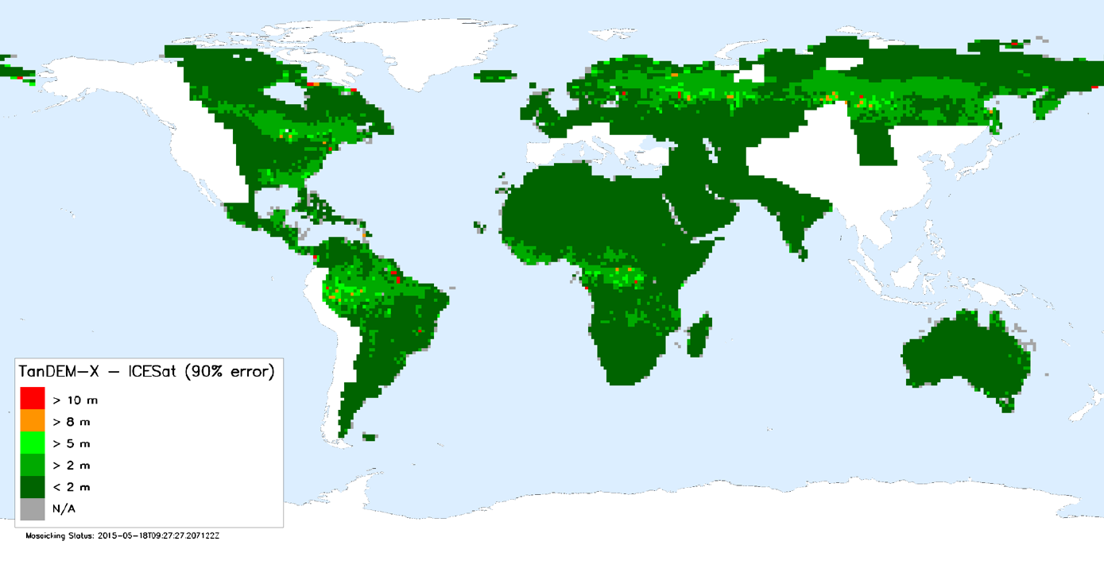



TanDEM-X
SAR-Interferometry-Mission to generate global Digital Elevation Model
NX-01 «USS Enterprise»
In Space 2151
over 450,000 individual DEM scenes processed (there of 90% good coherence)
> 75% of Earth land masses are available as final DEM
available data well within specifications
absolute height accuracy exceeds specification by one order of magnitude: 1.1m!
http://www.geo-airbusds.com/worlddem/ and https://tandemx-science.dlr.de/
CHARM-F on HALO
2015

Slide 3
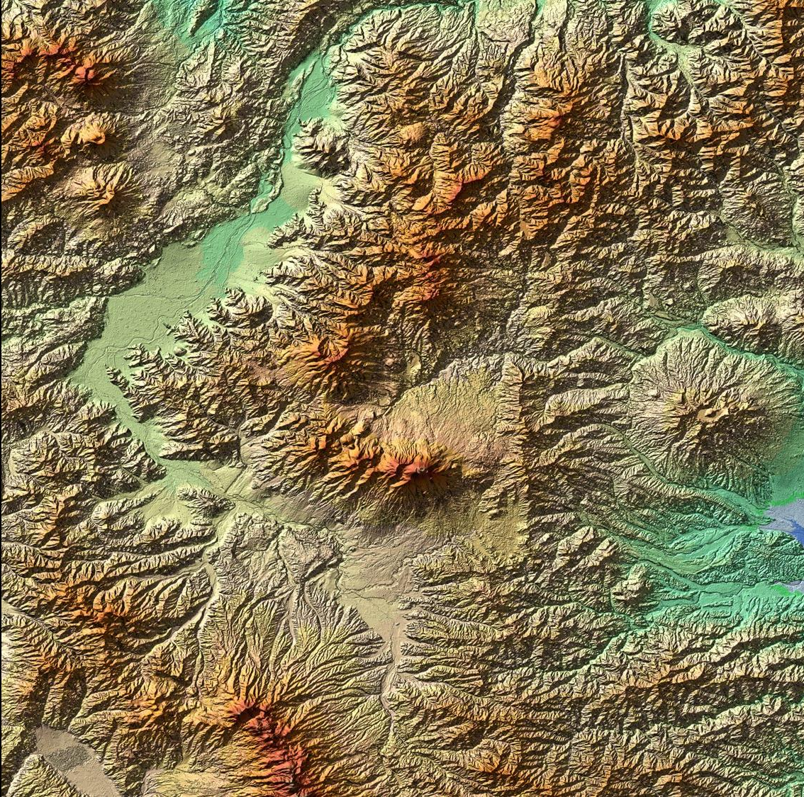
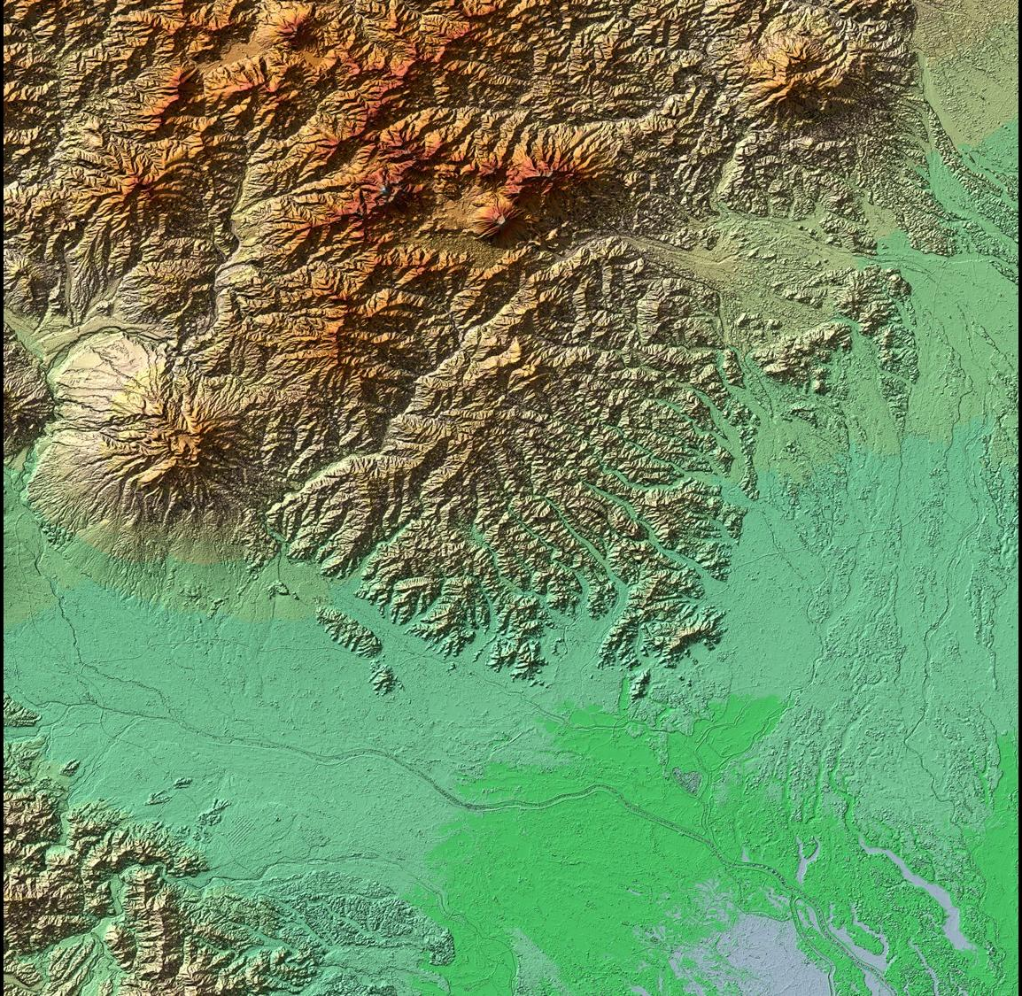
TanDEM-X – Global DEM
Nagano, Japan
Kurobi-san, Japan

Slide 4
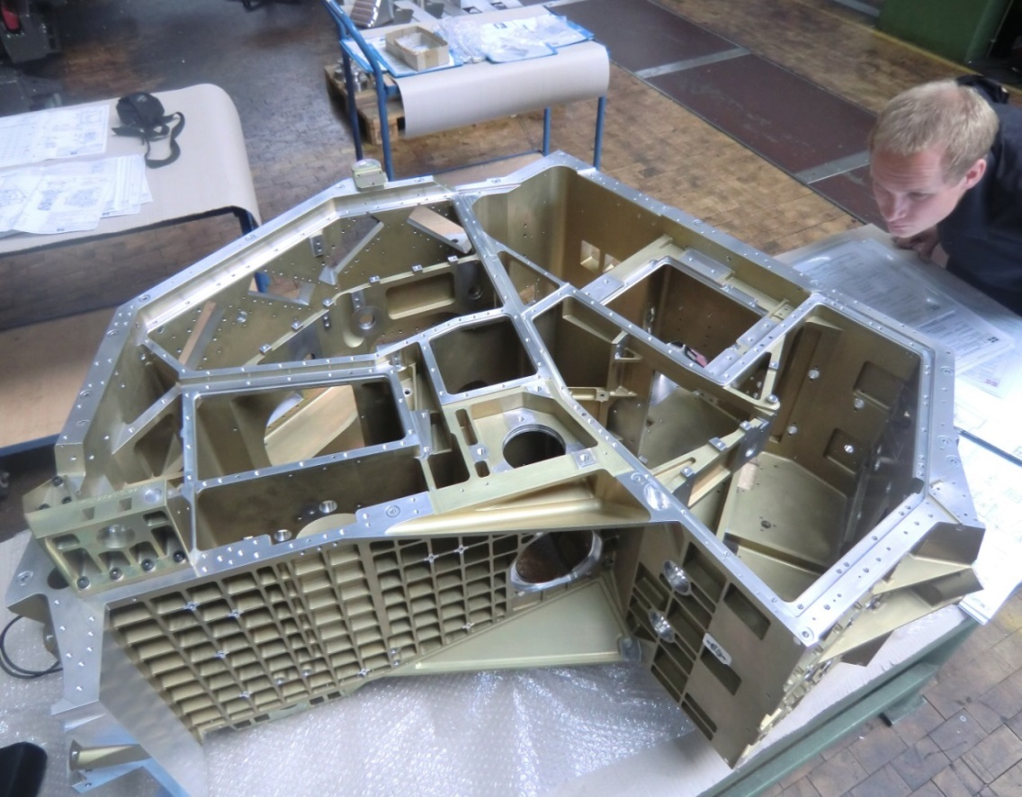
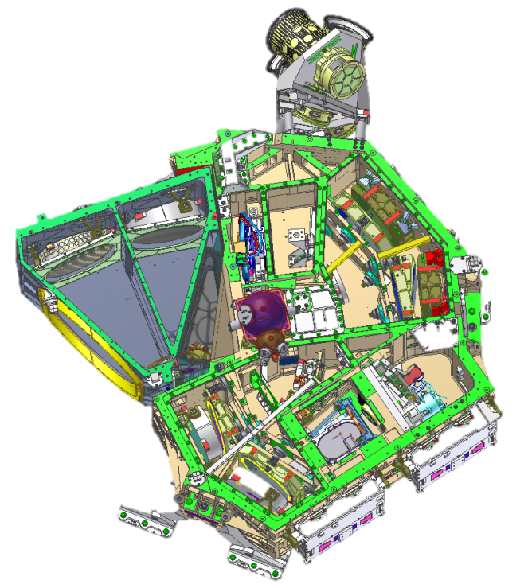
EnMAP
Hyperspectral mission, aims at
monitoring and characterising
the Earth’s environment on a
global scale
EnMAP serves to measure and
model key dynamic processes
of the Earth’s ecosystem
EnMAP is a scientific path finder
for later operational services
Status
    - in phase D
    - launch around 2018
www.enmap.org
VNIR
SWIR
Flight model of
Instrument structure (IOU)
Flight model of
Instrument structure (IOU)

Slide 5
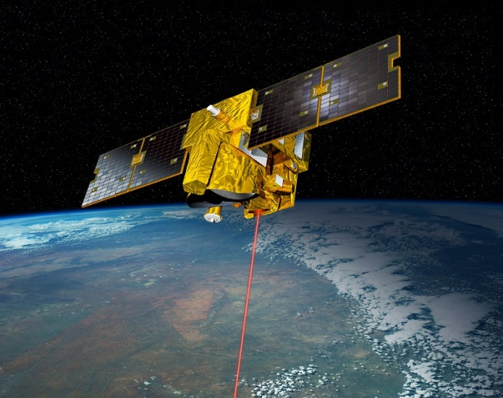
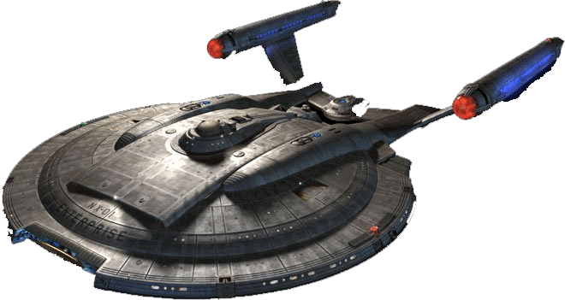
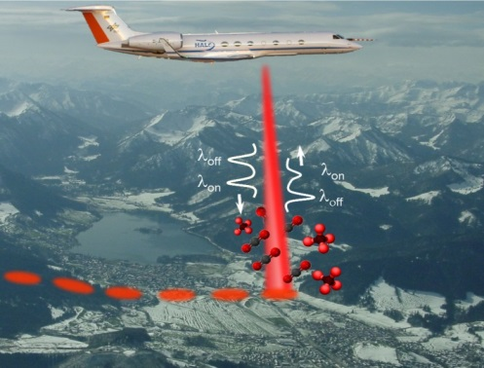
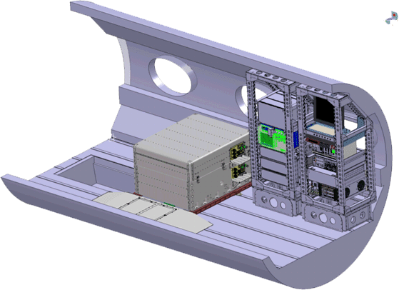

MERLIN
Franco-German (CNES/DLR) cooperation
on a climate satellite mission
first space-borne methane Integrated Path
Differential Absorption (IPDA) LIDAR
MERLIN will allow:
                global measurements of XCH4 at day and night
                on a country scale
        improvement of inverse modelling accuracy
Status:
  Phase B completed (in PDR)
  successful airborne demonstrator CHARM-F
  test flight May 2015 (CO2 & CH4 measurements)
upcoming major milestones:
  final design in 2017
  ready for launch around 2019/2020
  3 years of operation
  https://merlin.cnes.fr
  http://www.dlr.de/rd/en/desktopdefault.aspx/tabid-2440/3586_read-31672
MERLIN in Orbit 2020
NX-01 «USS Enterprise»
In Space 2151
CHARM-F on HALO
2015

Slide 6
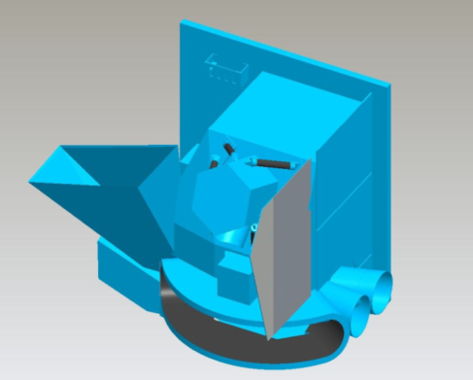
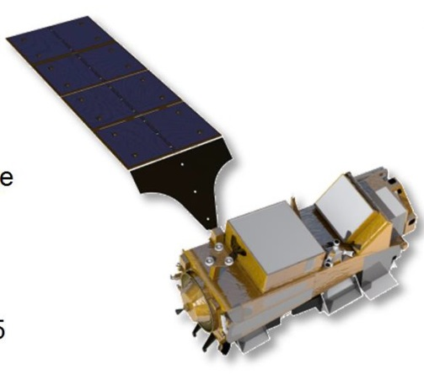

METimage
German contribution for the next EUMETSAT Polar System (EPS-SG)
                three generations of identical satellites
METimage is an imaging radiometer instrument
METimage will allow:
                measurement of physical parameters in atmosphere,
                sea & land surface for meteorological tasks
Status:
  begin of phase C
upcoming major milestones:
  final design in 2017
  delivery to ESA for integration with satellite: 2019
  launch of first METOP-SG satellite: 2021
  7 years of operation each
  http://www.dlr.de/rd/en/desktopdefault.aspx/tabid-2440/3586_read-10140/
NX-01 «USS Enterprise»
In Space 2151
CHARM-F on HALO
2015

Slide 7
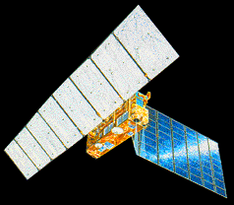
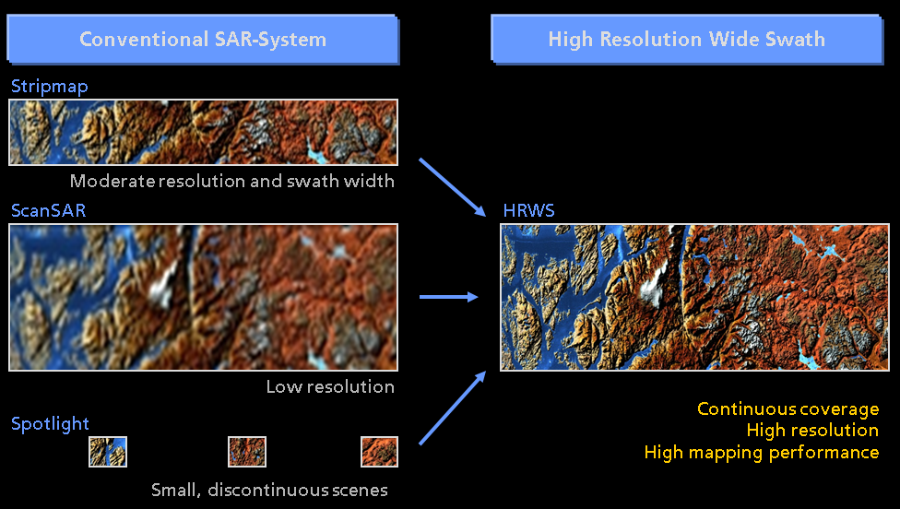
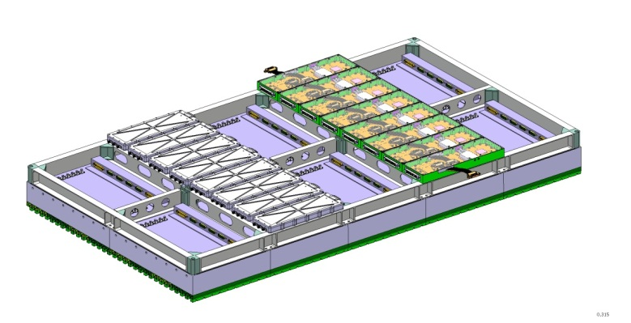
HRWS
HRWS: “High Resolution Wide Swath”
SAR performance potential beyond today's limitations by incorporating Digital Beamforming functions
integrated antenna demonstrator in final development
- to be realized and tested by end 2015
aiming for a HRWS mission around 2022+
- start Phase 0/A by early next year

