Slide 1
GFOI & SDCG Update
Committee on Earth Observation Satellites
Masanobu Shimada (CEOS Lead for GFOI)
& Stephen Ward (SDCG Sec)
CEOS Plenary 2016
Agenda Item 4.7
Brisbane, Australia
1st – 2nd November 2016

Slide 2
Contents
CEOS Lead Update on GFOI status and outlook
SDCG report and requests of Plenary
Questions/discussion/decisions

Slide 3
GFOI Status and Outlook 1/3
GFOI Office operating at FAO since early 2016
Funded by Australia and Norway
Led by Tom Harvey (Australia)
Improvement in coordination and outreach
Methods and Guidance Documentation V2 a significant milestone for GFOI and country engagement
Accompanying REDDCompass web system to assist
University course in development
Capacity Building component has active workshop programme, now emphasising the MGD
R&D Coordination component
Funded by ESA until March 2017
Active external research programme supported by CEOS agencies

Slide 4
GFOI Status and Outlook 2/3
GFOI Review undertaken in 2016:
Jim Baker (Clinton Foundation, ex-NOAA)
In support of renewed funding from Australia and Norway
To aid formulation of the next phase for GFOI
GFOI Review headlines:
GFOI successful in meeting initial goals
Space data availability and awareness much increased
Outreach and capacity building needs attention – FAO role will help
Paris agreement intensifies need for GFOI
UN-REDD aligning all in country materials around REDDCompass
Report will be provided to CEOS

Slide 5
GFOI Status and Outlook 3/3
New funding cycle for Australian support
Office renewal
MGD support
No more Space Data Component support as of Nov 2016
Chair of Leads for 2017 (Doug Muchoney gone to FAO)
Strong interest from the ‘GNU’ alliance in GFOI as an ‘assurance framework’
GNU committed $5bn in forest development aid at COP21
Positive first meeting in London in Sept around SDCG-10
Active follow-up by Leads/Office
Stephen Ward (SDCG Sec) serving as alternate when Masanobu Shimada not available for CEOS/GFOI mtgs

Slide 6
SDCG & GFOI Space Data Component Update
30th CEOS Plenary
Brisbane, 1-2 November 2016

Slide 7
SDCG Report – Global Data Flows
Global Data Flows Study concluded in 2016
Feedback on EO uptake obstacles and issues from many countries and intermediaries such as FAO and World Bank
Increase in satellite data volume and complexity is outstripping capacity of countries to handle. BAU is not sustainable.
Significant implications for all user-facing CEOS/GEO initiatives and for CEOS Agency programmes. Refer to the report recommendations.
In short, simplification of data handling and application is needed, and likely more centralized data handling.
User expectations are being changed by the likes of Google Earth Engine. And more non-expert users and uses are emerging.

Slide 8
SDCG Report – Global Data Flows
Global Data Flows issues for Plenary decision/discussion:
The Global Data Flows report from SDCG is provided for information and reference of CEOS. Agencies are asked to note the implications for agency and CEOS work in relation to Future Data Architectures.
In particular, SDCG notes the perceived importance of Analysis Ready Data to the study respondents and commends CEOS efforts to accelerate the definition and development of CEOS Analysis Ready Data. User-facing programmes such as GFOI will benefit significantly from this work.
SDCG supports the progress to date on the Future Data Architectures initiative and the new initiative on the interoperability of moderate resolution data products and stresses the strategic significance of these for the future success of government-sponsored EO programmes and the effectiveness of CEOS as the primary coordination body for those programmes.
SDCG commends the individual recommendations to all CEOS space agencies and to the various GFOI stakeholders. SDCG will pursue these recommendations through GFOI channels.

Slide 9
SDCG Report – CEOS Data Strategy for GFOI
Global Baseline – 2016 marks the achievement of the claim that all countries can be provided at least a single annual w2w coverage going forward to support reporting
Several requests to CEOS agencies in support
CONAE asked to ensure SAOCOM-1A data is freely and openly available for GFOI purposes
CNES and all relevant partners asked to assist CNES in repatriation of SPOT 1-5 data to be consistently processed and available for the community. Key gap filler in Landsat record (esp. Africa).
INPE asked to optimise spare CBERS capacity for Africa and S America forested countries
JAXA asked to make JERS-1 mosaics available on-line and to continue L-band systematic global acquisitions.

Slide 10
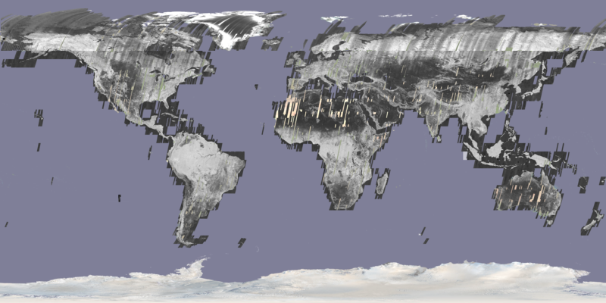
JERS-1 SAR historical dataset released
JERS-1 SAR global 25m mosaic and forest/non-forest map from 1990s
released for open public access by JAXA (October 2016)
Analysis-Ready Data (ARD) format
Recognised as Core Data Sets for GFOI
Complementing ALOS (2007, 2008, 2009, 2010) and ALOS-2 (2015) public open global 25m mosaic data.
JAXA EORC 10 m global PALSAR mosaic 2009
Public download at http://www.eorc.jaxa.jp/ALOS/en/palsar_fnf/fnf_index.htm

Slide 11
SDCG feedback to GFOI for CEOS approval
Need emphasis on country engagement now we have the MGD/REDDCompass and global data coverage
Request an uptake strategy and plan be developed to show a credible path
SDCG proposal to promote model national GFOI demo (Colombia) endorsed by Leads after GFOI Plenary – we now wish to see action in this direction
Confirmation of funding status and outlook from the GFOI Leads - pending reaction to GFOI Review

Slide 12
SDCG Sec funding
CEOS Plenary is the last activity for SDCG Sec after 8 years in support of defining/forming GFOI and 5 years defining and driving the SDCG for CEOS
Strong consensus at SDCG-10 to continue SDCG as a stand-alone group for the time being
Appeal sent to stakeholder CEOS agencies – no conclusion yet
Late update: CSIRO & NASA have agreed to contribute to funding needed for 2017 SDCG Sec operations.
Thanks to Govt Australia for their significant contribution these many years!!

Slide 13
For Plenary..
Any questions/discussion on Global Data Flows study?
Appreciate cited agencies accepting actions to consider requests in support of GFOI Space Data Strategy
Invite CEOS Lead to provide feedback, modified as necessary, to GFOI Leads from CEOS
Invite supportive CEOS agencies to consider contribution to funding continued operation of SDCG Sec.

