Slide 1

Committee on Earth Observation Satellites
Update on
German EO Programme
Klaus Schmidt, DLR, German Space Administration
Agenda Item # 9.1
30th CEOS Plenary
Brisbane, Australia
1st – 2nd November 2016

Slide 2
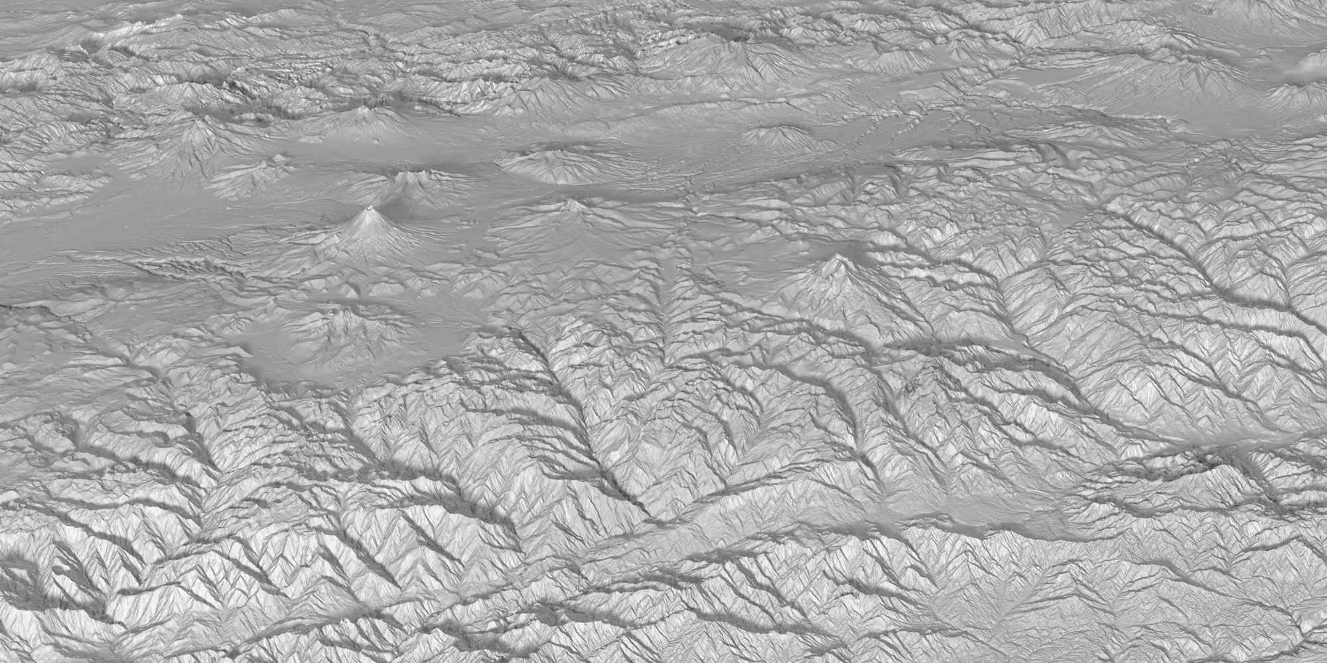



TanDEM-X – Global DEM
New 3D world map – TanDEM-X global elevation model completed
NX-01 «USS Enterprise»
In Space 2151
Pole-to-pole coverage: Homogenous standardised DEM for any spot on Earth
Unique quality: Superior elevation information anywhere on Earth
Unrivalled accuracy: 2m (relative) / 4m (absolute) vertical accuracy / 12m x 12m raster
Digital Surface Models and Terrain Models available
DEM AO&Proposal Call deadline December 1st 2016
http://www.geo-airbusds.com/worlddem/ and https://tandemx-science.dlr.de/
CHARM-F on HALO
2015

Slide 3
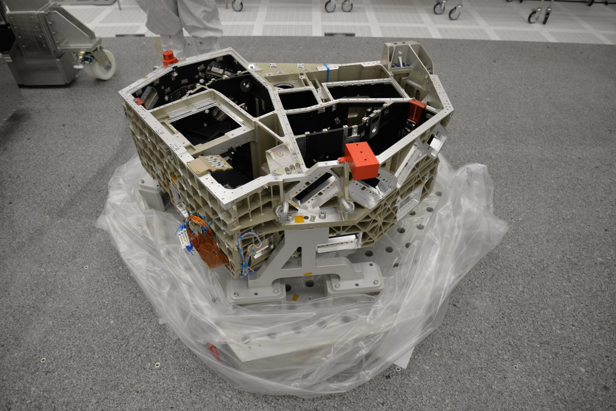
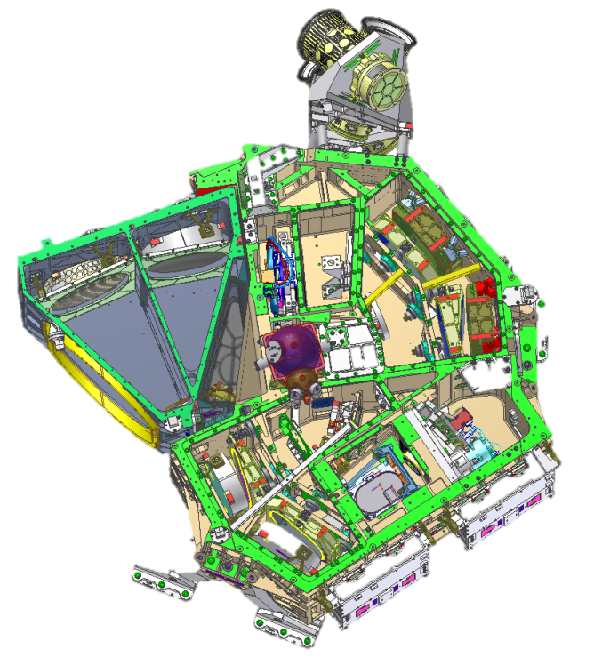
EnMAP
Hyperspectral mission, aims at
monitoring and characterising
the Earth’s environment on a
global scale
EnMAP serves to measure and
model key dynamic processes
of the Earth’s ecosystem
EnMAP is a scientific path finder
for later operational services
Status
    - in phase D
    - launch in 2019
www.enmap.org
Spectrometer optical bench

Slide 4
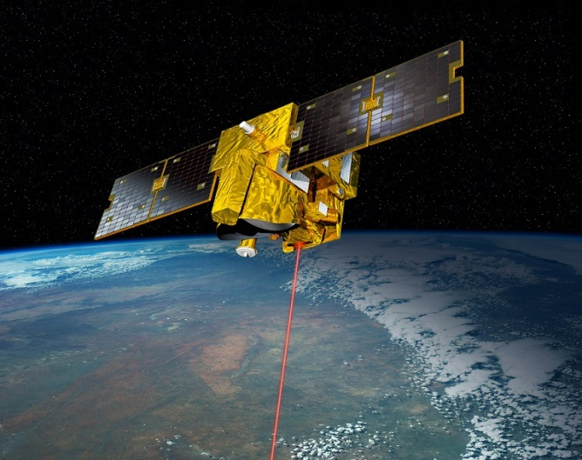
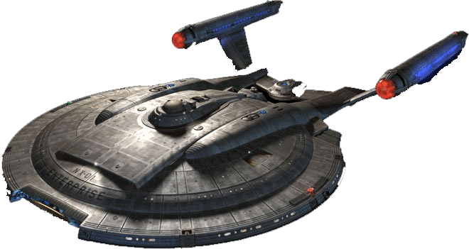
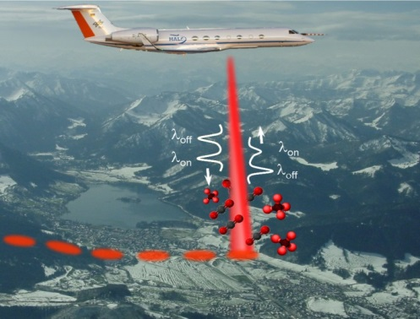
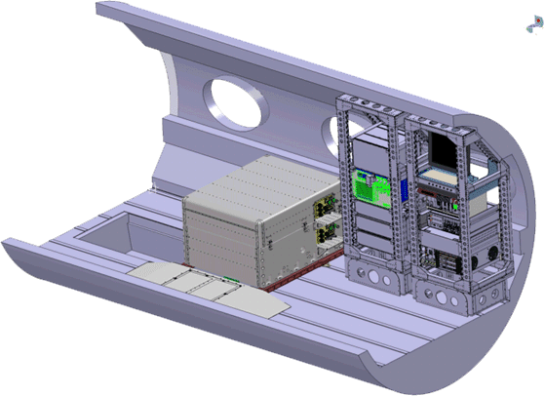

MERLIN
Franco-German (CNES/DLR) cooperation
on a climate satellite mission
first space-borne methane Integrated Path
Differential Absorption (IPDA) LIDAR
MERLIN will allow:
                global measurements of XCH4 at day and night
                on a country scale
        improvement of inverse modelling accuracy
Status:
  Early Phase C
  successful airborne demonstrator CHARM-F
  test flight May 2015 (CO2 & CH4 measurements)
upcoming major milestones:
  final design in 2018
  ready for launch in 2021
  3 years of operation
  https://merlin.cnes.fr
  http://www.dlr.de/rd/en/desktopdefault.aspx/tabid-2440/3586_read-31672
MERLIN in Orbit 2021
NX-01 «USS Enterprise»
In Space 2151
CHARM-F on HALO
2015

Slide 5
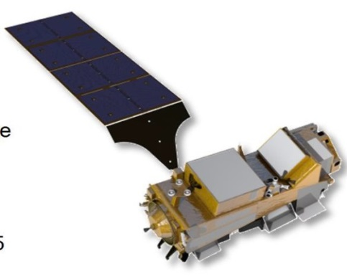
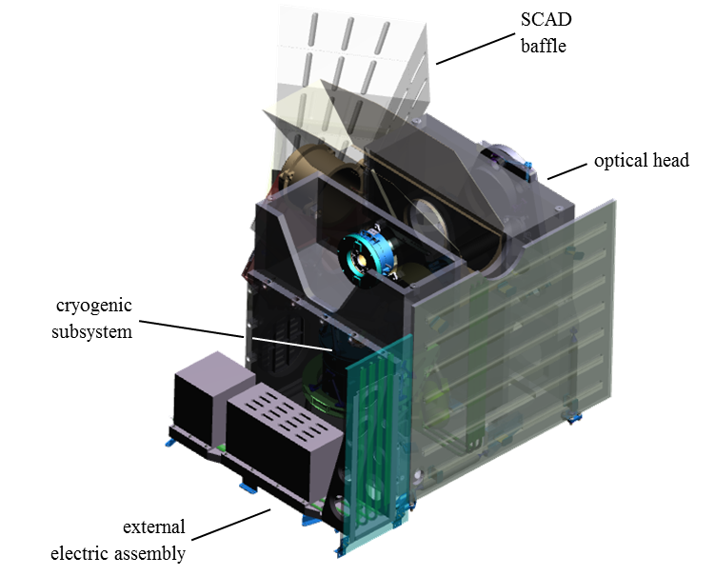

METimage
German contribution for the next EUMETSAT Polar System (EPS-SG)
                three generations of identical satellites
METimage is an imaging radiometer instrument
METimage will allow:
                measurement of physical parameters in atmosphere,
                sea & land surface for meteorological tasks
Status:
  in phase C
upcoming major milestones:
  final design in 2017
  delivery to ESA for integration with satellite: 2019
  launch of first METOP-SG satellite: 2021
  7,5 years of operation each
  http://www.dlr.de/rd/en/desktopdefault.aspx/tabid-2440/3586_read-10140/
NX-01 «USS Enterprise»
In Space 2151

Slide 6
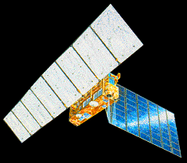
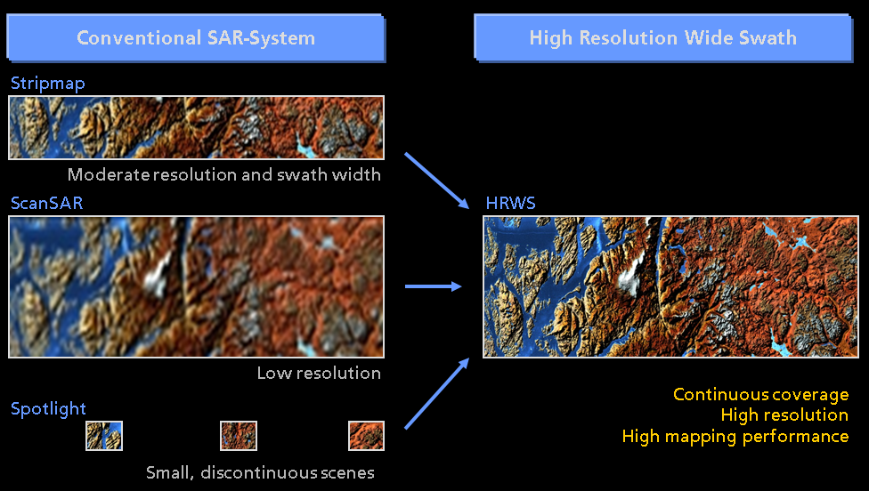
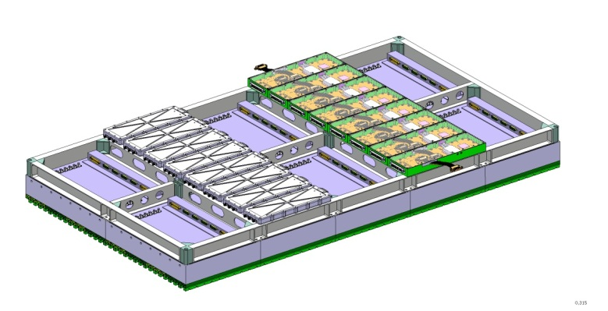
HRWS
HRWS: “High Resolution Wide Swath”
SAR performance potential beyond today's limitations by incorporating Digital Beamforming functions
integrated antenna demonstrator in finalized in 2015
Goal:
- HRWS mission around 2022+
Status:
- in phase 0

