Slide 1

JAXA’s Earth Observation Program
Committee on Earth Observation Satellites
JAXA
CEOS Plenary 2016
Agenda Item #9.1
Brisbane, Australia
1st – 2nd November 2016

Slide 2
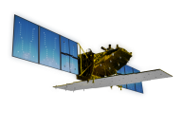

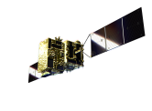







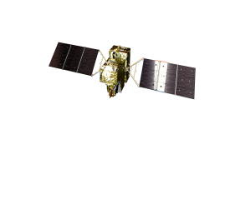
JAXA Earth Observation
Satellite Lineup
Targets (JFY) |  | 2008 | 2009 | 2010 | 2011 | 2012 | 2013 | 2014 | 2015 | 2016 | 2017 | 2018 | 2019 | 2020
Disasters & Resources
Climate Change & Water Water Cycle
Climate Change
Greenhouse gases
ALOS-2 PALSAR-2
ALOS/PALSAR
[Land and Disaster monitoring]
Advanced Optical Satellite
ALOS
ALOS/PRISM/AVNIR2
Advanced Radar Satellite
TRMM
TRMM/PR
GPM / DPR
Aqua
[Precipitation]
Aqua/AMSR-E
GCOM-W / AMSR2
[Wind, SST , Water vapor]
[Vegetation, aerosol, cloud, SST, ocean color]
250m, multi-angle, polarization
GCOM-C / SGLI
[Cloud and Aerosol 3D structure]
EarthCARE / CPR
[CO_{2,} Methane]
[CO_{2,} Methane, CO]
GOSAT
GOSAT-2
Mission status
Terminated
On orbit
Under Development

Slide 3
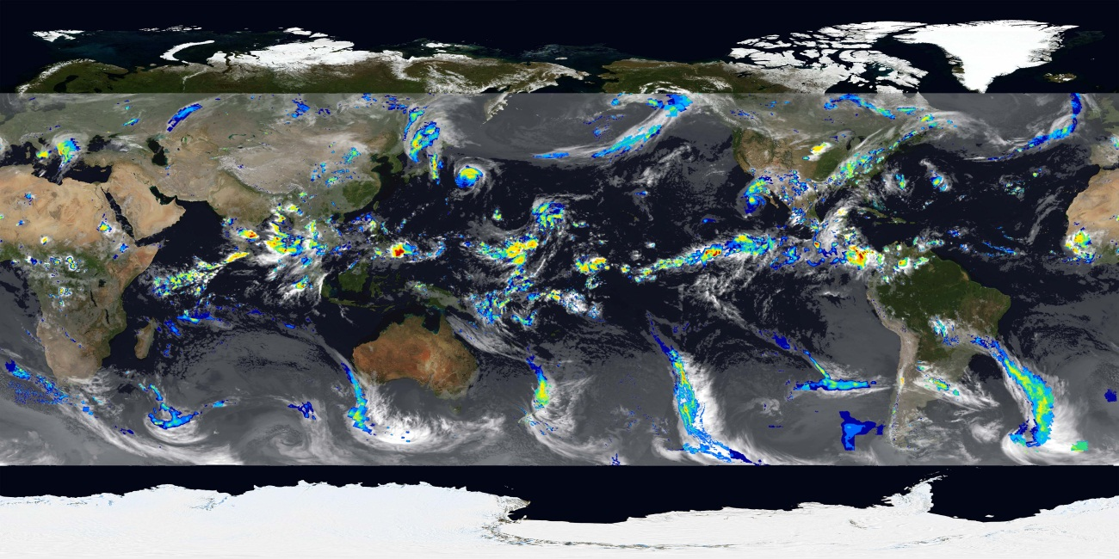
JAXA Global Rainfall Watch
http://sharaku.eorc.jaxa.jp/GSMaP/index.htm
Global rainfall observed by GSMaP_NRT on 10th September, 2015.
JAXA Global Rainfall Watch web site releases GSMaP_NRT products by merging GPM, GCOM-W and a number of passive microwave radiometers with geo-stationary IR information.
Variable | Rainfall rate (mm/hr)
Domain | Global (60N -60S)
Grid resolution | 0.1 degree lat/lon
Temporal resolution | 1 hour
Data latency | 4-hour after observation

Slide 4
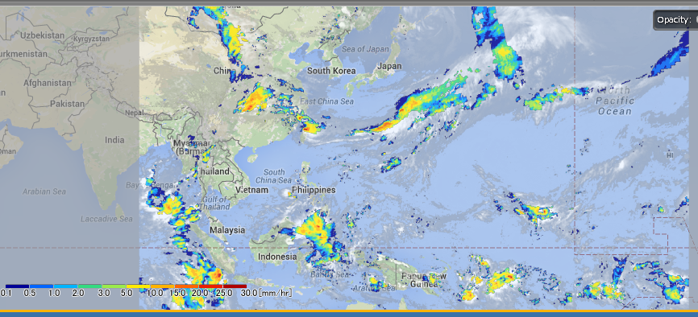
JAXA Realtime Rainfall Watch
http://sharaku.eorc.jaxa.jp/GSMaP_NOW/index.htm
New
05:00 – 05:59 UTC 2nd June, 2016
JAXA Realtime Rainfall Watch estimates current rainfall map using passive microwave observations within half-hour after observation and half-hour extrapolation of rainfall map based on cloud moving vector from the geostationary satellite.
Variable | Rainfall rate (mm/hr)
Domain | Geostationary satellite “Himawari” area
Grid resolution | 0.1 degree lat/lon
Temporal resolution | 1 hour
Update interval | 30 min
Data latency | 0-hour after observation

Slide 5
JAXA Global Rainfall Watch
Data incorporated
Satellite | Sensor (Type)
GPM Core | GMI (Imager)
GCOM-W | AMSR2 (Imager)
DMSP-F16 | SSMIS (Imager/Sounder)
DMSP-F17 | SSMIS (Imager/Sounder)
DMSP-F18 | SSMIS (Imager/Sounder)
NOAA-N18 | AMSU-A/MHS (Sounder)
NOAA-N19 | AMSU-A/MHS (Sounder)
MetOp-A | AMSU-A/MHS (Sounder)
MetOp-B | AMSU-A/MHS (Sounder)
Himawari (MTSAT) | IR data
Meteosat | IR data
GOES | IR data
GSMaP_NOW uses the same satellites data as listed here, except it uses only Himawari IR data to create cloud map (Meteosat and GOES are not included.)
Using the IR data from these geostationary satellites, GSMaP creates the cloud image.

Slide 6
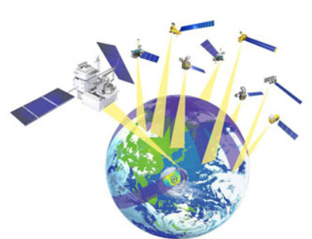
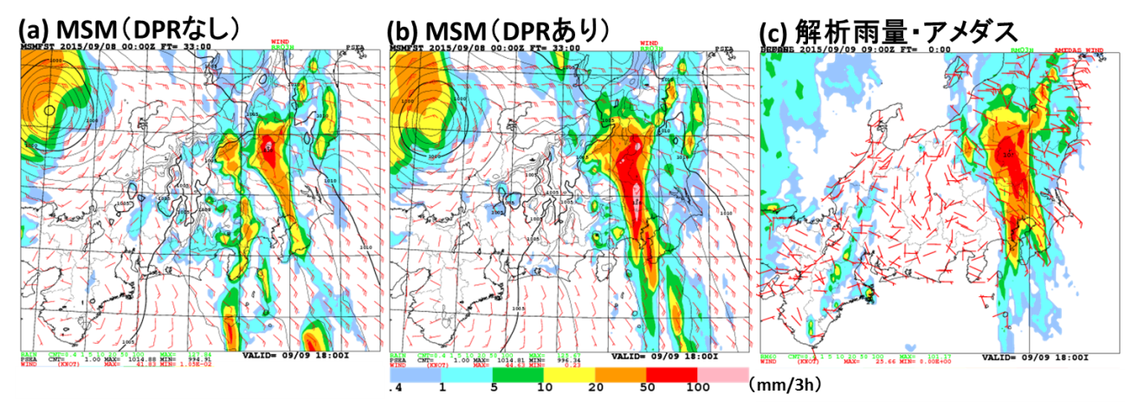
Operational use of GPM data by
the Japan Meteorological Agency
It is for the first time in the world for meteorological agencies to utilize satellite radar precipitation data such as DPR for numerical prediction.
Global Precipitation Observation
at 3 Hour Intervals
with GPM Core Satellite (DPR + GMI )
and Constellation Satellites (microwave radiometers/sounders)
Japan Meteorological Agency
Core sat in cooperation with NASA
(Without DPR)
(With DPR)
Ground Radar Obs.
Notes:
このように、気象庁は天気予報や防災気象情報等の基礎資料を作成する数値予報システムにおいて、降水等の予測精度が向上することを確認し、先月３月より、同衛星の観測データの定常的な利用を開始している。
As a result, JMA confirmed the accuracy improvement of the numerical prediction model for weather forecast system and disaster prevention weather information system. From this March, JMA stated to use GPM core satellite data to their operational numerical weather prediction system from this March
－－－－－－－－
（参考；図の解説）
第1図にDPRデータの利用によるMSMの降水予測の改善例を示します。2015年9月9日18時（日本時）を対象としたMSMによる前3時間降水量予測では、関東地方から東北地方南部にかけて観測された南北に伸びる線状の降水域（第1図（c））について、降水量が多い領域の位置ずれや降水量の過小傾向が見られました（第1図（a））。一方DPRデータを利用した予測ではこれらが改善していることがわかります（第1図（b））。これは、DPRデータにより、降水域の風上にあたる関東地方南海上における水蒸気量がより適切に初期値に取り込まれ、その結果として予測が改善したと考えられます。
GPM主衛星は、JAXAがNASAと共同で開発した地球観測衛星です。
GPM主衛星には、日本が開発した二周波降水レーダ（DPR）と、米国が開発したGPMマイクロ波イメージャ（GMI）の2種類の観測装置が搭載されています。
数値予報システムにDPRのような「三次元(鉛直)観測ができる」衛星搭載降水レーダのデータを利用することは、世界の気象機関では初めてのことになります。
The core observatory satellite is the earth observation satellite jointly developed by JAXA and USA.
The GPM's core observatory carries the Dual Frequency Precipitation Radar (DPR) developed by Japan and a GPM Microwave Imager (GMI) developed by the US.
It is the first occasion in the world that a meteorological agency utilized the data of satellite precipitation radar like DPR that can observe vertical information of precipitation system for the numerical prediction.
http://www.jaxa.jp/press/2016/03/20160324_gpm_j.html

Slide 7
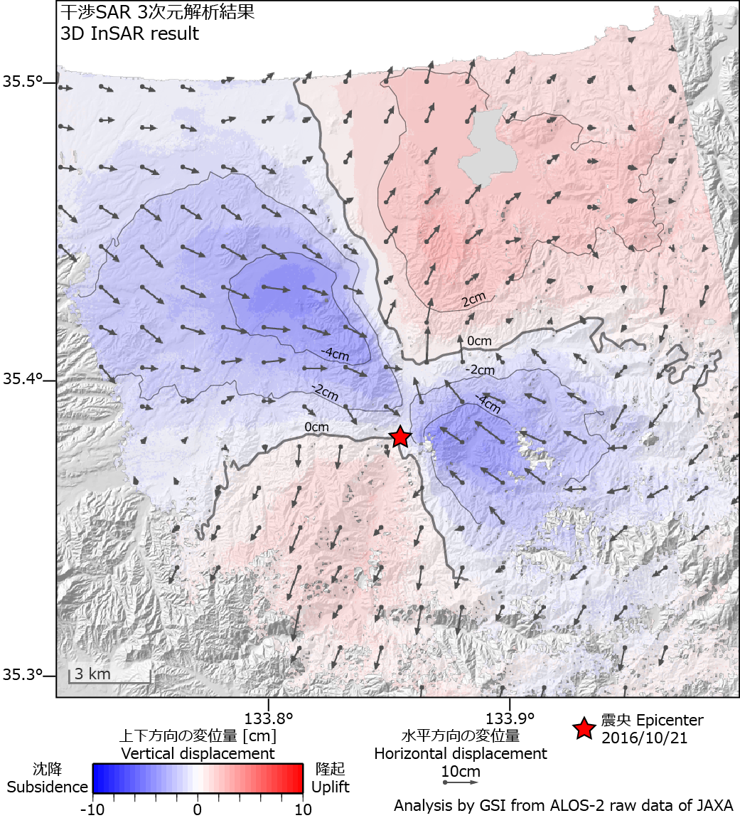
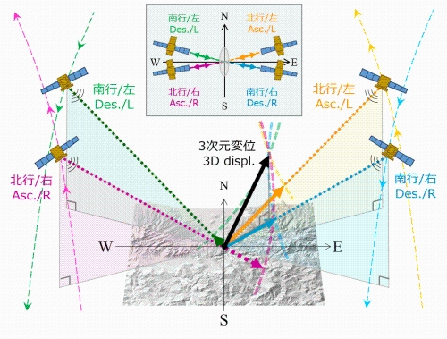
2016 Tottori Earthquake - 3D Crustal
Deformation Revealed by SAR-
Geometry of 3D InSAR
Copyright. Geospatial Information Authority of Japan. ALL RIGHTS RESERVED.
3D displacement revealed by 3D InSAR

