Slide 1

Global Climate Observing System (GCOS)
Committee on Earth Observation Satellites
CEOS Plenary 2017
Agenda Item 2.2
Rapid City, South Dakota, USA
19 – 20 October 2017

Slide 2
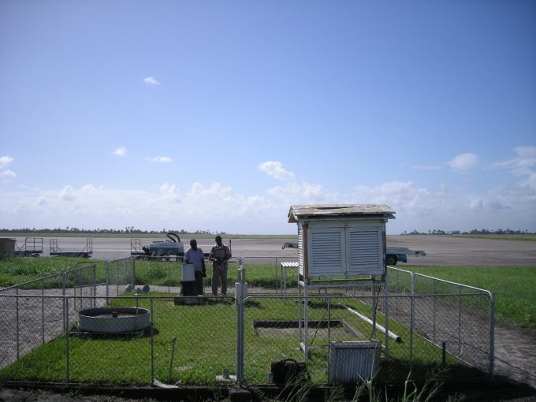
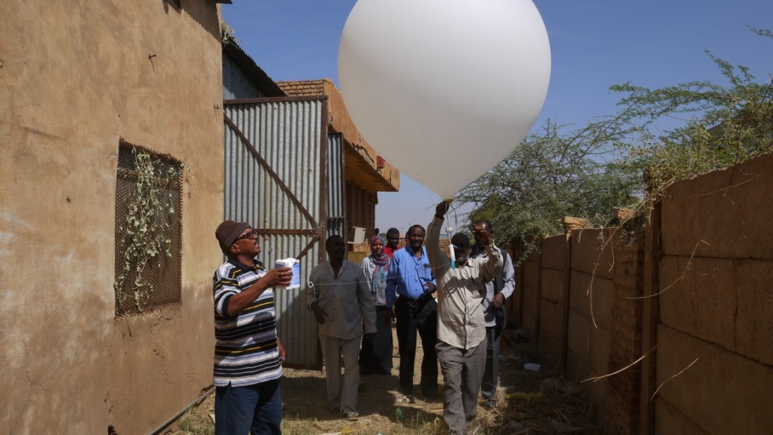
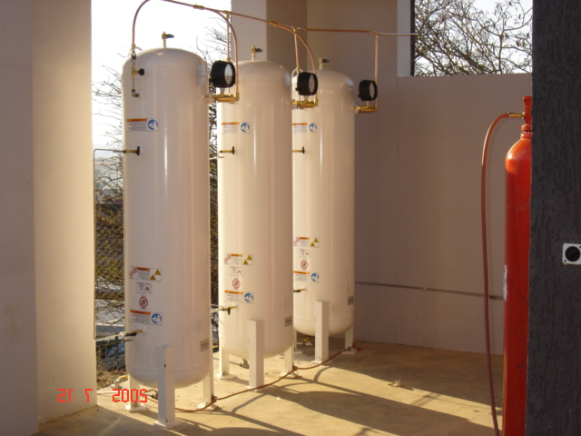
Scope
GCOS assesses progress and requirements, advises on implementation
    report and plan to be submitted to sponsors and UNFCCC in 2015/16
GCOS provides assistance with implementation of infrastructure
    funds provided in past year by Germany, Japan, Switzerland and the UK
    Network Manager is supported by the UK

Slide 3

GCOS Contributing to Paris Agreement
Art 4
Art 5
Art 7
Art 8
Art 9
Art 10
Art 11
Art 12
Art 13
Art 14
Art 7 (7c)
Paris Agreement Article 7 (7c): Strengthening scientific knowledge on climate, including research, systemic observation of the climate system and early warning systems.
Notes:
COP-21: Paris Agreement Article 7 (7c)
Strengthening scientific knowledge on climate, including research, systematic observation of the climate
system and early warning systems, in a manner that informs climate services and supports decision- making
Developing the Transparency Framework (the need to promote transparency, accuracy, completeness, consistency, and comparability, and environmental integrity)
Short Keys:
Art. 4. Nationally Determined Contribution
Art. 5. Mitigation (REDD+)
Art. 7. Adaptation & Early Warning Systems. Systematic Observations, Adaption planning
Art. 8. Loss and damage: Early warning systems, emergency preparedness, slow onset events etc.
Art. 9 Provide finance
Art. 10 Technology Transfer
Art. 11 Capacity Development
Art. 12. Improve Public Communications
Art. 13: para. 7 & 8. Reporting and transparency framework
Art. 14 Global Stocktake

Slide 4
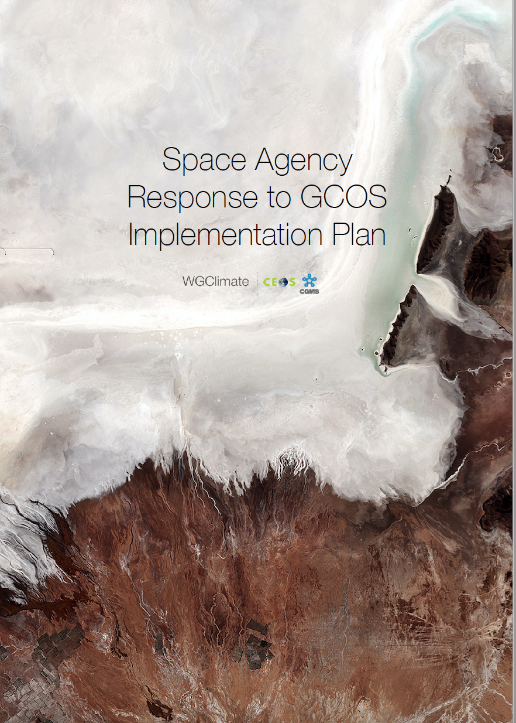


You can download the English edited version!
Also available: French translation
gcos.wmo.int
@gcos_un
2016
GCOS Implementation Plan

Slide 5
2017
Space Agency Response

Slide 6

What is new in the GCOS Plan?
Adaptation
& Mitigation
I
Water, Energy and Carbon cycles
II
New Plan
2016
Additional Essential Climate Variables
III
Emphasis on more help for networks in developing countries
IV
Climate Indicators
V
19 / CP.22
(Decision 19,
COP-22, Marrakech, Morocco)

Slide 7

Precipitation, Cloud Properties,
Water Vapour Surface Temperature
Ocean Acidification
Carbon Dioxide,
Methane
Deforestation
Mitigation
Ecosystem Loss
Sea Level Rise
Fisheries
Water
Carbon
Sea Surface
& Subsurface Salinity,
Sea Level,
Sea Surface Temperature
Soil Moisture,
River Discharge,
Lakes, Groundwater, Cryosphere, Water use
Inorganic Carbon
Soil Carbon,
Above-ground Biomass, Fire, GHG Fluxes
Coral Bleaching
Agriculture
Human Health
Floods
Droughts
Water Resources
Storms
Radiation Budgets, Temperature Wind speed & direction
Systemic Risks
Security
Slow Economic Development
Energy
Ocean Surface Heat Flux, Sea Surface & Subsurface Temperature,
Albedo,
Latent and Sensible Heat fluxes, Land Surface Temperature
Global Climate Cycles
Temperature
Heat waves

Slide 8
Targets: in need to be refined
Carbon Budget
  Quantify fluxes of carbon-related greenhouse gases to +/- 10% on annual timescales
  Quantify changes in carbon stocks to +/- 10% on decadal timescales in the ocean and on land, and to +/- 2.5 % in the atmosphere on annual timescales
Global Water Cycle
  Close water cycle globally within 5% on annual timescales
Global Energy Balance
  Balance energy budget to within 0.1 Wm⁻² on annual timescales
Explain changing conditions of the biosphere
  Measured ECVs that are accurate enough to explain changes of the biosphere (for example, species composition, biodiversity, etc.)

Slide 9
Climate Indicators – endorsed by GCOS SC25, September 2017
Notes:
Concept of suite of historical indicators endorsed
Purpose: information of general public
Rationale and overall criteria for selection broadly approved
Specific list noted:
Broadly agreed – Ts, OHC, SLR, CO2, Arctic sea ice extent
Some specific issues with eg deforestation
Desire to see some land-based indicator if possible
Need to define subsidiary indicators:
TOA Energy Balance, CH4, N2O, hdyrogenated GHGs, snow extent
Some other candidates suggested
Total area of permafrost
Seasonal indicator of some sort / phenology
Desertification/greenness…?
Extreme events has attraction of frequent update but specific definition problematic.
Many sources of indicators already exist
Need to consider what sources can be quoted /which are given seal of approval, and why
How should indicators be represented?
By links to other original sources
Copies of other site content
Specific graphs/data items/images?
Consider carefully use of maps (visualization)
Draw analogy between ECVs/climate variables and GCOS Headline Climate Indicators/overall climate descriptors
Link Climate Indicators to ECVs
Use as basis for wider communications activities including more detailed stories/links etc.

Slide 10
Climate Indicators - Criteria
Relevance: each one should be a clear and understandable indicator of global climate change, which has broad impact for a range of audiences. Some indicators will also have national and regional values
Representativeness: indicators as a package should provide a representative picture of changes to the earth system related to climate change
Traceability: indicators should be calculated using an internationally agreed and published method
Timeliness: indicators should be calculated regularly (at least annually) with a short lag between the end of the period and publishing the data
Limited number: to allow clear and concise communication, the number of indicators should be limited to less than 10
Notes:
How should indicators be represented?
By links to other original sources
Copies of other site content
Specific graphs/data items/images?
Consider carefully use of maps (visualization)
Draw analogy between ECVs/climate variables and GCOS Headline Climate Indicators/overall climate descriptors
Link Climate Indicators to ECVs
Use as basis for wider communications activities including more detailed stories/links etc.

Slide 11
Regional Adaptation Activities – closing the gap between global plans
GCOS Implementation Plan
Observations made by global networks
Reanalysis products
Downscaled models
Proxy measurements and data rescue
climate services
such as adaptation, mitigation planning and monitoring
GCOS Regional adaptation workshops
Local high resolution measurements
Additional parameters based on local needs
Socio-economic, health etc. data

Slide 12
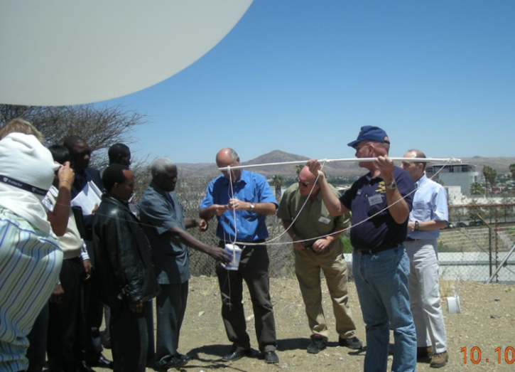
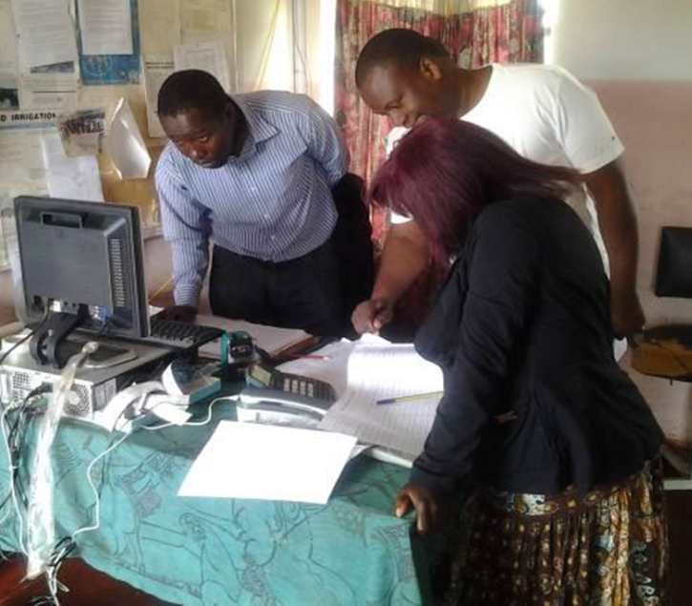
Regional Adaptation Activities – closing the gap between global plans and local needs
GCOS Implementation plan is global but also aims to support local needs: adaptation
GCOS is planning to start a series of regional workshops to
  identify needs and gaps
  produce plans
  identify other sources of information
GCOS Cooperation Mechanism provides practical support and capacity development

Slide 13
Regional Adaptation Activities – closing the gap between global plans and local needs
19 / CP.22
(Decision 19,
COP-22, Marrakech, Morocco)
Joint GCOS-WIGOS Workshop for Pacific SIDS, Nadi, Fiji, 9-12 October 2017
“Systematic upper air observations in the Pacific region, tend to have the highest measured impact, of all ground-based measurements, on the quality and accuracy of weather and climate analysis and prediction not only locally, but globally. The resulting products underpin weather and climate aspects of early warning systems as well as other climate-related services. “…
“…systematic observation is particularly challenging in this region.”
Notes:
Both the spatial density and observing frequency of the upper air network over the South Pacific region currently fall short of GCOS and WMO requirements. Due to the unique geography of the region – vast swathes of ocean surface with relative little land mass distributed over some 20 small island states with modest-size populations and correspondingly modest GDPs – systematic observation is particularly challenging in this region.
The upper air network over the South Pacific therefore needs sustained international support.

Slide 14
GCOS-WIGOS Workshop for Pacific SIDS – key outcomes
Pacific region observing network plan in support of the GCOS Implementation Plan and the Implementation Plan for the Evolution of Global Observing Systems (EGOS IP).
      As a reminder: EGOS is a major contributor to the GEOSS, with a space component through partnerships with CGMS, CEOS and interfaces with WMO partnered systems like GCOS and GOOS.
Commitment to free and open data sharing in accordance with WMO Resolutions 40 and 60 and the GCOS Monitoring Principles.
Meeting agreed international standards as well as national requirements.
Ensuring sustainability, including necessary elements of capacity development.
Developed by GCOS and WMO/WIGOS in collaboration with Secretariat of the Pacific Regional Environmental Programme (SPREP), the Pacific Islands Communication and Infrastructure Panel (PICI), and Pacific Meteorological Council, and submitted to COP 24.
Notes:
The future GOS will play a central role within the WMO Integrated Global Observing System (WIGOS). This evolved integrated observing system will be a comprehensive “system of systems” interfaced with WMO co-sponsored and other non-WMO observing systems, making major contributions to the Global Earth Observation System of Systems (GEOSS); and will be delivered through enhanced involvement of WMO Members, Regions and technical commissions. The space-based component will rely on enhanced collaboration through partnerships such as the Coordination Group for Meteorological Satellites (CGMS) and the Committee on Earth Observation Satellites (CEOS). Portions of the surface and space-based sub-systems will rely on WMO partner organizations: the Global Terrestrial Observing System (GTOS), the Global Ocean Observing System (GOOS), the Global Climate Observing System (GCOS), and others.

Slide 15
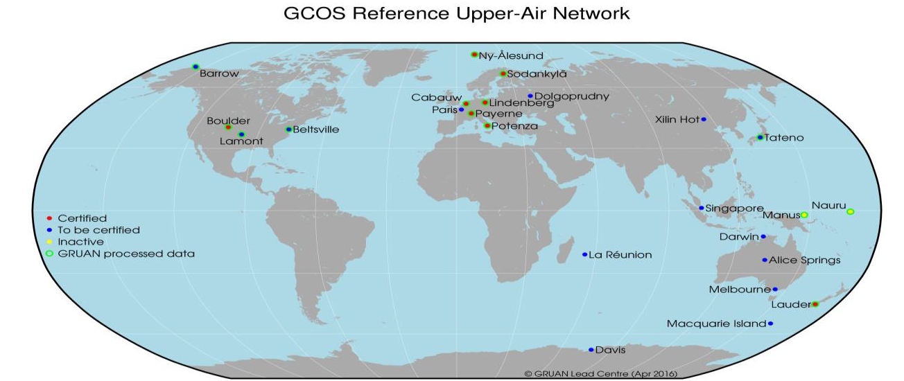
Satellite Cal/Val - need for reference networks
GCOS Plan Action A15: Implementation of Reference Upper-Air Network
Benefit: Reference-quality measurements for other networks, in particular GUAN, process understanding and satellite cal/val.

Slide 16

Key Points:
GCOS Implementation Plan – take actions in light of the Paris Agreement and contribute to the Global Stock Take process
Space Agency Response – strong commitment from CEOS & CGMS
3. Research needed on targets for Energy, Water and Carbon cycle: in need to be refined
4. Implement GCOS Climate Indicators which should be linked to ECVs and use it as a communication tool.
5. Regional Adaptation Activities – closing the gap between global plans
6. Tie the knot: surface and space – need for high quality reference networks

