Slide 1

Broader Coordination on Carbon Observations
Committee on Earth Observation Satellites
Mark Dowell
European Commission
CEOS Plenary 2017
Agenda Item # 3.6
Rapid City, South Dakota, USA
19 – 20 October 2017

Slide 2

CEOS Foundation
CEOS Carbon Strategy
GEO Carbon Report developed in June 2010 by team led by Ciais et al. (GCP).
CEOS Strategy for Carbon Observations from Space – written in response to above, completed in March 2014 – Wickland et al.
42 Actions identified in the report for specific response– first discussed at SIT Technical Workshop in September 2013

Slide 3
International
Policy context
UNFCCC
Global Climate Observing System
IPCC TFI
SBSTA Chair initiatives on EO, e.g. Earthinfo day 2017
Action T71*
Prepare for a Carbon Monitoring System
Review of 2006 Guideline for Inventories – due 2019
CEOS – Response to GCOS IP
CEOS – JAXA/MoE
Initiative -> include space

Slide 4
Action in GCOS IP 2016
“Specifically CEOS and CGMS will undertake, over the next few years, dedicated preparatory work in a coordinated international context…:
The definition of an architecture of space component elements to address the requirements of a CO₂ and GHG monitoring system , … This will provide a global holistic perspective both from the point of view of existing and planned space segment assets as well and that for an optimum global constellation.
The documentation of best practices on the relationships between individual space agencies and their counterparts working on the modelling aspects, the inventories and in-situ data provision, …
The further consolidation of partnerships and collaborations between the relevant international entities including: the relationship between CEOS and CGMS on the space component aspects, the partnership with the WMO and GEO on the broader framework, … and finally the relationships with GCOS itself, UNFCCC and IPCC TFI process in better defining the role for space-based observation in the inventory guideline process.”

Slide 5
Data “providers”
General International Framework??
Space segment coordination
In-situ Data Coordination
9
CEOS
1
CGMS
6
UN World Meteorological Organisation
7
Group on Earth Observations
2
CEOS Carbon Strategy
CGMS Sec
7
IG3IS
GEO Carbon & GHG
8
3
AC-VC
Architecture
CGMS contr AC-VC Arch
4
WDCGG
TCCON
ICOS
FLUXNET
SOCAT
…
5
CNES
NASA
JAXA
NOAA
CMA
JMA
ISRO
DLR
ESA
EC
EUM
…

Slide 6
GEO Carbon and GHG Initiative
Accepted as a GEO Initiative at 3rd GEO Programme Board 2016
The GEO C and GHG initiative provides cross integration and coordination of the interfaces (between: atmosphere, ocean and terrestrial domains; space-based, air-borne and in-situ monitoring systems;). It builds on existing strategies, initiatives, networks and infrastructures, and integrates them with the missing pieces to obtain a comprehensive globally coordinated GHG observation and analysis system.
Key Elements
  Task 1: User needs and policy interface (policy and science requirements)
  Task 2: Data access and availability (CEOS)
  Task 3: Optimization of observational networks (CEOS)
  Task 4: Budget calculation consistency (Global, Regional, sub-Regional, National, Local) (CEOS Carbon Strategy)
CEOS POC: Stephen Plummer, ESA – member of Executive Committee
Potential for this to be integrator for global in-situ networks

Slide 7
CEOS Chair 2018 priority A
Specific Chair Initiative #1: Laying the foundation for an international CO2 and GHG monitoring system
Three specific activities are foreseen for advancing this effort in 2017-2018:
Facilitate the completion and follow-on activities of the AC-VC whitepaper on defining an optimum constellation for CO2 and GHG monitoring, including the joint competences of CEOS and CGMS, and in the general framework of the continued implementation of the CEOS Carbon Strategy
Place the space segment in the broader context of a fully sustained system for CO2 monitoring. Individual CEOS Agencies have counterparts in their individual countries/regions who have responsibility for Inventories, the required modelling, in-situ infrastructure and the ground segment elements.
Advance the relationship with CGMS for an operationally implemented and sustained observation capability. Consider establishing a formal working relationship between CEOS and CGMS as with the successful ongoing relationship on Systematic Observations of ECVs in support of UNFCCC.

Slide 8
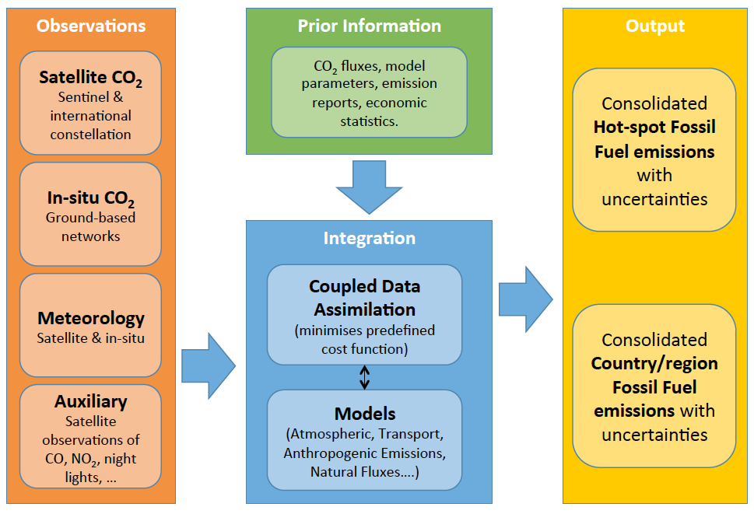
Overview of the Core Elements of the Anthropogenic CO₂ Emission Monitoring & Verification Support (MVS) capacity

Slide 9
Chair priority A workshop in 2018
On “placing the space segment in the broader context of a fully sustained system for CO2 monitoring”
The EC proposes to organise a dedicated discussion workshop:
Bringing together these different stakeholders to define best practices and synergies
Exploring possibilities for common approaches to some of the system development.
This would also require the strong engagement of CGMS as well as CEOS Associate members such as the WMO.
June 2018 period. Probably somewhere in Northern Italy …

Slide 10
CEOS CGMS Coordination on GHG monitoring - options
Continue adhoc collaboration in context of CEOS Carbon Strategy Actions e.g. as-in joint efforts on AC-VC Whitepaper
Establish a sub-group (with dedicated resources) in context of existing standing WG i.e. Joint WG on Climate
Establish a dedicated Joint WG specifically on Carbon /GHG observations
In the context of next year assess/discuss these different options both within CEOS and CGMS - propose a preferred option

Slide 11
“Conclusions”
CEOS Carbon Strategy provides us a strong foundation
CEOS has (and is fostering) solid links with the relevant international policy entities
Space Agency coordination is probably a first priority for action i.e. CEOS-CGMS relationship – EC Chair Priority
Continued dialogue with CEOS Associate members (GCOS, GEO, WMO) – encourage coordination of in-situ – both NMHS and non-NMHS
Broader coordination framework still in “definition” next 12-24 months will be critical.

