Slide 1

WGCapD Report
Committee on Earth Observation Satellites
Organization: SANSA
CEOS Plenary 2017
Agenda Item # 10.3
Rapid City, South Dakota, USA
18th – 20th October 2017

Slide 2
Working Group for Capacity Building and Data Democracy (WGCapD)
2016 – 2017 Progress to Date
Raise awareness of the value of EO data products and services to user communities
  SRTM-30m and SAR training workshops in AfriGEOSS, AmeriGEOSS, and Asia Oceania GEOSS regions
Support CEOS initiatives and helps WGs and VCs undertake their own capacity building initiatives
  Identified on-line and hands on training in EO best practices at each agency
  Draft document available by end of 2017
Collaborate with GEO, UNOOSA, and other UN agencies
  Contributed SAR expertise to 2016 AmeriGEOSS Week training
  Collaborated with UNOOSA on SAR trainings
  Provided training resources to GEOCAB, a system to collect capacity building resources

Slide 3
2016 - 2017 Activities
SAR Workshops
- Lusaka, Zambia (October, 2016)
- Pretoria, South Africa (January 2017)
- Libreville, Gabon (February, 2017)
- Tshwane, South Africa (May, 2017)
- AmeriGEOSS week in Costa Rica (Aug, 2017)
Other Workshops:
- Gift Workshop- Cape Town, 27- 28 August 2016
- One Earth Health-Earth Observations (EO) to Public Health Practices, Montreal Canada – 2017
Sentinel training - S1/S2/S3 during AfriGEOSS Symposium, Accra Ghana, 2017
Online
- Webinar on SAR – 2017 (Total Participants: 252 from 53 Countries (Apr.17-Jun 9, 2017)
            Languages: English and French
            Estimated # of Participants Onsite & online > 240
            Focus Areas: Disasters and Health
            Regions: Africa, South Asia, Australia, Latin America and the Caribbean

Slide 4
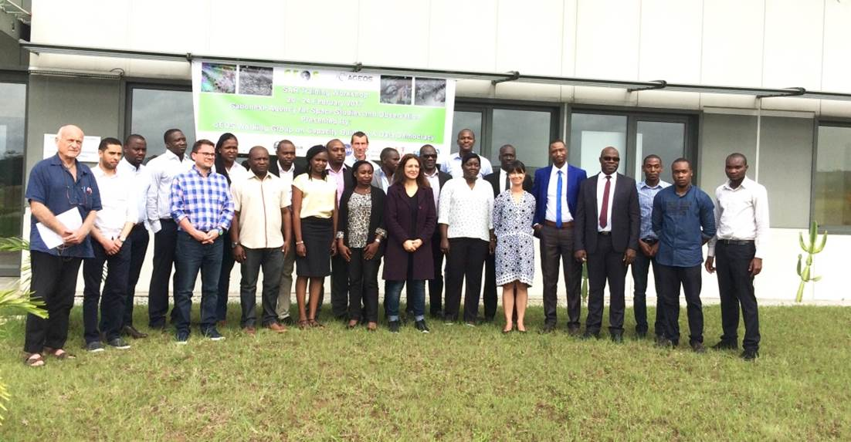
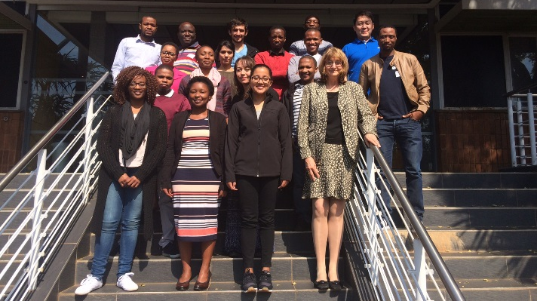

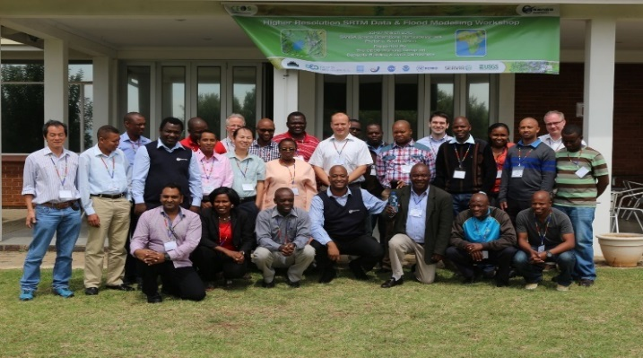
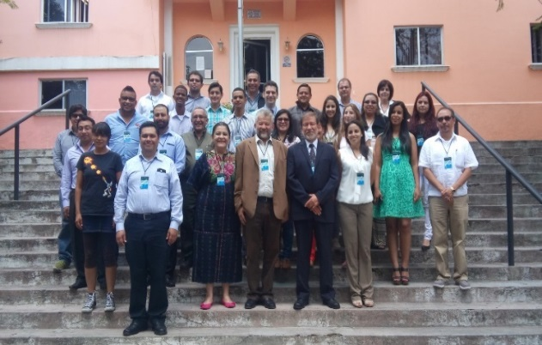
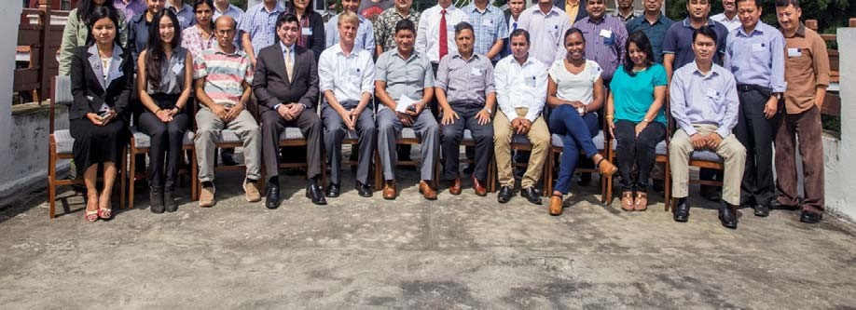
2016 - 2017 Activities
ISPRS SAR workshop -Pretoria
SAR workshop -Gabon
SAR workshop - Zambia
SRTM workshop –Kathmandu-Nepal
SAR workshop - Pretoria
SAR workshop – Costa Rica

Slide 5
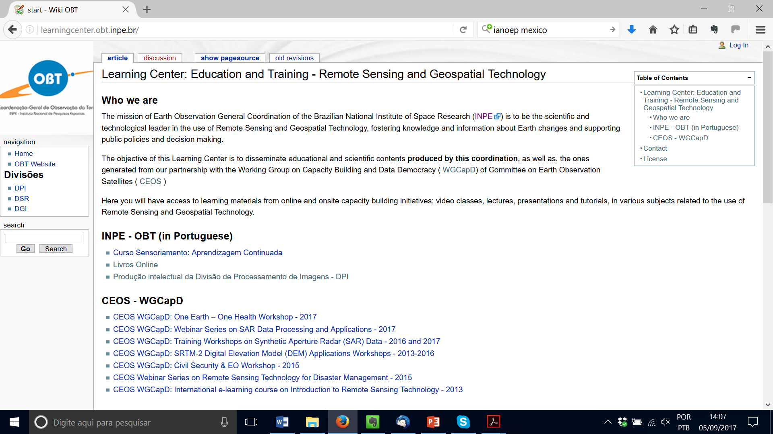
Lessons Learned and Best Practices
Digital Knowledge Repository for record and archival of teaching material – Free and open (Creative Commons License) at: http://learningcenter.obt.inpe.br/

Slide 6
Lessons Learned & Best Practices
Lessons Learned Reports from Capacity Building Initiatives are available on the site:
http://ceos.org/ourwork/workinggroups/wgcapd/e-learning/
http://ceos.org/ourwork/workinggroups/wgcapd/training-workshops/
Document being compiled: → Training: Methods & Best Practices
Training activities in general, using the five phases of the ADDIE (Analysis, Design, Development, Implementation, Evaluation)
General Tips
Webinar Tips
Summarized Steps for Creating Training Initiatives.

Slide 7

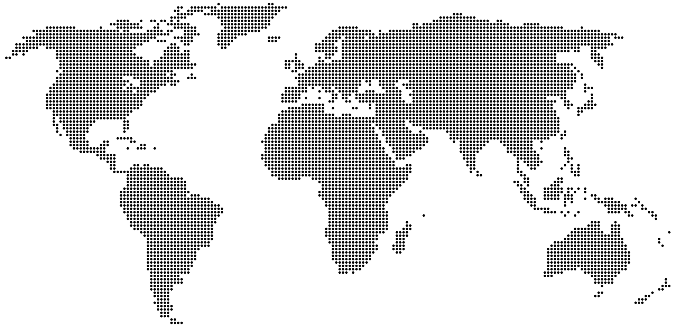
















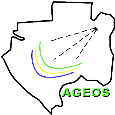





WGCapD: Members and Collaborators
Space Agencies, Associated Members, Universities, NGOs …
Based on voluntary contributions …

Slide 8


2018-2020 - Chairmanship
Phila Sibandze
Senthil Kumar
Vice chair position is still open !!

Slide 9
Committee on Earth Observation Satellites
Thank you for your support

