Slide 1
Outcomes from the Trial Joint Meeting of LSI-VC, SDCG/GFOI, and the GEOGLAM ad-hoc Working Group
Committee on Earth Observation Satellites
Stephen Ward, SIT Chair Team
CEOS Plenary 2017
Agenda Item #10.5
Rapid City, South Dakota, USA
19 – 20 October 2017

Slide 2
Agenda
For reference
Brief report on context and what emerged from the joint meeting
For debate
The proposed next steps on ‘rationalisation of CEOS LSI activities’

Slide 3
Background and status
Ongoing discussion around opportunity - main motives are representation/travel efficiency and improved coordination among related groups
Agencies represented in LSI, SDCG, GEOGLAM keen
Side meeting at Brisbane Plenary – trial meeting agreed as way forward
Discussion Paper and planning telcons followed

Slide 4
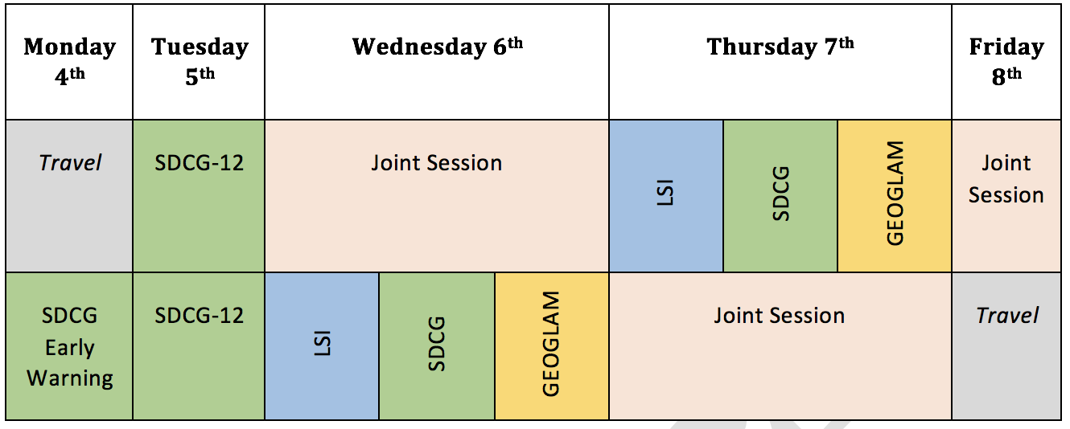
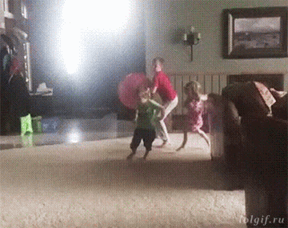
Trial Meeting
Individual sessions
Joint sessions
Lessons and process

Slide 5
Outcomes & Lessons Learned
Extremely productive
ARD, MRI, DataCube pilots, User Requirements, mission updates – significant overlap and interest across groups
Agreed to have thematic communities formally engaged in the ARD spec and review process
With benefits comes compromise – but manageable. More people and more rooms reduces number of hosts.
Less parallel sessions next time

Slide 6
For discussion: Way Forward
Essential to retain identify of thematic teams (GFOI, GEOGLAM) and their strong connection to their constituencies
No benefit in ‘nesting’ under LSI-VC at this time
Unanimous agreement that individual groups continue – with further joint meetings agreed to be beneficial
Less travel efficiencies in practice and some hosting complications

Slide 7
For discussion: Way Forward
What an annual cycle might look like…
GFOI
Plenary ~Q1
Joint meetings
LSI/GFOI/GEOGLAM
[Week before SIT TW]
GEOGLAM
Plenary

Slide 8
For discussion: Way Forward
Subject to Plenary conclusions, the 3 groups will meet again in the week of 4 Sep 2018 (week prior to SIT TW – our constraint)
Looking for a host somewhere in Europe
Expect to have more focused discussion on joint work planning
DISCUSS!

