Slide 1

CEOS Ad Hoc WG on GEOGLAM
Committee on Earth Observation Satellites
Brad Doorn (NASA) & Selma Cherchali (CNES)
CEOS Plenary 2017
Agenda Item #5.1
Rapid City, South Dakota, USA
19 – 20 October 2017

Slide 2
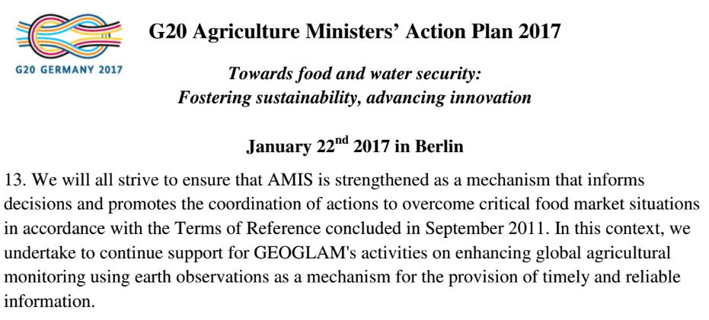
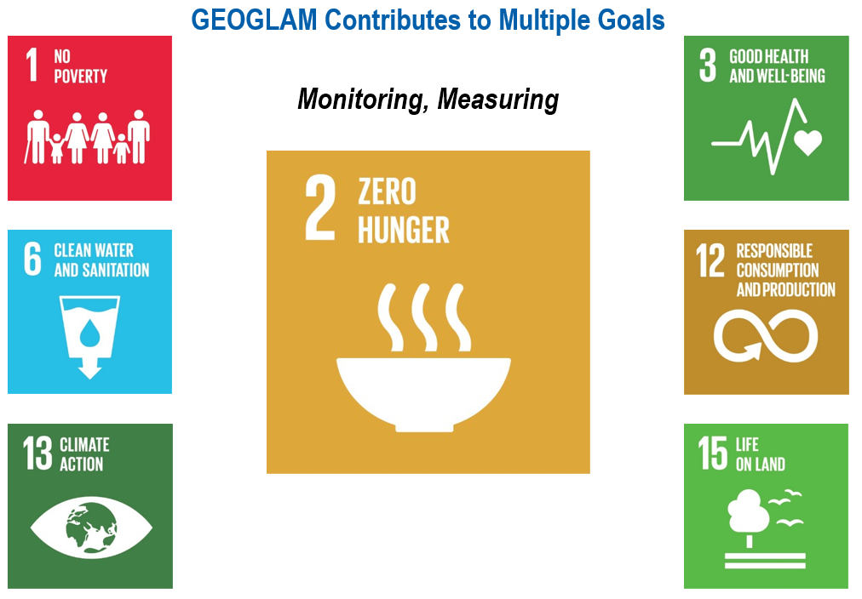
Continued Strong Mandate
Re-endorsement of GEOGLAM by G20
  Signaling ever greater support, strengthened political mandate
    EO for timely, reliable information
Contributing to the UN Sustainable Development Goals
  Short Term: Leverage existing activities
  Medium Term: quantitative metrics from R&D activities; accelerate RtO continuum
  Long Term: strengthen international cooperation and identify institutional homes for activities

Slide 3
GEOGLAM Programme Support
GEOGLAM has selected a new Programme Director, Ian Jarvis, Agriculture and Agri-Food Canada
  With support from Germany
  To start in Fall 2017
  Many thanks to Michel Deshayes (MinAg France), who served as Coordinator from 2013-2017 (retired September 2017)
  Other Secretariat support (Whitcraft, Becker-Reshef) remains
  Still seeking additional Secretariat staff (Admin; Promotional/Outreach Lead…)

Slide 4
GEOGLAM Programme Support: sample workplan activities/tasks
CSA has funded two SAR inter-comparison activities with JECAM.
CNES supporting crop classification tools adapted to smallholder agriculture (developed and tested on JECAM sites).
CNES supporting a platform integrating a spatialized crop model and satellite data for West Africa (linked to AGRHYMET early warning system, and potentially to GEOGLAM CM4EW). (Sen2f-Agri background and TOSCA R&D projects)
ESA providing an open source Sen2-Agri system developed in coordination with the JECAM network and extends the Sen2-Agri project to support the uptake by national and GEOGLAM partners.
NASA has established a Consortium led by the University of Maryland to implement a coordinated program of EO activities for global food security and agriculture applied research (incl GEOGLAM)
  NASA Distributed Active Archive Centers (DAAC) is funding GEOGLAM to implement a Data User Study Pilot for Agriculture.

Slide 5
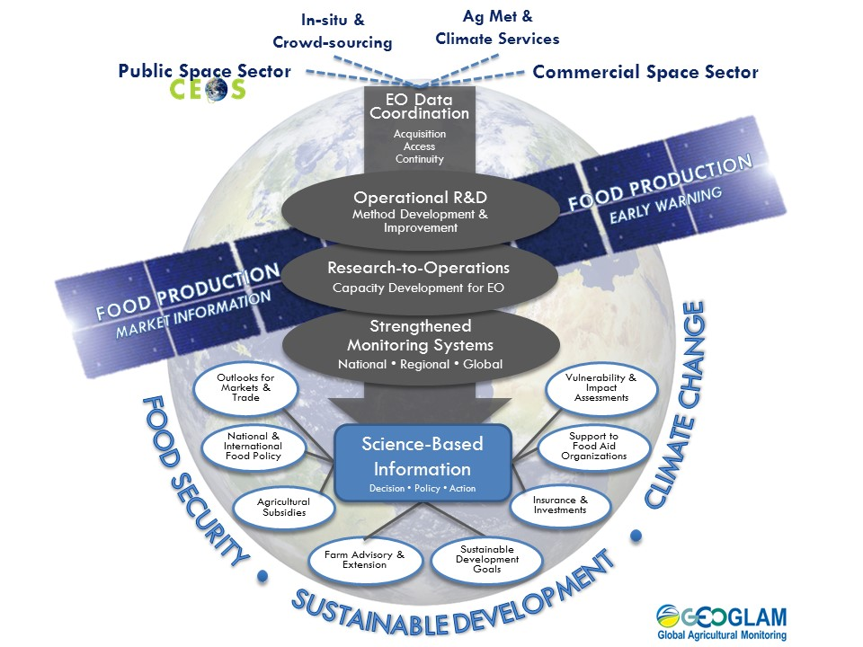
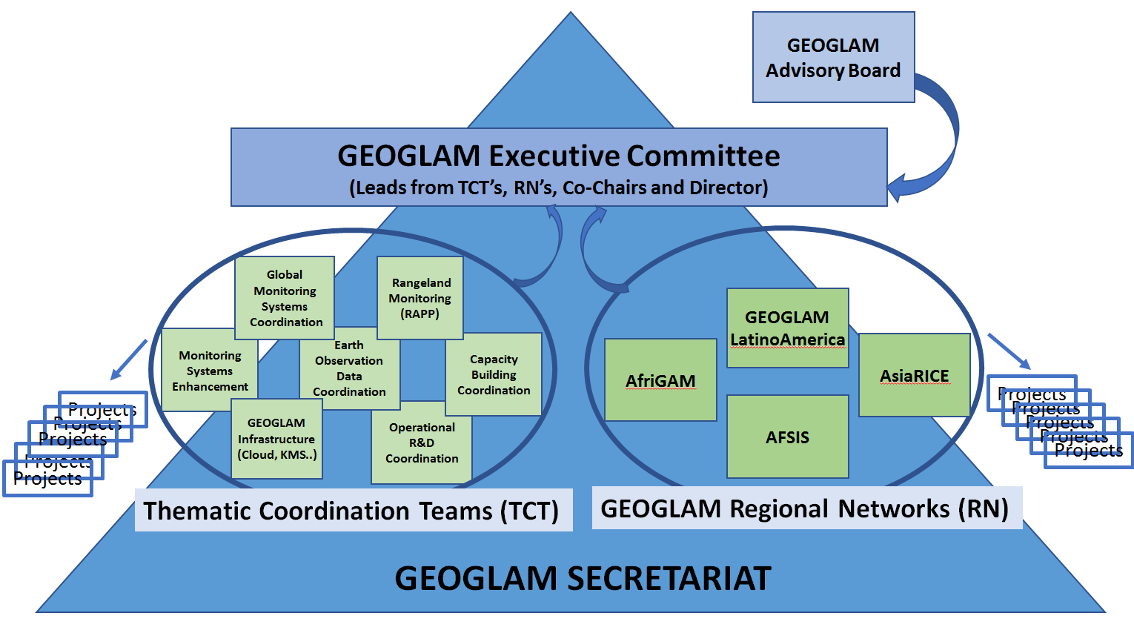
GEOGLAM 2.0
Implementation
Framework
Strategic Framework
GEOGLAM Implementation Team met in June 2017 and decided on a new road ahead for GEOGLAM – “GEOGLAM 2.0”
Renewed emphasis on regional networks, data/information management and infrastructure, and RtO continuum (capacity dev)
Revised Governance Structure
- Establishment of ExCom
  (evolution of the GEOGLAM IT)
  - GEOGLAM Secretariat underpins it all
Notes:
New Thematic Coordination Teams include:
Global Monitoring Systems
Rangeland and Pasture Productivity Monitoring (RAPP)
Enhancement of Monitoring Systems
Earth Observations Data Coordination & Link with CEOS
Operational R&D Coordination
Capacity Development Coordination
GEOGLAM Data and Information Infrastructure
Drafting of Terms of Reference for the ExCom and its constituents are underway
This complements GEOGLAM Workflow – this is about governance/organization vs. activities.

Slide 6
The Game is Changing
In 2011, at GEOGLAM’s inception, we were constrained by acquisition of data at appropriate resolutions
Now – in 2017, we are in a “big data” world, constrained by access and use (computational environments)

Slide 7
Short-Term Priorities
Dense optical time series exploitation
  Analysis ready time series at moderate (10-100m) resolution, including:
    cloud & cloud shadow screening
    High co-registration accuracy (<1/3 of a pixel) between sensors
    Harmonized surface reflectance
    NRT availability on cloud computing
Dense SAR time series exploitation
  Interferometric coherence at daily-weekly intervals
  Digital Terrain Model (potentially TerraSar-X) available on cloud computing infrastructure

Slide 8
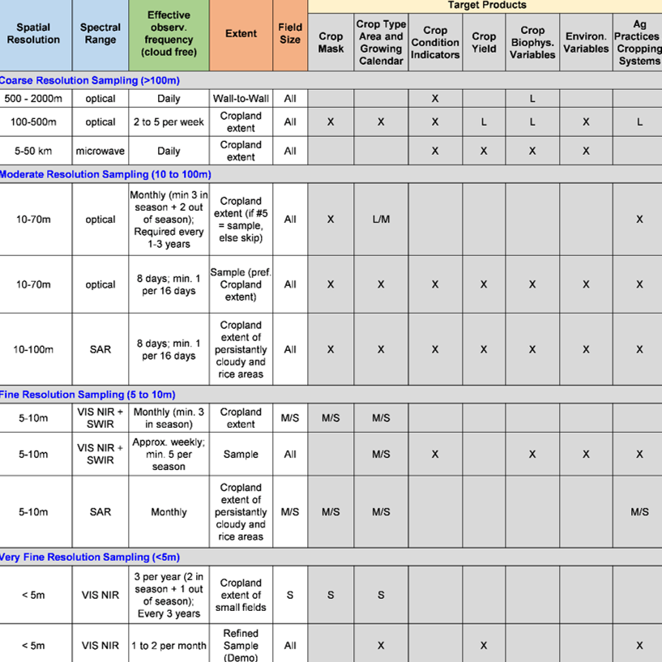
Rationale:
- State of Science & Operational
Monitoring Systems have evolved
- Seek more holistic approach
Very Successful GEOGLAM Req’s 2012-2014
GEOGLAM EO Requirements Refresh - ongoing
Objectives:
1. Update based on
R&D results, considering satellite & in situ data needs;
2. Support GEOGLAM’s
Compendium of Best Practices
3. Provide insight in future mission planning and current acquisition
planning
Notes:
Revised “support future mission planning” to say “provide insight in” – the idea being that this exercise is helpful and useful to space agencies in understanding community requirements both of current and future missions.

Slide 9
GEOGLAM Requirements Refresh
To reflect R&D findings from GEOGLAM R&D - methods have advanced
In support of data acquisition and future mission planning
To better understand “proximal user” data needs (ARD, FDA)
Consistent with JECAM’s “Minimum Datasets” principle
Supporting Compendium of “Best Practices”
Next Steps toward a holistic view of requirements:
Comparison of Original vs. Requirements Refresh
 | 2012-2014 | 2016-2017
Source | Montreal 2012 WG led by Pierre Defourny (lit review) | Multiple JECAM & Asia-RiCE Sites (experiment)
Variables Described | 7 | 13
Observation Types Collected | Satellite only | Satellite, In Situ, Ag Met
Analytical Needs | Not Addressed | 7 Questions
“Firmness” | Some had ranges | “Minimum” vs. “Preferred”
Application | Not explicit | R&D vs. Operational Latency Requirements Considered

Slide 10
Next Steps in EO Requirements Refresh
HOLISTIC PERSPECTIVE
Have R&D perspective, need operational perspective
Need to consider acquisition, access, and exploitation
AAFC, USDA, Earth observations for Food Security and Agriculture Consoritium (EOFSAC) are organizing a workshop on emerging technologies
  Bringing cutting edge EO and EO-use to operational users
  13-15 February 2018 in Washington, DC
Convene Operational User Workshop to drive requirements from user perspective
  Q2 2018; EC JRC potential host
A Data Cube to Support JECAM SAR Intercomparison

Slide 11

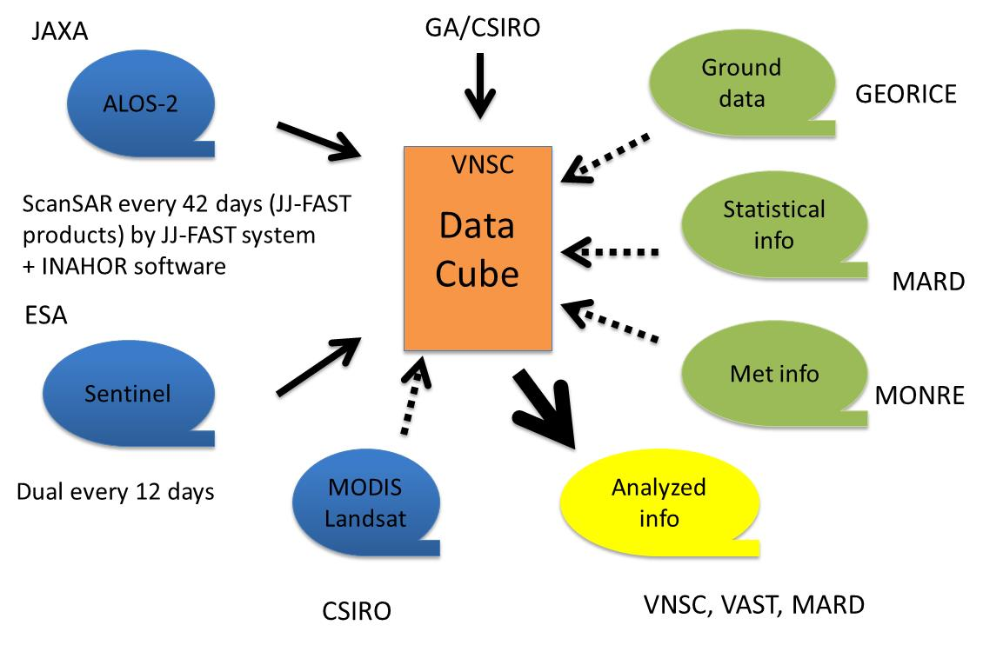
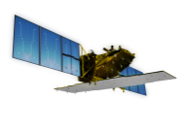
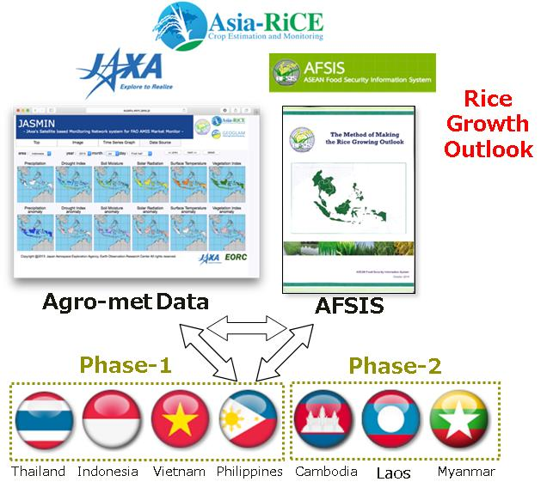
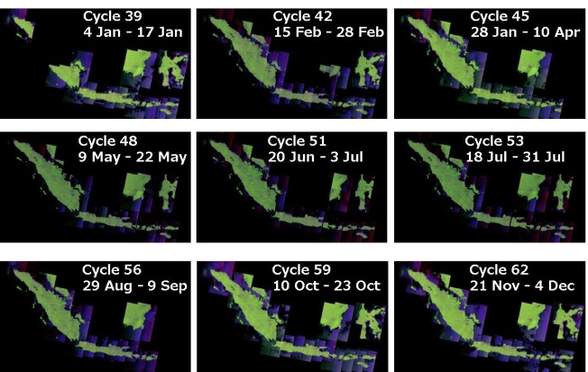


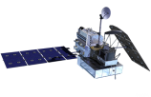
GEOGLAM AsiaRiCE (from demo to operation)
http://www.asia-rice.org
Asia-RiCE (Asia Rice Crop Estimation & Monitoring) program led by JAXA with CNES and more than 20 Asian Space agencies and Ministries of Agriculture with International organization such as ASEAN/AFSIS, UN/FAO, IRRI from 2013 (POC: Sobue.shinichi@jaxa.jp, ohyoshi.kei@jaxa.jp, Thuy.letoan@cesbio.cnes.fr)
ID | Target Agricultural Products | Requirements of EO data for operational use
P1 | Rice Crop Area Estimates/Maps | Wall-to-wall observation with SAR dual polarization with Opticals (week – bi-weekly - monthly) : Indonesia, Vietnam/Cambodia and Thailand/Lao projects
P2 | Crop Calendars/Crop Growth Status | Mid/coarse resolution opitcal frequent observation (MODIS, GCOM-C, Landasat, Sentinel-2, etc.) with SARs weekly
P3 | Crop Damage Assessment | Very High resolution SAR and Optical timely under international disasater charter, Sentinel Asia, etc.
P4 | Agro-meteorological Information Products | Daily Mid/coarse resolution optical, passive microwaver and PR with geostatinary met sat frequent observation (MODIS, Sentinel, GCOM-C/W, GPM, Himawari, etc.)
P5 | Production Estimation and Forecasting | Data fusion, data integration with ground base observation / statisitcal information and crop models
Time series observation by SAR for top 10 Indonesia main rice regions by ALOS-2 with MOA
Vietnam Data Cube starting from GEOSS-AP
(Hanoi, September) by VNSC/VAST with CEOS

Slide 12
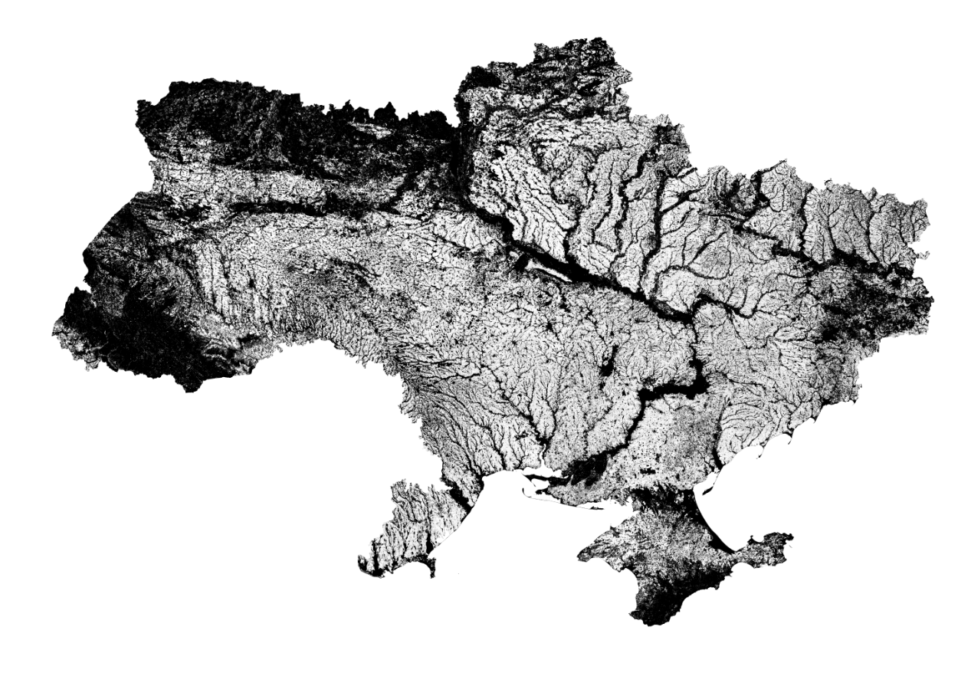

EO for crop acreage estimates thanks to S2 and L8
Sentinel-2 and Landsat-8 provided NRT 10 m cropland and main crop maps nationwide – demonstration for Ukraine, South-Africa and Mali by Sen2-Agri system
S2 & L8
+
Sen2-Agri open
source system
+
Cloud computing
+
Nationwide in-situ data collection
Cropland
Non-Cropland
Overall accuracy : 96 %
F-score cropland : 97 %
Sen2-Agri 10 m cropland map for Ukraine (July 2016)

Slide 13
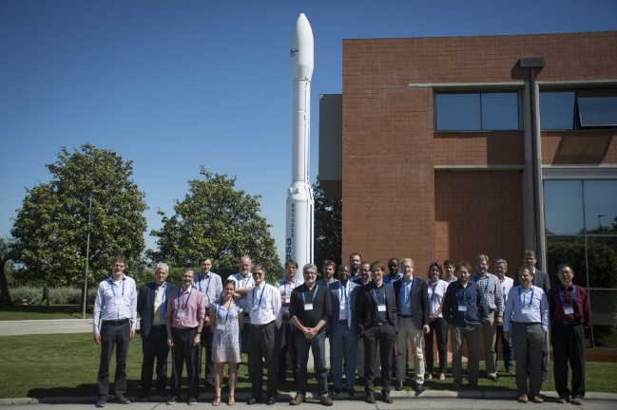
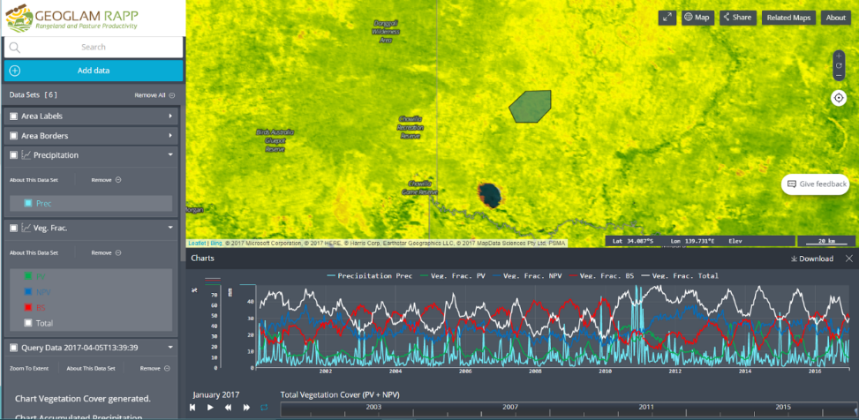

RAPP – Updates & Plans
New co-lead from SANSA: Clement Adjorlolo
RAPP Workshop (>30 participants) hosted at ESRIN
Priorities
Continued development of the RAPP Map – map.geo-rapp.org
High interest for moderate res (L8, S2) coverage over RAPP pilot sites – interest in implementing this via Data Cube
Development of an early warning system for rangelands
Support/engage in UN SDG process

Slide 14
GEOGLAM Latinoamérica & AmeriGEOSS Food Sec & Ag
AmeriGEOSS/GEOGLAM Latinoamerica
  4 day training course held in San Jose, Costa Rica, 1-4 August 2017 – General RS of ag, GLAM, Crop Monitor focus
  Interest from end users (agricultural cooperatives and ministries) in GEOGLAM products
  Potential for training in Brazil, 2018
    With CEOS WGCapD or during AmeriGEOSS week
  NASA recently funded US coordination of Food Security & Sustainable Agriculture (FSSA) WG – in collaboration with Chile, Argentina, Brazil, and Canada
  New Involvement of Chile and Costa Rica (potentially) in GEOGLAM Crop Monitor
Notes:
Both AmeriGEOSS week and CEOS WG CapD are being held in San Jose dos Campos, different times of year.

Slide 15
CEOS Ad Hoc WG Scope of Work
Activities 2017 & Beyond
Upon completion of the “refreshed” GEOGLAM EO Requirements, an evaluation of CEOS capacity to meet missions, as well as an investigation into solutions for data access and utilization challenges;
Evaluation of the acquisition metadata archives using the COVE tool, and requesting archival data for GEOGLAM usage in the production of baseline datasets (e.g. crop area & type masks, and crop calendars) and in promoting interoperability amongst datasets;
As-needed updates of the CEOS Strategic Response to GEOGLAM Requirements;
Further development of the Data Cube support to JECAM, Asia-RiCE and other GEOGLAM initiatives;
Evaluation of emerging agriculture initiatives that will require EO data (e.g. Rangelands and Pasture Productivity (RAPP), GEOGLAM Regional Networks, NASA Food Security & Agriculture Consortium);
Evaluation of new missions and datasets for GEOGLAM use, as well as continued consulting with mission design teams on an as-requested basis;
Continued collaboration with other CEOS groups, in particular LSI-VC and WGCapD.

Slide 16
Considerations & Decisions
For Consideration:
  The CEOS Ad Hoc Working Group for GEOGLAM Scope of Work Document
For Decision:
  Renew for another year the mandate of the GEOGLAM ad hoc Working Group

Slide 17
ANNEX SLIDES

Slide 18
EO requirements for time series exploitation for ag. applications
Top priority for optical dense time series exploitation :
analysis-ready time series (from 2 m and 10 m to 100 m) including
  enhanced performance of cloud and cloud shadow screening
(need for better solution than what is available for S2 and L8 today)
  thanks to additional spectral bands or a separate instrument on board or
  by exploiting parallax displacement related to the 3-D nature of cloud or …
  high co-registration accuracy (within one-third of pixel) between observation and possibly between sensors (currently non negligible misalignement between L8 and S2)
  harmonized surface reflectance (spectral and radiometric compatibility)
  NRT availability on cloud computing facilities

Slide 19
EO requirements for time series exploitation for ag. applications
Top priority for SAR dense time series exploitation (probably the best source for ag. practices monitoring in addition to crop mapping and biomass retrieval) :
  time series of interferometric coherence at 1-day interval to become very complementarity to optical time series and reduce soil moisture effect (based ERS-1&2 tandem mission results never repeated since then)
    possible demonstration with Radarsat constellation ?
    potential opportunity in 2021 with Sentinel-1c launch ?
  additional data on rainfall distribution or soil moisture effect on the SAR time series
  high resolution Digital Terrain Model (e.g. TerraSAR-derived) available on cloud computing infrastructure to correct the backscattered signal

Slide 20
Summary to turn EO in game changer
Securing daily global 50 to 100 m time series on long term
Enhanced the current revisiting capacity for 10 m optical sensors
Analysis-ready time series to focus on data interpretation rather than data preparation
Cloud computing facilities for EO ag. community (research and operational) much needed to the avoid downloading issues and possibly make available commercial dataset for specific uses (i.e. DTM, global VHR mosaic for georeferencing)
SAR coherence at 1-day to be further demonstrated for ag. applications
EO and IT (r)evolution very close to achieve the long-awaited operational applications in ag. :
annual global cropland mapping, crop specific growth monitoring, crop type mapping at the accuracy required for ag. statistics
crop management support, crop damages assessment

Slide 21
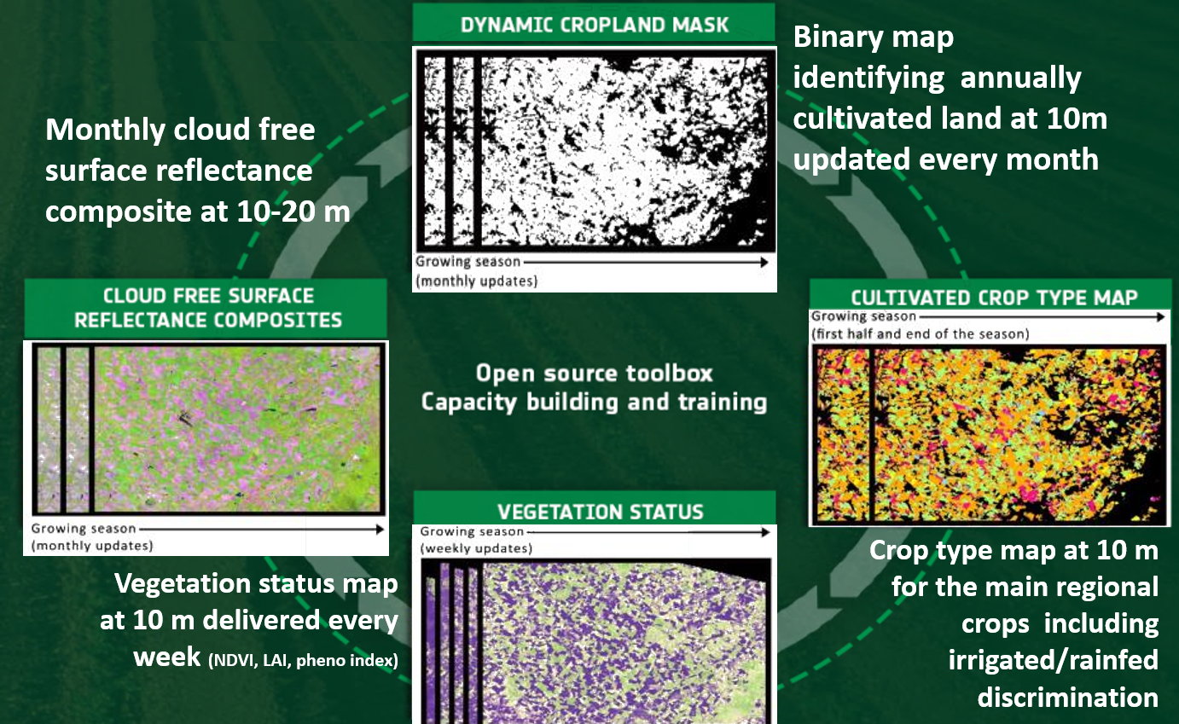
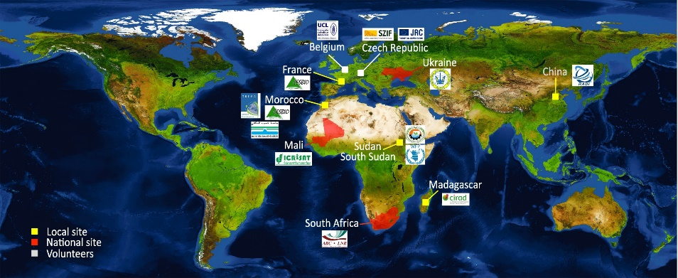
Current dense time series
already started to change the game
Sentinel-2 A & 2B + L8
Sentinel-2 A & 2B + L8
Sentinel-1 A & 1B
^{Source:} CEOS ACQUISITION STRATEGY FOR GEOGLAM PHASE 1
Sen2-Agri project supported by ESA and let by UCLouvain to
develop an open source system to exploit S2&L8 time series for
agriculture

