Slide 1
A Broader CEOS ARD Strategy
Committee on Earth Observation Satellites
Alex Held
CEOS Plenary 2018
Agenda Item 5.4
Brussels, Belgium
17 – 18 October 2018

Slide 2
Introduction
CEOS Future Data Architectures (FDA) Report - examined the changing landscape and context for CEOS agency EO programmes and the way in which they service their user communities
One of the most common concerns raised by the many CEOS agencies was the need for significant simplification of data handling and uptake by users
One solution: Pursuit of CEOS standards for Analysis Ready Data
Land Surface Imaging Virtual Constellation (LSI-VC) responsible for CEOS Analysis Ready Data for Land (CARD4L) Product Family Specifications (PFS)
SIT Vice Chair (CSIRO/GA) has flagged development of a broad CEOS ARD strategy as a flagship theme for their leadership

Slide 3
Objectives
to ensure continued relevance of public EO programme data and information, leveraging the availability of all relevant CEOS agency missions to meet user needs for information;
to meet the changing expectations of the user base, which is increasingly non-technical and more accustomed to simplicity in geospatial data sourcing, integration and application;
to establish a broad understanding of, and participation in, CEOS efforts to define, produce, and apply ARD in support of societal needs;
to ensure effective engagement of the three key stakeholder groups: EO data providers (both public and private); Big Data hosts and aggregators who stage increasing amounts of CEOS agency free and open data; and data users;
to manage expectations of all stakeholders as to the status and outlook for ARD availability – so that all might plan and invest with confidence in capabilities to best exploit the CEOS agency ARD;
to establish priorities for which products and applications might follow on from the current CARD4L PFS;
to ensure appropriate organisational responsibilities across the CEOS structure for the definition and execution of the way forward on ARD.

Slide 4
CEOS ARD Strategy Components
A number of activities foreseen in a comprehensive and successful strategy on ARD for CEOS:
Thematic product families – of which CARD4L is the first
ARD Stocktake and Outlook (user investment confidence)
Technical specification development and maintenance
Pilots and feedback
Promotion

Slide 5
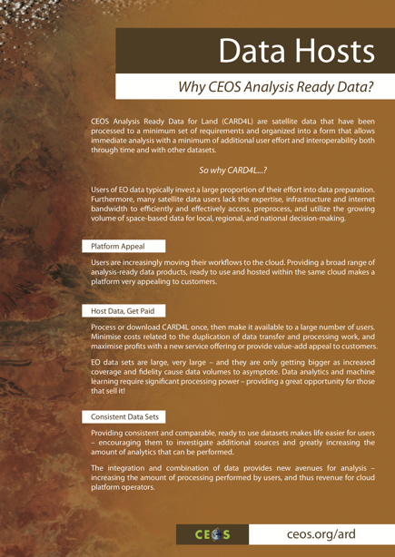
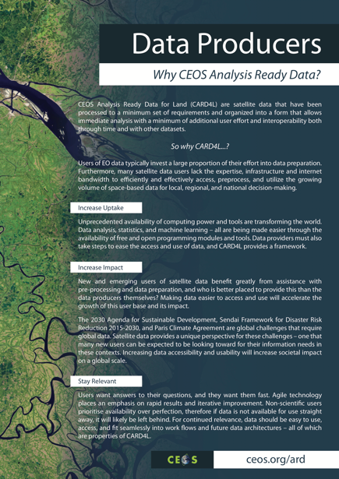
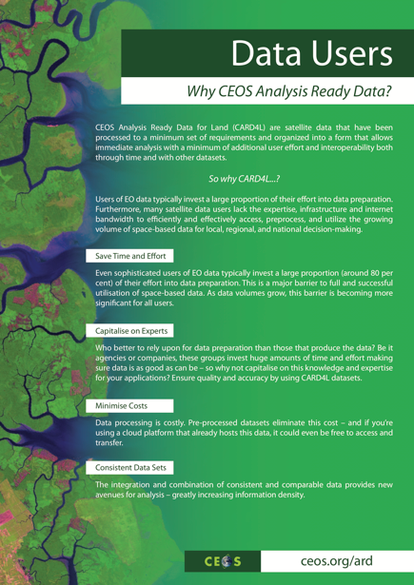
CARD4L Information Notes
Intended to inspire users and convince data providers and data hosts to adopt CARD4L.

Slide 6
ARD Stocktake and Outlook
A critical mass of participation is essential to achieve success
Management of expectations:
Agencies providing and processing data;
Their partners and corporations who are hosting and aggregating the data;
The users we all seek to serve
All need clarity in the outlook for confidence in investment needed to re-engineer processes and systems
CEOS should define and maintain a clear statement as to the current and future availability of the different datasets produced to its ARD specifications, and how to access them
This should include a current snapshot and forecast for say 1, 2, and 3 years hence
LSI-VC-5 agreed an action to produce such a stocktake and outlook for the CARD4L product family. In progress…

Slide 7
Technical Specification Development and Maintenance
The first steps for any new ARD standards across CEOS will be the development of the Product Family Specification as has been undertaken for CARD4L for 3 initial products:
Surface Reflectance (optical);
Surface Temperature (optical);
Backscatter (Synthetic Aperture Radar)
Future SAR: INSAR interferogram & coherence; polarimetric & others..
Need prioritisation/schedule of expansion: marine/coastal, geostationary…
Products have been processed to a minimum set of requirements and organized into a form that allows immediate analysis with a minimum of additional user effort
Products are intended to be flexible and accessible - suitable for a wide range of users for a wide variety of applications … but may not be suitable for all purposes, and are not intended as a ‘replacement’ for other types of satellite products

Slide 8
Technical Specification Development and Maintenance
LSI-VC has specified that the CARD4L branding is applied to a particular product when:
that product has been assessed as meeting CARD4L requirements by the CEOS agency responsible for production and distribution of the product;
that assessment has been peer reviewed by the CEOS Land Surface Imaging Virtual Constellation in consultation with the CEOS Working Group on Calibration and Validation
Agencies or other entities considering undertaking an assessment process should contact the co-leads of the Land Surface Imaging Virtual Constellation.
A product can continue to use CARD4L branding as long as its generation and distribution remain consistent with the peer-reviewed assessment
Assuming that the CARD4L model and process is deemed to be effective by CEOS and suitable for replication to other products and disciplines, a systematic and effective process will be required to ensure consistency and performance across the relevant standards and datasets.

Slide 9
Pilots and Feedback
Move from paper to practice – and quickly to sustain momentum and keep CEOS on front foot amidst active community interest
Provision and application of CEOS ARD essential to ensure that it is fit for purpose, and to develop user experience and data reputation
LSI-VC has an action underway to establish reference groups within GFOI and GEOGLAM to ensure diverse experience and opinion is fed back into the evolution of the specifications
A number of pilots related to the Open Data Cube are already yielding useful experience as to future evolution for CARD4L

Slide 10
Promotion
Active promotion of the benefits of ARD and experience gained by the pioneering organisations will be an essential part of achieving that critical mass for the standards to succeed
This must include:
data providers - both CEOS space agencies and private EO data providers;
data hosts and aggregators
data users
LSI-VC-5 agreed to prepare sample outreach flyers targeted at each of these communities for CARD4L
USGS reported to LSI-VC-5 that uptake of their Landsat-8 SR product is outpacing uptake of the equivalent level 1 product by a ratio of about 3:1

Slide 11
Broader CEOS Strategy for Analysis Ready Data (ARD)
A broader CEOS strategy for analysis ready data discussed at February LSI-VC meeting and September joint meeting with GFOI & GEOGLAM
SIT Vice Chair is adopting this topic for further development – the scope goes way beyond just LSI
Discussion paper started and will serve as a channel for community consultation (discussion at SIT-34?)

