Slide 1
SEO Report
Committee on Earth Observation Satellites
Brian Killough, NASA, CEOS SEO
CEOS Plenary 2018
Agenda Item 7.2
Brussels, Belgium
17 – 18 October 2018

Slide 2
Accomplishments in 2018
General Technical ... Supported the LSI-VC (ARD definition, gap analysis process), supported SDCG for GFOI and GEOGLAM (data acquisition planning, coverage reports), maintained and enhanced general CEOS tools (COVE, Data Policy Portal, website).
Data Cubes ... The SEO is a member of the Open Data Cube (ODC) “Partners Forum”. The SEO has made a number of significant code contributions (e.g. user interface, applications) to the ODC open source repository, coordinated and led training for the Africa Regional Data Cube (ARDC) and led many other country pilots. See Agenda Item 5.5
Outreach: Coordinated two IGARSS paper sessions (13 papers) and a Data Cube Training Workshop.
Kim Holloway (now part time): Managed website and news content, developed and facilitated social media content, provided meeting logistics support, developed new outreach materials and maintained the mailing lists.

Slide 3
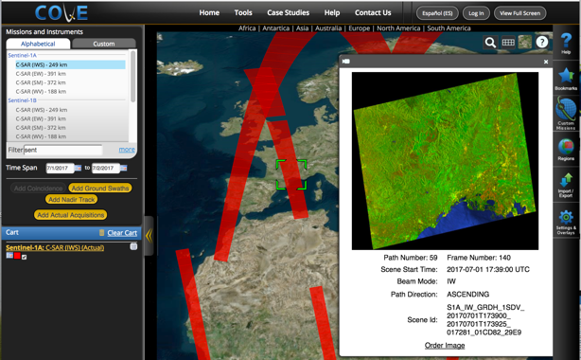
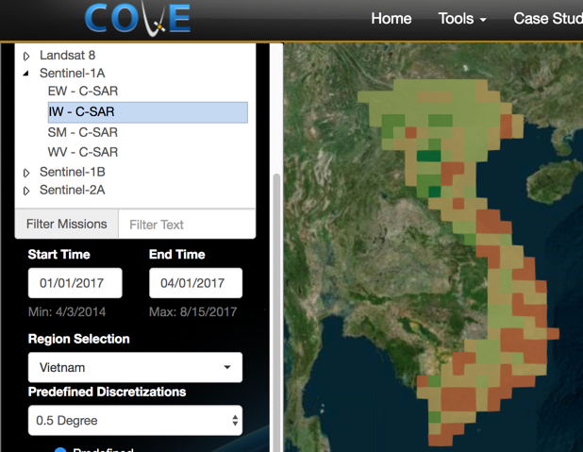
COVE Tool Summary
The CEOS Visualization Environment (COVE) is a browser-based suite of tools for searching, analyzing, and visualizing actual and potential satellite sensor coverage.
COVE is FREE and OPEN for anyone to use! There is a large international user base with 4000+ users.
COVE includes 131 missions and is linked to several mission archives to get metadata and browse images for past acquired data: Landsat-5/7/8, Sentinel-1, Sentinel-2, and CBERS-4.
Coverage Analyzer and Data Browser: New tools for coverage assessments and scene data to support data ordering. www.ceos-cove.org

Slide 4
Plans for 2019
GEOGLAM and SDCG for GFOI: Continued support for data acquisition planning, improved data access and systems analyses.
Work with LSI-VC to refine ARD definitions and develop gap analysis tools.
Work with WGISS to develop an Open Source Software Database.
Work with WGCapD to develop a CEOS Training Resource Database.
Work with the CEO to improve the CEOS Deliverables Database.
Ad Hoc Team for SDGs: Writing a chapter in an AGU publication ... “Satellite ARD for SDGs”.
Support annual updates to the Data Policy Portal and the MIM Database. Add an API function to the MIM database for enhanced queries and gap analyses.
COVE Tool: Complete enhancements to the Coverage Analyzer and Data Browsers tools, improve and increase links to mission archives, add a custom mission capability, improve coverage and revisit calculation products.
Outreach support for CEOS hosted or attended conferences. Continue to expand the impact of CEOS through social media.

Slide 5
CEOS Communications
CEOS Social Media:
Growing number of followers/likes every year!
Kim posts topics and news on a regular basis, so sned her new material or “tag CEOS”.
Twitter: @ceosdotorg
Facebook: @socialceos
5
1250 Followers!
1384 Likes!

Slide 6
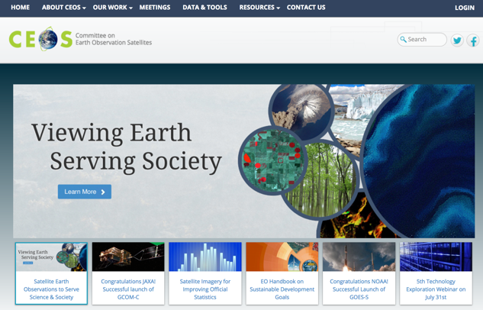
CEOS Communications
The CEOS website continues to be a popular destination with over 20,000 visitors (84% new) in 2018.
REQUEST ... Please provide new content, news items, edits and ideas to Kim to keep our content fresh and relevant.
Remember that the CEOS website has capabilities for meeting registration and document management.
New CEOS banners have been created for the upcoming GEO meeting .. come visit the exhibition!
Contact:
Kim.E.Holloway@nasa.gov
6

