Slide 1
WGClimate Greenhouse Gas Roadmap and Staff Resource Requirements
M. Dowell (European Commission), A. von Bargen (DLR), D. Crisp (NASA), A. Kuze (JAXA), and
J. Schulz (EUMETSAT)
CEOS Plenary 2019
Agenda Item # 2.4
14 – 16 October 2019

Slide 2
The CEOS Architecture for Monitoring Atmospheric CO₂ and CH₄ Concentrations
The CEOS Atmospheric Composition Virtual Constellation (AC-VC) white paper defines a global architecture for monitoring atmospheric CO₂ and CH₄ concentrations from instruments on space-based platforms
166-page document, 88 authors from 47 organizations
Executive Summary (2 pages)
Body of report (75 pages)
Technical Appendices (42 pages)
DOI: 10.2760/468219
http://ceos.org/document_management/Virtual_Constellations/ACC/Documents/CEOS_AC-VC_GHG_White_Paper_Publication_Draft2_20181111.pdf

Slide 3
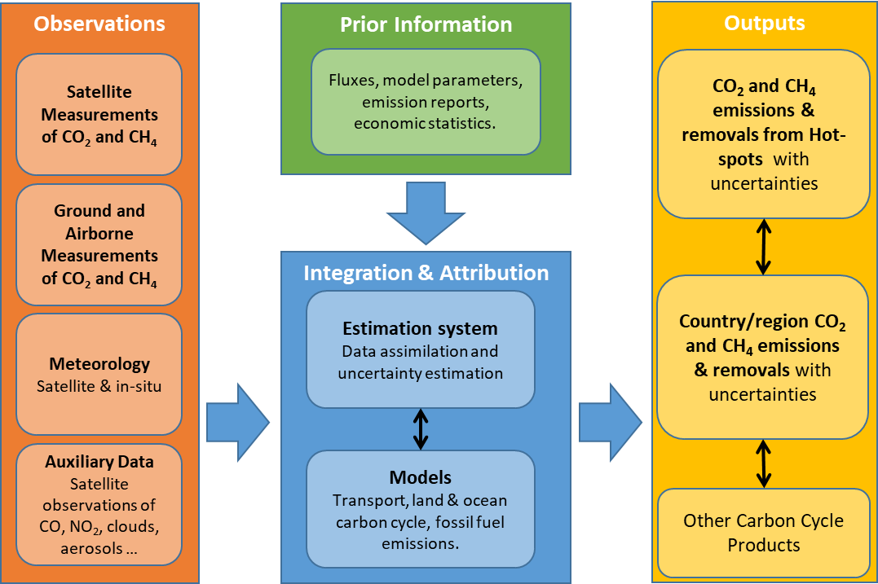
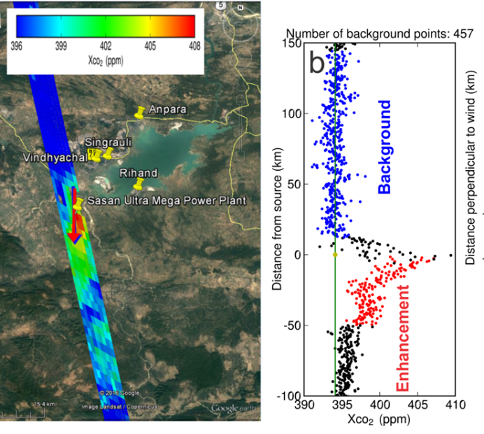
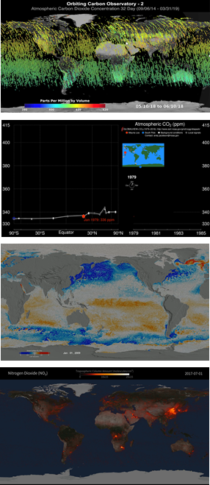
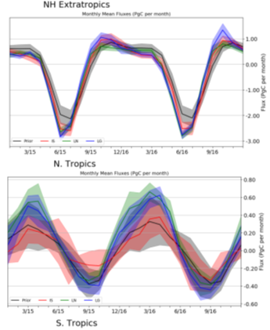
A System Approach is Adopted to Deliver Atmospheric CO₂ and CH₄ Inventories

Slide 4
Developing Atmospheric GHG Inventories
The CEOS AC-VC GHG White Paper recommends the following approach:
Refine requirements for atmospheric flux inventories
  Foster collaboration between the space-based and ground-based GHG measurement and modeling communities and the bottom-up inventory and policy communities
Produce a prototype atmospheric CO₂ and CH₄ flux inventory that is available in time to inform the bottom-up inventories for the 2023 global Stocktake
  Coordinate ongoing missions and atmospheric inversion efforts to produce a best-effort inventory
Use lessons learned from the prototype flux inventory to refine requirements
  A future, purpose-built, operational, atmospheric inventory system
  Improved atmospheric GHG inventories to support the 2028 global Stocktake and beyond

Slide 5
Implementing the GHG Architecture
Exploit combined efforts within CEOS and CGMS to meet goals of GHG Whitepaper
  WGClimate formed a dedicated task team on GHG monitoring, with resources and activities designed to address the recommendations identified in the White Paper
  AC-VC enlisted support GHG constellation development and synergistic GHG and atmospheric composition observations and modelling efforts
  WGCV enlisted to support the definition of the calibration and validation needs
  GSICS enlisted to support operational in flight calibration, instrument monitoring, cross calibration, and re-calibration
The first step was to develop a Roadmap for the implementation of recommendations including a justification for the resource request
Roadmap will evolve over time as the more detailed project plan is developed, within the constraints of the available resources

Slide 6
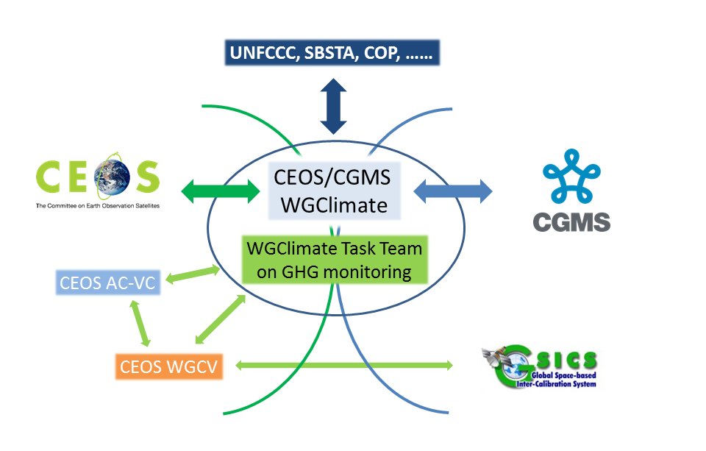
CEOS/CGMS GHG Roadmap Table of Contents
1 Scope and Objectives
2 Context
3 Roadmap Objectives and Approach
  3.1 Refine Requirements:
  3.2 Develop a Prototype System to Support the 2023 Stocktake
  3.3 Implement an Operational CO₂/CH₄ Constellation to Support Future Stocktakes
  3.4 Implementation Approach
4 CEOS and CGMS Implementation Entities and Roles
  4.1 Role of WGClimate and the GHG Task Team
  4.2 Role of Atmospheric Composition – Virtual Constellation
  4.3 Role of WGCV/ACSG and GSICS
  4.4 Role of other CEOS and CGMS Entities
5 Roadmap actions to 2021 and 2025
  5.1 Actions for WGClimate GHG Task Team
  5.2 Actions for Atmospheric Composition – Virtual Constellation
  5.3 Actions for WGCV/ACSG and GSICS
6 Expected Outcomes
7 Resource Implications
8 High-level Timeline

Slide 7
Summary of Primary Roles (1)
WGClimate
  Establish Task Team on GHG monitoring to coordinate CEOS and CGMS bodies
  Provide systematic reporting to UNFCCC/SBSTA
  Provide interface to GCOS, WCRP, (GEO)
  Report to CEOS and CGMS Plenaries
WGClimate GHG Task Team
  Develop and maintain the roadmap defining the project plan
  Identify additional resource needs and relevant CEOS and CGMS Agencies to dedicate appropriate resources
  Coordinate and track the development and implementation of the prototype and operational versions of the GHG Inventory System (including tracking of requirements, envisaged capabilities, design issues, end-to-end simulations, modelling approaches and the facilitation/propagation of best practices, etc.).
  Maintain an active interface with the national carbon inventory community and WMO IG³IS

Slide 8
Summary of Primary Roles (2)
AC-VC GHG Focus Area
  Coordinate ongoing agency activities to implement a prototype atmospheric GHG inventory product that incorporates data from a virtual constellation of sensors by 2021
  Coordinate efforts to perform OSSEs to support trade studies on constellation architecture
  Coordinate development of a more complete atmospheric GHG inventory product for the 2028 Stocktake
WGCV ACSG
  Identify best practices for prelaunch calibration of CO₂ and CH₄ concentration sensors and facilitate the exchange and harmonization of approaches and reference standards
  Identify best practices for on-orbit calibration of GHG sensors and disseminate standards including solar, lunar, and surface vicarious validation sites
  Define an operational validation approach

Slide 9
Summary of Primary Roles (3)
GSICS
  Coordinate efforts to develop operational in flight calibration and instrument monitoring
  Coordinate efforts to develop operational cross-calibration approaches based on prior work in AC-VC and WGCV
  Coordinate efforts to support re-calibration of sensors for long-term consistent GHG inventory products
Other CEOS and CGMS Entities
  CGMS WG-I to monitor the implementation versus WMO WIGOS vision
  CGMS WG-II to address definition and application of standards for operational GHG constellation products and operational aspects of the satellite data production systems at international level
  CGMS WG-IV to address operational access and end user support for GHG constellation products in cooperation with WGISS
  CEOS WGCapD and CGMS with WMO Virtual Lab to engage in necessary capacity building activities related to the usage of GHG inventory products

Slide 10
Primary Outputs of the GHG Roadmap Activity
Prototype Atmospheric inventory requirements (→ 2020)
  Collaborate with the space-based and ground-based GHG measurement and modeling communities and the bottom-up inventory and policy communities to refine requirements and implementation plans for atmospheric flux inventories including feedback to GCOS
Prototype Inventory (→ 2021)
  Coordinate ongoing efforts mostly by CEOS agencies to produce a prototype atmospheric CO₂ and CH₄ flux inventory in time to inform the bottom-up inventories for the 2023 global Stocktake
Architecture for an Operational GHG System (→ 2023 → 2026 → )
  Coordinate the development of a future, space-based, operational CO₂ and CH₄ constellation that more fully addresses the requirements of the inventory process in time to support the 2028 global Stocktake
  Coordinate the development of a system for integrating space-based measurements with in situ data and modeling tools to produce improved atmospheric inventories for use in the 2028 and future emission Stocktakes

Slide 11
Interface to and Feedback from External Communities
Engagement with external stakeholders and end users is fundamental to the success for this endeavour:
Engagement with the emission inventory community, critical in iterative feedback approach, both:
  Through existing international coordination mechanisms (e.g. GEIA - https://www.geiacenter.org ) -> Proposing a Dedicated WG
  Through working with champion users – «beta testers»
Continued engagement with international policy frameworks, i.e. UNFCCC/SBSTA, IPCC TFI
Engagement with technical implementing entities at international level i.e. WMO IG³IS and Joint Programmes supporting the Convention i.e. GCOS, as well as the broader modelling community

Slide 12
Roadmap Timeline
Paris Agreement
Global Stock
Take 1
Global Stock
Take 2
using inventories through 2021
using inventories through 2026
2015
2017
2019
2021
2023
2026
2028
CEOS GHG Whitepaper
Prototype
atmospheric
CO₂/CH₄
inventory
Refined
atmospheric
GHG
inventory
Initial
Operational
GHG
Constellation
Deployment
Prototype
Inventory
requirements
Refined
atmospheric
GHG
requirements

Slide 13
Types of Resources Needed
Three broad categories of resources are envisaged and requested for consideration by Agencies:
  Human resources from CEOS and CGMS members and external experts supported through Agency programmes & grants (next slide)
  Support for travel and hosting of workshops and networking activities with
      National inventory community
      Atmospheric GHG measurement and modelling communities
      Stakeholders (GCOS, UNFCCC/SBSTA)
  [On longer-term] Through internal funding mechanisms support research, development and infrastructure for priorities identified by GHG Task Team and Roadmap Implementation (annual updates will be provided to Agencies)

Slide 14
Staff Resource Requirements
Agencies are asked to continue/increase support to the GHG relevant staff (time & travel) contributing to the technical implementation tasks in AC-VC and WGCV
For the WGClimate GHG Task Team, the following specific “profiles” are required:
    Core team ensuring linkages to internal CEOS/CGMS entities (i.e. WGClimate – Dowell/von Bargen, AC-VC – Crisp, WGCV – Kuze)
    CEOS and CGMS Agency staff representing GHG missions/programmes
    Agency Staff/Experts from ‘operational’ agencies to ensure system implementation aspects
    Agency Staff/Experts with links to Inventory Community
    Agency Staff/Experts involved in modelling aspects
We envisage that the GHG Task Team would include ~12 members, typically dedicating 1PM/yr of effort each with those leading specific activities dedicating closer to 2PM/yr. Support should include necessary travel budgets for attending meetings/workshops.

Slide 15
Thanks to agencies who have already offered resources
CNES: C. Deniel for GHG Task Team
ESA: Y. Mejier for GHG Task Team
EUMETSAT: R. Lang for GHG Task Team
UKSA: P. Palmer (TBC) for GHG Task Team & offer to host/support workshops
JAXA willingness to contribute to Task Team, also some Secretariat support
EC: support workshop GHG-AFOLU Summer 2020 + modelling competence for Task Team
…

Slide 16
Status and Next Steps for GHG Task Team
The core GHG Task Team is in place and has delivered a Roadmap that
  Provides a high level overview of the project scope, schedule and deliverables
  Describes and justifies resource needs
Roadmap reviews are being solicited from a broader group within WGClimate, AC-VC, WGCV, GSICS, and other CEOS entities and CGMS Working Groups
  This review may refine the details of the implementation process but is not expected to timeline, primary deliverables or resource requirements
The Task Team is now developing a detailed Project Plan to execute and manage the effort described in the Roadmap
  Consolidated version will be presented to CEOS and CGMS Principals prior SIT-35 and CGMS-48.

Slide 17
Backup slides

Slide 18
Expected Outcomes and Impact
Space agencies have a «window of opportunity» to make a substantive impact on the implementation of the Paris Agreement through the Global Stocktakes and Enhanced Transparency Framework
  The timeline is very ambitious and demanding – but feasible.
The output of our joint efforts would support the international community in verifying and iteratively improving their emission estimates whilst providing multi-scale perspective to address mitigation option at regional, national and continental scales
Numerous agencies are developing missions & programmes, but there is systematic recognition that international coordination is a fundamental requirement
The CEOS/CGMS GHG Constellation Architecture provides the baseline for the development and implementation or activities

Slide 19
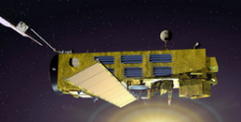
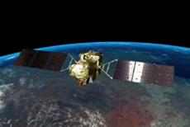
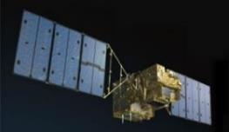

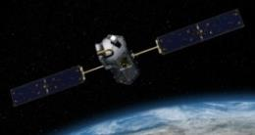
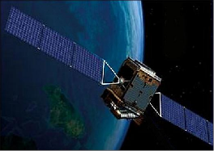
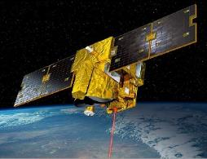
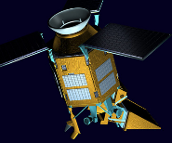
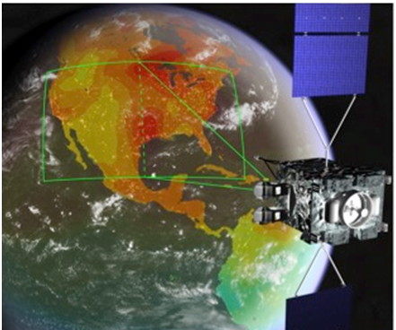
The Architecture Exploits the Evolving Fleet of CO₂ and CH₄ Satellites
Space agencies have supported several pioneering space-based GHG sensors
  SCIAMACHY on ESA’s ENVISAT
  Japan’s GOSAT TANSO-FTS, NASA’s OCO-2, China’s TanSat AGCS, Feng Yun-3D GAS and Gaofen-5 GMI, Copernicus Sentinel 5 Precursor TROPOMI, Japan’s GOSAT-2 TANSO-FTS-2 and NASA’s ISS OCO-3
Others are under development
  CNES MicroCarb, CNES/DLR MERLIN, NASA’s GeoCarb
Others are in the Planning stages
  Japan’s GOSAT Follow-on, Copernicus CO2M

Slide 20
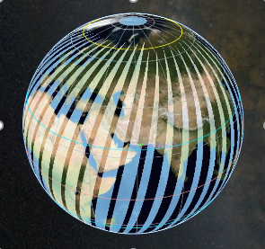
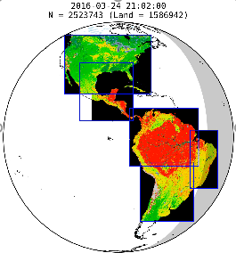
A Candidate Operational CO₂/CH₄ Constellation Architecture
The coverage, resolution, and repeat frequency requirements could be achieved with a constellation that incorporates:
A constellation of 3 (or more) satellites in LEO with
  Broad (> 250 km) swaths with a footprint size < 4 km²
  Single sounding random error < 0.5 ppm
  Vanishing small regional scale bias (< 0.1 ppm)
  Ancillary sensors to identify plumes (CO, satellites NO₂)
A constellation with 3 (or more) GEO satellites
  Stationed over Europe/Africa, Americas, and East Asia
  Diurnally varying processes (e.g. rush hours, photosynthetic uptake)
Possible augmentations include:
  Active (lidar) satellites in LEO for night-time/polar night coverage
  Satellites in HEO for improved high latitude coverage and repeat frequency

