Slide 1
ESA Earth Observation Status Report
33th CEOS Plenary – 15 Oct. 2019
Hanoi
Simonetta Cheli, ESA
Head of the Earth Observation Strategy, Programme & Coordinate Office

Slide 2
ESA Vision for EO
Taking the Pulse of our Planet
ESA UNCLASSIFIED – For Official Use
European Space Agency
Notes:
One might think that visions of space exploration have little to do with Earth Observation activities
Nothing is less true
The Earth is the spaceship of our species and all life we know
In ESA EOP our mission is to feel the pulse of our planet – spaceship Earth
EO is crucial in understanding the current state of our planet and its future

Slide 3
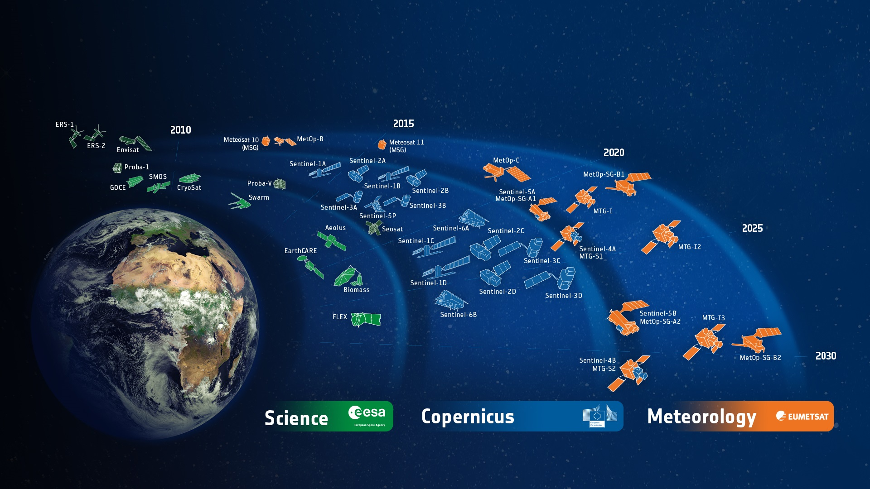
ESA-Developed Earth Observation Missions
Satellites
25 under development
15 in operation
ESA UNCLASSIFIED – For Official Use
European Space Agency
Notes:
D/EOP has three main lines of activities: Earth Science, Copernicus and Meteorology
Since the latest launch of Aeolus on 22 Aug. 2017, we have 25 satellites in development and 15 satellites in operation.

Slide 4
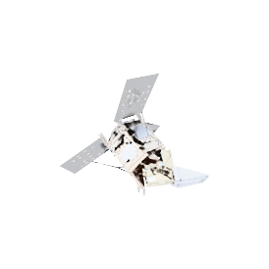
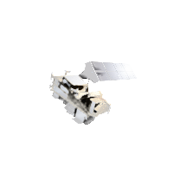
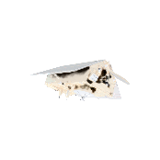
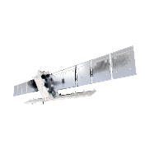
Copernicus – continued global excellence in EO
> 265.000
6 operational services
registered users
= tip of the iceberg
Land
Atmosphere
Ocean
Climate
Disaster
Security
7 Sentinels flying
250 TB satellite data distributed per day
S1 | S2 | S3 | S4 | S5P | S5 | S6
●● | ●● | ●● |  | ●
full, free & open data policy
preparing Copernicus 4.0
ESA UNCLASSIFIED – For Official Use
European Space Agency
Notes:
This infographic captures the key elements of the Copernicus EO system ➔ explain a few.
Copernicus is the Reference Backbone for an integrated EO observing system and, it is an excellent example of European global leadership in space.
Copernicus enables us to provide a routine health check of our planet.

Slide 5
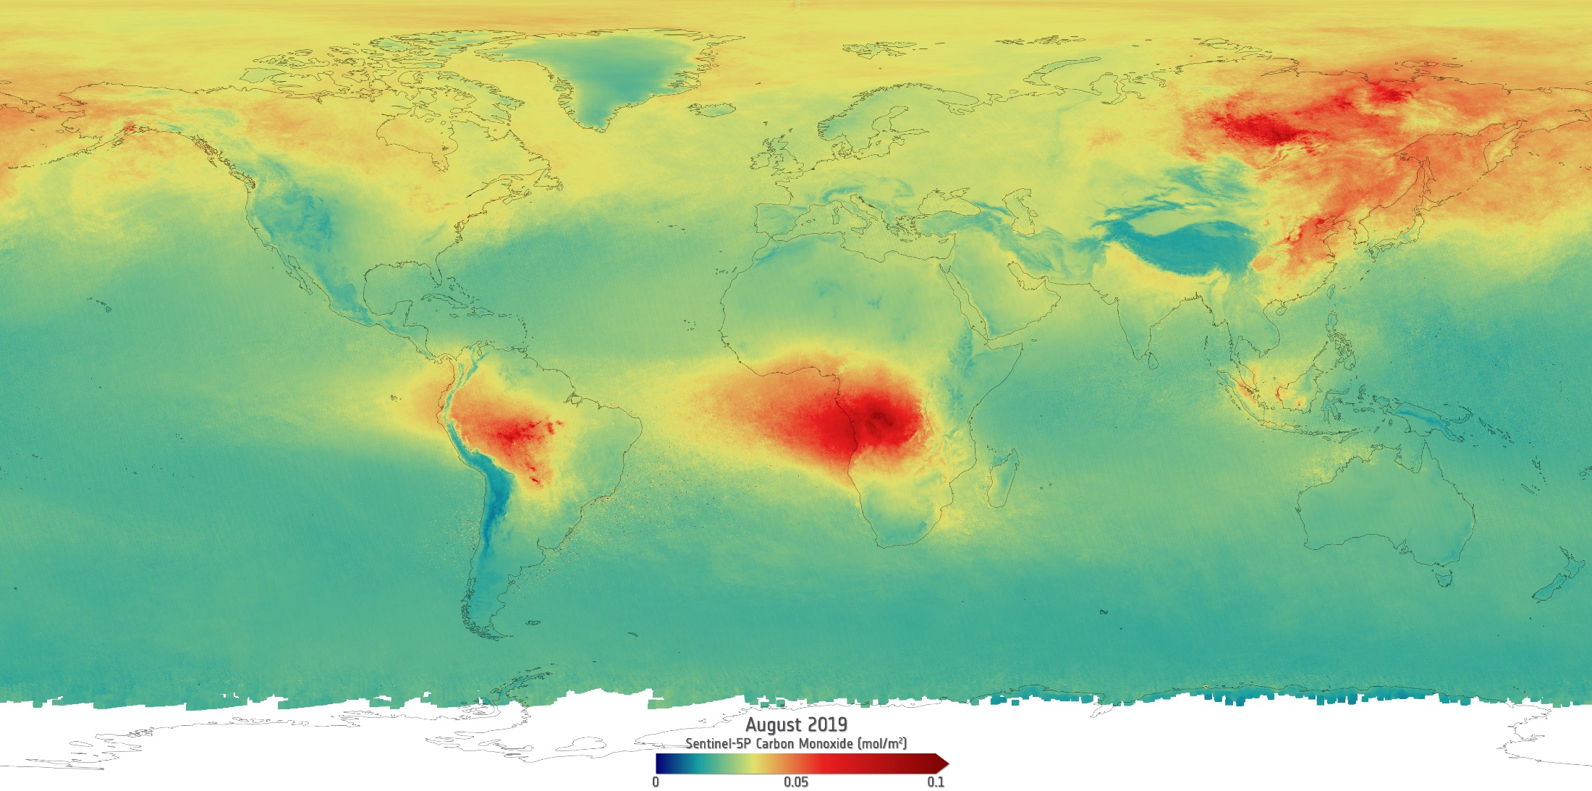
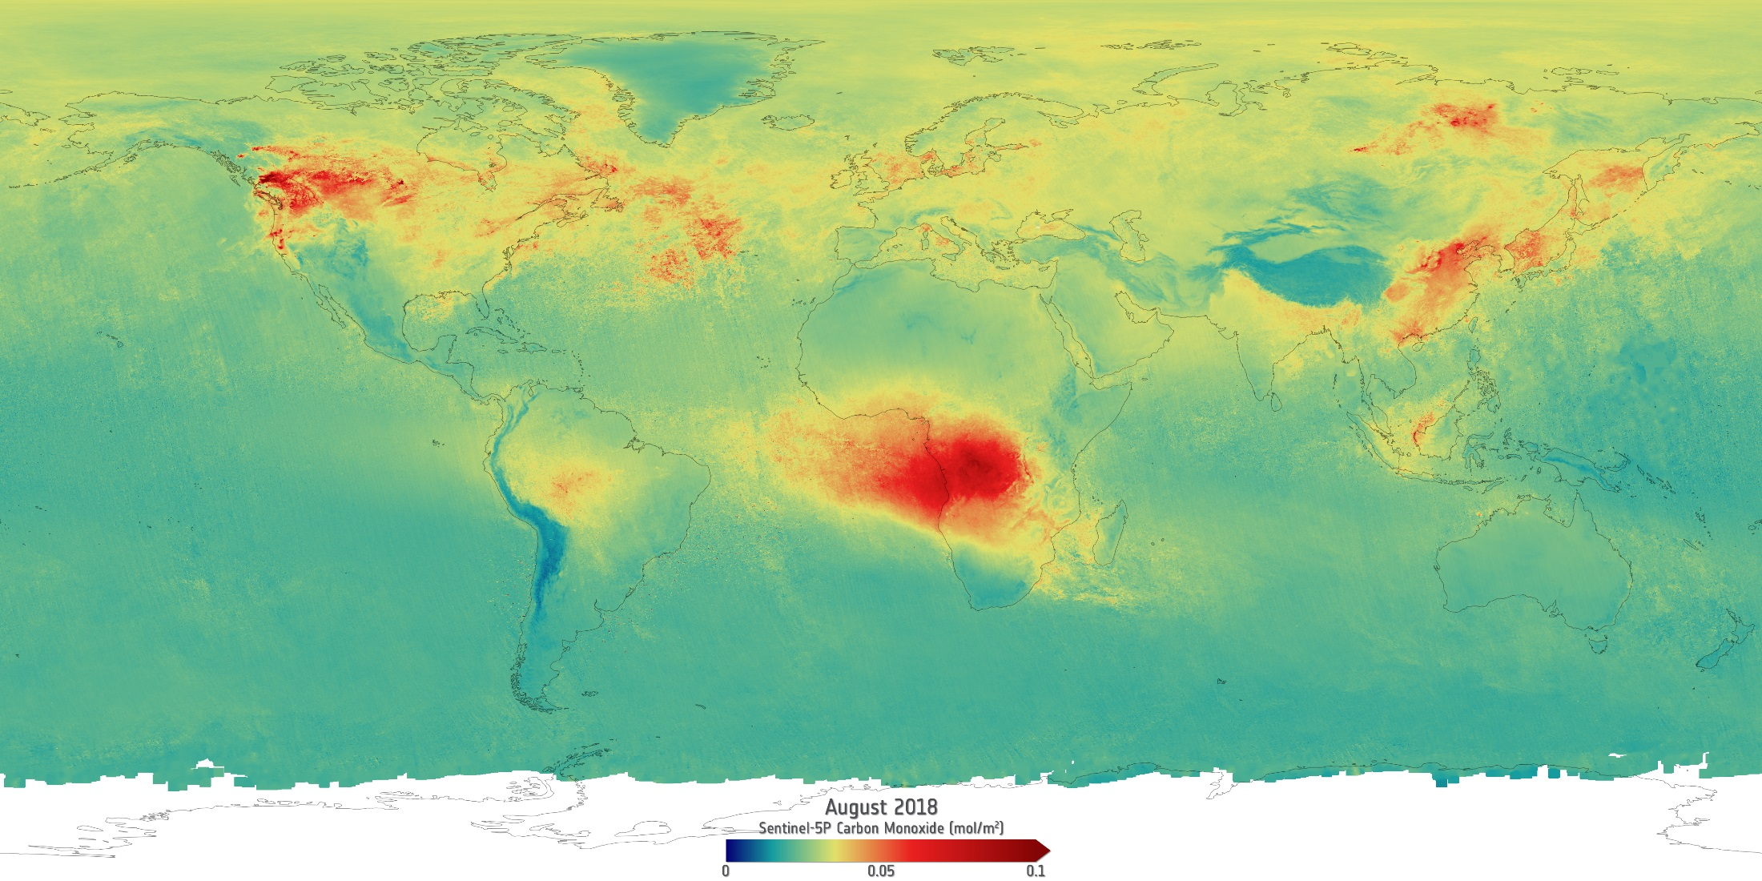
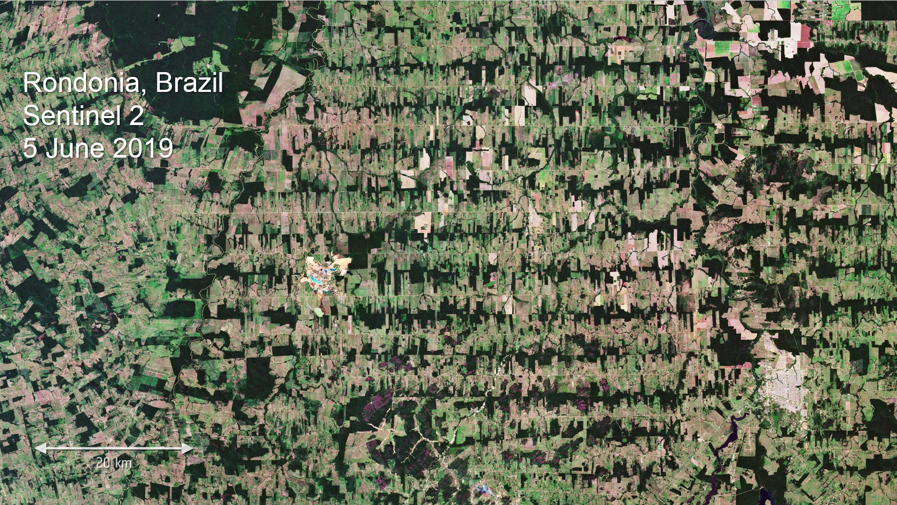
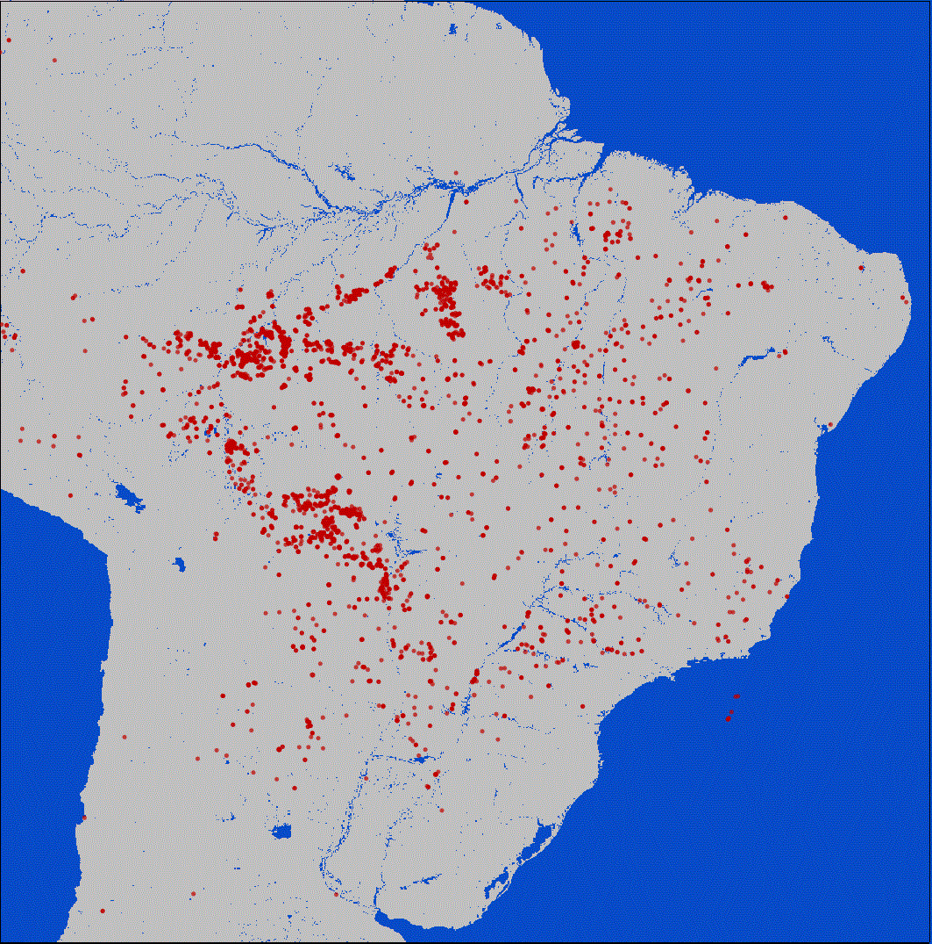
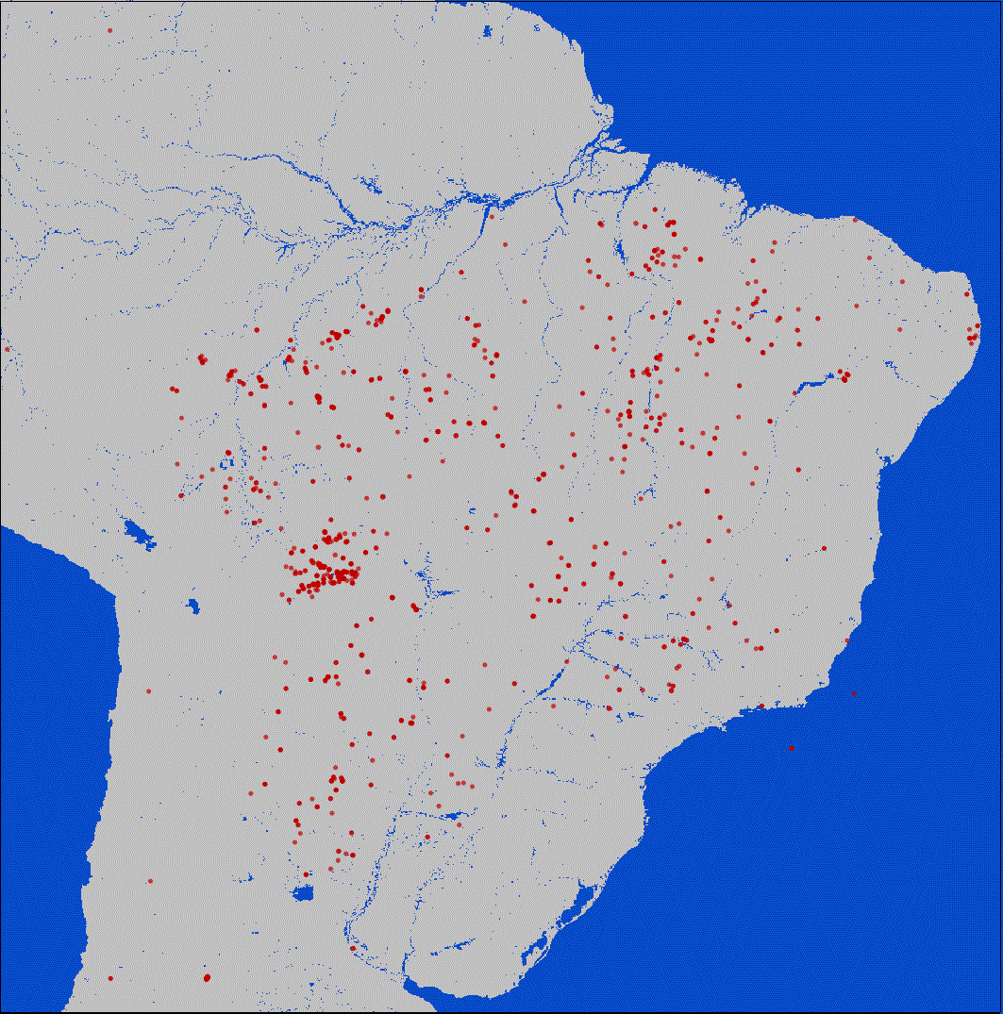
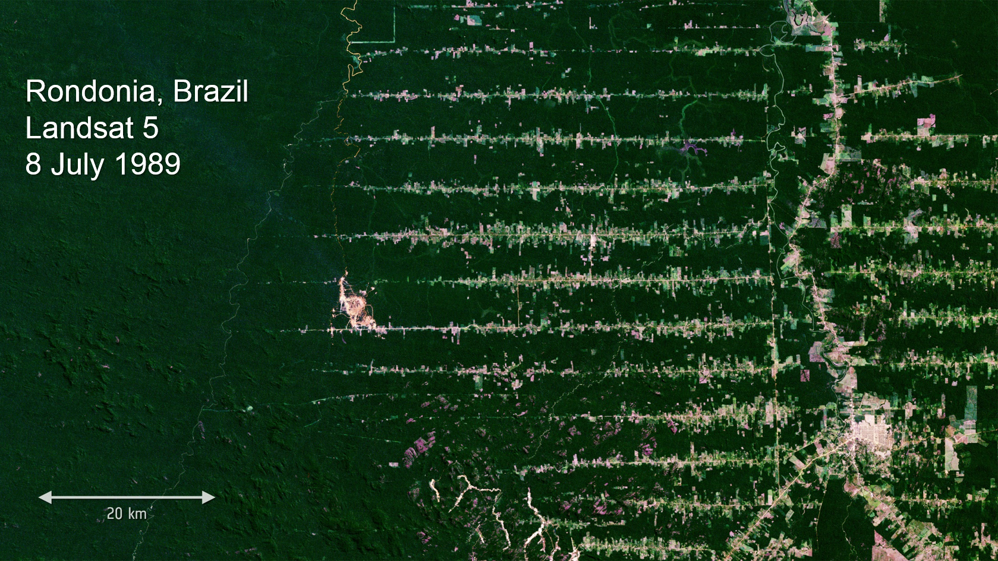
Rainforest Burning
Deforestation
August 2019
August 2018
ESA UNCLASSIFIED – For Official Use
European Space Agency
Notes:
Let me present one striking recent example that shows the impact of EO: the recent fires in the Amazon rainforest
On the left image we first see the average CO measured in august last year by our Sentinel-5P satellite, on the right image we see the fire atlas to track all fires in a given time
As I will now click, the CO data and the fire atlas of August this year will appear, showing a remarkable difference
By processing 249 images for August 2018 and 275 images for August 2019, we were able to see the incredible number of fires burning in the Amazon.
In total: almost 4000 fires were detected from 1 August to 24 August 2019, while last year there were far fewer during the same period, just 1110 fires!
This was achieved by the World Fire Atlas night time algorithm, in order to avoid any possible false alarms with the daytime algorithm
Observations like this over longer times allow us to make precise measurements by analysing the data
‘Click to reveal rainforest clearing GIF): by comparing recent Sentinel data with historical records, we can also map the overall changes in rainforest coverage
EO data such as this and other datasets from the Sentinels and the Earth Explorers are a key tool in helping to address climate change and in taking actions to preserve biodiversity

Slide 6
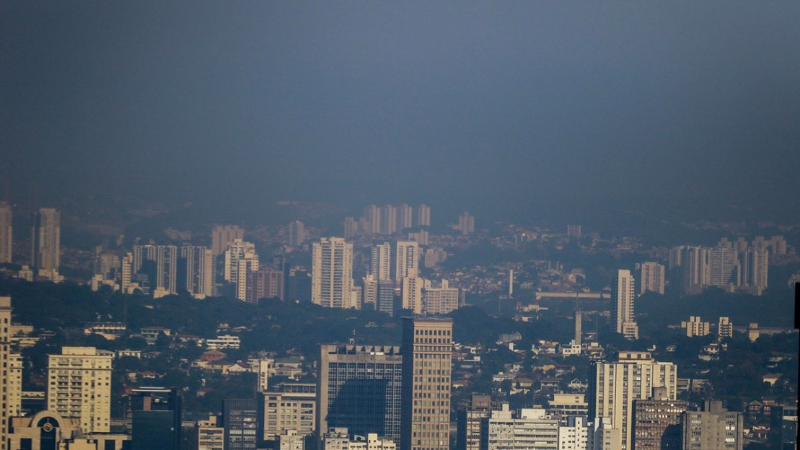
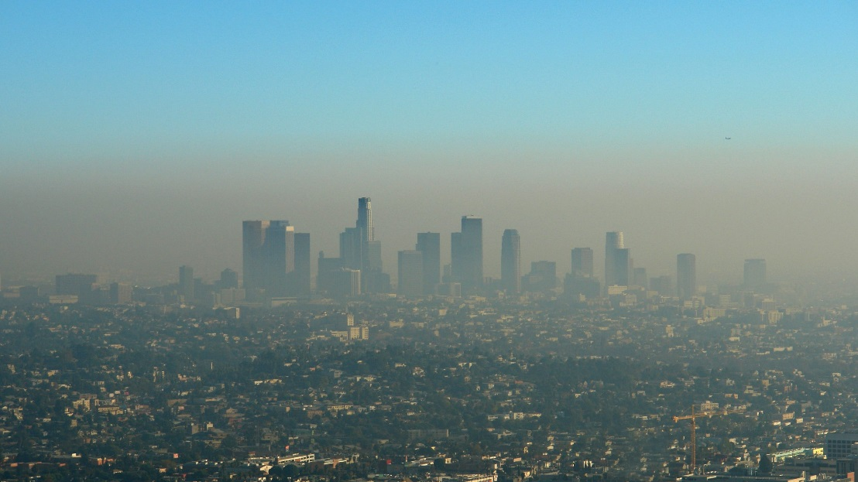
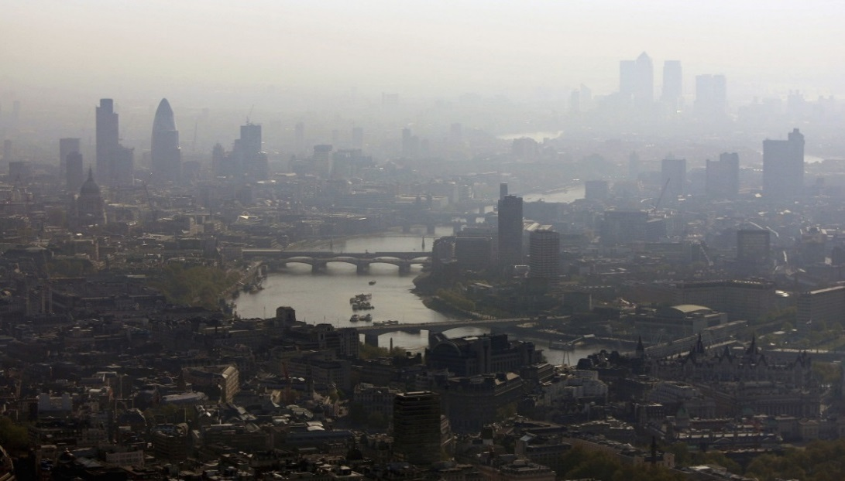
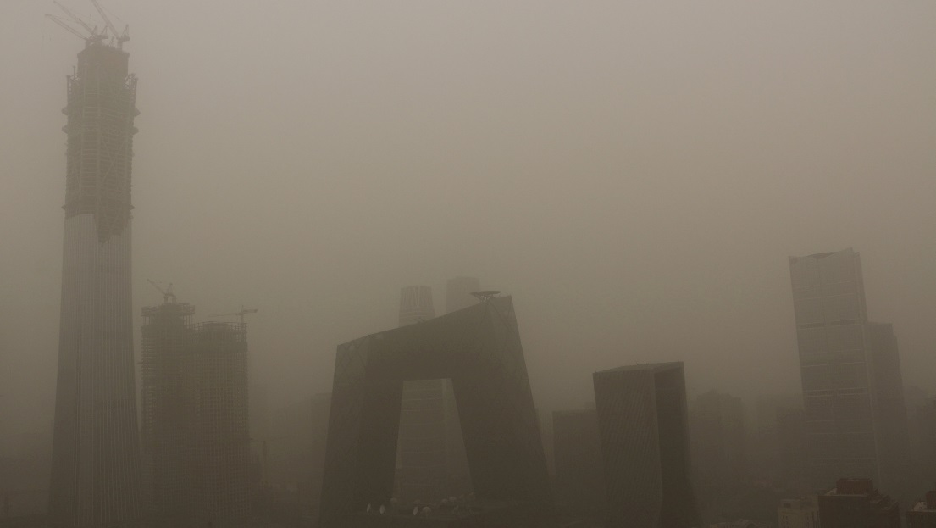
Sao Paulo
Brazil
Los Angeles
United States
Air Pollution
Copernicus Sentinel-5P
NO₂
London
United Kingdom
Beijing
China
ESA UNCLASSIFIED – For Official Use
Copernicus modified data (2018 - 2019)
European Space Agency
Notes:
Despite slow improvements, air pollution continues to exceed European Union and World Health Organization limits and guidelines according to the European Environment Agency
EEA estimates indicate that poor air quality (which includes many parameters such as fine particules) is responsible for about 422 000 premature deaths in 41 European countries in 2015

Slide 7
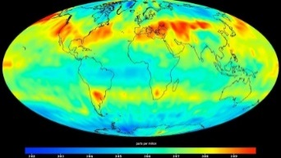
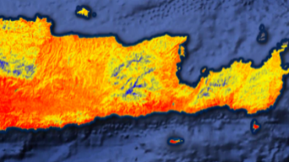
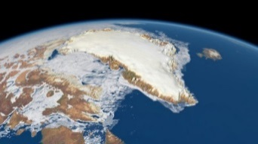
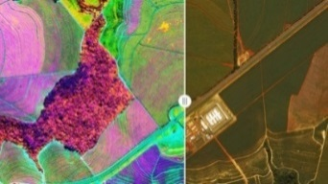
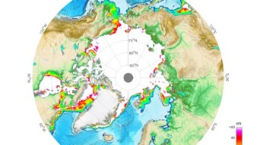
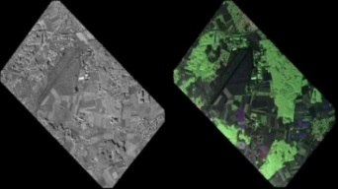
Copernicus new Missions
CO2M - Anthropogenic CO₂ Monitoring
LST – Land Surface Temperature Mission
Causes of Climate Change |  | Agriculture & Water Productivity
CRISTAL – Polar Ice & Snow Topography
CHIME – Hyperspectral Imaging Mission
Effects of Climate Change |  | Food Security, Soil, Minerals, Biodiversity
CIMR – Passive Microwave Radiometer
Rose-L – L-band SAR Mission
Sea: Surface Temp. & Ice Concentration |  | Vegetation & Ground Motion & Moisture
ESA UNCLASSIFIED – For Official Use
European Space Agency
Notes:
New segment of existing programme: implemented in three phases with only first phase (2020-2029) presented at Space19+
Phase 1 to support:
Phase B2/C/D/E1 of the six High Priority Candidate Missions
Ground Segment Development & Collaborative G/S activities
Co-funded by EC contribution (recurrent models, launch, operations)
For each HPCM: single procurement action under ESA procurement and project management for both prototype satellite (funded by ESA) and recurrent satellites (funded by EU)
Programmatic review at the end of ph B2 (before end of 2021)

Slide 8
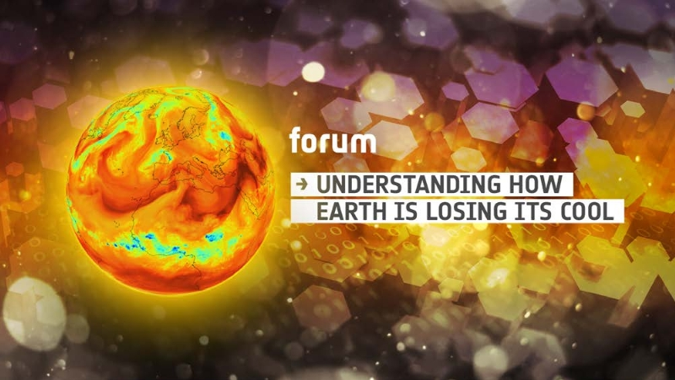
FutureEO – Earth Explorer 9: FORUM
Key for climate change science
By measuring radiation emitted by Earth into space, FORUM will provide new insight into the planet’s radiation budget and how it is controlled
ESA UNCLASSIFIED – For Official Use
European Space Agency

Slide 9
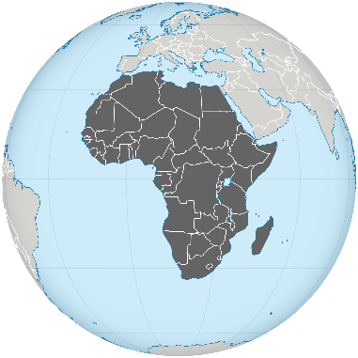
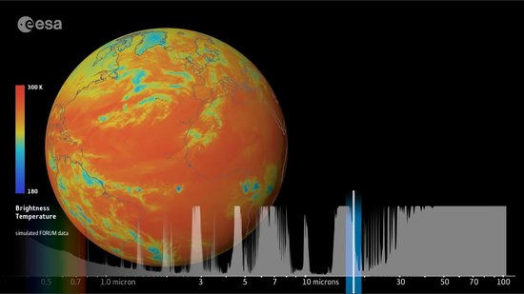
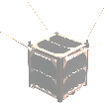
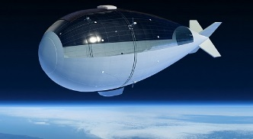
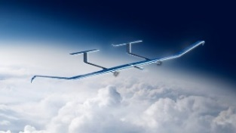
FutureEO – new Elements of Innovation
Hardware & Technology
Operations
Science & Applications
Increased Data Diversity & Volumes
EE-9: FORUM
EO
AFRICA
Machine Learning
Safety & Civil Security
EO contribution to
ESA-wide pillar
Scouts & Φ-Sats
AI for Space
and EO
Cloud Computing
HAPS
ESA UNCLASSIFIED – For Official Use
European Space Agency

Slide 10
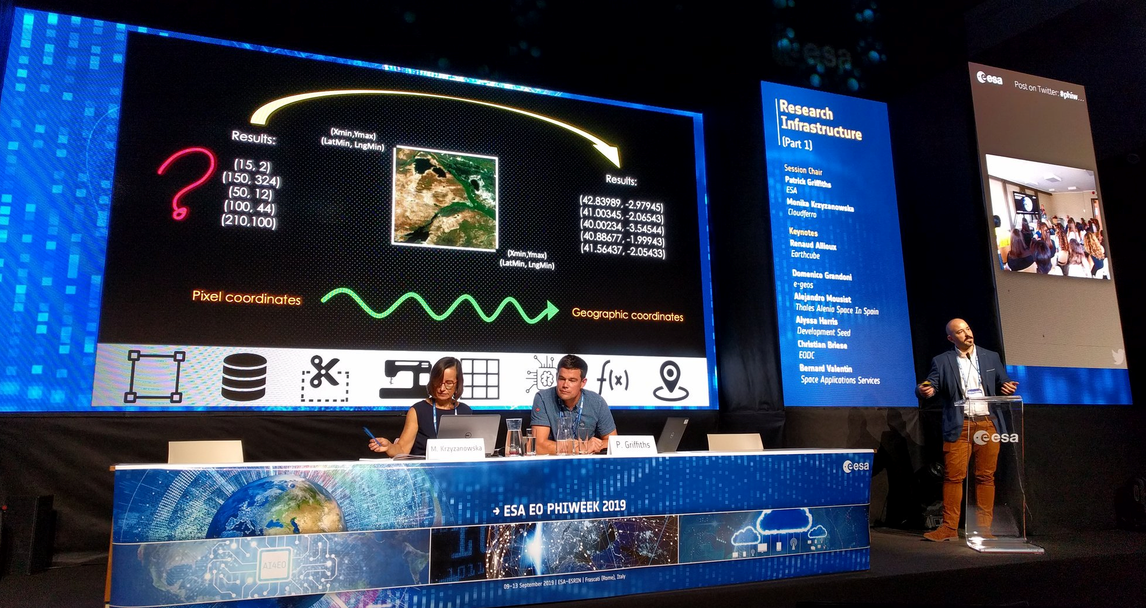
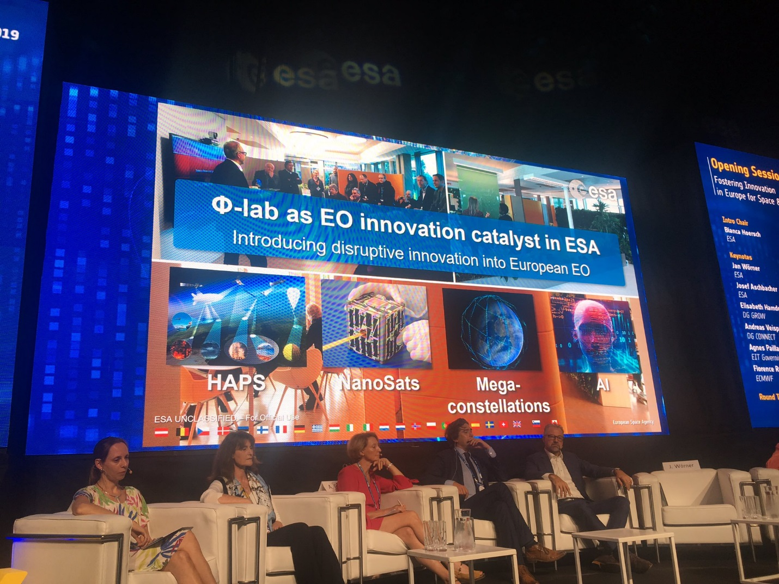
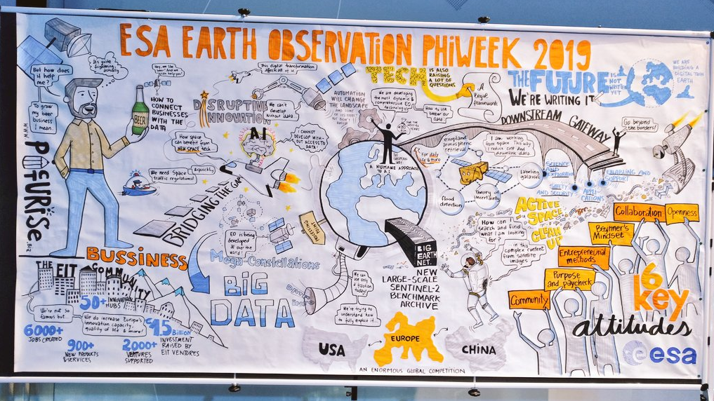
Φ Week 2019
700 selected participants of 1300 pre-registrations
5 days Bootcamp
160 posters
23 side events
Φ-Sat 2 Challenge
AI SIG Launched
ESA UNCLASSIFIED – For Official Use
European Space Agency
Notes:
Phi Week messages:
· 1300 pre-registrations · 700 selected participants, as we had to limit access for security/safety reasons, we introduced a strong online component (streaming + slido to interact on the web) · 12 Keynotes for today opening · 78 talks at the conference including 13 keynotes covering themes AI4EO, EO Next, Research Infrastructure · 160 posters · 23 side events ranging from to Training e.g. Earth System Data Cube, AI4EO, Diversity in Science, Woman in Aerospace, InCubed programme (with investors), Hackathon ESA Toolbox, workshops on Future of Education, Extreme Earth, Space mission designs, AI & Security, Energy, Insurance, Social Media, Blockchain · 5days Bootcamp with entrepreneurs to develop EO prototypes
Phi Sat Challenge
Cubesat with onboard AI for EO
1 M€* + ESA expertise for winning proposal
Challenge > 3 shortlisted Candidates > Studies > Selection of Winner
Winning team gets 1 year development time before launch & operations
AI SIG on Space
World’s first AI SIG on Space, established between ESA and CLAIRE
Work has begun with AI workshops on climate change and 10 visiting AI professorships
70 visiting AI scholarships, and projects and programmes planned for 2020
SIG includes leading researchers from within ESA and from France, Germany, Italy, Luxembourg, the Netherlands, Spain and Slovenia

Slide 11
Many new EO Missions at
TRUTHS
Phase A/B1
Earth Explorer 9
FORUM
Far-infrared-Outgoing-Radiation Understanding and Monitoring
Copernicus
6 ESA-funded Sentinels
(+ 6/7 EU-funded recurrent)
ARCTIC WEATHER SATELLITE
ALTIUS
Phase E
Small Missions
2 SCOUTS
and
2-4 Φ-sats
Proba-V
Extension + 2 Smallsat
Prepare future Missions
Phase A/B1 Sentinels NG included in FutureEO
Aeolus follow-on, Earth Explorer-10, Next Generation Gravity Mission with NASA
ESA UNCLASSIFIED – For Official Use
European Space Agency
Notes:
Arctic
Truths

Slide 12
Thank you for your attention!
www.esa.int
@AschbacherJosef

