Slide 1

Agency Updates – ISRO
Committee on Earth Observation Satellites
Dr. P.G. Diwakar, ISRO
CEOS 2020 Plenary
Agenda Item # 3.2
Ha Noi, Viet Nam
14-16 October 2019

Slide 2
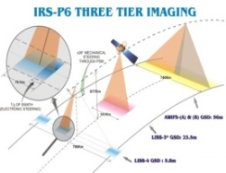
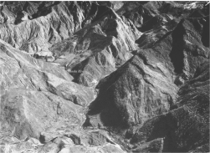
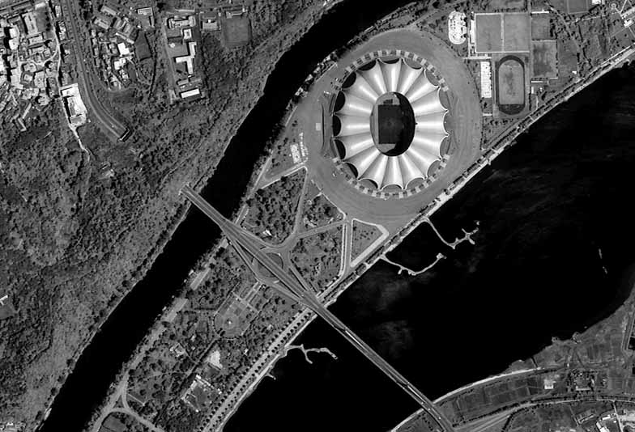
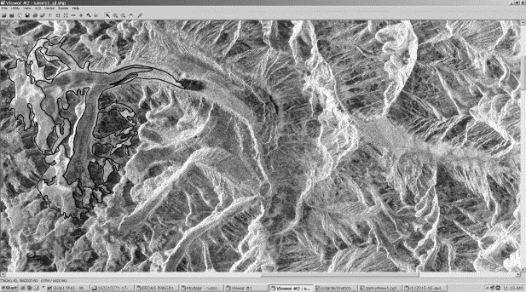
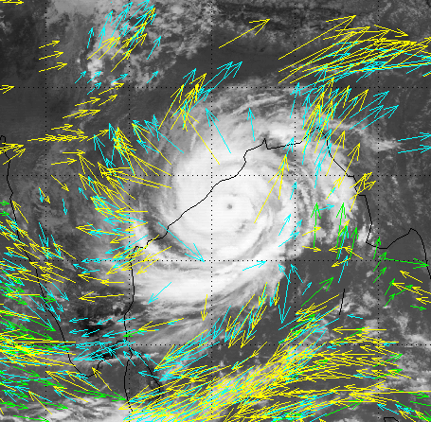
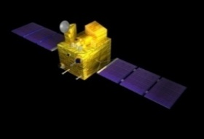
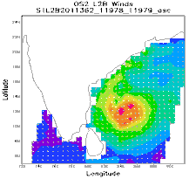
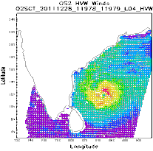

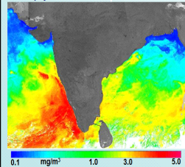

Operational Earth Observation
Satellites
Land & Water Resources Management & Infrastructure Planning
RESOURCESAT-2/2A
CARTOSAT- 1 CARTOSAT-2/2E
RISAT-1
56 / 23 / 5.8 Meters
2.5 Meter - Stereo
Sub- meter
All Weather Imaging
Weather & Climate
KALPANA
INSAT-3D & 3DR
MEGHA-TROPIQUES
Visible
WV
Thermal
6 Bands IMAGER
19 Channel Sounder
48 images per day
Radiation Budget
Atm. Profiles
Radio Occultation
3 Band VHRR - 2 / 8 km
Imager - 1 / 4 km ; Sounder
Oceanography
OCEANSAT-2
SARAL
SCATSAT
-
1
Ocean Color
Ocean Altimetry
Wind Vector
360 m / 2 days
Ka BAND ALTIMETER
Ku BAND
SCATTEROMETER
CEOS Plenary 2019, 14-16 October

Slide 3
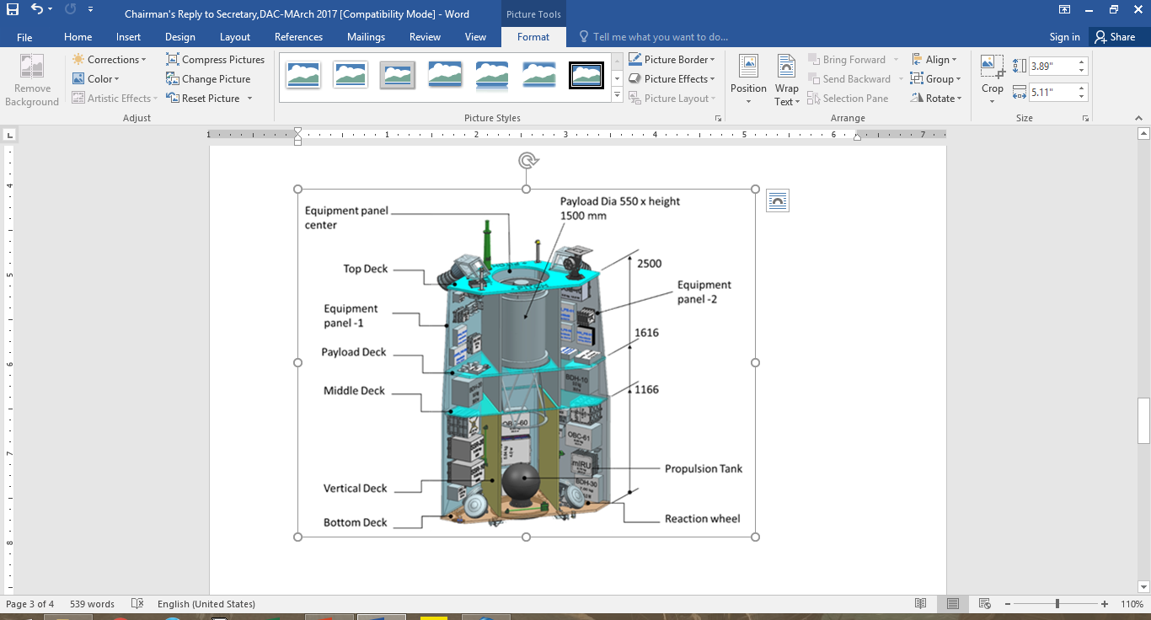
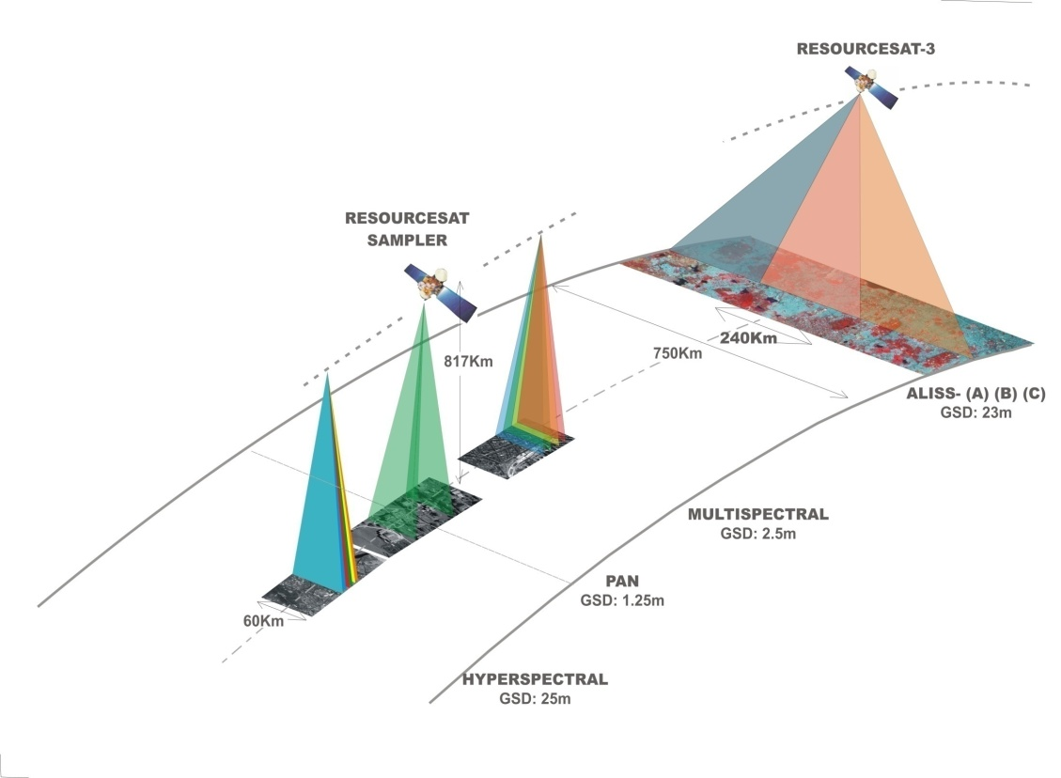

EO Satellites in making
Cartosat-3 (2019)
HRSAT-1 (2020) – 3 Nos.
Sensor | GSD | Swath | Revisit
PAN | 0.25 mt. | 15 km | 5 Days
MX | 1.mt. | 15 km
Sensor | GSD | Swath | Revisit
PAN | 1 m | 15 km | Daily of Area of Interest
MX | < 4 m | 15 km
LWIR | 20 m | 6 km
OCEANSAT-3/3A (2020/21)
Resourcesat Sampler – 3S/3SA (2020,21)
Sensor | Ocean Colour Monitor (ii) SSTM (iii) Scatterometer (iv) ARGOS
Res. | OCM: 360 x 236 m (across x along track), SSTM:1080m, Scat: 25km
Swath | 1420 km, 1440 km, 1800km
Sensor | GSD | Swath | Revisit
PAN | 1.25 m | 60 km | Revisit of 4 Days
MX | 2.5 m | 60 km
Advanced stereo PAN &
Multi-spectral imaging
CEOS Plenary 2019, 14-16 October

Slide 4
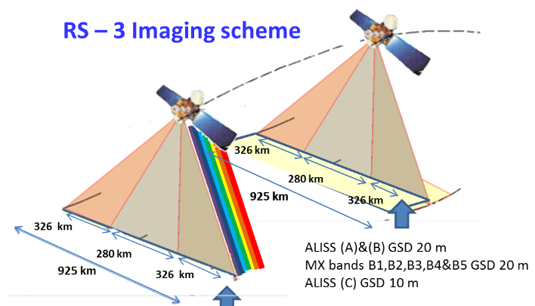
EO Satellites in making
RS-3 & 3A (2021 / 2021)
Sensor | GSD | Swath | Revisit
ALISS-3 (A,B&C) | 20 m | 925 km | 4 days
ALISS-3 (C) | 10 m | 280 km | 11 days
ATCOR 0.4-1 µm | 240 m
Spectral bands : B1-B5
Frequency | C-band (5.35 GHz)
Polarization | Single, Dual , & Circular (Hybrid)
Swath | 10 km to 240 km
Incidence Angles | 20° – 49°
Spatial Resolution | 3 to 6, 25, 50 m
Repetivity | 25 days for 240 km swath – systematic
Modes | Stripmap, CRS, MRS, Spotlight
RISAT-1A (2020) / 1B (2021)
CEOS Plenary 2019, 14-16 October

Slide 5

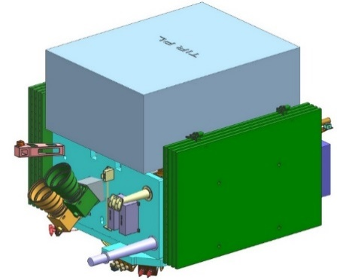
EO Satellites in making
GISAT-1 (2020)
 | Orbit | Geosynchronous
 | Payloads | Multispectral – VNIR (6 bands) : 50 meter LWIR - (6 bands) : 1.5 x 1.5 km Hyperspectral - VNIR : 320 meter Hyperspectral – SWIR : 192 meter
 | Swath | 1000 X 1000 km, 3000 X 3000 km, 6000 X 6000 km
Parameters | L-band SAR 1.25 GHz | S-band SAR 3.2 GHz
Orbit | 747 Km with 98.5° Inclination
Repeat, Nodal Crossing Time | 12 days repeat, 6AM / 6PM
Polarization | Single, Dual , Circular, Quad and Quasi-quad pol
Incidence angle range | 33 – 47 deg
Resolution (Azimuth × Slant range) | 6.9m × 7.5m (for 20MHz bw) 6.9m × 1.9m (for 80MHz bw) | 6.4m × 6m (at 25MHz bw) 6.4m × 2m (for 75MHz bw)
Max. Swath width | > 240 Km
NISAR (2022)
TRISHNA (2022)
Thermal Infrared Instrument | 4 bands (8.6 to 11.5 μm) 50 m resolution at NADIR, 932 km swath
VNIR Instrument | 6 bands (485 to 2130 nm) 50 m resolution at NADIR,932 km swath
CEOS Plenary 2019, 14-16 October

Slide 6
Recent Efforts to Augment EO Data Availability
Landsat Data Acquisition
Cooperation in the exchange of USGS satellite data (Landsat-7 & 8) and ISRO's Resourcesat-2'.
Copernicus Arrangement
Cooperation for direct access of all Sentinel satellite data on real time basis on International data hub and IRS data exchange
Virtual Ground Station
A virtual ground station (VGS) @ NRSC to acquire sub-meter resolution data over Indian sub continent through the Satellite’s on-board recorder.
Access to NovaSAR S-Band data.

Slide 7
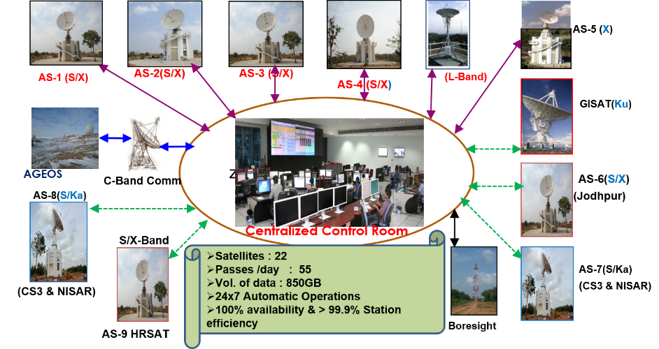
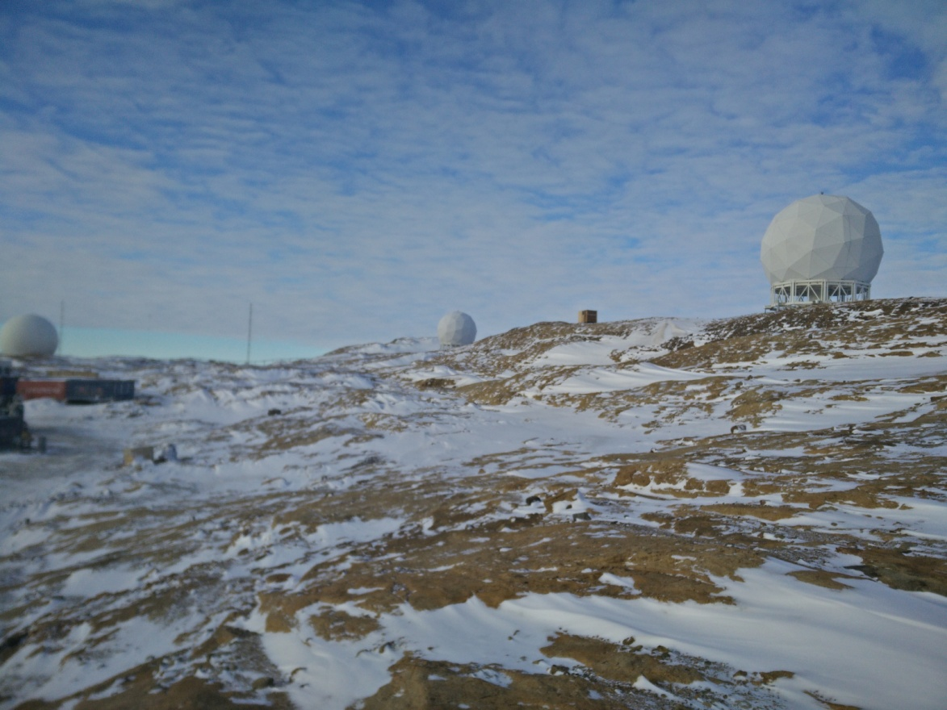
Satellite data & reception
Ground Segment for EO Satellites
Shadnagar ground station S/X-7.5M(4), L-1.2M(1), S/X-4.5 M(1) Antenna Systems
Antarctica ground station for EO Satellites (AGEOS) at Antarctica (7.5M S/X and S/X/Ka DRS)
AGEOS - TTC & Payload data supported for 14 IRS missions/ 55 passes
Data Communication Networks (ISRO / Spacenet)
Bore Sight Test Facility
AGEOS Communication link
IMGEOS

Slide 8
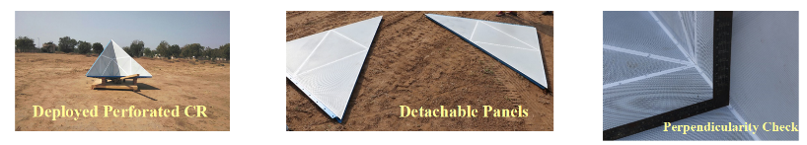

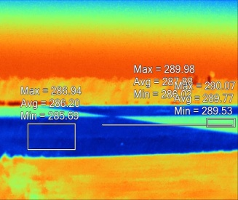
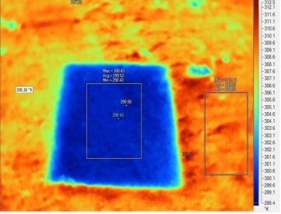
Cal-Val Initiatives
Design, Dev & of perforated detachable Corner Reflector of 2m for SAR calibration
Design & Development of CR for permanent deployment in Antarctica as a part of establishing permanent SAR calibration site in Antarctica
Dev. of Active Radar Calibrator for SAR
Dev. of Cal-Val network for SAR calibration
Periodic calibration of IRS sensors (space/airborne)
Data Type | Targets
Optical VNIR & SWIR | Natural Soil/Stone Contrast bars Edge /Point
Microwave | Square Trihedral and dihedral CRs ( 40 to 125 cm)
Thermal | Natural material Water body
High resolution targets
Targets for IR region

Slide 9
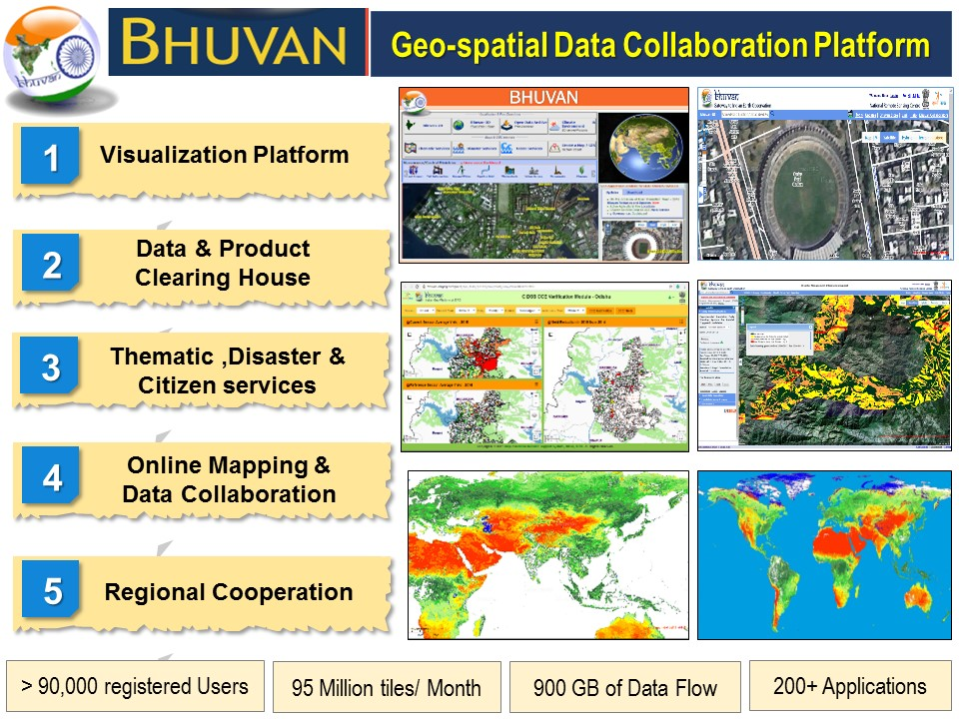
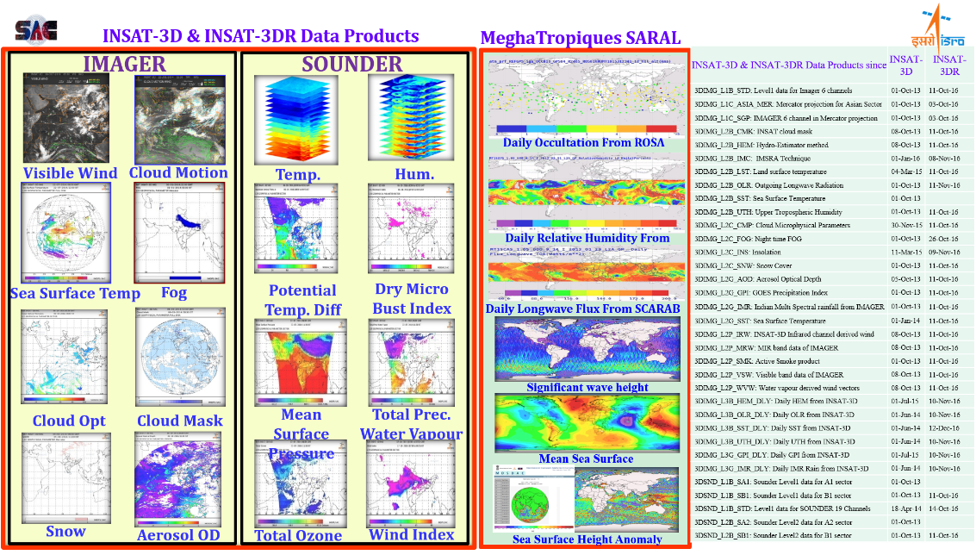
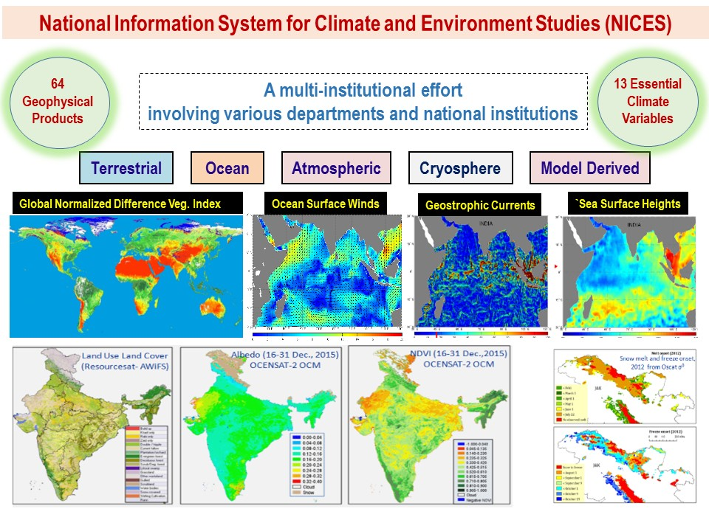
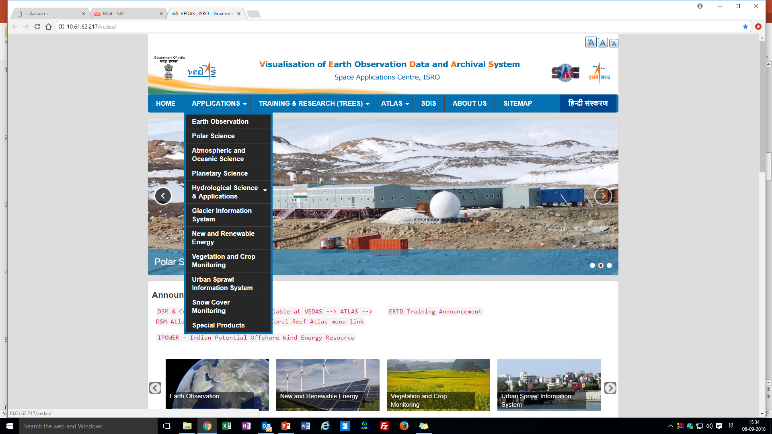
Data Dissemination Platforms
http://www.bhuvan.nrsc.gov.in
http://www.mosdac.gov.in
http://vedas.sac.gov.in/vedas/

Slide 10
THANK YOU
CEOS Plenary 2019, 14-16 October

