Slide 1
CEOS/CGMS Joint Working Group Climate
Jörg Schulz, EUMETSAT, WGClimate Chair
Albrecht von Bargen, DLR, WGClimate Vice-Chair
CEOS Plenary 2019
Agenda Item 2.2
Ha Noi, Viet Nam
14 – 16 October 2019

Slide 2
Status of Plenary Actions
CEOS-32 Plenary actions
Actionee | AGN item | Action # | Description | Action feedback/closing document | Deadline | Status
WGClimate | 2.1 | CEOS-32-02 | WGClimate to develop a ‘decision-maker’ version of the Statement of Space Agency Contributions in Support of Each Article of the Paris Agreement. | WGClimate Chair developed a presentation used at ESA Living Planet and several workshop. This serves as basis for a brochure still to be delivered. | 29 Feb 2019 | OPEN
WGClimate | 3.6 | CEOS-32-05 | WGClimate to report on internal implementation for the way forward on CEOS-CGMS coordination on GHG monitoring, including a roadmap based on the mapping of the whitepaper actions and the JRC workshop conclusions | WGClimate reported at SIT-34 and TW. Item 2.4 contains a detailed report on the roadmap. | SIT-34 | Proposed for Closure

Slide 3
Achievements 2019
CGMS-47, Sochi, Russia:
Achieved formal endorsement for WGClimate leadership change;
Achieved formal endorsement of the greenhouse gas monitoring constellation white paper;
Achieved formal endorsement of WGClimate GHG Task Team and updated TOR;
Closed all open actions on CGMS side. Reminded CGMS agencies to participate in WGClimate;
Aligned and synchronised CGMS HLPP with CEOS work plan;
Achieved formal endorsement of the Resolution on Progress on Implementation of the Architecture for Climate Monitoring from Space at WMO Congress-18;
Finalised and delivered the space agency statement to SBSTA-50, Bonn, Germany;
Participated in dialogue on Systematic Observations with the SBSTA chair that also included IPCC, WMO and WCRP (outcomes still to be delivered by the UNFCCC Secretariat);
Worked hard on population and verification of ECV Inventory #3, gap analysis, and update of action plan
Published an article on WGClimate in the CEOS newsletter.
Notes:
Noting the significant progress that has been made in observing the Earth globally and synoptically with higher temporal, spectral and spatial resolutions, which before the advent of satellites was all but impossible,
Noting also the essential nature of combining space-based observations for climate monitoring with ground-based observations in an integrated observing system,
Convinced of the pivotal role of satellite data to contribute to scientifically sound, evidence-based policy- and decision-making for sustainable development,
Noting that space-based observations will be vital for the successful implementation of the Paris Agreement,
Having assessed progress made on the implementation of the Architecture for Climate Monitoring from Space (hereafter/thereafter referred to as “Architecture”) as provided in the Annex to the present resolution,
Taking note that the Architecture provides an overall framework for assuring that the space-based component of the WMO Integrated Global Observing System will provide vital observations and products for climate monitoring in line with user requirements,
Noting further that the Architecture has been reviewed by GCOS, CEOS, CGMS and by the Joint CEOS/CGMS Working Group on Climate,
Appreciates the progress made with the implementation of the Architecture and confirms its importance,
Considers favourably the significant contributions made by CEOS and CGMS satellite operators in the implementation of the Architecture,
Endorses the approach taken for the implementation of the Architecture;
Requests the Secretary-General to take appropriate action through the WMO Space Programme and in partnership with WMO Members for the further implementation of the Architecture including through its effective integration in the development of the Global Framework for Climate Services;
Urges CEOS and CGMS satellite operators to maintain their efforts towards full implementation of the space-based climate observing system component in accordance with the Vision for WIGOS in 2040.

Slide 4
Case Studies for the Climate Architecture
Finalised work plan Action CMRS-13: Plan development and promotion of case studies
Based on earlier 13 case studies published in 2015, WGClimate is developing a new much bigger set of case studies promoting the use of CDRs in applications supporting policy and decision making
WMO has agreed to lead a report with a target publication date in the second half of 2020
WMO GFCS and GCOS (being cosponsors of the first report) send supportive messages but won’t engage due to lack of resources
Several agencies have provided use case headlines (>20) ranging from scientific to service type applications using CDRs
It is common understanding that use cases shall provide information suitable for the WGClimate web presence which is under redevelopment
Not all case studies will be ready for the 2020 report, but will become available via the web.

Slide 5
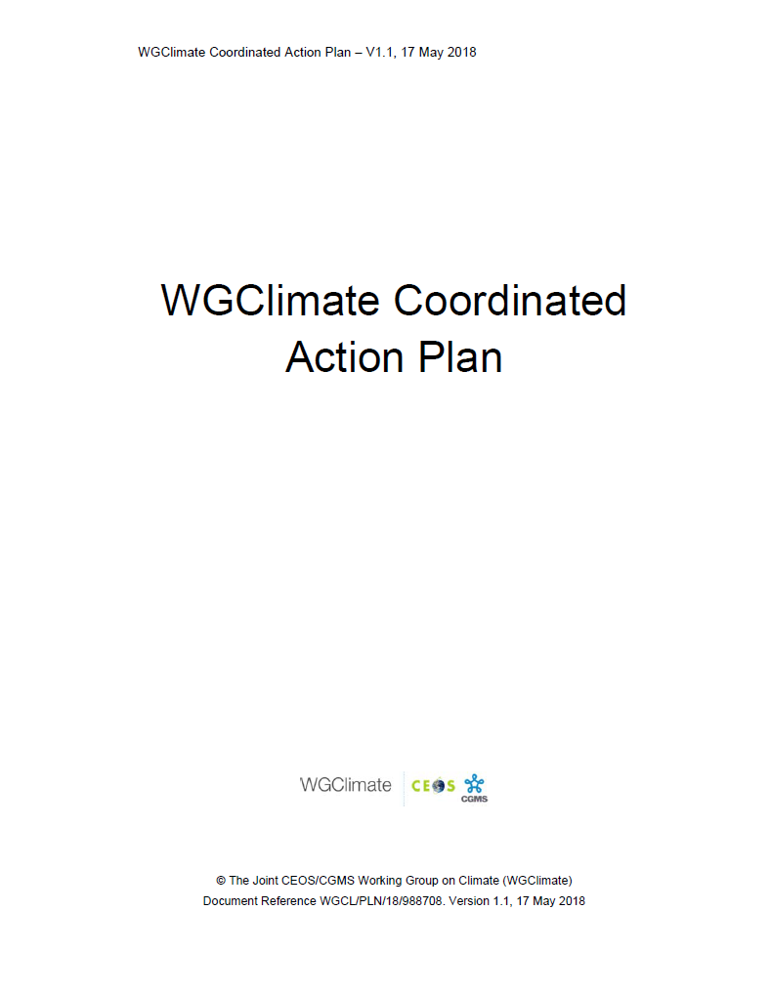
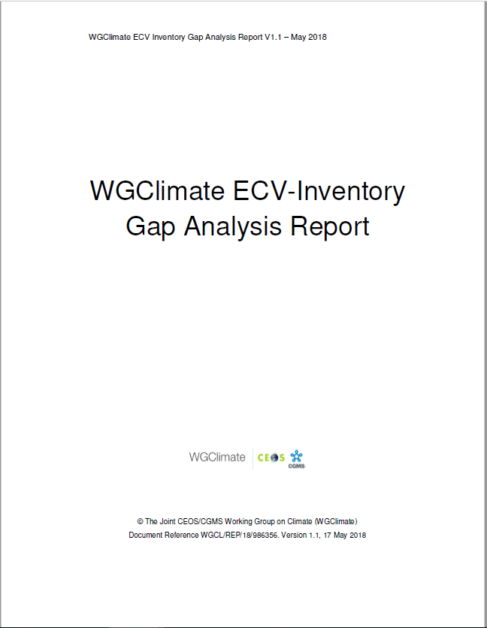
GCOS ECV CDR Inventory – Set up and Benefits
Recurrent actions CMRS-17, 20, and 21
ECV Inventory fully describes current and planned implementation arrangements (ECV-by-ECV) within the Architecture
Content fully verified and updated annually with approval from CEOS and CGMS
Informs space agency planning, improves availability and interoperability of climate data records
Feeds material for all future responses of the space agencies to the GCOS status report and IP
Is used by Climate Services to chose CDRs, e.g. Copernicus Climate Change Service
Users can download the ECV Inventory content for own analysis, find direct access points to CDRs in the Inventory, get access to WGClimate gap analysis results and planned actions
Action Plan & Creation of conditions to deliver CDRs
ECV Inventory
Gap Analysis & Recommendations
2018
2018

Slide 6
ECV CDR Inventory and Gap Analysis
http://climatemonitoring.info/ecvinventory
Successful round of inputs in 2019:
Inventory covers contributions to 35 out of 53 GCOS ECV (37 being accessible by satellite)
Inputs on previous gaps in ECVs: above-ground biomass, sea-surface salinity, lightning (previous gaps), and permafrost (new ECV)
Significant amount of newly planned CDRs from ESA CCI+ and EC-Copernicus Climate Change Service
New / stronger contributors: KMA / JAXA and JMA
Worked with ~200 responders (64 + 6 replacements newly registered).
Total number of data records worked on |  | Available data records for gap analysis
1396 records | 976* inherited (#2) | 943 | 649 existing | 1300 records
 |  |  | 294 planned
 | 420 new (#3) | 357 | 172 existing
 |  |  | 185 planned
*(913 published + 63 non finished/verified from Cycle #2)

Slide 7
ECV CDR Inventory and Gap Analysis
ECV Inventory contains:
72% CDRs
28% ICDRs
CDR length:
27% < 10 years
73% >= 10 years
33% >= 20 years
18% >= 30 years
Maximum length possible: ~50 years.

Slide 8
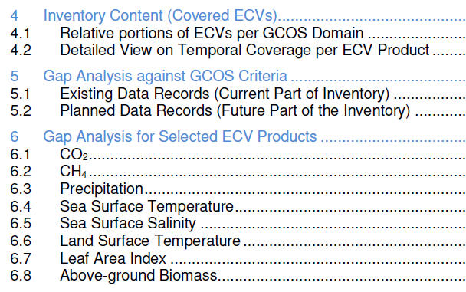
ECV CDR Inventory and Gap Analysis
Automatic assessment
Statistical analysis tools and graphical display
Statistical analysis tools and graphical display on the web interface
Analysis of delta to version #2
Detailed analysis per ECV / ECV Product:
Assesses progress for 8 ECVs addressed last year
Selected 13 additional ECVs (5 atmosphere, 5 land, 3 ocean) not addressed before that are specifically part of 2016 GCOS-IP actions
Postponed 2 land (FAPAR, Glaciers) and 1 atmosphere (lightning) due to missing support
Notes:
Revisit set of ECVs / ECV Products targeted by the previous gap analysis (CO2, CH4, Precipitation, Land Surface Temperature, Leaf Area Index, Above-Ground Biomass, Sea Surface Temperature, Sea Surface Salinity) and assess evolution, cross-referencing with the Recommendations and Actions

Slide 9
Schedule for Gap Analysis and Coordinated Action Plan
November
Q3.2019
Q4.2019
December
January
Q2.2019
February
March
Preparation (piecewise continuous)
Data collection and Verification (continuous)
Analysis and Reporting (annually)
Update of web interface (Responders, Admin, GA Experts), development of new tools (all users, statistical outputs, reporting)
Registration of new Responders and population of the database: update of pre-existing entries (contacts, URLs, deletion of obsolete/redundant content – e.g. new approach to ICDR-like data records, conversion planned > existing) + input of new entries
2019 Gap Analysis
2019 GA Report and Coordinated Action Plan
Verification of submitted contents for completeness and consistency, in preparation for publication and Gap Analysis
Ask CEOS/CGMS Plenaries for virtual endorsement in Q4/2019 after review of documents by agencies.
1st deadline for the cut-off of data collection for v3.0
Final cut-off date of data collection for v3.0
Intermediate results at the CGMS Plenary
Publication of ECV Inventory v3.0
Submission of Reports to CEOS Plenary
WGClimate #10

Slide 10
Needed support for ECV CDR Inventory and Gap Analysis
Observed decline in support to population, verification and gap analysis for ECV Inventory #3 within CEOS/CGMS agencies and bodies
Estimated support to the ECV Inventory work is ~ 6.5 PY per annum assuming 220 working days:
~2.0 PY, (1.5 PY funded by EC) EUMETSAT support
~0.5 PY, WGClimate members coordinating individual agency contributions
~3.5 PY, ~150 responders in agencies populating and verifying the ECV Inventory (5 working days is assumed for each responder)
~0.7 PY, ~30 individuals supporting the gap analysis (two stages (i) closeness of processes to GCOS guidelines, ii) analysis of individual GCOS ECVs including future need for measurements and missed opportunities) (5 working days is assumed for each person)
It is of high importance that the inventory only contains verified information on which we base recommendations and actions
Agencies are asked to continue/enhance their support to the ECV Inventory related work and to award full appreciation to engaged contributors within their agencies

Slide 11
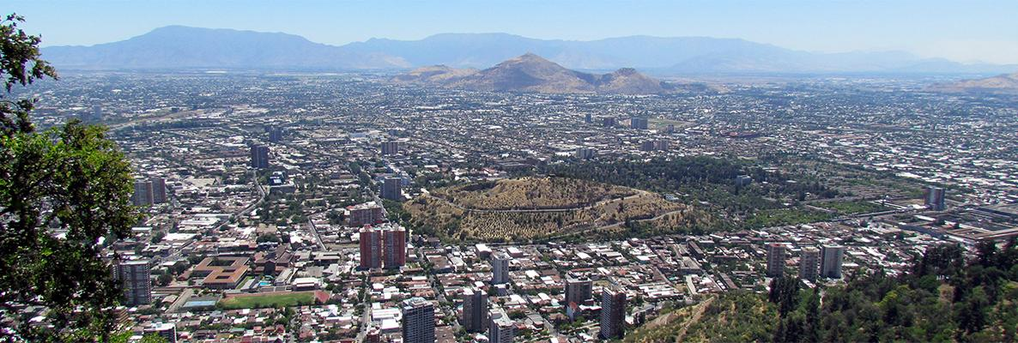
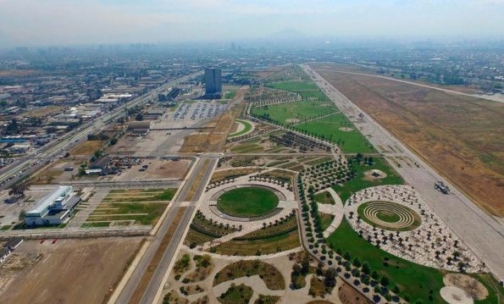
COP-25/SBSTA-51
The Santiago Climate Change Conference will take place in Parque Bicentenario Cerrillos in Santiago de Chile, Chile from 2 to 13 December;
COP 25 will take place from 2-13 December 2019;
SBSTA 51 will take place 2-9 December 2019.

Slide 12
COP-25/SBSTA-51 Space Agency Statement
Joint statement from CEOS/CGMS, work plan action CMRS-22
Statement needs to be delivered to UNFCCC Secretariat one week ahead of SBSTA-51, i.e., 22 November 2019. It is read out on day-1 of SBSTA-51 (1-2 minutes) if not cancelled
Content is space agency contributions relevant to the UNFCCC:
Systematic observations of the Earths’s Climate System – Implementation of the Architecture
IPCC guidelines on use of satellite data for GHG Inventories
Progress on implementation of the GHG constellation architecture and potential usage of outputs
Forest monitoring and Above Ground Biomass missions
WGClimate Chair drafted statement and coordinated with involved entities
Statement is presented for endorsement at this CEOS Plenary
Statement will be delivered by WGClimate Chair via observing organisation EUMETSAT on behalf of India (Party to the Convention of incoming CEOS Chair ISRO)

Slide 13
COP-25/SBSTA-51 Earth Information Day
An Earth Information day will be held at SBSTA-51 on 3 December 2019 (10:00-15:00) with a Plenary and poster session
Three broad themes will be covered:
Updates on the State of the global climate (plenary presentations 10mins plus Q&A from WMO, IPCC)
Updates on implementing Earth observation: for region and country support, and needs (plenary presentations 10mins plus Q&A – including from GCOS, CEOS/CGMS (GHG and biomass), IOC)
Earth observation for science, policy and practice: retooling global cooperation to respond to future climate risk (plenary panel discussion to include GEO, Copernicus and others)
Received a draft info note on 7th October asking for content of CEOS/CGMS contribution inclusive proposal for one or more posters supporting the short presentation
Event allows to present information to Parties for their subsequent consideration during negotiations, so we can focus on clear messaging, e.g., how to use GHG products for improvement/verification of emission inventories

