Slide 1

CEOS Carbon Strategy
Committee on Earth Observation Satellites
Mark Dowell
European Commission
CEOS Plenary 2019
Agenda Item # 2.3
Ha Noi, Viet Nam
14 – 16 October 2019

Slide 2

CEOS Carbon activity - history and Background
GEO Carbon Report developed in June 2010 by team led by Ciais et al. (GCP).
CEOS Strategy for Carbon Observations from Space – written in response to above, completed in March 2014 – Wickland et al.
42 Actions identified in the report for specific response– first discussed at SIT Technical Workshop in September 2013
April 2014:Proposed establishment of a study team to take forward the Actions and also identify formal CEOS mechanism to manage Actions.
Plenary 2016: Agreed approach with dedicated pilots activities
http://ceos.org/home-2/the-ceos-carbon-strategy-space-satellites/

Slide 3
Truly cross-cutting within CEOS
Mapped Actions identified lead CEOS “Entity” as:
    Atmospheric Composition: 6 Actions
    Land Surface Imaging-VC: 4 Actions
    Working Group Climate: 7 Actions
    Working Group Calibration/Validation: 11 Actions
    Strategic Implementation Team: 7 Actions
    N/A: 2 Actions
    Other WGs and VCs named as contributing

Slide 4
Process Adopted
No “traffic light” approach to monitoring and review Carbon Action for some
Identified a number (~ 5) of WG and VC proposed initiatives
Distributed “workplan” approach
These acted as pilots” for number of crosscutting aspects related to the Carbon Action implementation i.e.:
  Initiatives addressing multiple Actions
  Initiatives across multiple CEOS entities VCs & WGs
  Initiatives addressing multiple thematic examples from the same Carbon Action
  Initiatives which “CEOSize” efforts previously undertaken within a specific CEOS Agency or through bilateral efforts

Slide 5
What have we accomplished?
Considerable progress and many of these initial Actions have come to completion including:
the early work be LSI-VC in documenting the mid and course resolution optical sensor links to carbon variables, [Not GEOGLAM-type requirements]
the work within WGClimate on including a number of carbon relevant ECVs in the initial iterations of ECV Gap Analysis, (CO2, CH4, Biomass, LAI)
the work lead by our colleagues from JAXA with contributions from many other agencies and CEOS entities in contributing to the review of the IPCC TFI Guideline process,
the work of WGISS the development of a CEOS Carbon Portal, a resource we expect to build upon and further expand in the future,
CEOS flagship Whitepaper report, produced by AC-VC, defining the characteristics of a GHG monitoring constellation to address the needs of UNFCCC and the outcomes of the Paris Agreement. This report is fast becoming a reference document for the broader community and provides the baseline on which CEOS (and CGMS) intend to build a concrete coordination mechanism in the future.

Slide 6
… &More in 2019
We expect more within this year
activity originally proposed by NASA and ESA on a Biomass Cal/Val Strategy,
Several shorter-term milestones CARB-19 & CARB-16.2 already accomplished and major deliverable planned on WGCV LPV Biomass Protocol Planned by the end if the year
Grown into a established WGCV activity, expects to complete a major Deliverable this year with the finalization of effort on defining a series reference protocols for cal/val.
Biomass, will potentially become an increasingly important topic for CEOS to address from multiple points-of-view in the forthcoming years.

Slide 7
Background
Action T71 from GCOS IP 2016
GCOS-200
“Specifically CEOS and CGMS will undertake, over the next few years, dedicated preparatory work in a coordinated international context…:
The definition of an architecture of space component elements to address the requirements of a CO₂ and GHG monitoring system , … This will provide a global holistic perspective both from the point of view of existing and planned space segment assets as well and that for an optimum global constellation.
The documentation of best practices on the relationships between individual space agencies and their counterparts working on the modelling aspects, the inventories and in-situ data provision, …
The further consolidation of partnerships and collaborations between the relevant international entities including: the relationship between CEOS and CGMS on the space component aspects, the partnership with the WMO and GEO on the broader framework, … and finally the relationships with GCOS itself, UNFCCC and IPCC TFI process in better defining the role for space-based observation in the inventory guideline process.”
Mark Dowell, 6/2018

Slide 8
A System-Level Approach for Integrating Atmospheric Data
Observations
Prior Information
Outputs
Satellite Measurements of CO₂ and CH₄
Fluxes, model parameters, emission reports, economic statistics.
CO₂ and CH₄ emissions & removal Hot-spots with uncertainties
Ground and Airborne Measurements of CO₂ and CH₄
Integration & Attribution
Estimation system
Data assimilation and uncertainty estimation
Country/region CO₂ and CH₄ emissions & removals with uncertainties
Meteorology
Satellite & in-situ
Auxiliary Data
Satellite observations of CO, NO₂, clouds, aerosols …
Models
Transport, land & ocean carbon cycle, fossil fuel emissions.
Other Carbon Cycle Products

Slide 9
What Next?
Good time to think about the next phase for the CEOS Carbon Strategy.
The Strategy still stands, it may need updating. I would not propose to address that at present. I think that much of the "what" needs to be done in the CEOS Carbon Strategy is still valid even if the "how" and the "where" may be a bit dated.
Propose to wait till the end of a subsequent round of Actions to think about revising the Strategy text.
Opportunity to start discussing new activities and Actions

Slide 10
What new Activities
May build of the activities so far
Or, address new areas of the Strategy,
There may be areas where work in one area has identified gaps in others (e.g. the insights on the need for targeted efforts on the natural carbon stock and fluxes resulting from the work of the GHG trends and dynamic undertaken through AC-VC).
In particular we should try to identify activities from CEOS entities with carbon-relevant competences who did not submit suggestions in the previous phase (e.g. OCR-VC and SST-VC, WGCapD).
Following our discussions, at the SIT-TW new proposed activities by the 33rd CEOS Plenary to be included in the CEOS 2020 Workplan, under the CARB section.

Slide 11
Initial Points from Discussions
WGClimate: there are additional Actions in the GCOS IP (GCOS-200) which are relevant to Carbon and GHG, assess how to address them.
AC-VC and WGCV: addressing follow-on Actions for Carbon Strategy resulting from GHG Monitoring Roadmap
LSI-VC/GFOI/GEOGLAM: Assess what Action can be proposed to enhanced land-surface variables in support of the AFOLU carbon aspects in support of UNFCCC. For LSI-VC specifically also LST product specification, phenology.
WGCV: Implementation of Biomass Protocol and establish dedicated Supersites, testing and refining protocol, BRIX-2 Biomass Intercomparison exercise …
OCR-VC: preparing a special journal issue on Carbon, and establishing a working group through the IOCCG that will define priority Actions.
General: the increase in capability of Atmospheric GHG measurement and products over the last few years has underlined the need to establish compatible and consistent products representing the natural carbon cycle from the land and ocean biosphere and multiple scales. Ultimately we could envisage an ambitious effort (a la IMBIE) to look at closure of the the global carbon cycle including cross-domain involvement and many satellite derived variables (& ECVs).

Slide 12
Broadening and Consolidating UNFCCC engagement
CEOS (& CGMS) has been very effective over last 8 years in establishing a positive and proactive dialogue with UNFCCC/SBSTA
This is in large part due to the to the symbiotic relationship we have established with the Global Climate Observing System (GCOS) and the Climate Monitoring Architecture which has been our guiding framework
The creation of the Joint WGClimate established an unambiguous entry point for the discussion between SBSTA and the the Space Agencies
This engagement, through the SBSTA Research and Systematic Observation (RSO) subgroup has largely, to date, focused on our support on Climate Data Records for GCOS ECVs
But in recent years our support has been visibly expanding: CEOS Carbon Strategy, GHG monitoring, CEOS GFOI support and evolution to biomass, other AFOLU, Climate Services and support to Climate Adaptation etc. so…

Slide 13
Broadening and Consolidating UNFCCC engagement (2/2)
We need to adopt a longer-term strategy accounting for the multitude of contributions CEOS, and Space Agencies more generally, can make to the Convention
Maintaining the effective focal point established through WGClimate
But increasing communication on contributions from other parts of CEOS (in statements, SBSTA Briefings etc.)
Use, and re-enforce, CEOS Carbon Strategy as framework for carbon relevant aspects.
Give greater visbility to GFOI/Biomass aspects as well as Agriculture not only through REDD+ but also RSO
In short/mid term:
  Build on priorities of incoming SIT Chair (AUS) on Carbon and Biomass, as well as current visibility on GHG Monitoring
  Initiate dialogue between GHG and AFOLU communities – Workshop hosted by EC June 2020
  Dedicated discussion at SIT TW (Zagreb, Sep 2020) with all CEOS entities, GCOS and UNFCCC Secretariat

Slide 14
Reference Slides
Questions?

Slide 15
Initial Proposed Initiatives
AC-VC: aiming for a white paper on a Carbon constellation;
LSI-VC: adopt GEOGLAM gap analysis
WGClimate: focusing their gap analysis work on carbon-specific ECVs;
WGISS: on a carbon data portal to facilitate the discoverability and accessibility of ECV products and space-borne CDRs relevant for the carbon actions.;
NASA-ESA: on cal/val and production of biomass products from CEOS missions – based on previous bi-lateral NASA/ESA initiative
WGCV: Cal/Val Protocol and assessment mechanisms for carbon relevant variable e.g. FAPAR, LAI
JAXA: on the opportunity to engage with IPCC Inventories and promote satellite EO
These address a good cross-section of Actions across the Carbon Strategy

Slide 16
Some Actions have been undertaken…(from LSI-VC)
CARB-08-03: CEOS Agencies with historical moderate-resolution (~250 m - 1 km) satellite data records will strive to ensure these data are publicly available …
CARB-08-04: CEOS Agencies with historical medium-resolution (~30 m -100 m) satellite data records will strive to ensure these data are publicly available …

Slide 17
WGISS Carbon Portal
Objective: development as WGISS project of a CEOS WGISS Carbon Portal prototype similar to the Water portal (http://waterportal.ceos.org/) to allow displaying Carbon datasets and providing assistance to scientists and general users in the development of related services & tools.
Approach: collection of needs from Carbon (or WGClimate) experts on what needs to be in the portal (Q1/Q2 2017); Carbon Portal requirements definition and system design (Q2/Q3 2017); start development (Q3/Q4 2017).
Additional Resources: requirements definition and development resources provided by NOAA; support from WGClimate and experts for requirements definition.
Notes:
Carbon Portal prototype

Slide 18
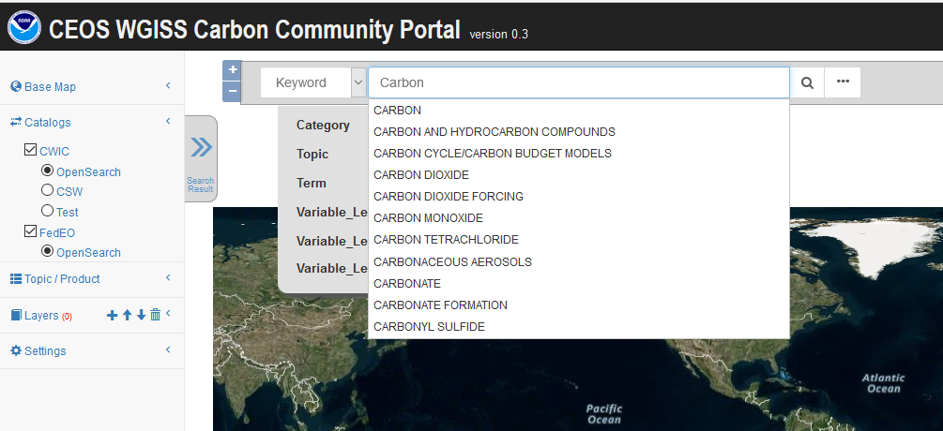
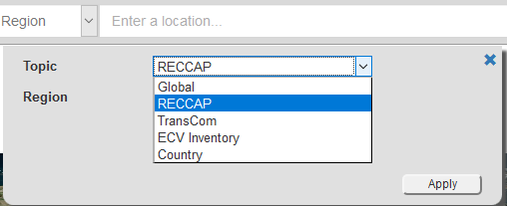
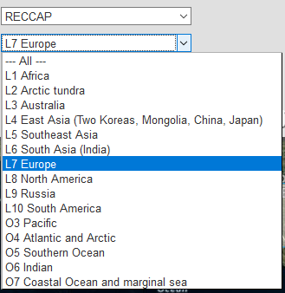
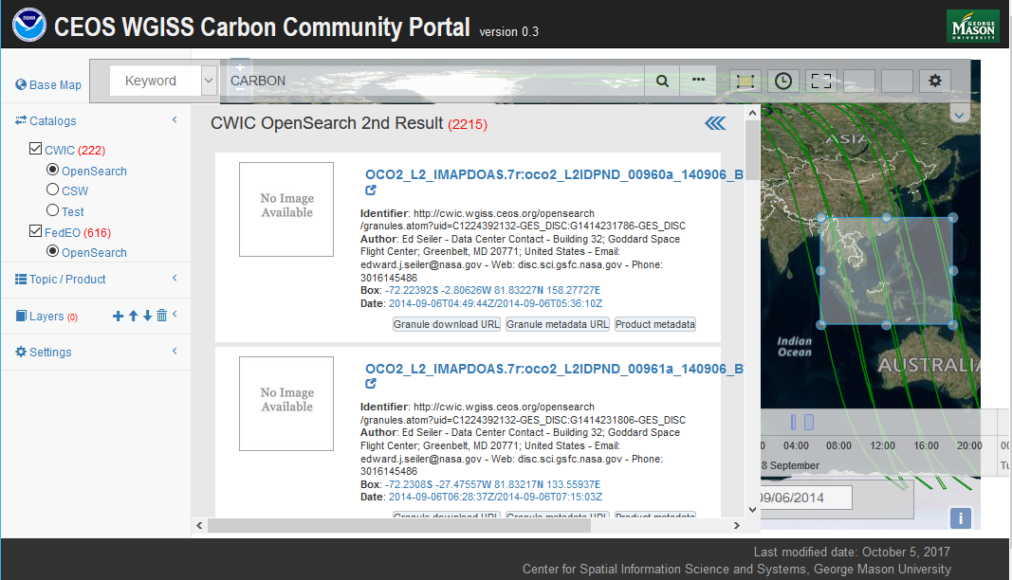
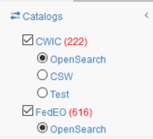

Achievements & Planned Outputs
WGISS Carbon Community Portal
Special regions: Global, RECCAP, TransCom, Country Names, ECV Inventory)
Temporal Searches: support for time range and specific date
Pre-defined Carbon topics/datasets: (Atmospheric, Ecosystem, Ocean, Mixed-Theme)
Keywords (auto-completion with IDN Science Keywords)
Return records from both CWIC and FedEO
  CARB-15: Carbon Data Portal prototype
Discussions ongoing with CEOS Chair Team to evaluate possible use of Carbon Portal in support to Chair Initiative in the Mekong area.

Slide 19
NASA-ESA Initiative
Follow-up to NASA-ESA initiative on Biomass
Recommended Actions
  Need to identify people who have the mandate to coordinate across missions;
  Develop network-level agreements for data sharing rather than each mission making agreements with each individual project
  Meetings to check the status of cal/val as the missions progress
  Coordinated supersite selection and data collection using all remote sensing techniques
  Develop a common data portal or network of data portals to archive and distribute biomass data
Near-Term Deliverables
  Report on the synergy of cal/val objectives across satellite missions
  Report on the detailed suggested approach for selecting key locations globally and what is needed at those locations

Slide 20
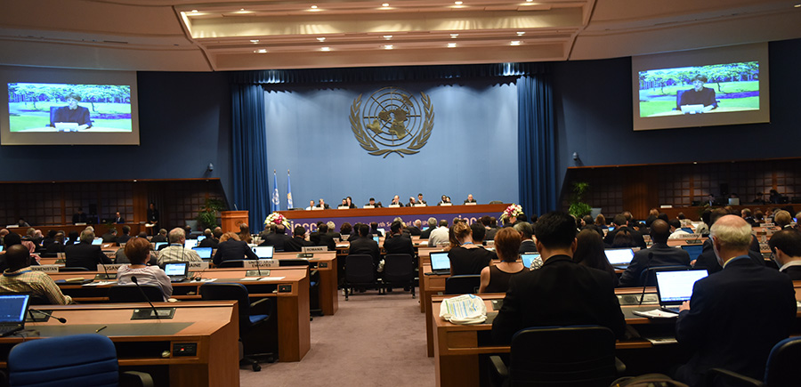
Engagement with UNFCCC and IPCC
IPCC Task Force on National Greenhouse Gas Inventories (TFI) developed “2006 IPCC Guidelines for National Greenhouse Gas Inventories” which will be updated and released in 2019.
  The current guidelines 2006 indicates that each country preferably use independent data to verify GHG inventories, and also indicates that satellite data has limitations in spatial, vertical and temporal resolution.
  Discussion for updating the guidelines is underway and its outline was defined at the IPCC plenary in October. Update of verification guidance is expected, expecially the guidance with atmospheric measurement and new datasets.
  Republic of Korea, supported by Belgium and Japan, proposed to include direct measurement of GHG emissions from sources, noting that they help to improve accuracy of estimates.

Slide 21
Shorter term outputs: WGCV
End Q1 2017: Carbon Action #8 - related to LPV subgroup - identifying priorities of land data products to validate
LPV document its current list of validated land data products and candidate land data products to be validated. The list of land products will be compared to the Carbon Task Force report to identify possible gaps and resources that would be needed to assess those gaps.
Document a set of best practice validation protocols with documented methods and an online platform for intercomparison of terrestrial carbon products. This is part of closing out Carbon Action #8 as well as making significant progress on Carbon Action #34 when coupled with identifying the best mechanism for making WGCV intercomparisons of carbon products available.

Slide 22

CARB-19: Global Surface Albedo Product validation protocol
Although CARB-19 is closed, the Land Product
Validation Subgroup continues to develop valid-ation protocols for global land products within
their focus areas.
The latest protocol to be created is for
Albedo product validation, to be endorsed at
the WGCV-45 in Perth, Australia.
Authors: Wang, Z., Schaaf, C., Lattanzio, A., Carrer, D., Grant, I., Román, M., Camacho, F., Yu, Y., Sánchez-Zapero, J. & Nickeson, J.
https://doi.org/10.5067/doc/ceoswgcv/lpv/albedo.001

Slide 23
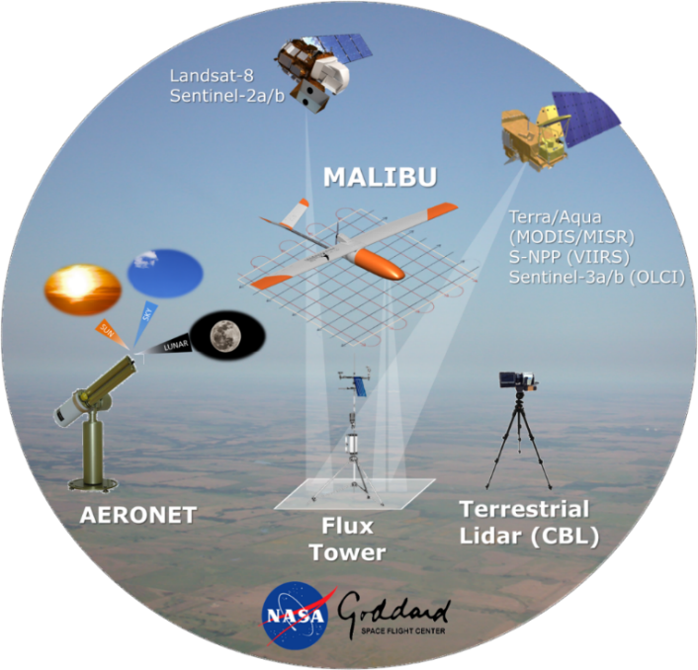
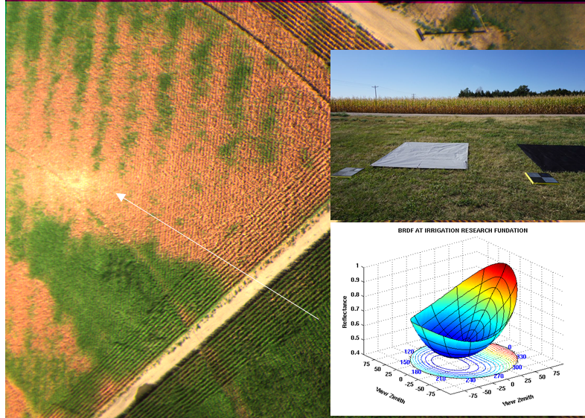
CARB-19: Land Surface Albedo Product Validation
Hot spot region
https://viirsland.gsfc.nasa.gov/Campaigns.html
Flight plan to acquire multi-angular observations
Yuma cropland, CO, USA
NASA’s Goddard Space Flight Center’s Multi AngLe Imaging Bidirectional Reflectance Distribution Function small-UAS (MALIBU) instrument package includes two multispectral imagers oriented at two different viewing geometries (i.e., port and starboard sides) to capture the surface reflectance anisotropy (i.e., BRDF shape) and albedo.
The MALIBU platform that acquires extremely high resolution sub-meter measures serves as an important resource of reference data to improve global land product validation efforts in particular over heterogenous surface, and resolve the uncertainties in the various existing products generated by NASA and its international partners.

Slide 24
CARB-16: Cal/Val and production of biomass products from CEOS missions
The LPV Focus Area on Biomass is currently developing a community-driven good practices guidebook for EO biomass product validation.
Mission | Funding Agency | Expected Launch Date | Data Type | Product Resolu-tion | Geographic Domain | Accuracy Requirement
NISAR | NASA/ ISRO | 2021 | L-band SAR | 1 ha (<100 Mg/ha) | Global | <20% RMS accuracy for <100 Mg/ha
GEDI | NASA | Dec 4, 2018 | 1064 nm waveform lidar | 1 km | ISS (+/- ~51.6°) | <20% SE for 80% of forested 1km cells
BIOMASS | ESA | 2022 | P-band SAR | 4 ha | Global (minus defense issues) | Accuracy of 20%; 10 Mg/ha for <50 Mg/ha
MOLI | JAXA | 2020? | 1064 nm waveform lidar | 500 m | ISS (+/- ~51.6°) | NA
SAOCOM | CONAE | 2018 | L-band SAR | NA | Global | NA
ICESat-2 | NASA | Sept 15, 2018 | 532 nm photon counting lidar | NA | Global | Global
TanDEM-L | DLR | 2022-2023? | L-band SAR | 1 ha | Global | 20% accuracy or 20 Mg/ha
ALOS-4 | JAXA | 2020 | L-band SAR | NA | Global | NA

Slide 25

CARB-16: Deliverables
CARB-16-2018-2 : Review paper on the Importance of Biomass Product Validation
  Accepted in Surveys in Geophysics, one of many review
  papers in a Special Issue from the 2017 Workshop on
  Space-Based Measurement of Forest Properties for Carbon
  Cycle Research, held at the International Space Science
  Institute (ISSI) in Bern, Switzerland.

Slide 26
Biomass Mission Data Sharing and Coordinated Data Collection
GEDI, ICESat-2, NISAR, and ESA BIOMASS teams are coordinating cal/val efforts

Slide 27
CARB-16-2018-3: Components of CEOS LPV Biomass Protocol
The protocol will be a good practices guide to biomass model calibration and product validation at a global (or near global) scale
Good practices for biomass estimation in the field
  Allometric Error
  Field Measurement Error
  Terrestrial Laser Scanning
Linking remote sensing observations to field estimates
  Geolocation & Spatial Scale
  Using airborne data to scale from field to spaceborne data
Error Propagation
  Sources of Uncertainty
  Extrapolating models to global maps
Using existing in situ data for map validation
  For stakeholders who need their own validation
  Linking field plots to spaceborne data
  Independent Validation and Reporting
    Reporting requirements for each stage
    Scope/scale of products
    Error reporting by strata
    Inter-comparison of maps
    Requirements for online portal
Utility of Protocol for Other Communities
    Modeling community
    Policy communities
    Non-forest communities
  Knowledge Gaps
    Experiments that will advance the field
    Airborne / Field data gaps
    Cross mission cal/val plans

Slide 28
ACC Initiatives
  Deliveries:
  Merged CARB AI 16+18: ACC to support the organisation of yearly IWGGMS (International Workshop on Greenhouse Gas Measurements from Space): next planned at FMI (Helsinki, Finland) on 6-8 June 2017
  Merged CARB AI 17+19+23: ACC will prepare a white paper within 2 years (?)
  CARB AI 20: ACC will write a Technical Note within 2 years
  People involved:
  ACC GHG activities lead: D. Crisp (NASA)
  M. Nakajima, K. Shiomi (JAXA) – GOSAT, GOSAT2; D. Crisp (NASA) – OCO2, OCO3;
  Y. Liu (CAS) – TanSat; C. Zehner, Y. Meijer (ESA) – S5P, S5, future GHG Sentinel; A. Friker (DLR) – MERLIN - tbc; C. Deniel (CNES) - MERLIN, MicroCarb, R. Munro (EUMETSAT) – IASI, IRS; D. Edwards (NCAR) – GEO CH4; A. Butz - (DLR) GEO CO2; B. Pinty (EC) - tbc; – expecting updates follwing recent ACC-12 meeting, Seoul, 13-14 Oct 2016

Slide 29
LSI-VC Initiative
Intentions was to perform an assessment of Terrestrial Carbon Strategy variables using GEOGLAM requirements ”matrix” process as a framework
Difficulties in establishing concrete user dialogue could repropose this in next round of Actions

Slide 30
WGClimate Initiative
For consistent ECV Carbon products take advantage of Inventory output to produce subset of ECV Products contributing to Carbon Strategy
Space Based GCOS ECVs in Inventory
      Products requested in Carbon Strategy
Carbon Variables included in Gap Analysis (Cycle 2 & Cycle 3):
CO2, CH4, LAI, Above Ground Biomass

Slide 31
Actions assigned to WGClimate
Encourage the production and availability of high-quality, consistent long time series data products based on multiple sensors and missions for carbon and climate science and for model-data and data-data intercomparison exercises. | WGCV AC-VC LSI-VC OCR-VC
Make publicly available all information necessary to document the accuracy, clarity, and traceability of the satellite data and data products they produce. | WGCV VCs
Coordinate efforts to develop compatible (e.g., temporal and spatial resolution, grids, data formats, common auxiliary data, units) carbon data products from multiple missions | OCR-VC AC-VC LSI-VC WGCV
Ensure the long-term accessibility of satellite data and data products for carbon cycle science and policy. This must include arrangement for secure archives, documentation, and metadata as well as for provisions for easy discovery and access | WGISS
Serve as a point-of-contact for appropriate satellite products for major model-data intercomparison exercises related to the carbon cycle. | WGClimate chair membership on WDAC
Notes:
Activation highlighted in red consistent with WGClimate Inventory-Gap Analysis process

