Slide 1
2020 CEOS Chair Priorities Presentation
Committee on Earth Observation Satellites
ISRO, 2020 CEOS Chair Team
CEOS Plenary 2020
Agenda Item #1.2
20 October 2020

Slide 2
CEOS Chair 2020 Objectives
ISRO as CEOS Chair 2020 pursuing the following initiatives:
Focus on Virtual Constellation (VC) with regard to EO satellites - Gap analysis in priority areas, global studies….
Applications focus on SDGs for BIMSTEC Region - Vegetation, LULC, Water etc.
Renewable energy assessment (Solar & Wind) from Space
Explore new tools for disasters management: Geo-Leo based solution !

Slide 3
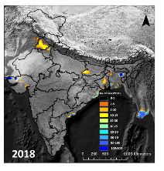
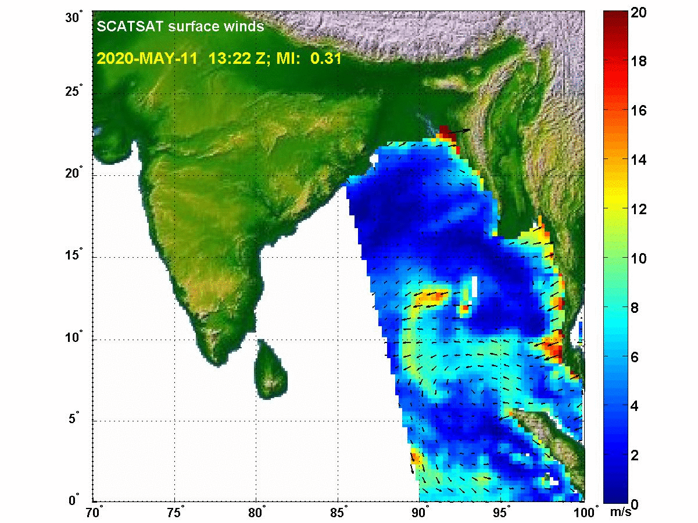
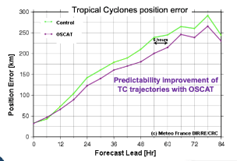
Focus on Virtual Constellation (VC) Example taken Scatterometers
Scatterometers, proven technology for Ocean Surface Vector Winds
Additionally provide measurements of ice extent, icebergs, large water bodies
Major Applications:
Satellite OSVW Impact on NWP Models ; F/c error reduction by DA
Cyclone position improvement; Marine Weather Warnings; Ice motion,….
As per WMO WIGOS 2040 Vision, Scatterometers are part of the “Backbone System with specified orbital configuration and measurement approaches”
Required Sun-synchronous in three orbital planes
IOVWST Recommendations: At least 3 Scatterometers to meet WMO requirements (observations every 6 hours or better)

Slide 4
Focus on Virtual Constellation (VC)
Various LEO satellites are presently – operational & planned
ASCAT, SCATSAT, HY2 Series, CFOSAT, FY3,Oceansat
Discussions on optimum coverage and observing system requirements
Observation requirements may vary depending on the phenomena
Need for Study teams to regularly analyse Operational / Approved / Planned missions, as part of Gap Analysis
Sharing of information (sensor and measurements) sufficient for independent validation and verification
Open and near real-time data access to support the marine weather mission
Systematic and sustained high quality and consistent observations

Slide 5
Focus on Virtual Constellation (VC) Status of the work
Discussions with CEOG WGCV
WGCV (Microwave) shown interest in working with OSVW-VC
Meeting was organised between OSVW-VC and WGCV in April 2020
Discussions on Standard and Metrics for Scatterometery
Meeting was held in June 2020 with OSVW-VC, WGCV and others
Working Team formed to prepare comprehensive document to
Identify and recommend validation sources and metrics
Inter-calibration of the backscatter data from different sensors
Generate climate quality products
Dev of unified GMFs & retrieval algorithms for all space-borne Scats
Algorithms for extreme wind cases & impact of other env. parameters
Identification of the global Scat constellation to monitor extreme events, diurnal variability, improvement in NWP forecast, climate products

Slide 6
Focus on Virtual Constellation (VC) Status of the work
Working Team meeting
Draft of the work plan discussed
Work components also identified
Team members identification
Data sets identified and data sharing started

Slide 7
Focus on Virtual Constellation (VC) Status of the work
Special Session on Satterometery in CGMS
With an Objective “Coordination of global Scat constellation including coverage optimisation and data sharing in response to WIGOS 2040”
Participation from NOAA, EUMETSAT, CMA, NSAOS, ISRO
Resolved to form a Working Team to discuss the present issues, future scatterometer missions and Gap analysis
Team to be formed by CGMS
Suggestion to have coordinated CEOS-CGMS task team to take into account the user requirements from CGMS & missions feasibility by CEOS

Slide 8
Applications focus on SDGs for BIMSTEC
Potential Applications
Application Categories | Application Types | Linkages
Land Use Land Cover (LULC) | Level – 1 & Level-2 LULC mapping & Change detection with special reference to Urban sprawl & snow cover mapping | SDG 2, 3, 6, 7, 11, 12, 13 Sustainable Land management (SLM), Land Degradation Neutrality (LDN)
Water | Water quality (e.g. turbidity) assessment for Case 2 & Case 3 water, Water spread area, PFZ & coastline change detection | SDG 6 Global Water Watch
Agriculture | Mapping annual & seasonal-scale net cultivated / sown area Dominant crop type mapping and condition assessment | SDG 2, GEOGLAM
Forest | Forest cover monitoring and change /loss assessment (e.g. Deforestation alert, degradation, burnt area) | UN Strategic Plan for Forests (UNSPF) Aichi Biodiversity targets SDG 13
 | Mapping forest phenological metrics (SOS: Start-Of-Season, MOS: Maximum-Of-Season, EOS: End-Of-Season)

Slide 9
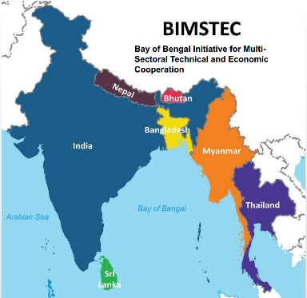
Applications focus on SDGs for BIMSTEC
Data population progress
Present Infrastructure Target Satellites
Future Infrastructure Target Satellites
IRS-R2A
IRS-R2
Landsat-8
Oceansat-2
Sentinel
Landsat-4,5,7
Bhutan
Duration – 2012 - 2019
Total Count – 280 and counting
Nepal
Duration – 2012- 2019
Total Count – 1860 and counting
Myanmar
Duration – 2012 - 2019
Total Count – 1200 and counting
Bangladesh
Duration – 2012 - 2020
Total Count – 2700 and counting
Sri Lanka
India
Thailand
to be initiated
soon

Slide 10
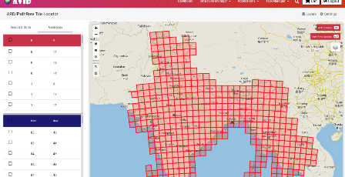
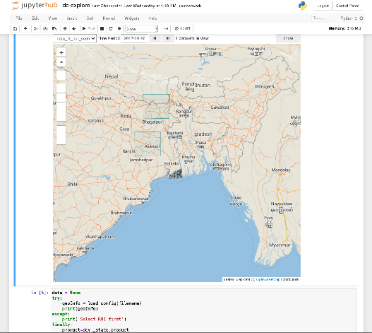
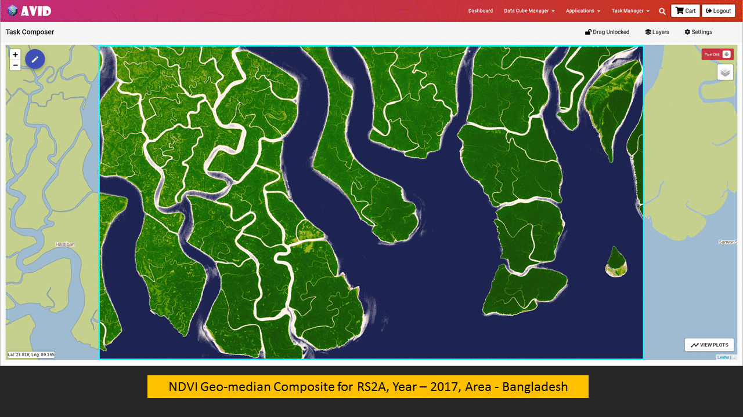
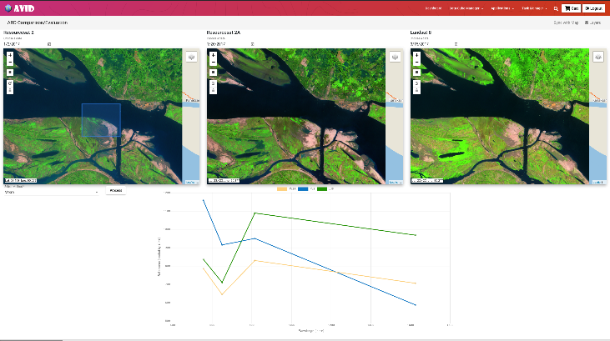
Applications focus on SDGs for BIMSTEC
AVID (Analytics & Visualization for ISRO Datacube )
Multi user analytics environment based on Jupyterhub for visualization and analysis of data as per user’s need.
FEATURES
Multi product/time selection
Mean, Median, Min, Max based compositing
WMS style selection
Band math operations

Slide 11
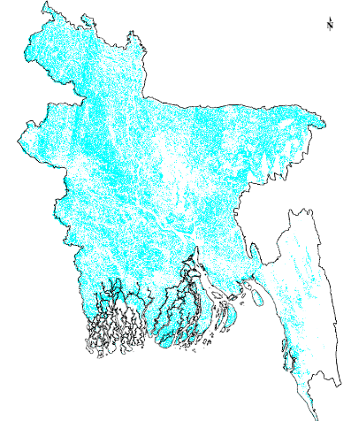
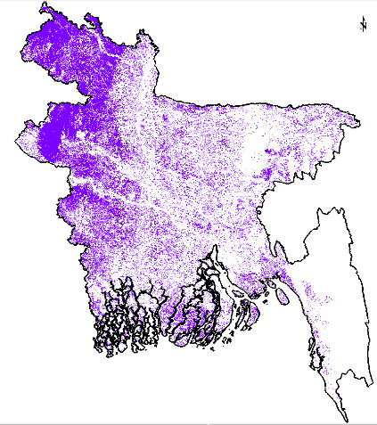
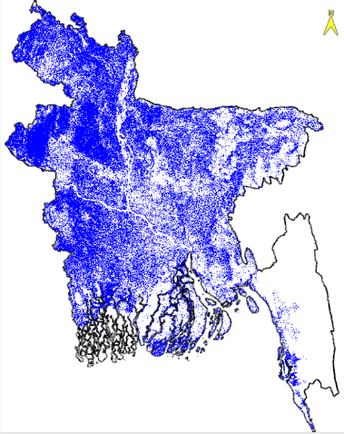
Applications focus on SDGs for BIMSTEC
‘Aman’ Rice Planted Area over Bangladesh
ISRO-JAXA joint initiative for BIMSTEC region
Major crop type mapping and acreage estimates are one of the major focus Use ISRO and JAXA with ISRO data cubes for BIMSTEC countries as CEOS2020 chair initiative, follow up CEOS2019 chair initiative by VNSC for low Mekong.
Opti-SAR combination from ISRO’s RS-2 AWiFS and JAXA’s ALOS-2 PALSAR-2 ScanSAR data were used to map ‘Aman’ (July – December) rice planted area over Bangladesh for 2018. This resulted into acreage estimates with 95% accuracy of reported long-term averages and found better than ‘only-optical’/ ‘only-SAR’
ISRO-JAXA will jointly continue this effort over specified regions over India, Thailand and other Asian countries including BIMSTEC for rice monitoring in cooperation with GEOGLAM Asia Rice & APRSAF SAFE rice crop project.
Rice planted area from ALOS-2 PALSAR-2
Rice planted area from Resourcesat-2 AWiFS
Rice planted area from AWiFS & ALOS-2 PALSAR-2 ScanSAR
Machine learning based (Random Forest) unsupervised classification
+
=>
ALOS-2 L-band PALSAR-2 ARD 50m spatial res.
HH, HV; 963 tiles (1° x 1°) for each pol.
Resourcesat-2 AWiFS ARD 56 m
red and NIR reflectances, five 15-day NDVI composites
Courtesy: JAXA
Courtesy: ISRO
Courtesy: ISRO/JAXA
Training/test data :
Visual interpretation from VHR data,
Past RISAT-1 & Radarsat-2 data,
Common rice area ALOS-2 & past Radarsat-2

Slide 12
Applications focus on SDGs for BIMSTEC
On-Going Activities and Action Remaining
Meeting conducted in regard to BIMSTEC Data cube development, deployment & cooperation
Consolidation of specific application requirements for individual countries in terms of their expectations from deployed Datacube setups.
Target sites identification for ARD evaluation.
ARD consistency checking for similar target types.
Training for usage, focused themes of applications
Scientific exchanges for making application-wise execution plan, schedule
Applications development in consultation with BIMSTEC and integrated with AVID
Discussions with SIT Chair Team & WGISS
CARD4L self-assessment and compliance
Video Demonstrations
Video #1: AVID ARD Comparison and Evaluation
Video #2: AVID Data Discovery and Visualization
Video #3: AVID Jupyterhub Demo
Video #4: AVID Task Composer Demo

Slide 13
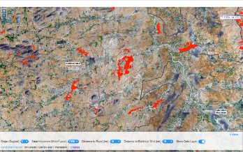
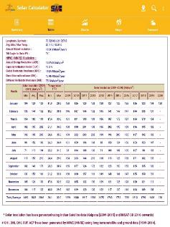
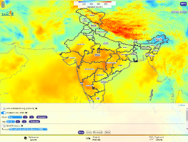
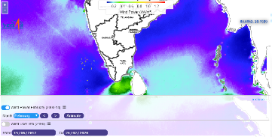
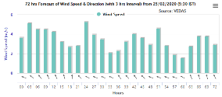
Renewable energy assessment from Space
(Solar and Wind)
Web Application and Mobile app for monthly/yearly Solar energy potential.
Solar site selection tool for identification of potential areas based on multi-parameter filters including: slope, distance to grid, roads and landuse type.
Offshore monthly Wind energy Potential.
Next 72 hours Solar and Wind forecast at 15 minutes interval.
Solar Site Selection tool
Solar Calculator Mobile app
Next 72 Hours Wind forecast
Solar Energy Potential
Wind Energy Potential (Offshore)

Slide 14
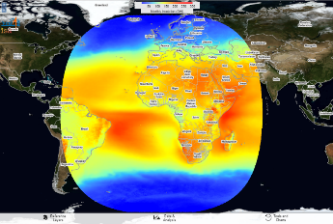
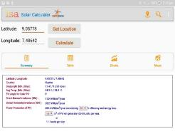
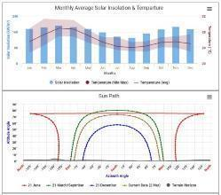
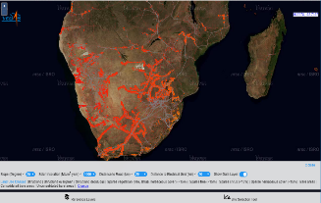
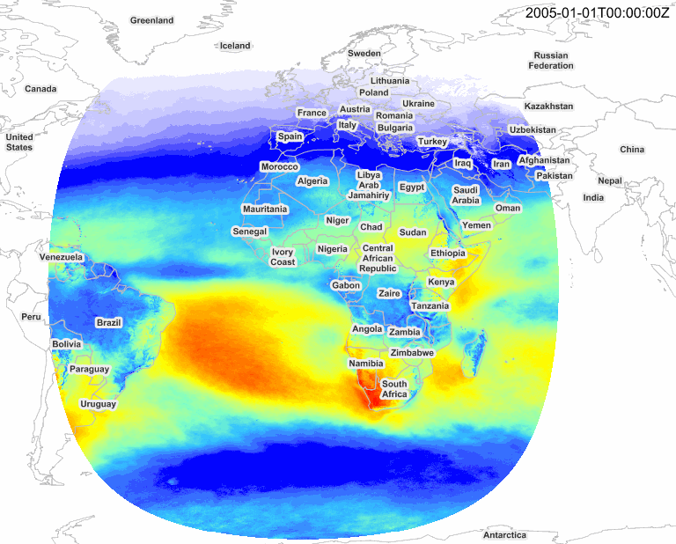
Renewable energy assessment from Space
Solar Insolation over Africa
Web Application developed for monthly and yearly Solar energy potential of Africa Continent.
Mobile app developed for calculating solar energy potential and related parameters at any given location (entered Long and Lat value).
Solar Site Selection tool for Africa
Initial Discussions with GEO-VENER
Shared our work with them
Future Work
Solar Energy Potential
WebGIS application for Global Solar and Wind Energy Potential Visualisation.
Global Solar & Wind Energy forecast.
Site Selection tool for identifying energy potential sites for entire World.
Solar and Wind Calculator Mobile App for selected location on World Map.
Meeting with GEO-VENER planned in November
Month
Solar Site Selection tool

Slide 15
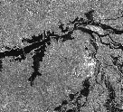
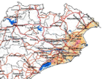
Disaster Management –GEO-LEO Tools
Contributions – CEOS WGDisasters
Disaster Applications
Improved Flood Monitoring using GEO-LEO-SAR
Flood Risk Assessment
Forest Fire Danger Index
On-line Processing Tools
Online satellite data processing tools
Proto-type initiative for International Charter
Discussions in CEOS WGDisasters
Proposal for Flood Pilot appreciated.
Possibility of initiating a Pilot on Forest Fire Danger Index was discussed. Discussions initiated with CSA.
CEOS WGDisasters Chair suggested other members to explore the utility of ISRO strengths and integrating the on-line tools in CEOS WGDisasters.

Slide 16
Disaster Management –GEO-LEO Tools
Flood Pilot – Proposal – Flood Mapping
Daily estimation of flood inundation extent very important for effective monitoring
LEO sensors, though useful, have limitations wrt revisit, swath cloud
GEO-Sensors have advantages wrt revisit, swath, though coarse in resolution
DEMs are useful in in improving the resolution of water theme in the Coarser Grids of GEO / Passive Microwave Sensors.
Integration of GEO-LEO-SAR-DEM, improve the flood monitoring capabilities, substantially
NOAA agreed to work together, discussions going on
Broad Methodology
1
LEO
Optical
SAR
2
High Res.Water
Index
GEO Optical
Passive
Microwave
Low Res.Water
Index
Model
Model
3
DEM
Flood
Susceptibility
Index
4
Flood
Extent
Model
Integrate

Slide 17
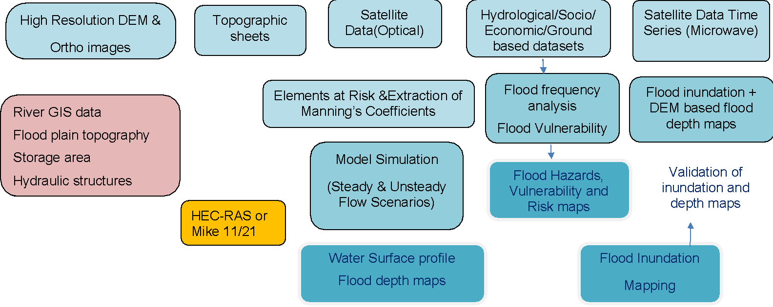
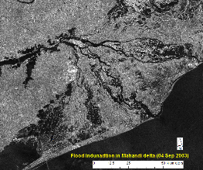
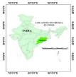
Disaster Management –GEO-LEO Tools Flood Pilot – Proposal – Flood Risk
Objectives
To map flood hazard and depth using time series of SAR & optical datasets and DEM
Vulnerability Assessment through field survey
To create flood risk maps
To prepare best practices and training document
Support from CEOS
Vulnerability Assessment - Very high resolution satellite data over the study area
Hydro-Dynamic Modelling – High resolution DEM (at present CartoDEM-10m posting is proposed to be used)
Mahanadi River Delta
Approach

Slide 18
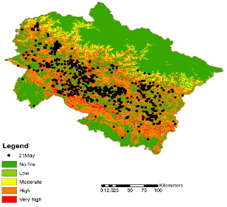
Disaster Management –GEO-LEO Tools Forest Fires Pilot – Proposal
Decision Support System for forest fire danger
Inputs: Temperature, relative humidity, fuel characteristics, topographic conditions, vegetation type, edaphic conditions.
Two biophysical components:
STATIC INDEX: based on the constant parameters such as fuel characteristics, topographic conditions, vegetation type, edaphic conditions.
DYNAMIC INDEX: based on weather parameters such as air temperature, relative humidity, wind speed and rainfall;
INTEGRATED INDEX: Static & Dynamic Indices are integrated to provide the
Western
Himalaya
Indexing into different classes of fire danger viz. No danger, Low, Moderate, High and very High for rapid characterization.
Validation based on Active fire points from SNPP-VIIRS
Discussions are going on with CSA

Slide 19
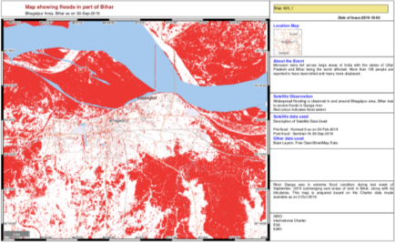
Disaster Management –GEO-LEO Tools
On-line Processing Tools
The Need
Use Case: Bihar Floods
With increasing disasters across the globe and increased satellite data contributions (about 300-500 datasets) from International Charter, it is difficult to download, analyse and provide VAPs for rapid response.
The Solution
ISRO’s proto-type Processing Environment provides cloud-based analysis tools available for needy countries.
This processing environment facilitates automatic data download, visualisation, pre-processing, analysis, annotation and map generation tools.
Way Ahead
This tool is presented to WGDisasters
With further deliberations, this can be customised for the needs of CEOS

Slide 20
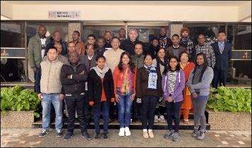
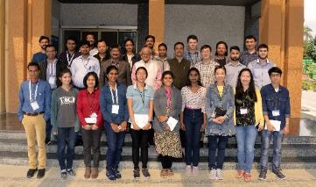
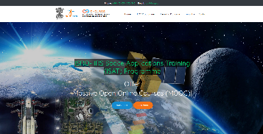
Capacity Building Programmes
Face-to-Face Courses:
CSSTEAP PG Diploma Course in RS & GIS: 22 participants (10 countries)
ITEC (MEA) Courses:
Geoinformatics (Sep-Nov’19): 21 participants (17 countries)
Remote Sensing course (Jan-Mar’20): 21 participants (16 countries)
Online Courses/ Webinars for International Participants:
Topic | Duration | No. of Countries | No. of Participants | No. of sessions
UNNOOSA-CSSTEAP MOOC on Geospatial Application for Disaster Risk Management | Oct 13, 2020 to Dec. 31, 2020 | 110* | 2137* | 18
Webinar Series on RS in Crop Monitoring & Assessment | May 19, 2020 to June 9, 2020 | 45 | 1660 | 04
Webinar Series on Hyperspectral Remote Sensing and its Applications | Nov. 07, 2019 to Dec. 06, 2019 | 24 | 180 | 04
CEOS-WGCapD & ISRO Webinar Series on Geospatial technology for Wild Fire Management | Oct. 01, 2019 to Oct. 29, 2020 | 03 | 55 | 05
Application of RS in Hydromet & Geological Disasters | Sept 17, 2019 to Sept. 20, 2019 | 13 | 180 | 04
https://isat.iirs.gov.in
*Till Oct 15, 2020

Slide 21
THANK YOU

