Slide 1
CEOS MIM Database
Annual Report 2020
Committee on Earth Observation Satellites
Ivan Petiteville, ESA
CEOS Plenary 2020
Agenda Item #2.8
20 October 2020

Slide 2
Summary
The CEOS MIM (Missions, Instruments, Measurements) service remains a key ‘connective tissue’ across the CEOS community.
http://eohandbook.com/
2020 Survey is complete 31 new missions added
Annual Traffic Update more than 15,000 users in the past year
Enhancements and activities
Significant effort to harmonise and map measurements with OSCAR-Variables
Thematic content (GCOS, ECVI v3)
Database is shared when requested with a number of groups
e.g. CEOS SEO, WGClimate, ECV Inventory Team, OSCAR Team

Slide 3
2020 Survey Response
Responses received from 32 of 38 agencies surveyed
Thanks for the significant agency effort in support
The last 2-3 years it has been a challenge to secure quality inputs from CAST, CRESDA, NRSCC, NSMC-CMA
Augmented this with recently integrated information from NORAD
OSCAR/Satellite and CGMS Plenary materials provide some helpful references
31 new mission records, more than 250 mission records updated
12 new instrument records, more than 250 inst. records updated
93 new instrument-measurement mappings added

Slide 4
MIM Survey – Annual Effort
Survey Team annual FTE effort: ~500 man.hours or 12 man.weeks
Sustained annual effort building on 12 years of effort to date
Approximately 30 agency points of contact putting in a variable amount of effort depending on agency size
Some agencies are simple
Some agencies require coordination with 10’s of mission contacts to gather technical details
Estimate 30 x 4h (average) = ~120 hours or ~3 weeks FTE
Annual effort of at least 15 weeks FTE for CEOS Agencies
https://www.facebook.com/photo/?fbid=10220852517517441&set=a.1444511507493

Slide 5
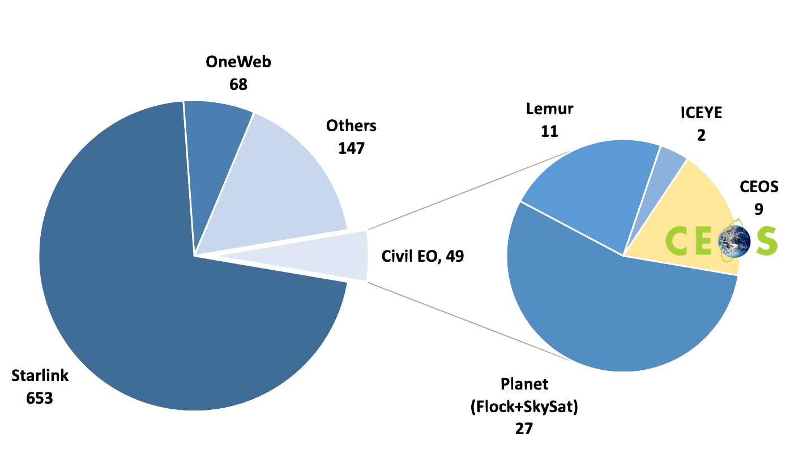
2020 Launch Activity (Year To Date)
917 SATCAT tracked satellites launched 1-Jan to 16-Oct-2020
+ 123 new tracked debris pieces in the same period
721 LEO Communications satellites (Starlink, OneWeb)
49 Civil EO satellites
40 ‘New Space’ EO satellites
9 CEOS Agency EO satellites (year to 16 Oct)
SAOCOM 1B, GEO-KOMPSAT-2B, HY-2C, HY-1D, MeznSat, PhiSat-1, HJ-2A, HJ-2B, ZY-3-03
Past years CEOS:
2019: 18
2018: 28
2017: 14
2016: 16
2015: 9
33 projected now to end 2021
2020 Launches 1-Jan to 16-Oct

Slide 6
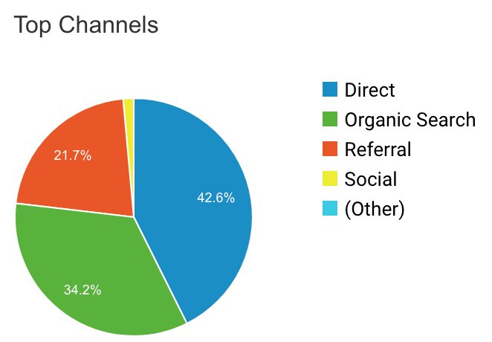
Audience and Content Update
Traffic (Since September 2019)
15,360 visitors (MIM 65%, EOHB 35%)
85,571 pageviews (MIM 85%, EOHB 15%)
Content Consumption (approx. breakdown)
Missions 38%
Instruments 32%
Measurements and timelines 19%
Other 11%
Mobile and tablet traffic up from 13% to 20% year-on-year
In 2018 mobile was 3.5% - consumption is changing!
Social media small but increasing source of visitors 1.4%

Slide 7
OSCAR-Variables Harmonisation
Significant effort to revise MIM measurement list
87 measurements either added or revised
Overall objective to harmonise with the community
improve … “consistency of measurement names and descriptions with conventions used by GCOS, WMO and others in the climate monitoring community.”
Consultation with thematic experts from VCs and CEOS Agencies
AC-VC: Jay Al-Saadi/NASA, Chris Kidd/NASA
Land: Philippe Goryl/ESA
OCR-VC: Marie-Helene Rio/ESA
Snow/Ice: Anna Maria Trofaier/ESA
Builds on existing CEOS DB - OSCAR-Missions mapping

Slide 8
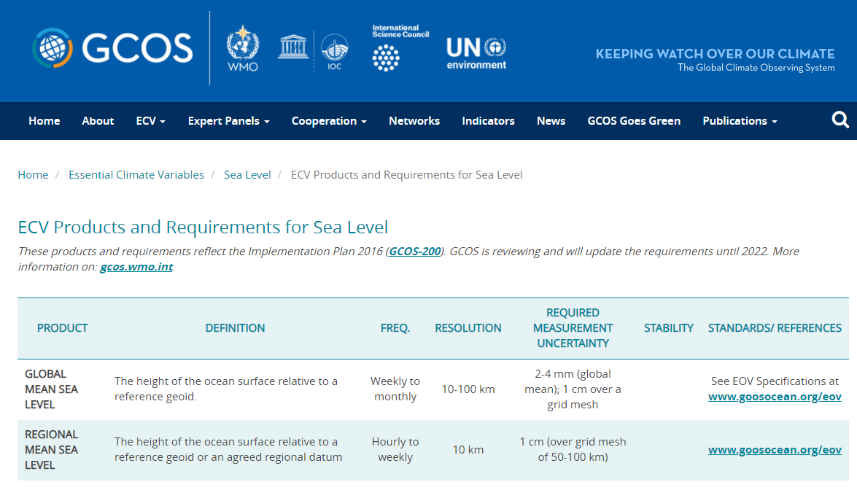
Thematic Content: GCOS ECVs
Objective: communicate links between instruments and measurements and thematic areas for CEOS DB users
Supports optimisation of community resources
Incorporated GCOS-200 thematic information into the database
Mapped GCOS products to CEOS DB measurements (using OSCAR-Variable harmonisation)
Linked out to GCOS web content for descriptions and products
Used to populate new Thematic Links section in CEOS DB instrument profiles

Slide 9
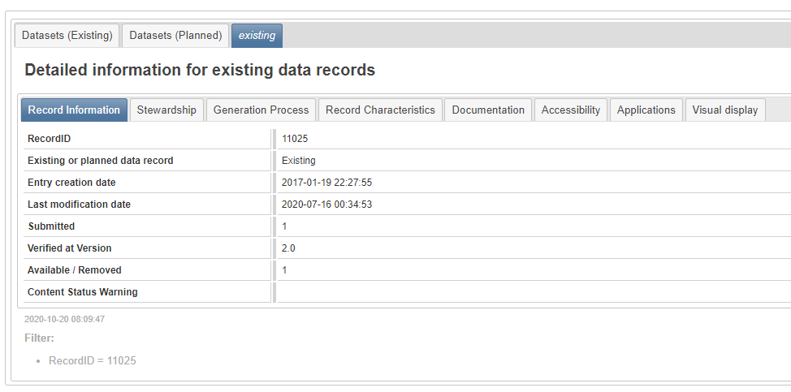
Thematic Content: ECV Inventory v3
Objective: communicate links between instruments and measurements and the ECV Inventory for CEOS DB users
Incorporated ECV Inventory v3 (Excel export) into the database
Mapped ECVI v3 ‘satellites and instruments’ information to CEOS database missions-instruments
Used this to include ECV Inventory v3 record links in the new Thematic Links section in CEOS DB instrument profiles
Extends 2019 efforts to include links to datasets via OpenSearch

Slide 10
Future Work: Thematic SDG Content?
Some initial discussion around SDGs and the SDG AHT
Similar objective: communicate links between missions, instruments and measurements and the SDGs
Help support case for policy relevance of satellites to the SDGs
Would build upon work of CEOS SDG AHT sub-teams on indicator requirements
Mockup of SDG Thematic Content

Slide 11
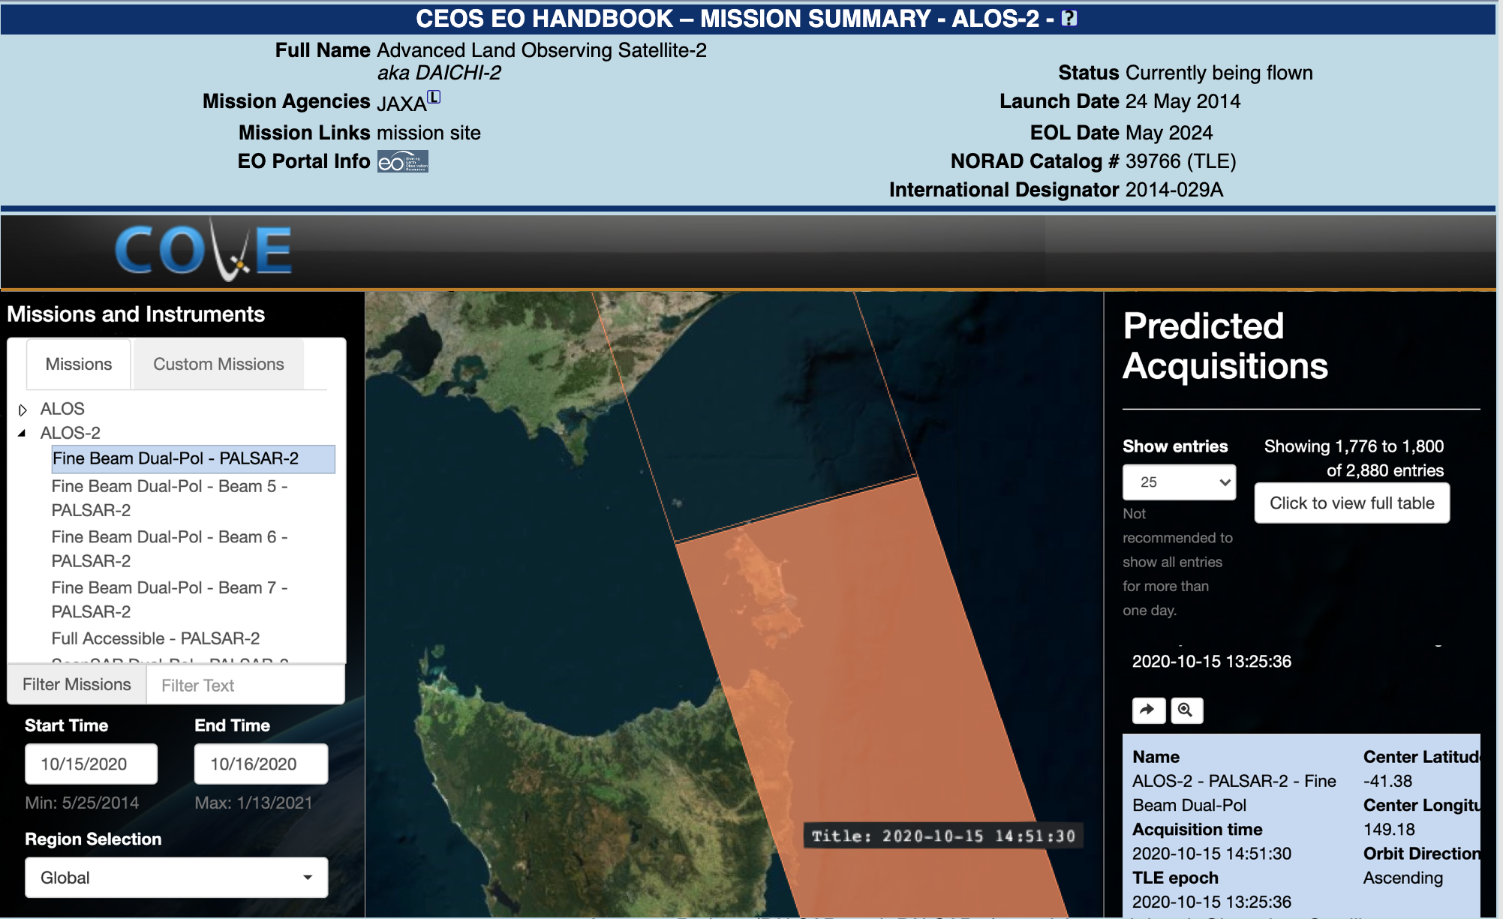
Future Work: Integration and Analysis
Working with the SEO on a test integration of the newly launched CEOS COVE API
Demonstration of Jupyter Notebooks for a more flexible analysis environment

Slide 12
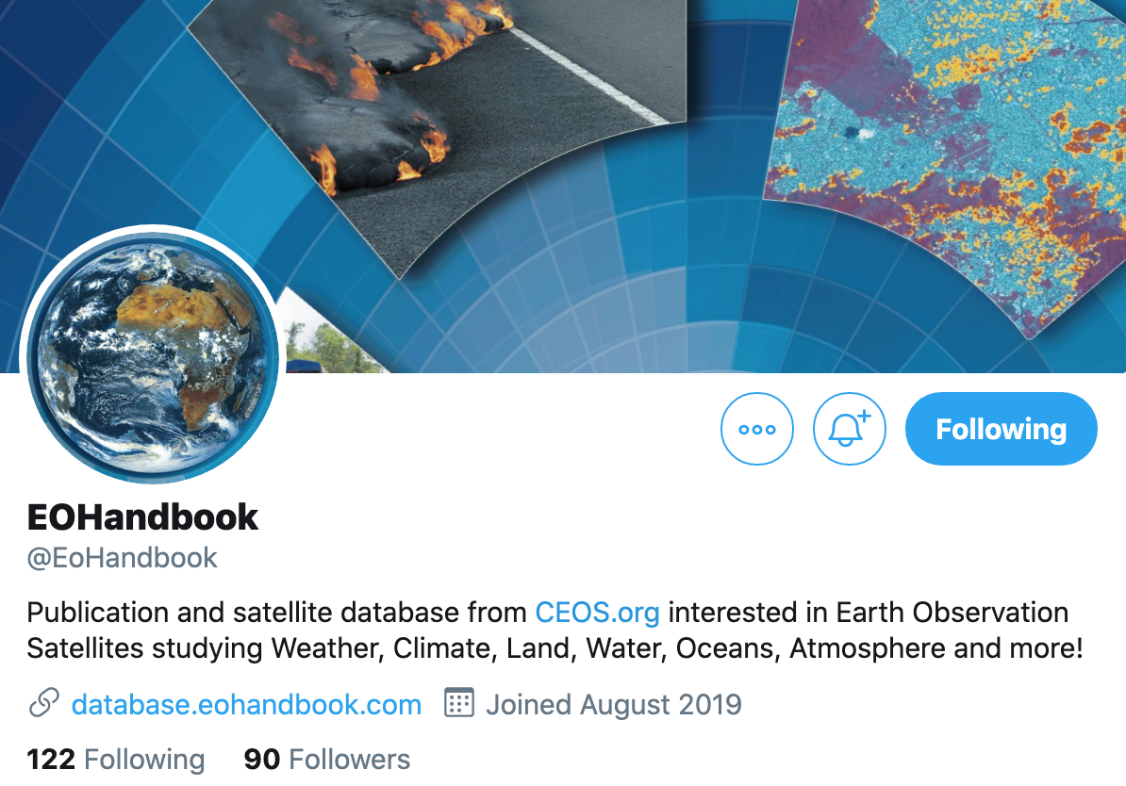
Other Activity - Quick Summary
Ongoing integration with OSCAR/Satellite, SATCAT, COSPAR and Union of Concerned Scientists database information
Mission datasets included via OpenSearch APIs (from NASA, ESA)
New Featured Datasets added - CARD integration coming shortly
Mission date and status updates added ‘nominal’ and ‘extended’ status
Fielded user community suggestions via ‘report an issue’ link
Thanks!

