Slide 1
A CEOS AFOLU Roadmap
Discussion Paper
Committee on Earth Observation Satellites
Osamu Ochiai (JAXA) & Frank Martin Seifert (ESA)
CEOS Plenary 2020
Agenda Item # 3.5
20 – 22 October 2020

Slide 2
Desired Outcomes from Agenda Item
Principals’ understanding of the opportunity presented to space agencies by the UNFCCC Global Stocktake process and the importance of land sector within it
Debate strategic CEOS engagement in the process
Decision on whether to proceed with a CEOS AFOLU Roadmap. Which means:
Key agencies commit representatives and resources
2021 activity on GST1 deliverables

Slide 3
The “Ambition - Cycle" of the Paris Agreement
Take action to implement Paris Agreement
At national and international level
Limit global warming to < +2° C / 1.5° C
Enhance adaptive capacity, resilience, & low-emissions development
Finance compatible with resilient development and low emissions
Report individual efforts (backward looking)
Biennial transparency reports (BTRs): 2024, every 2 years after Includes information necessary to track progress made in implementing and achieving NDCs
Communicate individual efforts (forward looking)
NDCs: 2020, 2025, 2030 … Adaptation Communication: … Long-term low GHG development strategies: 2020
5 years cycle
Take stock of implementation of the Paris Agreement and assess collective progress towards its purpose and long-term global goals
Global stocktake (GST) (2023, 2028, 2033) Comprehensive: mitigation, adaptation and means of implementation and support
Informs Parties in:
Updating NDCs in a nationally determined manner (progression clause)
Enhancing international cooperation for climate action
🡪 Key to catalyze progress
IPCC assessments
Constituted Body reports
Secretariat synthesis reports
UN agencies
…
The global stocktake – an anchor for the ambition cycle to bring it all together

Slide 4
Global Stocktake
Space agencies (CEOS & CGMS) have emphasised ECVs and Physical Climate via the GCOS framework very effectively for the past decade
The importance of NDCs to Paris Agreement, and specifically the Global StockTake (GST), raises new challenges around country needs and implications for using EO data with greater emphasis on mitigation and adaptation, and national-level datasets
A whole new dimension to our climate coordination - both a huge opportunity and a significant challenge (discussion later in agenda)
“...if Land Use, Land Use Change and Forestry targets involved in the initial NDCs were implemented in full, this would represent approximately a quarter of pledged mitigation efforts up to 2030“
SIT-35 action: JAXA and ESA explore the development of a CEOS AFOLU (Agriculture, Foresty and Other Land Uses) Roadmap. The aim of the Roadmap is to assess the will, direction and capability of the relevant CEOS Agencies, with the SIT Chair team supporting communications with Principals and identifying team nominees.

Slide 5
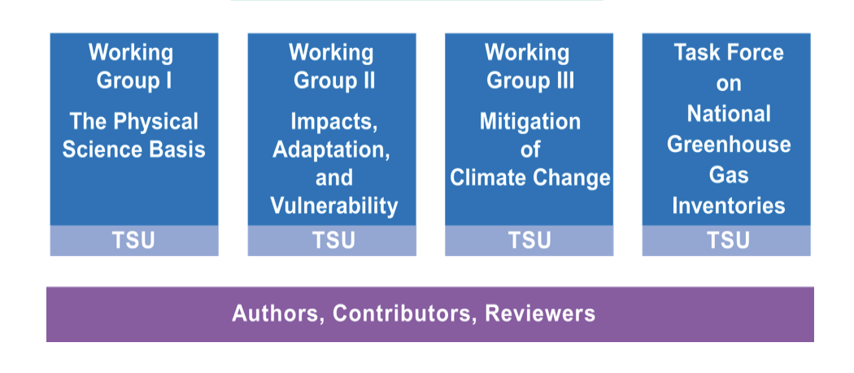
Science Adaptation Mitigation
Paris Agreement
Adaptation
Capacity Development / Technology transfer
Mitigation
Loss & Damage
National Reporting /
Global Stocktake
GST emphasises country reports, NDCs, mitigation and adaptation?
CEOS-CGMS WGClimate - GCOS Response
- ECVs
- Inventory
WGClimate GHG Roadmap starts support to inventories from GST1
Transparency Framework
GFOI brought country focus for forest reporting
Global Stocktake
New GEO WG? - SG2 proposes a focus on IPCC WGII & III
AFOLU Roadmap adds biomass, agriculture and OLU for reporting & NDCs
Systematic Observations
Earth Observation

Slide 6
AFOLU Team Participation
Osamu Ochiai, JAXA & GFOI (Co-Lead)
Frank Martin Seifert, ESA & GFOI (Co-Lead)
Stephen Ward, JAXA
Ake Rosenqvist, JAXA
Takeo Tadono, JAXA
Richard Lucas, ESA/CCI
Shaun Quegan, UK & ESA/CCI
Heather Kay, ESA/CCI
Ian Jarvis, GEOGLAM
Alyssa Whitcraft, GEOGLAM
Steven Labahn, USGS
Michael Falkowski, NASA
Laura Duncanson, UMD
Brad Doorn, NASA
Christine Mcmahon-Bognor, NASA
Brian Killough, NASA
Team building up and monthly calls since SIT-35

Slide 7
Discussion Paper
Title: A CEOS AFOLU Initiative for the UNFCCC Global Stocktake Process A Discussion Paper for CEOS Plenary to explore the development of a CEOS AFOLU Roadmap
Context:
Introduction
Opportunity of the Global Stocktake
EO Capabilities in support of AFOLU
Deployment of Capabilities
Potential Roadmap Actions
Summary and Next Steps
References

Slide 8
Objectives
Provide the case to CEOS and its agencies for investing in development of an AFOLU Roadmap
Provide a clear statement of the technical capabilities of CEOS agency EO satellite data and their characteristics
capabilities and datasets for inclusion in the UNFCCC Synthesis Report on Systematic Observations
Propose a specific way forward for 2021 and deliverables for GST1 as the critical first deadline
“If supported by CEOS agencies, a full CEOS AFOLU Roadmap will identify opportunities for using EO data to quantify the extent and dynamics of land activities and impacts at the global level and in relation to the NDCs that individual countries are engaged in and which national-level datasets might support. It would assess the EO data and derived products that are available or anticipated over the next five years and beyond, and identify further work needed to maximise opportunities presented by the GST for CEOS agency data; this may include data production activities, but also education and capacity-building measures.”

Slide 9
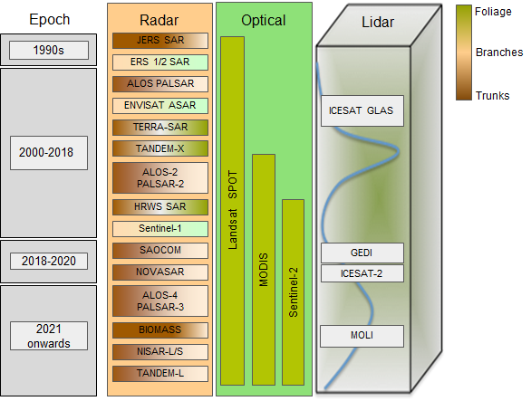
Key Missions

Slide 10
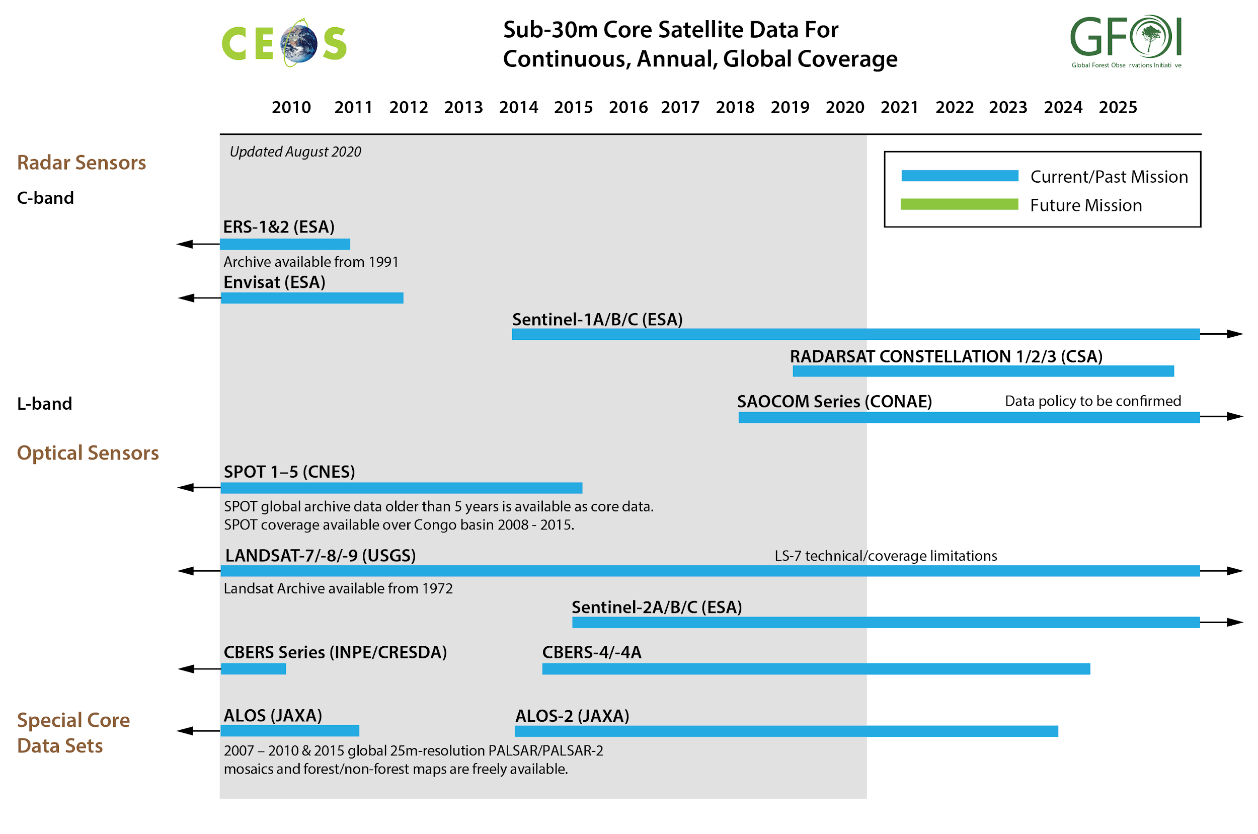
Key Missions

Slide 11
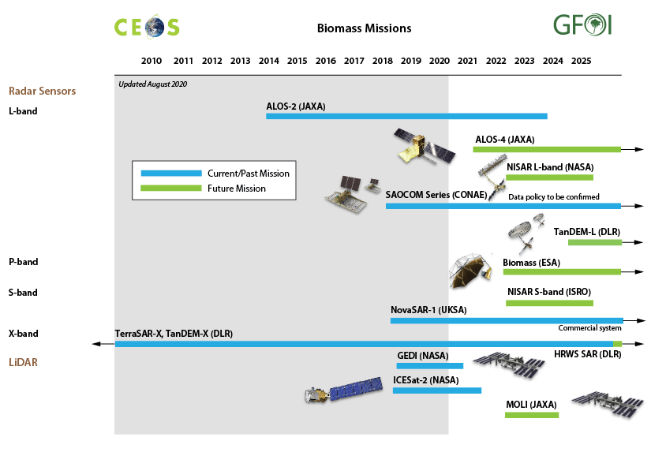
Key Missions
GST1

Slide 12
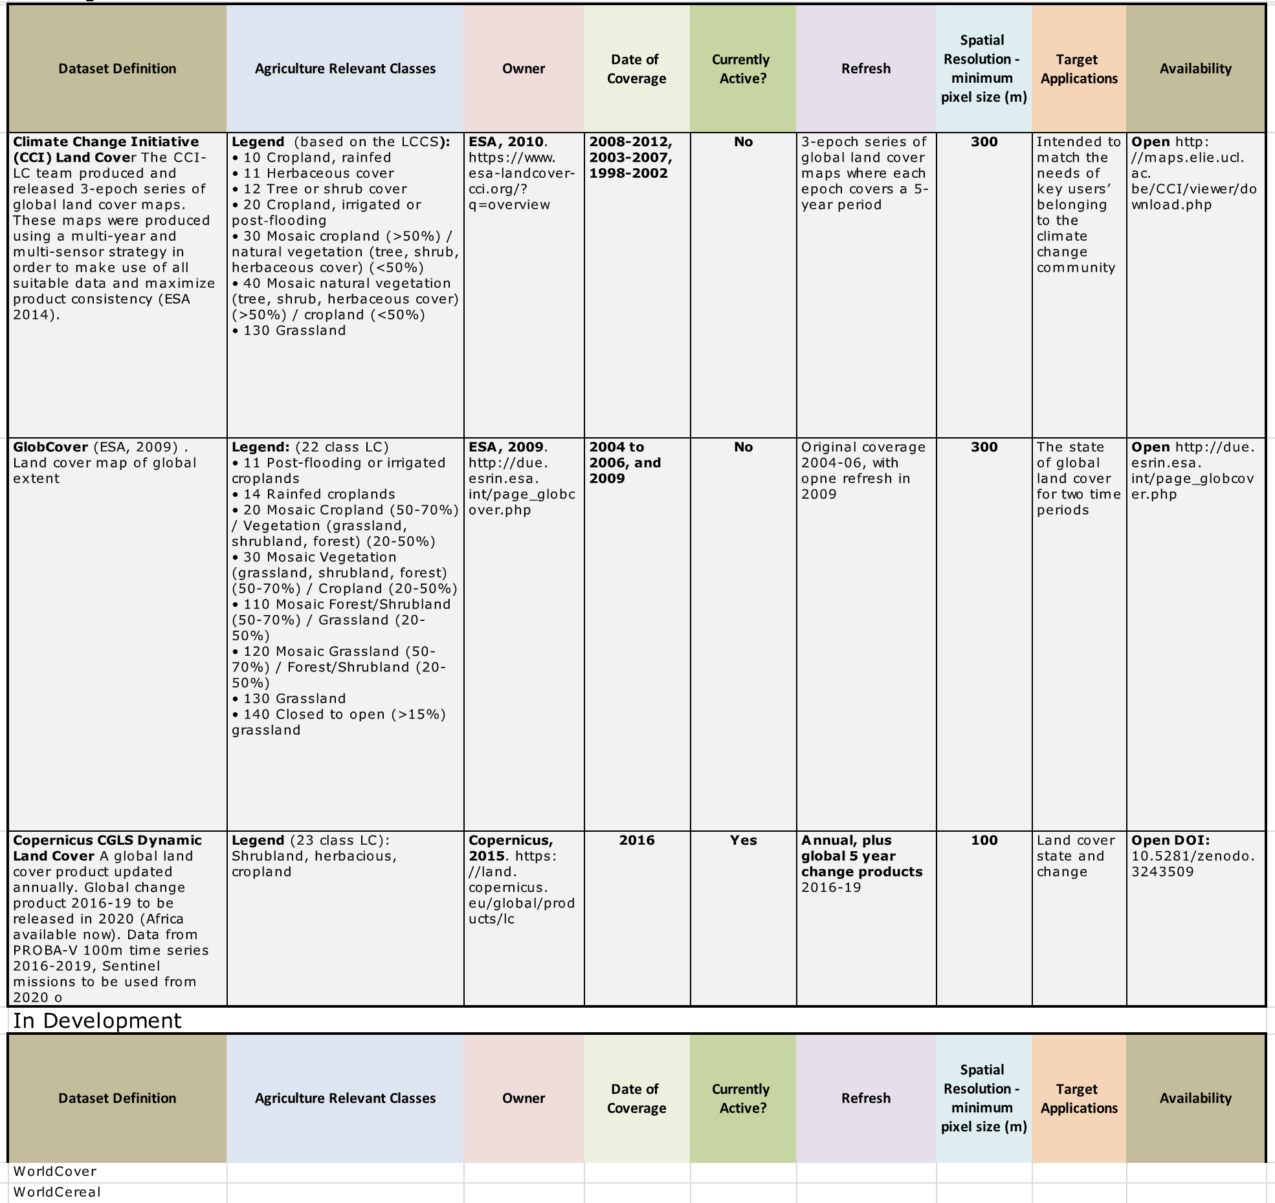
Key Datasets (Agriculture)

Slide 13
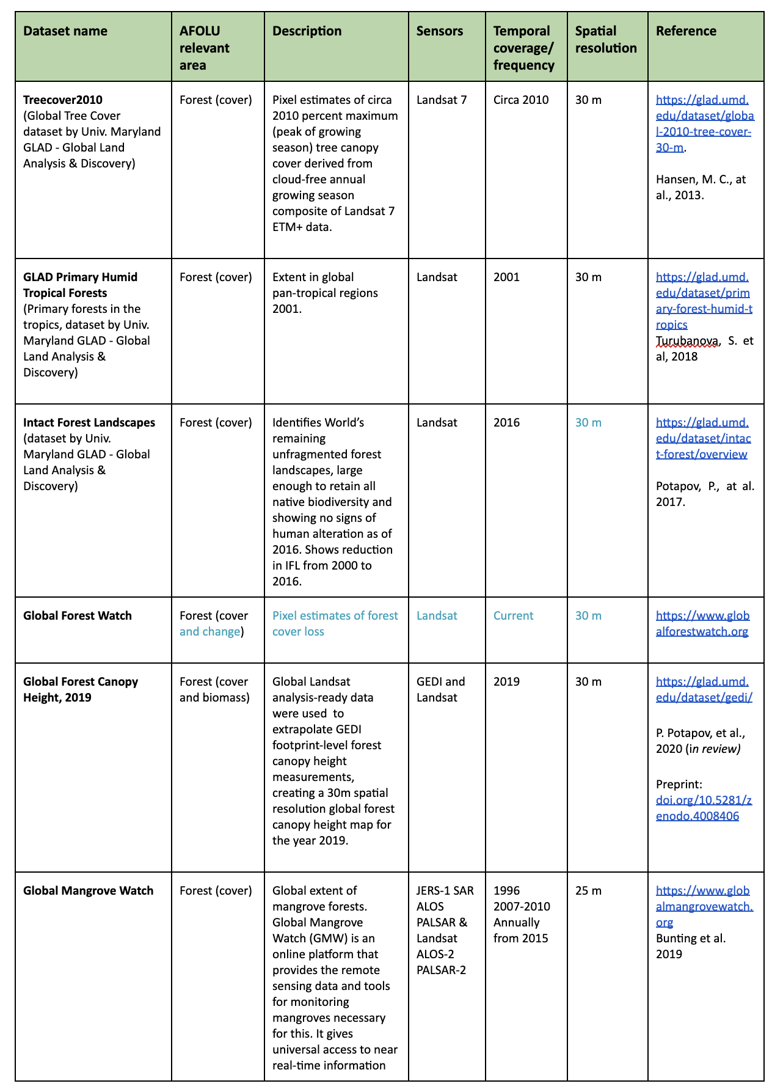
Key Datasets (Forests)

Slide 14
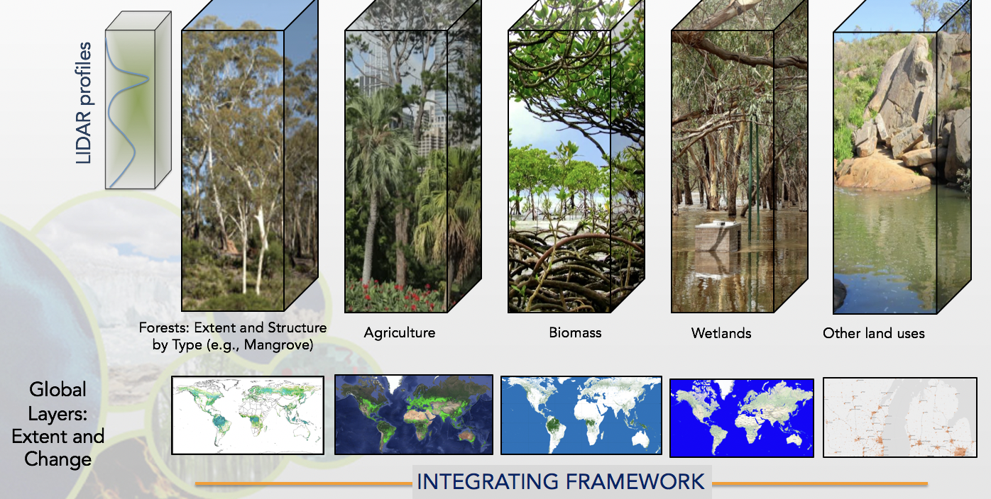
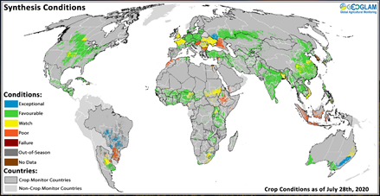
CEOS Agencies' Capabilities AFOLU
Lays out the range of capabilities of EO satellites for
Agriculture
Forest (extend and structure)
Biomass (AGB)
Other Land Use
Identifies the main deployment of these capabilities as datasets available to support both convention and national level
Agriculture, Forest, Biomass, OLU also

Slide 15
Potential Roadmap Opportunities
Improving EO capabilities to better meet the needs of the Convention and Parties, globally and on national level
Providing new measurements that do not currently form part of CEOS agency capabilities
Engaging with countries and stakeholders (such as GFOI and GEOGLAM) in case studies to improve understanding and uptake of EO data by countries
Taking actions to assure the policy relevance of new capabilities (e.g., through measures such as the CEOS Biomass Protocol)
Increasing efficiencies and effectiveness in the process by which climate data requirements are set (e.g., by GCOS) and to which CEOS and CGMS space agencies respond.
Pragmatic focus for delivery to GST1 and GST2 like GHG Roadmap

Slide 16
GST1 Action Plan - 2021!
Agriculture (in cooperation with GEOGLAM):
Global crop productivity maps for reference years
Country cases for agricultural land use and change, agriculture management practices and agricultural biomass burning supporting reporting of NDCs
Forestry:
Global forest cover and tree density maps (in cooperation with GFW and UMD)
Biomass:
Global above ground biomass maps in GST1 reference year 2021 with 2020 as backup and historical datasets from previous years (Contributions of CCI biomass with inputs from GEDI and IceSat-2 missions and WGCV LPV team)
Country cases of carbon stock in forests supporting reporting of NDCs (in cooperation with GFOI)
Other Land Use: (TBD)
Notes:
2021 is assume reference year for GST1

Slide 17
Progress and Next Steps
Discussion paper has only summarised the landscape and highlighted the opportunity, including for GST1
The Team supporting include many non-agency expert volunteers who completed most of the work so far
Plenary is asked to debate and decide on whether to proceed with
AFOLU Roadmap Development
GST1 action plan aimed at AFOLU deliverables in 2021
Needs representation and resources from key agencies invested in the relevant missions and major dataset programs
EC, ESA, JAXA, NASA, USGS

Slide 18
Progress and Next Steps
5 points for Plenary from Report
1. CEOS Plenary is asked to recognise the magnitude of the opportunity for satellite Earth observations in support of the Global Stocktake (GST) process.
2. CEOS agencies involved in the operation and data processing for missions identified as relevant to the proposed GST1 inputs are asked to support the preparation of those inputs in 2021. These agencies include EC, ESA, JAXA, NASA, and USGS amongst others.
3. These same key agencies are asked to decide at Plenary whether they are willing to provide representation and resources going forward to support the development of a full CEOS AFOLU (Agriculture, Forestry and Other Land Uses) Roadmap in support of the GST process.
4. The CEOS-CGMS GHG Roadmap already envisions a number of deliverables targeting support to the GST1. The AFOLU Roadmap and the GHG Roadmap deliverables will likely require a degree of coordination and collaboration and the AFOLU team will commit to that effort in 2021.
5. During the CEOS TW in September, CEOS has appointed three focal points to the UNFCCC SEC GST process: Osamu Ochiai (for AFOLU issues), David Crisp (GHG issues), Jörg Schulz (general issues). These focal points will keep CEOS informed on GST developments.

Slide 19
Progress and Next Steps
Institutional arrangements
Based on an agreement by Plenary to proceed towards a CEOS AFOLU Roadmap, it is assumed that the established core team - expanded with additional resources - will lead the effort in 2021. This will include the CEOS internal relationships with WGClimate - as lead for the CEOS interface to UNFCCC - and with the GHG Task team and WGCV LPV, and the external relations to GFOI and GEOGLAM. Sustained institutional arrangements within CEOS will be necessary to underpin a substantial AFOLU activity and proposals for these will be developed during 2021.

