Slide 1
Global Stocktake Systematic Observation Synthesis Report and the CEOS Contribution
Frank Martin Seifert, ESA &
David Crisp, NASA JPL Agenda
Item #2.20
2021 CEOS Plenary Virtual Meeting
1-4 November 2021

Slide 2










Systematic Observations
Systematic Observations Community
Paris Agreement
Adaptation
Capacity Development / Technology transfer
Mitigation
Loss & Damage
National Reporting /
Global Stocktake
Transparency Framework
Global Stocktake

Slide 3
Systematic Observations Community Synthesis Report for GST
Synthesis Report (SR) of the Systematic Observation Community (SOC) will be part of UNFCCC’s information collection and preparation phase for GST, and feed into the technical assessment
SOC established a writing team (~12 participants) and had a first call in June, next will be this month.
SB Chairs issued a "non-paper" in June with dedicated questions for synthesis reports, update expected this month
How can the Systematic Observation Community support the GST on global and national level?

Slide 4
Manuscript Structure & Writing Team
Structure of Manuscript
Introduction
Mitigation – Systematic Earth Observations to support Greenhouse Gas Inventory Development and Assessment
  Top-down GHG Budgets
  Space-based AFOLU products
Adaptation – Systematic Earth Observations to improve resilience to the adverse impacts of climate change
Means of Implementation
Cross-cutting issues including Loss and Damage
Capacity Building
Writing Team
Albrecht von Bargen (DLR)
Anthony Rea (WMO/GCOS)
Carlo Buontempo (ECMWF)
Crisp, David (NASA/JPL)
Frank Martin Seifert (ESA)
Helen Findlay (PML)
Jörg Schulz (Eumetsat)
María José Sanz Sánchez (BC3)
Mark Dowell (EC/JRC)
Maxx Dilley (WMO)
Osamu Ochiai (JAXA)
Sara Venturini (GEO)

Slide 5
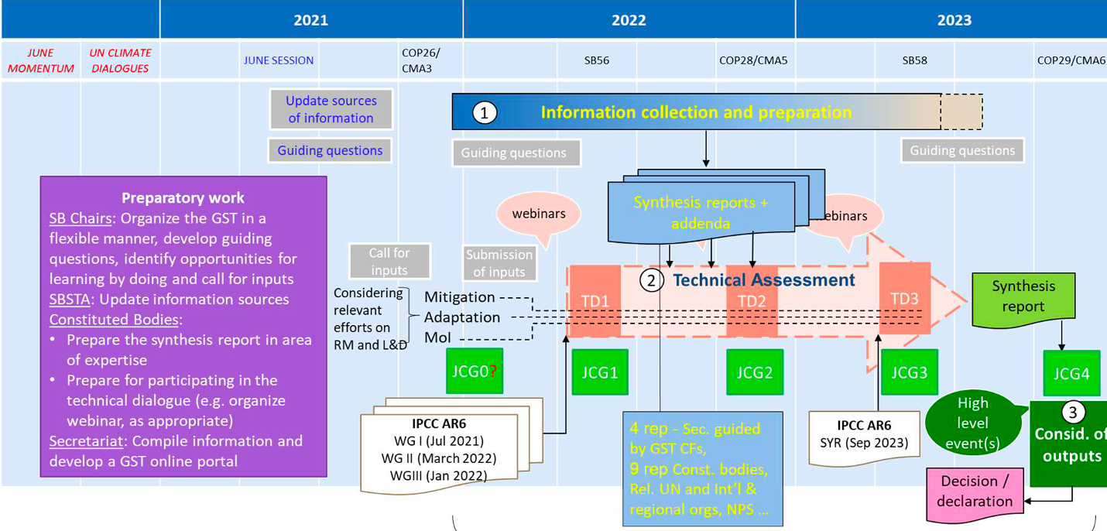
GST Timeline

Slide 6
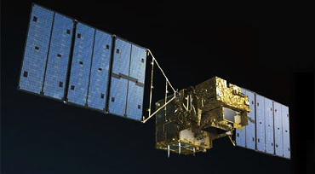
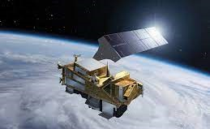
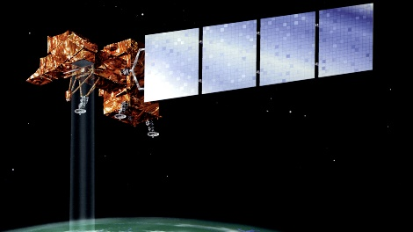
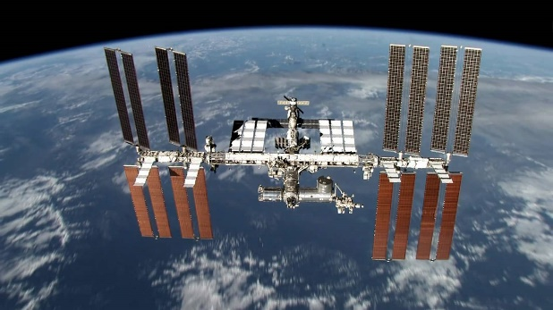
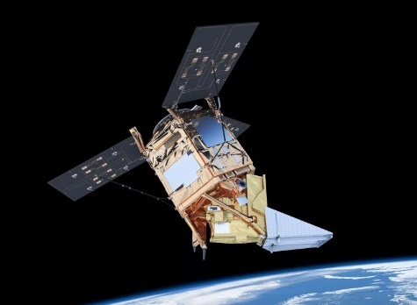
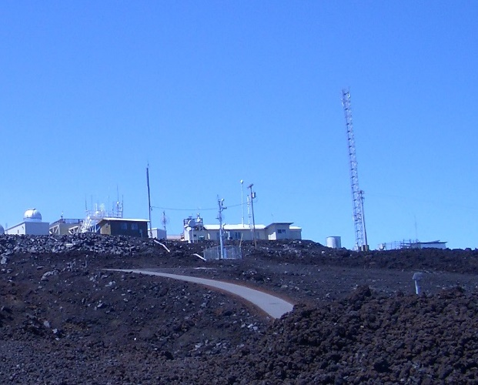
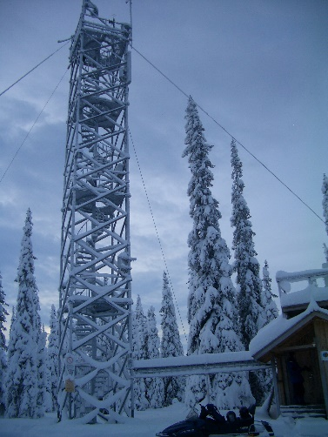
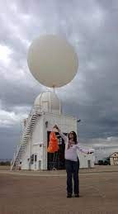
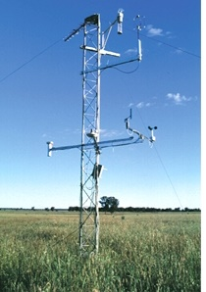
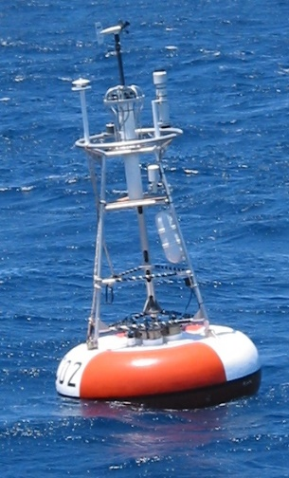
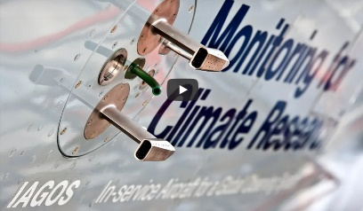
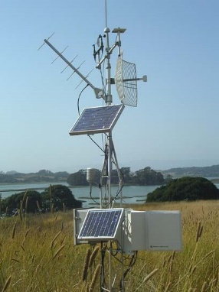

Systematic Earth Observations
Space-based measurements from a growing fleet of satellites provides high spatial and temporal resolution and greater coverage of the globe.
Ground-based and airborne data provide accurate estimates of weather, climate, air quality and greenhouse gases on local and global scales.

Slide 7
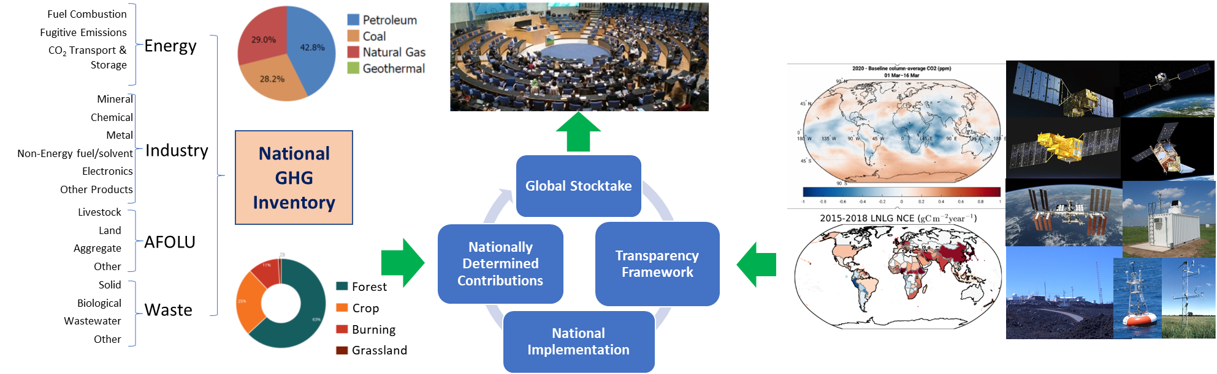
Mitigation - GHG
Bottom-up national GHG inventories can be combined with top-down atmospheric GHG budgets to produce a more complete and transparent Global Stocktake
Bottom-up GHG Inventories
Top-down GHG Budgets

Slide 8




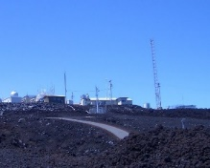


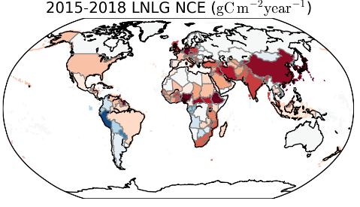
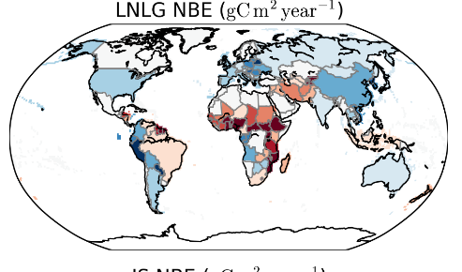
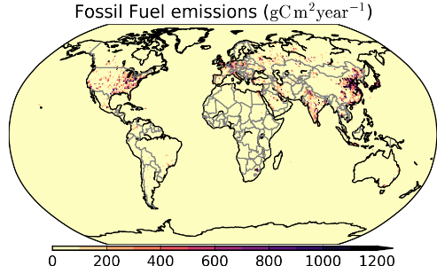
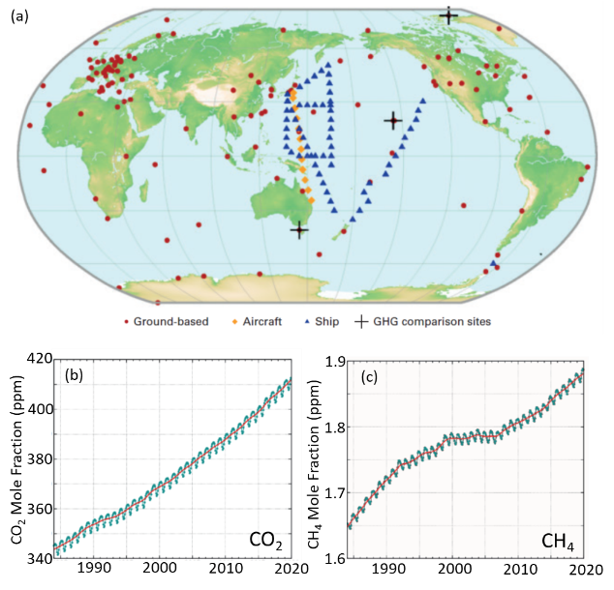
CEOS Role – Top-down GHG Budgets
Ground-based and space-based measurements of atmospheric CO₂ and CH₄ are being analyzed with atmospheric inverse methods to estimate greenhouse gas CO₂ and CH₄ emissions and removals from human activities and the natural biosphere and ocean.
=
+
Net Carbon Exchange
(NCE)
=
Net Biospheric Exchange
NBE
+
Fossil Fuel

Slide 9
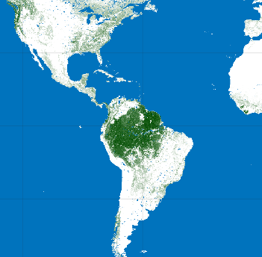
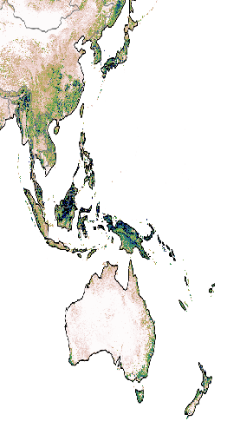
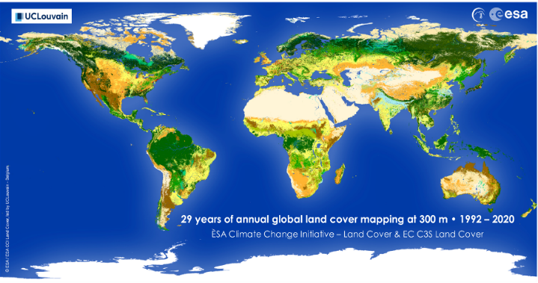
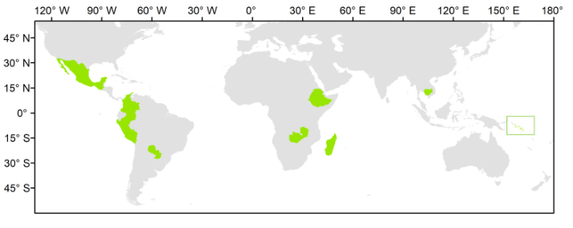
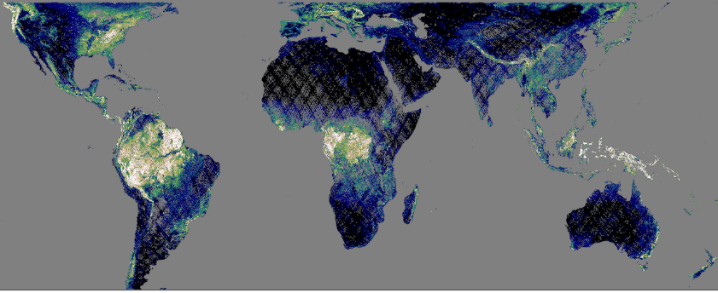
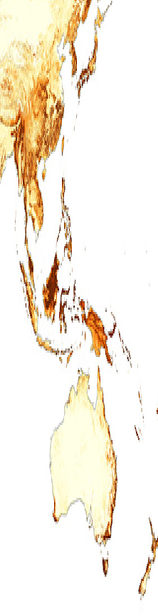




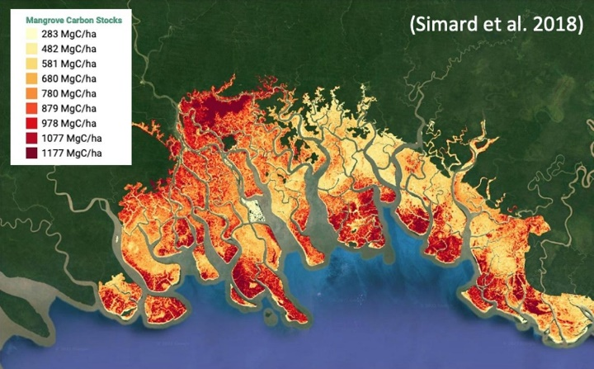
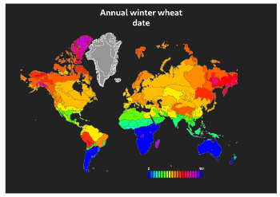
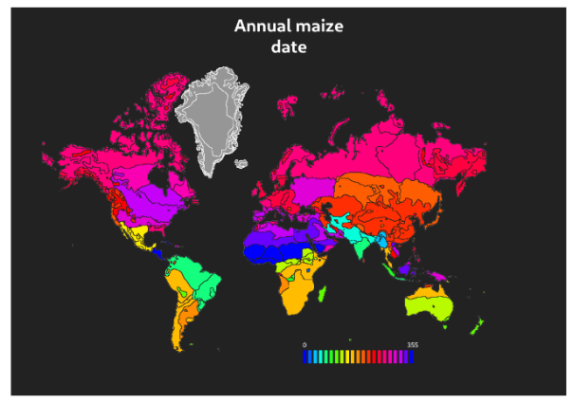
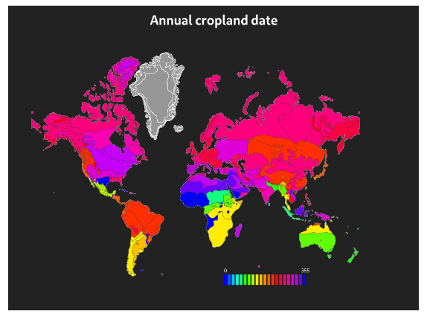
Mitigation - AFOLU
Agriculture, Forestry and Other Land Use (AFOLU) contributes the second largest source of emissions (after fossil fuel use) globally, and is the primary source of emissions in many developing nations
NASA 2015
JPL Biomass
ESA 2018
CCI Biomass
NASA 2020
GEDI Biomass
CCI
Aboveground Biomass Density (Mg/ha)
Land Cover
Forests
Global Mangrove Watch
Mangroves
Agriculture

Slide 10
Adaptation
Assessment of progress on adaptation of countries to climate change ➔ GST
Important areas include agriculture and food security, water supply, coastal vulnerability, exposure to increased climate extremes, energy, health – AFOLU contributes to these areas
multiple datasets on many spatial scales and many non-physical data eg demographic, economic, social data
We are looking for systematic approaches to integrate and assimilate multiple data sets into models to support countries in their adaptation efforts

Slide 11
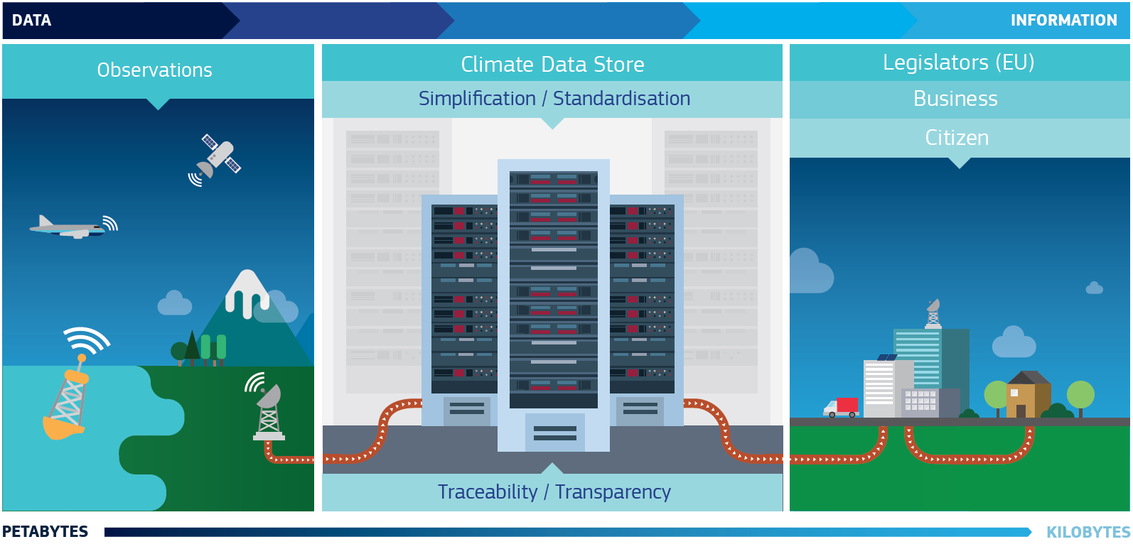
Adaptation - Climate Services
Systematic Observations are underpinning climate services
WMO established the Global
Framework for Climate Services
European Union created under Copernicus Climate Change Services, implemented by ECMWF

Slide 12
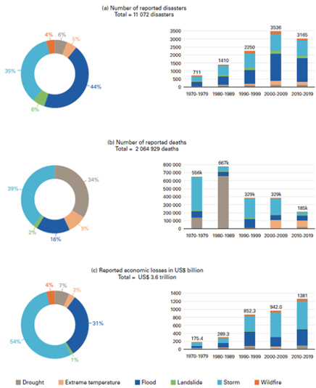
Cross-Cutting
Earth observation is increasingly supporting investment decisions for climate resilience and Nature-based Solutions, and the SO community is expanding relevant collaborations with the sustainable finance sector.
Systematic observations of loss and damage associated with hydro-meteorological hazards provide a basis for global indicator of adaptation and resilience
Earth observation data (EO) and tools, when co-developed with and for Indigenous peoples, can promote a "people-centered" and Indigenous knowledge-driven approach to climate action.

Slide 13
Take Home Messages
The Systematic Observation community is ready to support the GST
  Systematic Observations are the basis for climate science and greenhouse gas emissions mitigation
  Integration of atmospheric GHG and AFOLU data sets to avoid gaps and produce a more complete and transparent GST
  With harmonised and recommended AFOLU datasets, CEOS is simplifying the offering to users on national and global level.
CEOS participants in the ad hoc team are continuing to emphasize the value of open data and knowledge exchange can make critical contributions to the Enhanced Transparency Framework
Country engagement will be key
  The CEOS GHG and AFOLU team are working with countries on an easy uptake of data streams and boost capacity building

