Slide 1

Support for Key Stakeholders & Global Agendas
COVERAGE
CEOS Ocean Variables Enabling
Research & Applications for GEO
https://coverage.ceos.org
Vardis Tsontos, NASA
Conference Agenda Item 24
2021 CEOS Plenary
Virtual Meeting
1-4 November 2021

Slide 2
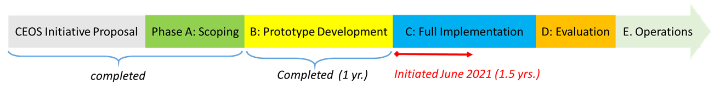
Support for Key Stakeholders & Global Agendas
COVERAGE Overview
CEOS COVERAGE Initiative
Cross-cutting, interagency collaboration involving:
Ocean VCs, GEO-MBON, GEO-Blue Planet and Intergovernmental agency stakeholders (Sargasso Sea Commission, Inter-American Tropical Tuna Commission)
Governance: Interagency Advisory board
Participation in the UN Decade of Ocean Science for Sustainable Development on behalf of CEOS
Motivation & Goals
Enable more widespread, synergistic use of interagency satellite data for the oceans in support of Open Science & multidisciplinary applications for societal benefit, particularly among emerging user communities.
Technology platform implementation providing access to complementary satellite & in-situ datasets from distributed sources via value-added data services
Demonstrate utility of the approach in the context of pilot thematic ecosystem applications defined jointly with partnering stakeholders
Phased Development
Phase-C project: regional spin-off applications
continued UN Ocean Decade support
Slide 2

Slide 3

Support for Key Stakeholders & Global Agendas
UN Decade of Ocean Science for Sustainable Development
COVERAGE Involvement in the UN Decade of the Oceans on Behalf of CEOS
Serving as:
Cumulative CEOS contribution to the UN Decade of the Ocean for Sustainable Development
Joint CEOS liaison points with the IOC on the UN Decade Process
COVERAGE “Ocean Shot” Concept
Concept proposal submitted to Ocean Decade U.S. (National Academy of Science committee) in December 2020
“Next Generation Data Service Infrastructure for a Digitally Integrated Ocean Observing System
in Support of Marine Science and Ecosystem-Based Management”
Linkage to UN-SDG 14: “life below water”, emphasizing the role of Earth Observations and improved data infrastructures in supporting ecosystem-based management
Presented at Ocean Decade U.S. launch meeting in February 2021
Published in special edition of Marine Technology Society Journal (June 2021) https://doi.org/10.4031/MTSJ.55.3.45
Collaborative advancement of COVERAGE Ocean Shot during Phase-C
Alignment & Coordination with relevant Decade U.S. and IOC efforts
Open Ocean Cloud
Digital Twins of the Oceans (DITTO)
Marine Life 2030
COAST
Slide 3

Slide 4
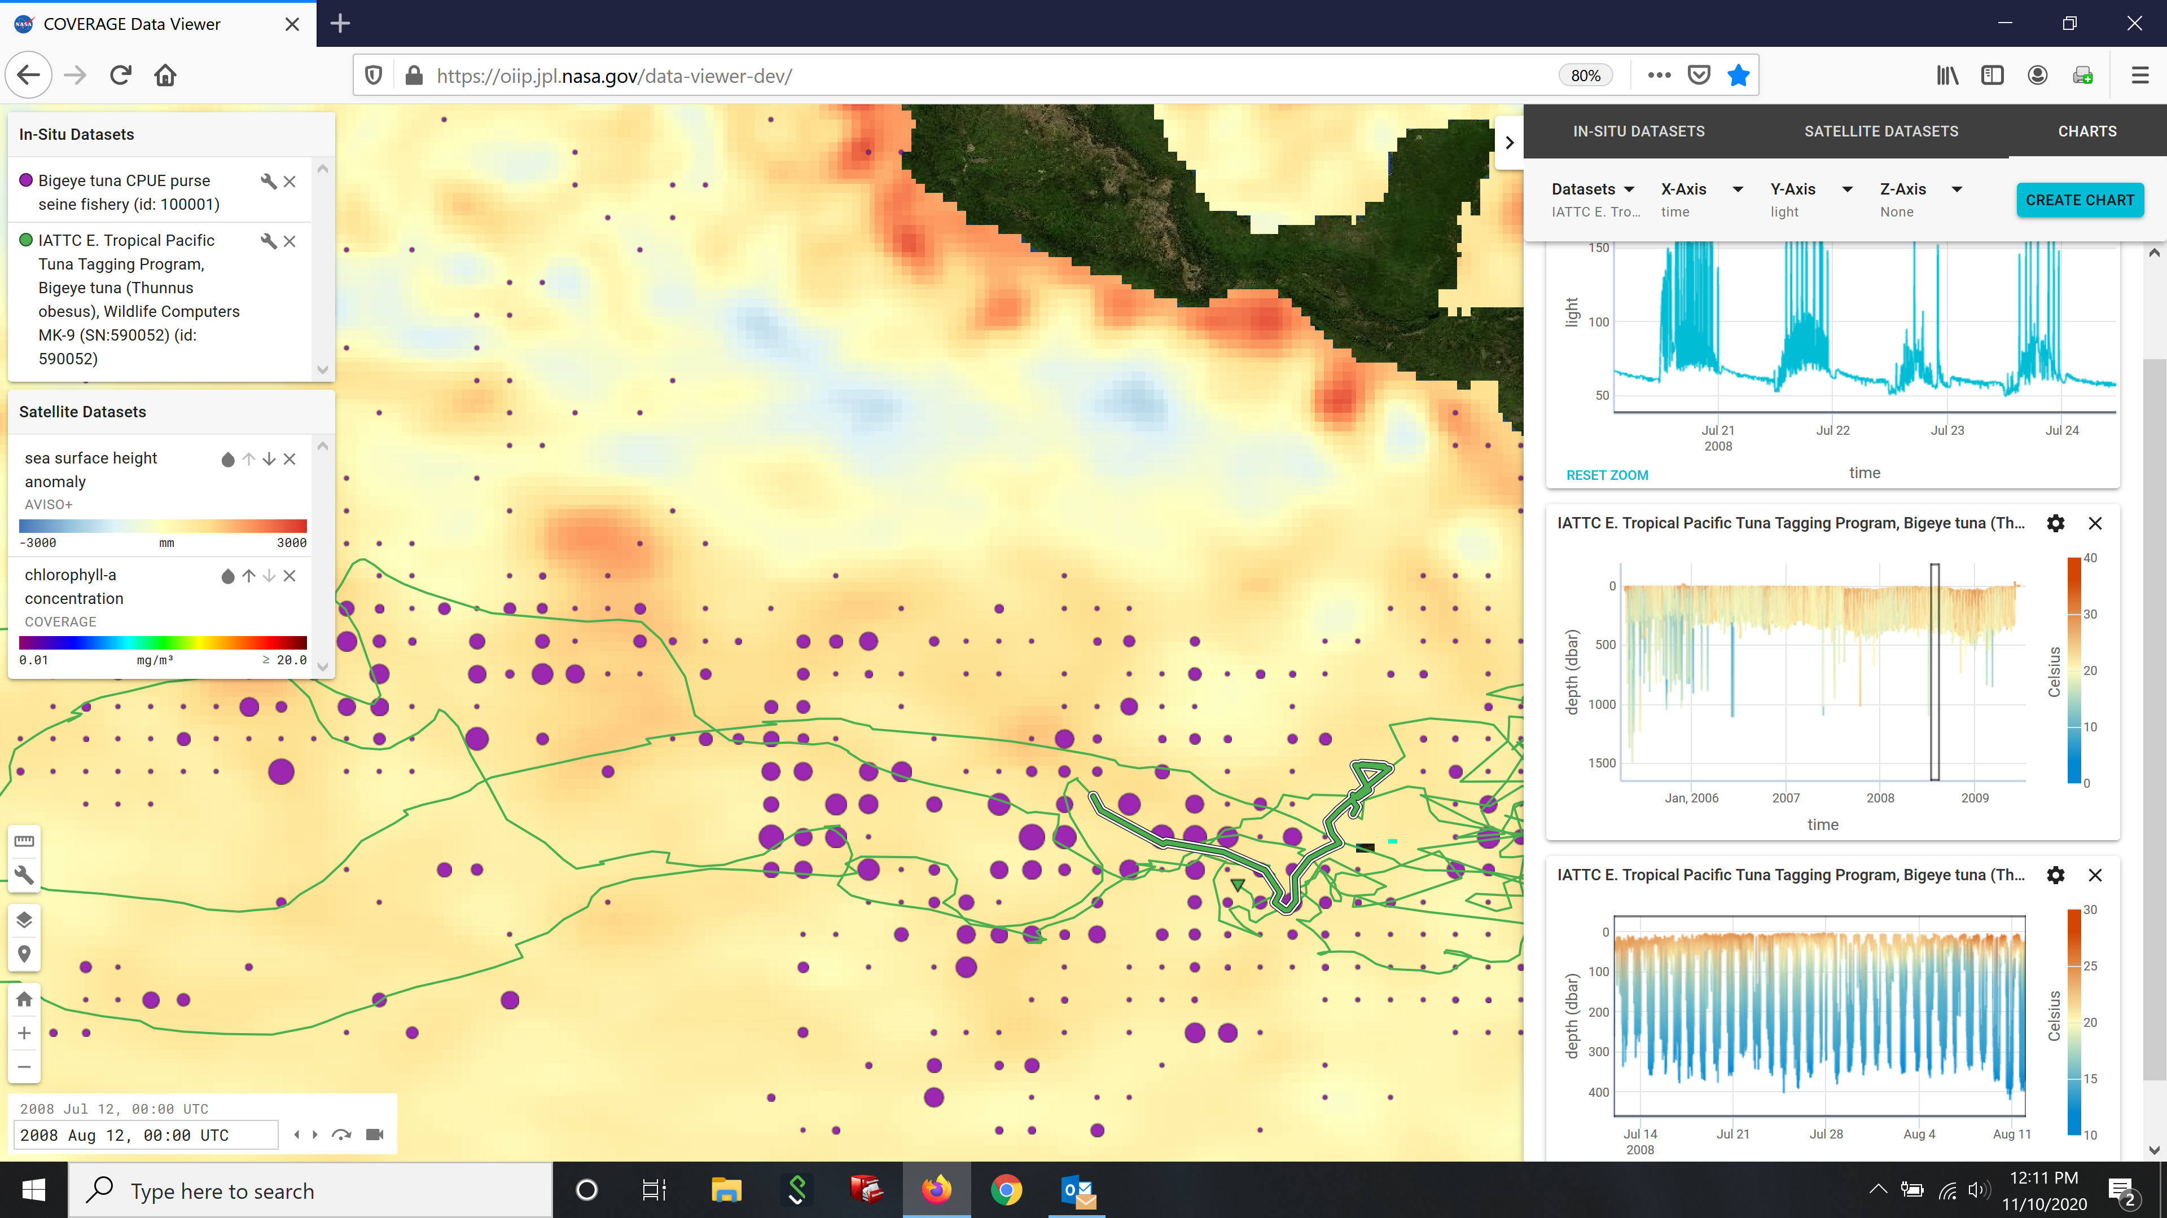
Support for Key Stakeholders & Global Agendas
Inter-American Tropical Tuna Commission Partnership
Inter-American Tropical Tuna Commission (IATTC)
21 Nation Intergovernmental Regional Fisheries Management Organization (RFMO)
Responsible for the scientific assessment and management of Tuna and large pelagic fisheries in the Eastern Tropical Pacific (ETP)
Potential applications of remote sensing data in fisheries investigations in support of Dynamic Ocean Management
  Habitat analyses and changes in resource distributions under environmental regime shifts
  Spatial catch forecasting
  Fishery closed areas & Marine Protected Areas (MPAs)
  By-catch mitigation (protected/vulnerable species)
COVERAGE collaboration with IATTC during Phase-C
MOU signed between IATTC and NASA/JPL for a collaborative activity under COVERAGE
Spin-off application for the Eastern Tropical Pacific to be developed during Phase-C
Build upon prototype (Phase B) demonstration application based on publicly accessible RFMO data:
  Augment with detailed Fisheries observer datasets and higher resolution remote sensing datasets
  Support IATTC quantitative statistical analysis workflows via COVERAGE analytics capabilities
  Recreate a published analysis use case to demonstrate end-t0-end utility of COVERAGE
IATTC Bigeye Tuna archival tag & spatial catch distribution data relative to AVISO-SSHA and animal telemetry environmental measurements
Slide 4

Slide 5

Support for Key Stakeholders & Global Agendas
Sargasso Sea Commission GEF Project Partnership
Sargasso Sea Commission (SSC)
Established by the 2014 Hamilton Declaration for conservation of the Sargasso Sea area of collaboration by 10 signatory nations
Promote stewardship of the Sargasso ecosystem via work program and action plan development for this high seas area
Multiple institutional partners, including NASA via COVERAGE since 2016
SSC multi-year, Global Environmental Facility (GEF) funded project
“Strengthening the Stewardship of an Economically and Biologically High Seas Area – The Sargasso Sea”
Part of an overall global GEF Programmatic Approach entitled Common Oceans – Sustainable utilization and conservation of biodiversity in areas beyond national jurisdiction (ABNJ) involving 4 child projects under UN agency oversight (FAO, UNEP, UNDP) and linked to UN BBNJ treaty
UNDP and IOC-UNESCO oversight roles (implementing and executing UN agencies)
Future instrument supporting UN BBNJ Treaty (under negotiation) and High Seas Governance
Complex, multi-faceted project involving:
  Development and adoption ecosystem-based stewardship approach for the Sargasso Sea
  Ecosystem Diagnostic Analysis, identifying trends and impacts from available environmental, biological and socio-economic data
COVERAGE collaboration on SSC GEF project
  Regional spin-off application focusing on the Sargasso during Phase-C
  Integrative data system enabling the production and communication of ecosystem indicators for scientific and policy assessments
Signatories: Azores, Bermuda, Monaco, United Kingdom, United States, British Virgin Islands, Bahamas, Canada, Cayman Islands, Dominican Republic
Slide 5

Slide 6
Support for Key Stakeholders & Global Agendas
COVERAGE
QUESTIONS
Slide 6

