Slide 1
Virtual Constellation of Ocean Surface Vector Wind: Status and Recent Progress
Stefanie Linow (EUMETSAT),
Raj Kumar (ISRO)
and Paul Chang (NOAA)
Conference Agenda Item 35
2021 CEOS Plenary
Virtual Meeting
1-4 November 2021

Slide 2
Wind Vector Constellation Status
EUMETSAT
ASCAT (METOP-A, B and C)
Open and near real-time data access
METOP-B and METOP- C phased for overlap versus maximizing coverage in tropics
METOP-A will cease normal operations on November 15, 2021
ASCAT available through the EPS-SG/SCA launch
SCA (ASCAT Follow-On, EPS-SG, from ~2025)
NSOAS
HY2 series: HY-2B (launch 25 Oct 2018), HY-2C (launch 21 Sep 2021), HY-2D (launch 19 May 2021)
HY-2B and HY-2C will be available via EUMETCast from 4 November 2021
CNSA + CNES
CFOSAT (launch on 29 October 2018), SWIM L2 data on EUMETCAST
ISRO
SCATSAT-1 (launched Sept 2016)
Open and near real-time OSCAT data access from April 24, 2017 until unrecoverable anomaly on February 28, 2021
OSCAT follow-on (OceanSat-3) now planned for Q1 / 2022 launch
CMA
FY-3E (launch July 4, 2021)
OSVW measurements from WindRad (in commissioning)

Slide 3
The Virtual Scatterometer Constellation
 | Instrument | Satellite | System | Orbit | 2018 | 2019 | 2020 | 2021 | 2022 | 2023 | 2024 | 2025 | 2026 | 2027 | 2028 | 2029 | 2030 | 2031 | 2032 | 2033 | 2034 | 2035 | 2036 | 2037 | 2038
C-band | ASCAT | Metop-A | fixed fan beam | 08:46 desc | launch 19 Oct 2006
 | ASCAT | Metop-B |  | 09:30 desc | launch 17 Sep 2012
 | ASCAT | Metop-C |  | 09:30 desc
 | SCA | Metop-SG-B1 |  | 09:30 desc
 | SCA | Metop-SG-B2 |  | 09:30 desc
 | SCA | Metop-SG-B3 |  | 09:30 desc
C-/Ku-band | WindRAD | FY-3E | conical scanning | 05:30 desc
 | WindRAD | FY-3I |  | 05:30 desc
Ku-band | SCAT (CFOSAT) | CFOSAT | rotating fan beam | 07:00 desc
 | SCAT (CFOSAT) | CFOSAT follow-on |  | 07:00 desc
 | SCAT (HY-2A) | HY-2A | conical scanning | 06:00 desc | launch 15 Aug 2011
 | SCAT (HY-2A) | HY-2B |  | 06:00 desc
 | SCAT (HY-2A) | HY-2C |  | 66 °
 | SCAT (HY-2A) | HY-2D |  | 66 °
 | SCAT (HY-2A) | HY-2E |  | 06:00 desc
 | SCAT (HY-2A) | HY-2F |  | 66 °
 | SCAT (HY-2A) | HY-2G |  | 66 °
 | OSCAT | OceanSat-3 |  | 12:00 desc
 | OSCAT | ScatSat-1 |  | 08:45 desc | launch 26 Sep 2016
 | operational
 | commissioning
 | planned
 | considered

Slide 4
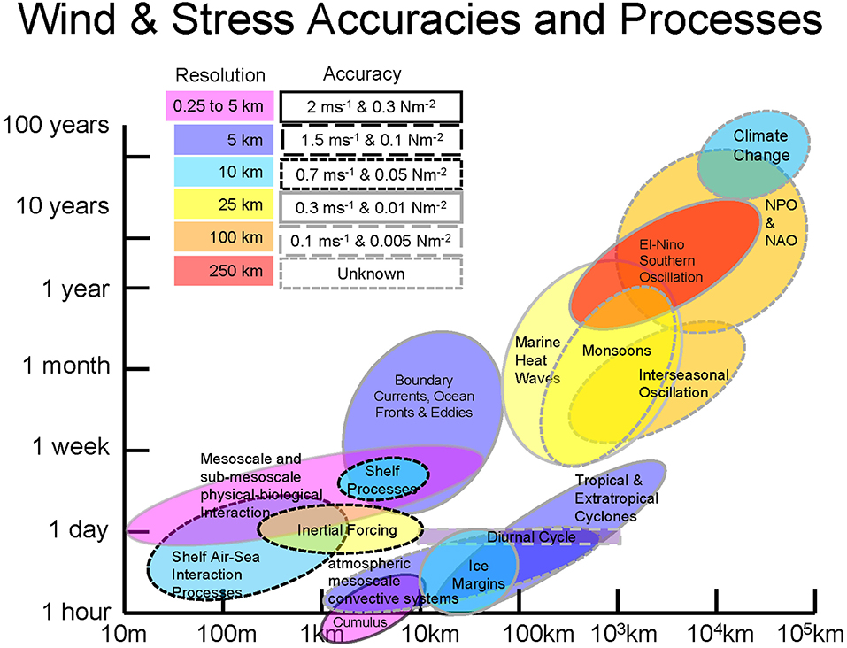
Observing System Requirements
What is really needed?
Discussion of observing system requirements for accuracy and resolution(space and time):
Observation requirements vary greatly depending on the spatial and temporal scales of phenomena that need to be captured in a model.
Sampling requirements in space and time are driven by the need to capture the variability
Minimum Constellation
At least 3 scatterometers in orbits designed to roughly meet WMO requirements (observations every 6 hours)
One instrument in a non-sun-synchronous orbit for sampling the diurnal cycle, better mid-latitude sampling and provide inter-calibration
Figure: OceanObs’19 White Paper
https://doi.org/10.3389/fmars.2019.00443

Slide 5
Requirements for the OSVW Constellation
Instruments
Applications
Spaceborne scatterometers (C-, Ku-band) are the trusted reference standard to provide global ocean surface wind vector data.
Other remote sensing techniques have demonstrated varying capabilities at retrieving ocean surface winds:
Microwave radiometers: Multi-frequency / Polarimetric / L-band
Synthetic Aperture Radar (SAR)
GNSS-R
HF radars (regional coverage but frequent temporal refresh)
Weather forecasting: nowcasting (analysis) + short range
Climate observing / analysis (seasonal, inter-annual and longer time scales)
Ocean dynamics...
Needs analysis of:
Global statistics
Geographical distribution / temporal sampling
Spatial resolution (actual versus gridding resolution)
Performance in the extremes (low (< 3m/s) and strong wind speeds (> 30m/s))
Dependency on ancillary data
How do these other techniques compare with microwave scatterometry and where do they fit within the OSVW observing system portfolio?
Need a standard set of metrics + validation methodologies.

Slide 6
Cross-calibration of missions, Cal/Val
and data product standards
Ongoing efforts in the OVWST community on the quality assessment of data products and wind retrievals:
Wind retrievals during extreme winds (what is really being measured?)
GMF development and validation
Comparison of wind retrieval algorithms
Assessment of rain effects in the tropics (particularly relevant for Ku-band instruments / radiometers)
Spatial scaling effects
Generation of a quality-controlled wind reference dataset linking dropsondes / buoys / SFMR (plane-based measurements) / SAR data
Cross validation of C-band and Ku-band retrievals
Recent activities / highlights:
CEOS OSVW-VC special sessions @ IGARSS’21 :
Status and Recent Progress
Consolidation of Standards and Metrics for Optimized Scientific and Operational Applications
IOVWST’21
Cross-cutting activities / synergies:
Within CGMS: Ocean Surface Wind Task Group (OSW TG) in the CGMS IWWG that coordinates actions/recommendations with GSICS, CEOS, the IOVWST and other relevant entities
Within WGCV: formed Working Team to consolidate standards and metrics; preparation of draft work plan; shared datasets for intercalibration and consolidation of standards and metrics

Slide 7
Future focus
We need to clearly articulate:
What we need to measure (speed and direction?) and why?
How often do we need to measure this? Times of the day?
Under what environmental conditions do we need to measure it?
What real spatial resolution is required?
One cannot resolve features that occur over spatial scales of kilometers with a measurement footprint of 40km
Why is this important?
There are many competing technologies making various claims to be able to provide ocean wind products.
We need to be able to objectively evaluate these technologies based on a solid foundation based on data and facts.
We need to differentiate products that are developed to retrieve the actual winds versus products that are tuned to infer the maximum wind speeds.

Slide 8
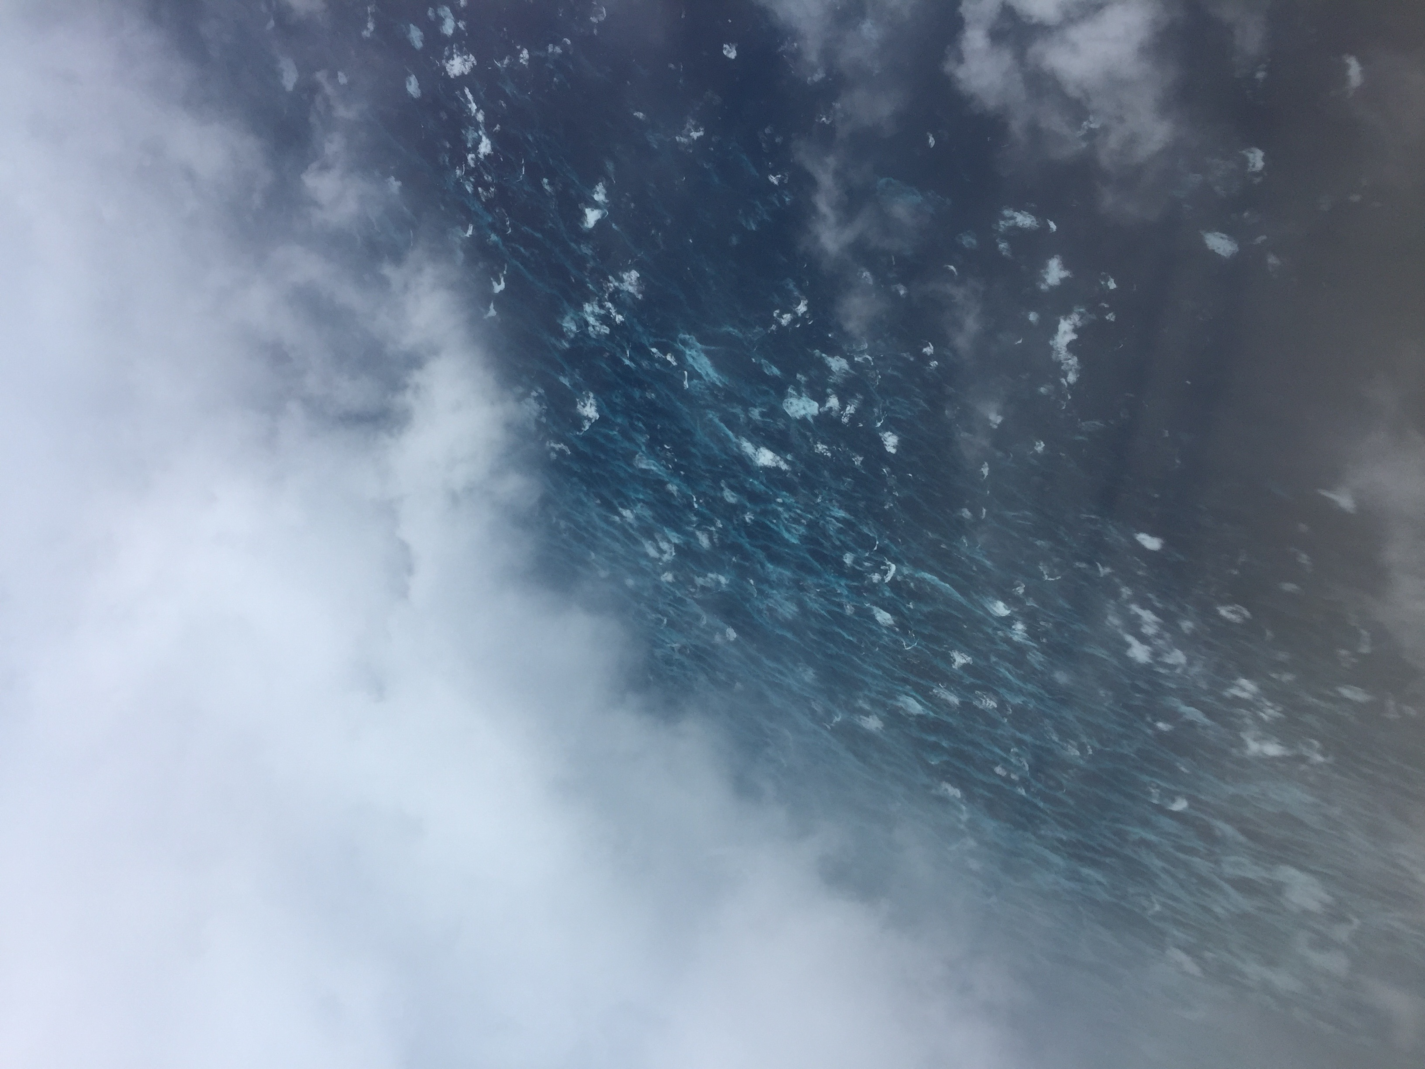
Do we need to remotely sense this?
Eye Wall Winds
Center of Eye
Hurricane Matthew

