Slide 1
2.5: CEOS Interoperability Framework
LSI-VC
Agenda Item #2.5
2022 CEOS Plenary
1 December 2022

Slide 2
SIT TW Action
SIT-TW-2022-09 | LSI-VC Co-Leads to prepare an agenda item for the 2022 CEOS Plenary formulating an action for CEOS to further define and develop the concept of a CEOS Interoperability Framework with other interested parties (e.g., WGISS, WGCV) and to bring a concrete proposal for consideration at SIT-38. | 2022 CEOS Plenary
 | Rationale: Given the scope of the EO data interoperability problem, with numerous components distributed across many CEOS groups (e.g., LSI-VC, WGISS, WGCV, etc.), a robust framework and coordination mechanisms are needed to address the problem in a systematic and comprehensive manner.

Slide 3
Requests of CEOS Principals
Resource staff to participate in an Interoperability Task Team under LSI-VC to develop the initial concept of a CEOS Interoperability Framework.
Between Plenary and SIT-38, the Task Team will:
Propose an appropriate high-level framework
Identify necessary components of the framework
Make a preliminary mapping of CEOS activities / groups / people to each interoperability component
Come to SIT-38 ready to discuss the suggested components of the framework and consider resources for the various activities.
Agree the ‘home’ for each of these components in the CEOS organisational structure
Agree the oversight/coordination mechanism for implementation (continued Interoperability Task Team under LSI-VC?)
Resources to progress first core piece of Interoperability Framework: CEOS Common Dictionary
Will underpin all further activity
Underway in LSI-WGCV-WGISS, but needs more support, participation, elevation and (eventually) adoption!

Slide 4
Why Interoperability?
Huge amount of data and growing
Significant investment in collecting this data
Now make use of all of the information for societal benefit
Additionally: explosion of commercial and ‘new space’ datasets
Enable interoperability of all these datasets
In an ‘open’ way, i.e., direct from the data providers – not relying on others downstream to do the interoperability steps
Maximimise impact for all users, avoid platform dependency
Avoid unsuitable downstream handling of data / different approaches

Slide 5
Background
CEOS Analysis-Ready Data (CEOS-ARD) suite of specs aims at increasing the interoperability of Earth observation datasets.
CEOS-ARD is a first step on the interoperability spectrum :
CEOS-ARD specs only cover a subset of what needs to be considered
From WGISS & LSI developed CEOS Interoperability Terminology Report (2020)

Slide 6
Why a framework?
Discussion Paper
Addressing the full scope of interoperability requires a framework that captures all aspects of the problem.
Factors and components are distributed across many CEOS groups (e.g., LSI-VC, WGISS, WGCV, etc.)
Need a robust framework and coordination mechanisms
What do these ‘components’ look like…?

Slide 7
Possible Framework Components
Terminology / Semantics / Data Context
CEOS Common Dictionary
A very preliminary idea of the sorts of pieces of the interoperability framework
Needs further discussion and development
Propose team to work on identifying framework components for SIT-38 consideration
SIT-38 then to consider actioning activity on blocks (+ agree coordination mechanism)
Structural / Data Architecture
CEOS-ARD
Minimum Data Processing Level + Documented
Uncertainty measures
Consistent / Interoperable Metadata
MRI Framework and PFS parameters?
Authoritative data certification
Interoperability Blocks / Activity Areas
Common References: Grids, DEM, GCP (?)
Discrete Global Grid System (DGGS)
Formats / Syntactic / Data Language
COG / Cloud-enabling
Accessibility / System / Data Presentation
STAC
Cross-cloud data access and discovery

Slide 8
Questions for “Task Team”…
What is the appropriate high level framework
Key components
Characterise each initiative by what it is about (e.g., attach a number of predefined keywords)
Responsibilities across CEOS and any gaps?
Framework scope
What is out of scope - adding further keywords to which an interface should be established

Slide 9
Interoperability Component: Terminology
CEOS Common Dictionary

Slide 10
Terminology / Semantics / Dictionary
One component is clear…Terminology!
Terminology and consistency across CEOS and the interoperability components is critical
Underpins the whole framework
Suggest CEOS Principals resource additional people to contribute to this activity already underway (a joint WGCV-WGISS-LSI activity)
Suggest elevation and mechanism for broad adoption across CEOS? Discuss.

Slide 11
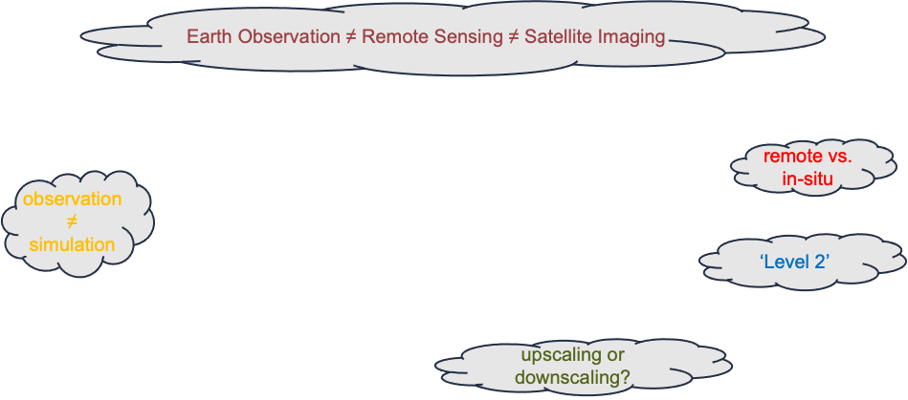
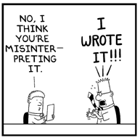
Why is Terminology important?
Harmonised use of a term
Clear outline of a technical concept
Facilitation of targeted discussions
Avoiding of misunderstanding
© Dilbert

Slide 12
Example: CEOS Processing Levels
Processing Levels were so far defined as a more or less generic chain of refinement regarding the radiometry (or more general the 'measurand') and the geometry of the (satellite) observation data.
If one considers these two types of refinements separate, a matrix could be built in which classical Processing Levels would (roughly) appear as below:

Slide 13
A new Processing Level matrix
For the discussion of 'Analysis Readiness' of data, a clearer separation of these two 'dimensions' of processing yields a chance to obtain a transparent scheme in which also recommendations about best possible paths (processing sequences) are feasible. This would be advantageous for defining 'Analysis Ready Data' standards at different processing Levels and for their respective interoperability.

Slide 14
Summary, Decisions

Slide 15
Summary
Huge amount of data and growing
Enable interoperability in an open way for maximum uptake and societal benefit
Interoperability components are distributed across many CEOS groups
Need a robust framework and coordination mechanisms
Consistent CEOS terminology will underpin the whole framework and existing work should should be prioritised and elevated.

Slide 16
Requests of CEOS Principals
Resource staff to participate in an Interoperability Task Team under LSI-VC to develop the initial concept of a CEOS Interoperability Framework.
Between Plenary and SIT-38, the Task Team will:
Propose an appropriate high-level framework
Identify necessary components of the framework
Make a preliminary mapping of CEOS activities / groups / people to each interoperability component
Come to SIT-38 ready to discuss the suggested components of the framework and consider resources for the various activities.
Agree the ‘home’ for each of these components in the CEOS organisational structure
Agree the oversight/coordination mechanism for implementation (continued Interoperability Task Team under LSI-VC?)
Resources to progress first core piece of Interoperability Framework: CEOS Common Dictionary
Will underpin all further activity
Underway in LSI-WGCV-WGISS, but needs more support, participation, elevation and (eventually) adoption!

Slide 17
Thanks!

Slide 18
Backup Slides

Slide 19
What is Interoperability?
Interoperability is the “ability of two or more systems or components to exchange information and to use the information that has been exchanged.”
ISO 25964 Thesauri and Interoperability with other Vocabularies (ISO 25964-2:2013)
Interoperability has several aspects with different requirements, e.g:
Exchange requires technical and organisational connectivity
Use requires common understanding and legal agreement
… and what exactly is ‘information’ btw?

Slide 20
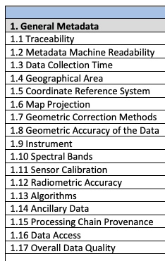
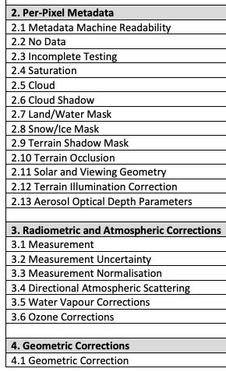
Background
The CEOS-ARD Product Family Specifications (PFS) define parameters which facilitate interoperability
Only a subset of what needs to be considered when trying to achieve full interoperability of datasets

Slide 21
Interoperability Layers
Example from knowledge organisation (KO), https://www.isko.org/cyclo/interoperability

Slide 22
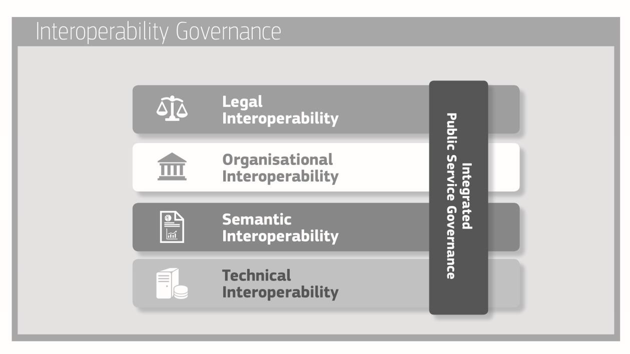
European Interoperability Framework
https://eur-lex.europa.eu/resource.html?uri=cellar:2c2f2554-0faf-11e7-8a35-01aa75ed71a1.0017.02/DOC_3&format=PDF

Slide 23
European Open Science Cloud - Interoperability Framework
Legal interoperability* is about ensuring that organisations operating under different legal frameworks, policies and strategies are able to work together. This might require that legislation does not block the establishment of European public services within and between Member States and that there are clear agreements about how to deal with differences in legislation across borders, including the option of putting in place new legislation.
Organisational interoperability refers to the way in which organisations align their business processes, responsibilities and expectations to achieve commonly agreed and mutually beneficial goals (source: European Interoperability Framework).
Semantic Interoperability. It ensures that the precise format and meaning of exchanged data and information is preserved and understood throughout exchanges between parties, in other words ‘what is sent is what is understood’.*
Syntactic interoperability. If two or more systems use common data formats and communication protocols and are capable of communicating with each other using open standards (source: Interoperability - Wikipedia)
Technical interoperability. A characteristic of an Information Technology (IT) system, whose interfaces are completely understood, to work with other IT systems, at present or in the future, in either implementation or access, without any restrictions or with a controlled access (source: Interoperability - Wikipedia).
https://op.europa.eu/en/publication-detail/-/publication/d787ea54-6a87-11eb-aeb5-01aa75ed71a1/language-en
*https://joinup.ec.europa.eu/collection/nifo-national-interoperability-framework-observatory/glossary

Slide 24
An early geospatial (EO) IF

Slide 25
Faces 1-3
Parametrisation
Semantics
Quality metrics
Metadata
Discretisation
Digitisation
Binning (1D)
Gridding (2D)
Encoding
Formats
File systems
Databases
Tiling
Organisation
[some illustrations courtesy: R. Gibb; P. Baumann/rasdaman]
Notes:
Parameter: definitions such as ‘clouds’, land cover’, ‘spectral reflectance’, maybe also ‘Level 2’, or resolution classes (MR, HR, VHR), quality parameters etc.
Binary, continous, discontinuous, categorical,

Slide 26
Faces 4-6
IT Hardware (storage, proc. network)
Facilities (buildings, power, …)
Functionality:
Querying
I/O
Manipulation
Analysis
Visualisation
APIs
Standards
P. Strobl, P. Baumann, A. Lewis, Z. Szantoi, B. Killough, M. Purss, M. Craglia, S. Nativi, A. Held and T. Dhu, (2017), "The Six Faces of the Data Cube” BiDS’17, Toulouse (France), https://publications.europa.eu/en/publication-detail/-/publication/78a7f64a-d3ee-11e7-a5b9-01aa75ed71a1/language-en
Notes:
7

Slide 27
Terminology Example: “In-situ”
NASA:
Latin for 'in original place.' Refers to measurements made at the actual location of the object or material measured. Compare remote sensing.
INSPIRE:
The FeatureOfInterest is a sampling feature which is co-located with the ultimate FeatureOfInterest (i.e. the sampledFeature).
OGC:
Not available
No consistent spelling: in_situ, in-situ, in situ, in-Situ, insitu, …

Slide 28
Terminology Example: “Resolution”
ISO - resolution (a. of a sensor) (b. of imagery)
smallest difference between indications of a sensor that can be meaningfully distinguished Note to entry: For imagery, resolution refers to radiometric, spectral, spatial and temporal resolutions.
smallest distance between two uniformly illuminated objects that can be separately resolved in an image
NASA:
A measure of the ability to separate observable quantities. In the case of imagery, it describes the area represented by each pixel of an image. The smaller the area represented by a pixel, the more accurate and detailed the image.
INSPIRE:
Resolution expresses the size of the smallest object in a spatial data set that can be described. It refers to the amount of detail that can be discerned. It is also known as granularity. Resolution is also limited because geo-spatial databases are intent

Slide 29
Terminology Example: “Remote sensing”
ISO:
collection and interpretation of information about an object without being in physical contact with the object
NASA:
The technology of acquiring data and information about an object or phenomena by a device that is not in physical contact with it. In other words, remote sensing refers to gathering information about the Earth and its environment from a distance, a critical capability of the Earth Observing System. For example, spacecraft in low-Earth orbit pass through the outer thermosphere, enabling direct sampling of chemical species there. These samples have been used extensively to develop an understanding of thermospheric properties. Explorer-17, launched in 1963, was the first satellite to return quantitative measurements of gaseous stratification in the thermosphere. However, the mesosphere and lower layers cannot be probed directly in this way--global observations from space require remote sensing from a spacecraft at an altitude well above the mesopause. The formidable technological challenges of atmospheric remote sensing, many of which are now being overcome, have delayed detailed study of the stratosphere and mesosphere by comparison with thermospheric research advances. Some remote-sensing systems encountered in everyday life include the human eye and brain, and photographic and video cameras.
INSPIRE:
The FeatureOfInterest is a sampling feature which is also the ultimate FeatureOfInterest (i.e. the sampledFeature).
OGC:
Acquisition of raster images of the Earth, often involving spectral frequencies other than the visible band, by devices typically carried on airborne or satellite platforms. Sometimes refers also to image analysis of these images

Slide 30
Semantic elements
Terminology (specialized words or meanings)
Taxonomy (within-dimension hierarchy)
Ontology (multidimensional relationship)
What do we mean by ‘Earth’ ‘Observation’
Do we need to distinguish between ‘observation’ and ‘modelling’, how?
What’s the difference between ‘in-situ’ and ‘remote’
What is the difference between ‘data’, ‘product’, and ‘information
How to parameterise a property that is observed?

