Slide 1
PIAG <> CEOS Duplex
01 December 2022,
Noumea, New Caledonia
Vani Koroisamanunu (SPREP)

Slide 2
Views of the Pacific EO Community
Outline:
Territory knowledge
Water resources
Wetlands

Slide 3
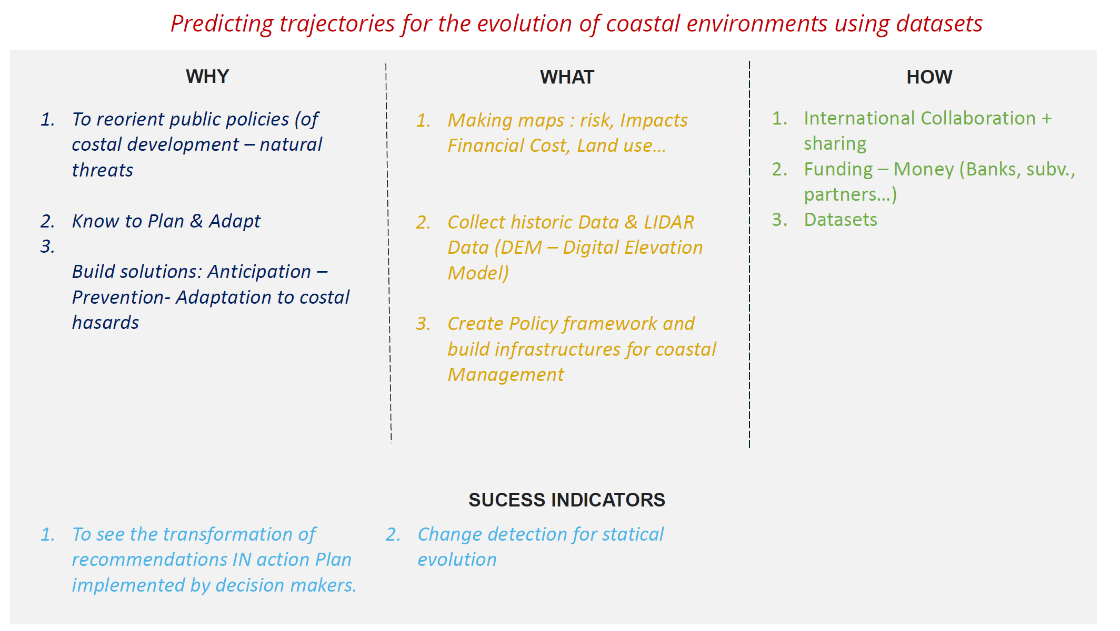

Slide 6
GEO TRACK OUTCOMES

Slide 7
Visioning: the way forward
As an advisory group, PIAG is a temporary body within GEO
What should PIAG transition to and when?
Where are we now, what needs to happen?
How do we strengthen links with GEO activities / programs?

Slide 8
Some of the ‘keys’ that were outlined at today’s GEO Track
Endorsement and support
International Governance
“Champions”
Data sharing
Partnerships and communities of practice
Regional frameworks and roadmaps

Slide 9
Details of these ‘keys’ (1/2)
Promote accountability and ensure return of investment from time and energy in projects and programmes
Ensure that the technical experts are in the room and remain engaged with decision making processes
Building and strengthening a community of practice
Build, support and encourage teams and teamwork
Ensure we have a sustainable pipeline of “champions” continuing to grow and develop generational capability
Keep “labs” at a local scale and do not isolate stakeholders
Ensure optimal change takes place.
Challenge efforts to ensure they take place in the most optimal way

Slide 10
Details of these ‘keys’ (2/2)
Ensure actions create measurable impact
Ensure partnerships and pathways are credible
Development towards something clear and tangible like frameworks and a roadmap
Make sure the pathway is in the hands of PICTs
Collaborate and synthesise all thoughts and needs
Make sure no-one gets left behind.
Ensure that a way forward is balanced

Slide 11
Key Outcomes
Continued support from the Pacific Community (SPC)
Key role of Pacific Geospatial Survey Council
Agreement from Ministers to attend the GEO Ministerial Summit in 2023
Links will be facilitated with the Pacific Island Forum (PIF) to achieve wider regional endorsement.

